Slide 1
Introduction to Management of Information Technologies
Week 1

Slide 2
LEARNING OUTCOMES
Discuss the role of IT in business
Discuss the relationships among people, information technology, and policies
Compare management information systems (MIS), information technology (IT), and business intelligence (BI)
Explain the difference between data and information
2
Notes:
1.1 Discuss the role of IT in business
Today, IT is everywhere in business. Understanding IT and its potential is key business operations efficiency
1.2 Describe the relationships among people, information technology, and policies
IT in and of itself is not useful unless the right people know how to use and manage IT efficiently and effectively
People, policies, and information technology (in that order of priority) are inextricably linked
If one fails, they all fail.
1.3 Compare management information systems (MIS) and information technology (IT)
MIS is not IT. MIS is a business function. IT is a computer-based tool. Most organizations have an IT Department that is responsible for performing the MIS function. This is similar to an organization having an Accounting Department that is responsible for performing the accounts payable and accounts receivable functions.
1.4 Explain the difference between raw data and information

Slide 3
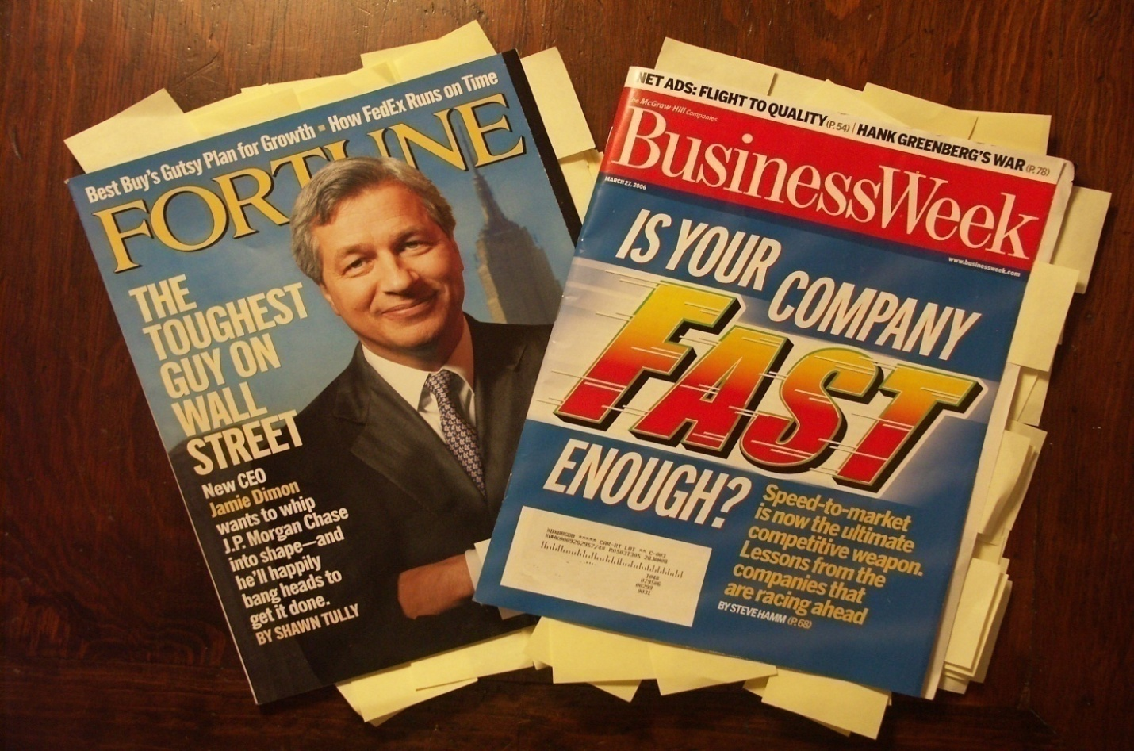
WHY SHOULD BUSINESS PEOPLE LEARN ABOUT TECHNOLOGY?
Information technology is everywhere in business
IT is key to business operations efficiency.
3
Notes:
Why do you think you need to study information technology?
The picture above says it all – technology is everywhere in business
These are business magazines, not technology magazines, and yet they are filled with technology
CLASSROOM EXERCISE THAT CAN BE DONE IN A FACE-TO-FACE CALSS MEETING
Understanding the Relevance of Technology In Business
This is a great exercise to begin the course. It clearly demonstrates why anyone involved in business must understand technology. It can be a real revelation for students who do not see the need for taking an IT course.
Bring in several copies of BusinessWeek, Fortune, Fast Company, or any popular business magazine. The magazines do not have to be current. Provide a marking tool such as a small set of Post-It Notes. Ask for a few volunteers and have the students review the magazine and stick a Post-It Note on each technology-related article, advertisement, etc. When the student has completed this task, the magazine will be covered in Post-it Notes, clearly demonstrating that technology is everywhere in business, even in the popular business magazines such as BusinessWeek.
Since this task can be time consuming, you can put in the Post-It Notes prior to class and simply show your students the completed magazine. You can have one student sit in the front of the class and begin the exercise, placing Post-It Notes on a copy of BusinessWeek. After they have completed several pages on their own, you can produce the same “completed” magazine with all of the Post-It Notes. This saves classroom time and still reinforces the point that technology is everywhere in business.
Be sure to reinforce that these are business magazines, not technology magazines. Yet they are completely filled with technology – which is clearly demonstrated by the Post-It Notes. How can any business student today possibly argue that they do not need to know or understand technology when faced with a magazine, such as BusinessWeek, that is filled with technology? Read a few of the articles or advertisements. Ask how many of your students are familiar with Siebel, Oracle, or PeopleSoft and can articulate what they can do for a company?
The goal of this course is to help your students understand the business side of technology. Being able to understand all of the technology articles in BusinessWeek is one of the benefits your students will receive upon completion of the course.

Slide 4
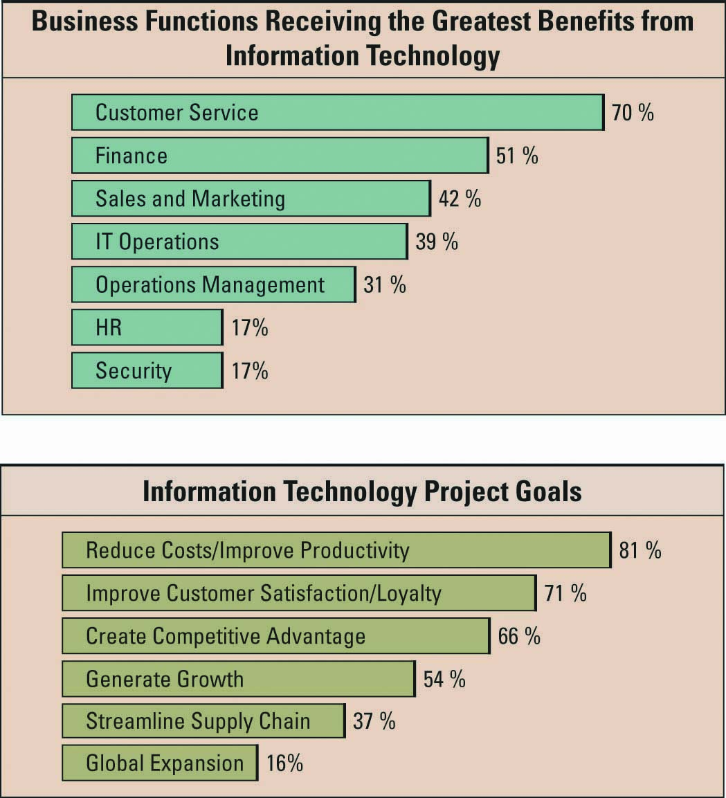
Information Technology’s Impact on Business Operations
Source: CIO Magazine
4
Notes:
Describe a few of the types of IT services each business function might be receiving from IT
Customer service: click-to-talk, call scripting, auto answering, call centers
Finance: accounting packages, Sarbanes Oxley
Sales and marketing: campaign management, customer relationship management
Operations: supply chain management
Human resources: software to track employees at risk of leaving
While Customer Service uses and depends heavily on IT (70% in the graphic), IT accounts for a small percentage (i.e. 17% in the graphic) of the success of the (Information) Security function
IT is only one component of information systems. We will use the People-Technology-Policy framework to explain the role of IT in information systems and why IT may account for only 17% of the success of the Security function.

Slide 5
PTP
People
Technology
Policies/Procedures/Processes
5
Notes:
5
1. Fall of the Berlin Wall The events of November 9, 1989, tilted the worldwide balance of power toward democracies and free markets
2. Netscape IPO The August 9, 1995, offering sparked massive investment in fiberoptic cables
3. Work flow software The rise of applications from PayPal to VPNs enabled faster, closer coordination among far-flung employees
4. Open-sourcing Self-organizing communities, such as Linux, launched a collaborative revolution
5. Outsourcing Migrating business functions to India saved money and a Third World economy
6. Offshoring Contract manufacturing elevated China to economic prominence
7. Supply-chaining Robust networks of suppliers, retailers, and customers increased business efficiency
8. Insourcing Logistics giants took control of customer supply chains, helping mom-and-pop shops go global
9. Informing Power searching allowed everyone to use the Internet as a “personal supply chain of knowledge”
10. Wireless Wireless technologies pumped up collaboration, making it mobile and personal

Slide 6
IT helps achieve business goals
Source: CIO Magazine
6
Notes:
Which types of IT services can be used to meet these types of goals?
Reduce costs/ improve productivity: supply chain management, enterprise resource planning
Improve customer satisfaction/loyalty: customer relationship management, loyalty programs
Create competitive advantage: business intelligence/data warehousing
Generate growth: sales management systems
Streamline supply chain: demand planning software
Global expansion: ebusiness

Slide 7
IT and globalization
Thomas Friedman’s 10 Forces That Flattened the World
  Fall of the Berlin Wall
  Netscape IPO
  Workflow software (protocols SMTP, HTML, … that allow work to flow)
  Open-sourcing
  Outsourcing
  Offshoring
  Supply-chaining
  Insourcing
  Informing
  Power searching allowed everyone to use the Internet as a “personal supply chain of knowledge”
  Wireless
Thomas Friedman’s speeches/lectures on World flatteners:
MIT Lecture (1:15:00) : http://video.mit.edu/watch/the-world-is-flat-9145/
MIT Lecture (0:47:00. Start @ 0:8:00) : http://video.mit.edu/watch/the-world-is-flat-30-9321/
7
Notes:
7
1. Fall of the Berlin Wall The events of November 9, 1989, tilted the worldwide balance of power toward democracies and free markets
2. Netscape IPO The August 9, 1995, offering sparked massive investment in fiberoptic cables
3. Work flow software The rise of applications from PayPal to VPNs enabled faster, closer coordination among far-flung employees
4. Open-sourcing Self-organizing communities, such as Linux, launched a collaborative revolution
5. Outsourcing Migrating business functions to India saved money and a Third World economy
6. Offshoring Contract manufacturing elevated China to economic prominence
7. Supply-chaining Robust networks of suppliers, retailers, and customers increased business efficiency
8. Insourcing Logistics giants took control of customer supply chains, helping mom-and-pop shops go global
9. Informing Power searching allowed everyone to use the Internet as a “personal supply chain of knowledge”
10. Wireless Wireless technologies pumped up collaboration, making it mobile and personal
At least half of the forces that help flattened the world are IT-related.

Slide 8
IT and Business Intelligence
Information technology (IT) refers to
  a field concerned with the use of technology in managing and processing information
  Computer-based tools used to capture, store, protect, process, retrieve, and transmit information
IT is a main part of Business Intelligence
Business Intelligence
  A broad range of applications and technologies used to gather, provide access to, and analyze huge amount of data to support decision making. Its use allows discovering trends, patterns, associations, etc.
  Information collected from multiple sources (suppliers, customers, competitors, industry, internal data, etc.) that analyses patterns, trends, relationships for strategic decision making.
8
Notes:
IT does not equal or represent business success and innovation, it is simply an enabler of business success and innovation
Will spending large amounts of money on IT guarantee automatic success?
Spending large amounts of money on IT will not guarantee an organization automatic success
Organizations need to allocate resources on the right types of IT that correctly support their business operations to be successful

Slide 9
Management Information Systems (MIS)
MIS
  Is a business function and academic discipline
    That deals with the application of information systems and information technology to solve business problems
  Can also be seen as a tool for generating and managing information for managers
MIS is a business function, similar to Accounting, Finance, Operations, and Human Resources
9
Notes:
MIS is not technology
MIS is a business function
Most organizations have an IT department that is responsible for performing the MIS function
This is similar to an organization having an Accounting department that is responsible for performing the accounts payable and accounts receivable functions
But the term MIS is also used to refer to the set of tools (or information systems) used generating and managing information for managers.

Slide 10
Information Systems
Information Systems – systems designed for use by organizations in order to transform raw data into information that can help workers do their job and managers make decisions.
An information system has the following key components:
  People
  Technology
  Policies/Procedures
Technology:
Hardware
Software
Databases
Networks
10

Slide 11
Data versus Information
Data = raw facts that represent the characteristics of an event
  Example 1:
    Event: High temperature
    Data: 100° F
  Example 2:
    Event: Sale
    Data: Sale’s date, item number, item description, etc.
Information = facts within a given context
  Information results from transforming data by adding context and meaning to make it more useful.
  The temperature today at noon in Times Square, NYC was 100° F
The difference between data and information can be explained using the I-P-O framework
P
I
O
11
Notes:
The term Data (or raw data) is used to refer to facts that characterize events. If the event is a sale transaction, the data may be the date of sale, the item number, the item description, the quantity sold, etc.
Information is typically define as data put in a specific context which makes it more meaningful. The statement “The temperature today at noon in Times Square, NYC was 100° F” is a meaningful information. It is the result of adding context and meaning to some raw data.
In the next slide, we are going to use the IPO framework to better understand the difference between data and information.

Slide 12
Data versus Information (cont.)
IPO stands for Input Processing Output
Use the IPO framework to analyze a payroll information system
The Input represents the raw data and the Output represents the information
Note: Info generated by one system may be used as input in another system. This makes it hard to distinguish between data and information.
I | P | O
12

Slide 13
The Value of Information –
Information Quality (IQ)
Characteristics / dimensions of IQ:
Accuracy (Is information correct? Can we rely on it?)
Timeliness (How current is the information?)
Accessibility (Can the information be accessed when needed?)
Engagement (Is the information capable of affecting a decision?)
Application (Is the information relevant to the current context?)
Completeness (Are any of the values missing?)
Consistency (Is aggregate/summary info in agreement w/ detailed info?)
Rarity (Is the information previously known?)
13

Slide 14
Cost of using low quality information
Making wrong decisions
Inability to accurately track customers
Difficulty identifying valuable customers
Marketing to nonexistent customers
Inability to identify selling opportunities
Inability to build strong customer relationships
14
Notes:
Can you list any additional business effects resulting from poor information? (focus on organizational strategies such as SCM, CRM, and ERP)
Poor information could cause the SCM system to order too much inventory from a supplier based on inaccurate orders
Poor information could cause a CRM system to send an expensive promotional item (such as a fruit basket) to the wrong address of one of its best customers
What occurs when you have the inability to build strong customer relationships?
Increase buyer power
Gartner podcasts are excellent course resources. Here is a good podcast on the cost of poor data to an organization:
http://www.gartner.com/it/products/podcasting/about_gartner_voice.jsp

Slide 15
Benefits of high quality information
High quality information can significantly improve the chances of making a good decision
Good decisions can directly impact an organization's bottom line
15

Slide 16
Raw Data Quality: What makes raw data valuable?
The characteristics / dimensions of data quality are:
Accuracy / Correctness (conforming to fact)
Timeliness (How current is it?)
Reliability of the data source
Etc.
16

Slide 17
Information System Quality
What determines the quality of an IS?
Data validation
Rigorous processing
Ease of use
Etc.
17

Slide 18
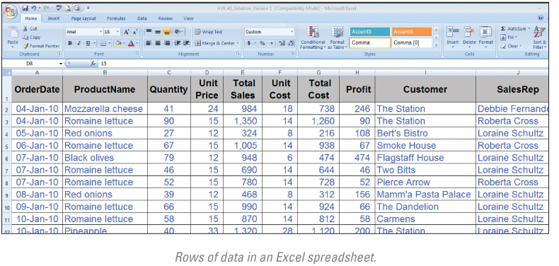
Raw data in a spreadsheet
18
Notes:
Rows of data in an Excel spreadsheet demonstrate data
Show the students that this is simply data, it does not explain any types of information or business intelligence such as how much did Roberta Cross sell this month?
Who is the best customer?
What is the best product?
These are all examples of information and BI – in this spreadsheet we see simply data
A fundamental role of all business managers is to be able to take the data and analyze it to find information to make great business decisions

Slide 19
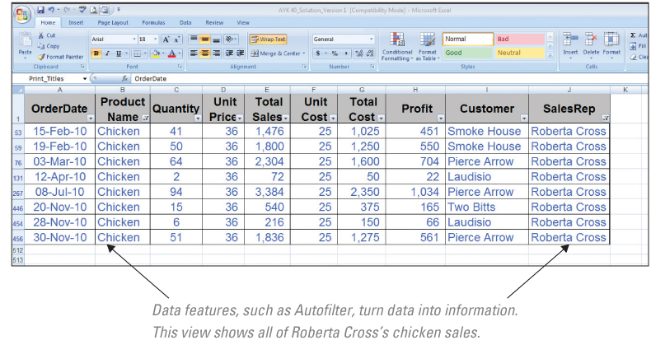
Raw data transformed into Information
19
Notes:
Data features, such as Auto filter, turn data into information
This view shows all of Roberta Cross’s chicken sales
Ask your students what other types of questions would you ask to find BI in this data?
Who is the best customer?
Who is the best sales representative?
What is the best selling product?
It is important to ask your students would they look at total sales or profit to determine the answer to these questions?

Slide 20

Technologies & business functions
Click-to-talk
  also known as click-to-call, click-to-chat and click-to-text.
  form of Web-based communication in which a person clicks an object (e.g., button, image or text) to request an immediate connection with another person in real-time either by phone call, instant messaging, or text.
  typically used in eBusiness to assist online store visitors in selecting products.
20

Slide 21

Technologies & business functions (cont.)
Call Center
  Is centralized office set by large organizations in order to receive and transmit a large volume of requests by phone.
  Is, typically, operated by a company to administer incoming product support or information inquiries from consumers.
  Is also used for outgoing calls for telemarketing and debt collection.
21

Slide 22
Technologies & business functions (cont.)
Call Scripting tools
  Refer to application software typically used by call center employees to help provide accurate answers to customers and react appropriately to their inquiries.
  Are, typically, connected to the corporate database, which allows pulling off the needed data to be used in assisting callers.
Benefits of Call Scripting include:
  agents can be guided through calls in a predictable way
  uniformity in the way call center employees handle cases.
  reduced errors and complaints, increased effectiveness
22

Slide 23
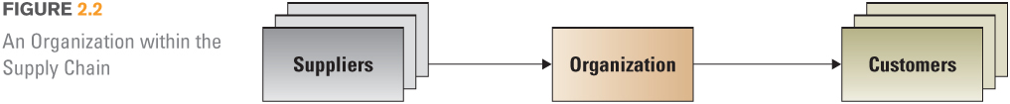
Technologies & business functions (cont.)
Supply Chain Management (SCM) Systems
  Refer to a category of IS that support the activities related to business supply chain.
  Supply chain involves: (a) materials flow from suppliers, (b) transformation of materials and production processes, (c) distribution of products to customers
Typical activities supported:
  Procurement / purchase of supplies
  Tracking orders from suppliers
  Handling customers orders
  Invoicing
  Tracking customers orders
23

Slide 24
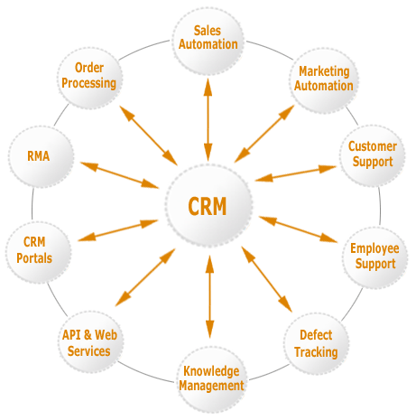
Technologies & business functions (cont.)
Customer Relationship Management (CRM) Systems
  Refer to a category of IS that support the activities related to managing and nurturing a company’s interactions with customers, clients, and sales prospects.
  Help increase organizational effort by multiple departments like marketing, sales, support division, and customer service to improve customer relations
  Goals: (1) find, attract, and win new clients – (2) nurture and maintain existing customers – (3) entice former customers back into the fold
Typical activities supported:
  Managing Sales teams
  Tracing potential customers
  Running MKT campaigns
  Analyzing sales
24

Slide 25
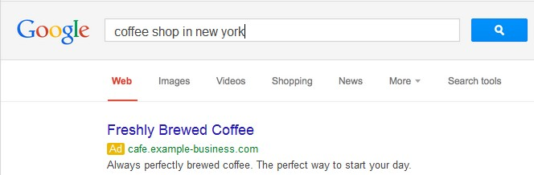
Technologies & business functions (cont.)
Search Engine Optimization (SEO)
  Internet Marketing tool that increases the visibility of a website in a search engine's unpaid results.
  Optimizing a website may involve editing its content, HTML and associated coding to both increase its relevance to specific keywords and to remove barriers to the indexing activities of search engines
Google AdWords
  Google’s advertising service that makes your website appears on top of Google Search results.
25

Slide 26
Technologies & business functions (cont.)
Finance, Accounting, ERP software
Open Source
Freeware | BIG4books · Microsoft Office Accounting Express · Outright.com
Retail | Advanced Business Solutions · AME Accounting Software · CGram Software · Fortora Fresh Finance · iBank · Intacct · IRIS Software · Microsoft Dynamics AX · Microsoft Dynamics GP · Microsoft Dynamics NAV · Microsoft Dynamics SL · Microsoft Money · Microsoft Office Accounting Professional · Microsoft Small Business Financials · Moneydance · NetSuite · NewViews · NOSA XP · Open Systems Accounting Software · Pastel Accounting · Peachtree Accounting · QuickBooks · Quicken · SAP Business One · TRAVERSE · Xero Accounting Software
Non-web | GnuCash · Grisbi · HomeBank · KMyMoney · OpenERP · RCA Open-Source Application · Tryton · TurboCASH
Web-based | Adempiere · BlueErp · Compiere · Dolibarr · FrontAccounting · IntarS · LedgerSMB · Openbravo · OpenERP · opentaps · PhreeBooks · webERP
26

Slide 27
Technologies & business functions (cont.)
Hepling customers find best deals
Web sites | Mobile apps
GasBuddy.com | GasBuddy for smartphone
Pricewatch.com | iGas for iPhone
PriceGrabber.com | PriceGrabber
Mygroceryspy.com | RedLaser – Reads bar code & searches the net for best deal
Nexag.com | GoogleShopper
Do In-Class Exercise 1: Technologies supporting business functions
27

Slide 28
SUMMARY QUESTIONS
See Summary Questions 1 posted to the class web site

