Slide 1
New Opportunities in Graduate Education
Peter Ping Liu, Ph D, PE, OCP, CQE and CSTM Professor and Coordinator of Graduate Study School of Technology
Center for Clean Energy Research and Education
Eastern Illinois University

Slide 2
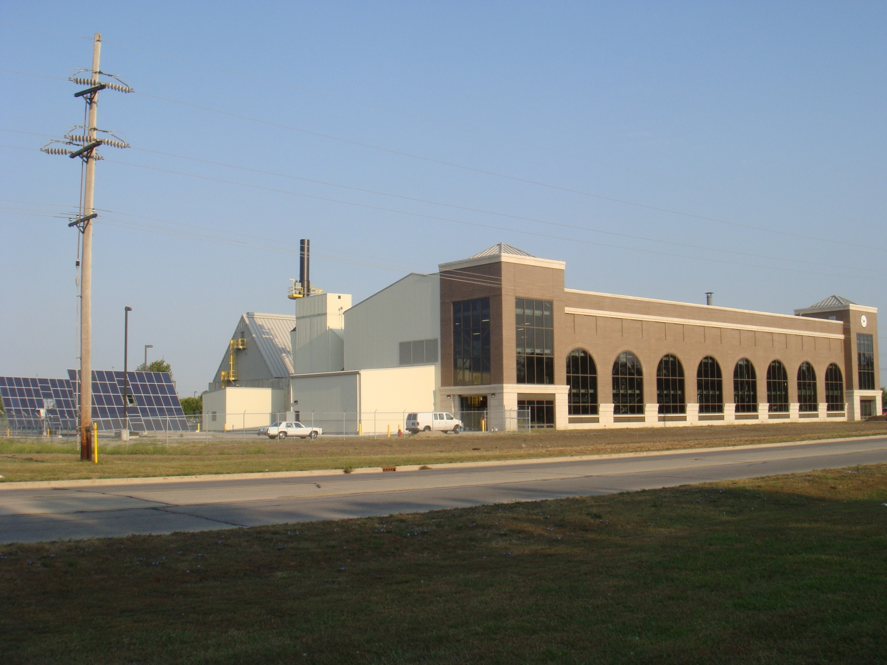
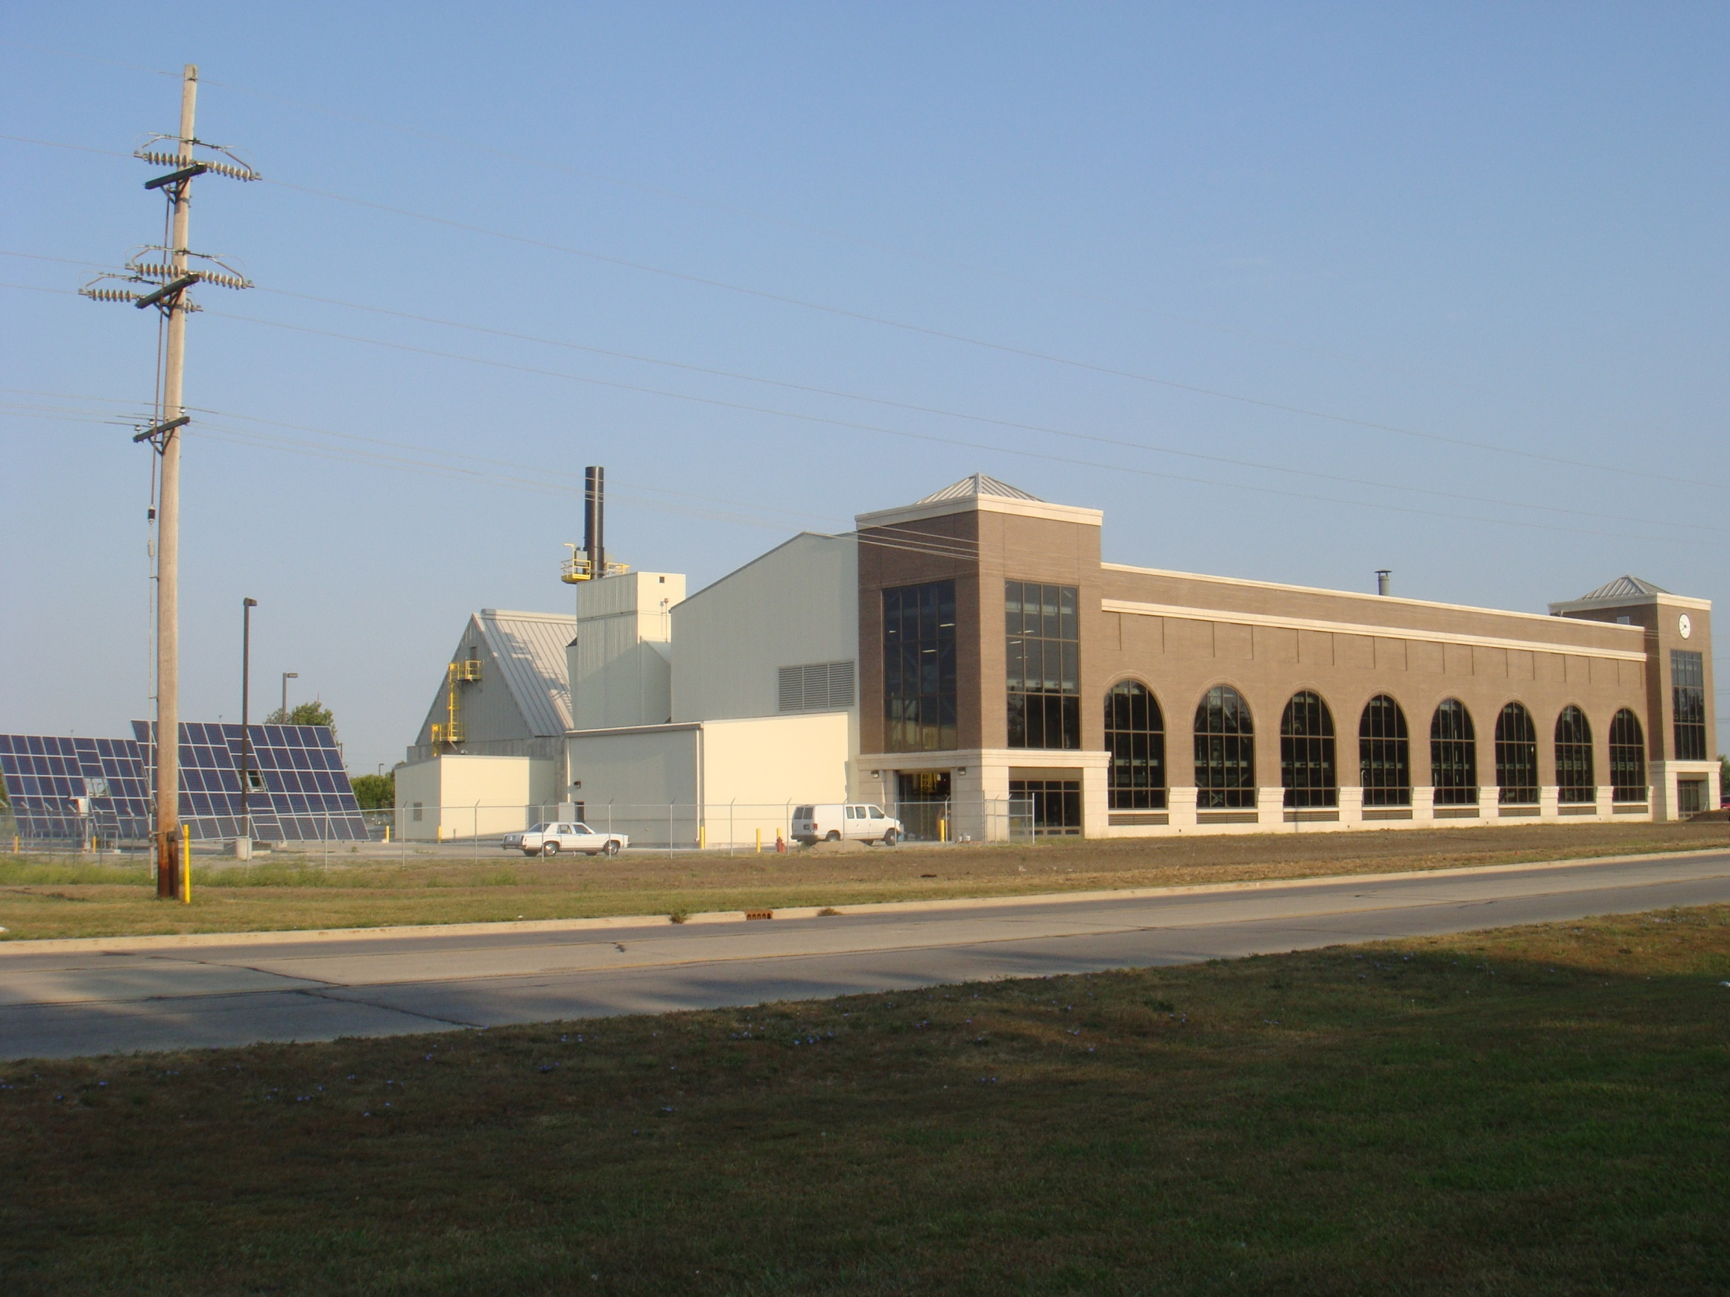
Renewable Energy Center

Slide 3
A call from President Perry and Provost Lord to integrate students learning with the opportunities brought with the Renewable Energy Center.

Slide 4
Center for Clean Energy Research and Education (CENCERE)
Create and provide opportunities for faculty, students and staff engaged in study of clean energy across the whole campus.

Slide 5
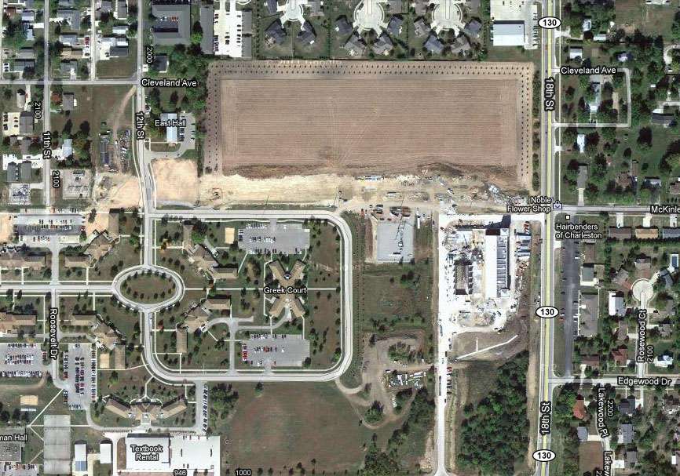
Energy Park at EIU
An Engine for Regional Economy
A Gateway to Communities
Clean Energy Incubator (including R and D, Training, and space for private companies)
Energy Crop Plots
Renewable Energy Center

Slide 6
Center for Clean Energy Research and Education (CENCERE) Multi-disciplinary Master of Science in Sustainable Energy
Program Vision: Provides Leaders for Energy Industry

Slide 7
Center for Clean Energy Research and Education (CENCERE) Multi-disciplinary Master of Science in Sustainable Energy Provides Leaders for Energy Industry
Research
Communication
Technology Management
Sciences
Economics and Policy
Degree Niche/Nature: Science-Based, Technology Management Focused

Slide 8
Center for Clean Energy Research and Education (CENCERE) Multi-disciplinary Master of Science in Sustainable Energy
Program Mission and Student Learning Outcome:
Students will have a solid understanding of the sciences and technology related to energy production, conversion, utilization and conservation.
Students will understand the economic, environmental and policy impact of a sustainable energy practice for a sustainable society.
Students will develop the research and communication ability to be effective leaders in the energy industry.

Slide 9
Center for Clean Energy Research and Education (CENCERE) Multi-disciplinary Master of Science in Sustainable Energy Provides Leaders for Energy Industry
Technology
Physics
Business
Chemistry
CENCERE: MS in Sustainable Energy
Communication Studies
Biological Sciences
English
Political Science
Geology/Geography
Economics

Slide 10
Tentative Courses
Science Cluster: 12 hours Bioenergy and Bioresources (Biological Sciences) (3 hours) Energy Chemistry (Chemistry) (3 hours) Energy Physics (including geothermal, solar and wind, and energy efficiency) (Physics) (3 hours) Biomass Gasification (Technology) (3 hours)
Technology Management Cluster: ( 9 hours) TEC 5103 Leadership (Technology) (3 hours) TEC 5133 Quality Management (Technology) (3 hours) Energy Management (including supply chain) (Business) (3 hours)
Research: TEC 5143 Research (Research Methods from other departments applicable) (3 hours)
Energy and Sustainability Communication (Communication Studies/English) (3 hours)
Energy Economics and Policy (Geology & Geography/Economics/Political Science) (3 hours)
Energy Practicum at Renewable Energy Center or Other Energy Facility (3 hours) ) – Graduation Requirement
Energy Research Project (3 hours) – Graduation Requirement

Slide 11
Things to Remember
Diverse student body: students come from mutli-backgrounds. (No pre-requisites for any course.)
Students will be assigned a home department closest to their undergraduate degrees, unless students choose differently.
Course delivery on a set sequence.
All courses are required for graduation. Students may start at any point.
Student research adviser: from home department.
Synergy between home degree program and this multi-disciplinary degree program: Any courses for this degree may be taken by students of respective home program as either elective or required courses. Allow students to complete dual degrees to make them more marketable, either concurrently or sequentially. (Overlapped courses will double count.)

Slide 12
“…The Renewable Energy Center is in operation and a formal grand opening will be held on October 7, 2011. Our efforts in sustainability and faculty leadership in related academic disciplines are leading to a minor, a master's degree ,and industry support for research and education. …”
President Bill Perry (August 31, 2011)

