Slide 1
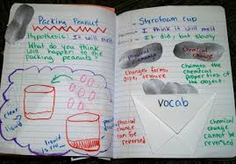
Interactive Notebooks
Student Reading Council
2/28/2018

Slide 2
Getting Started—Planning
What type of notebook should be used?
What should be included on every entry?
What types of organizational tools will students need? (scaffolds)
What types of investigations will help students develop content understanding, organization skills, literacy development?
How will students use the data in their notebooks?

Slide 3
Reading/Language Arts Notebooks
Reading Goals
Reading Wish Lists
100 Things About Me as a Reader
List of Books Read
Reference Sheets
Annotating
Lifting a Line
Drop in and Give Advice
Character Connections
What did I learn from the Characters?
Sketch to Stretch
Jot Thoughts

Slide 4
Possible Notebook Guidelines
Decorate the cover to make it your own!
Use the front and back of every page.
Use pencils, ballpoint pens, crayons, colored pencils, not markers.
Number your pages.
Include a title of the entry on your table of contents.
Include observations, drawings with labels, measurements, data, charts, etc.
Notes:
Pass out the notebooks.

Slide 5
Formative Assessment
We define the formative assessment process as one in which the teacher determines goals, implements the lesson, reviews student work, gains insight into student understanding, uses that information to inform instruction, provides students with feedback, and allows time for revision.
(Fulton & Campbell, 2014, 62)

Slide 6
Assessment
Examine science notebooks to understand student thinking.
Identify science misconceptions or incomplete ideas
Use information to plan instruction
Give students specific feedback
Provide opportunities for self-assessment

Slide 8
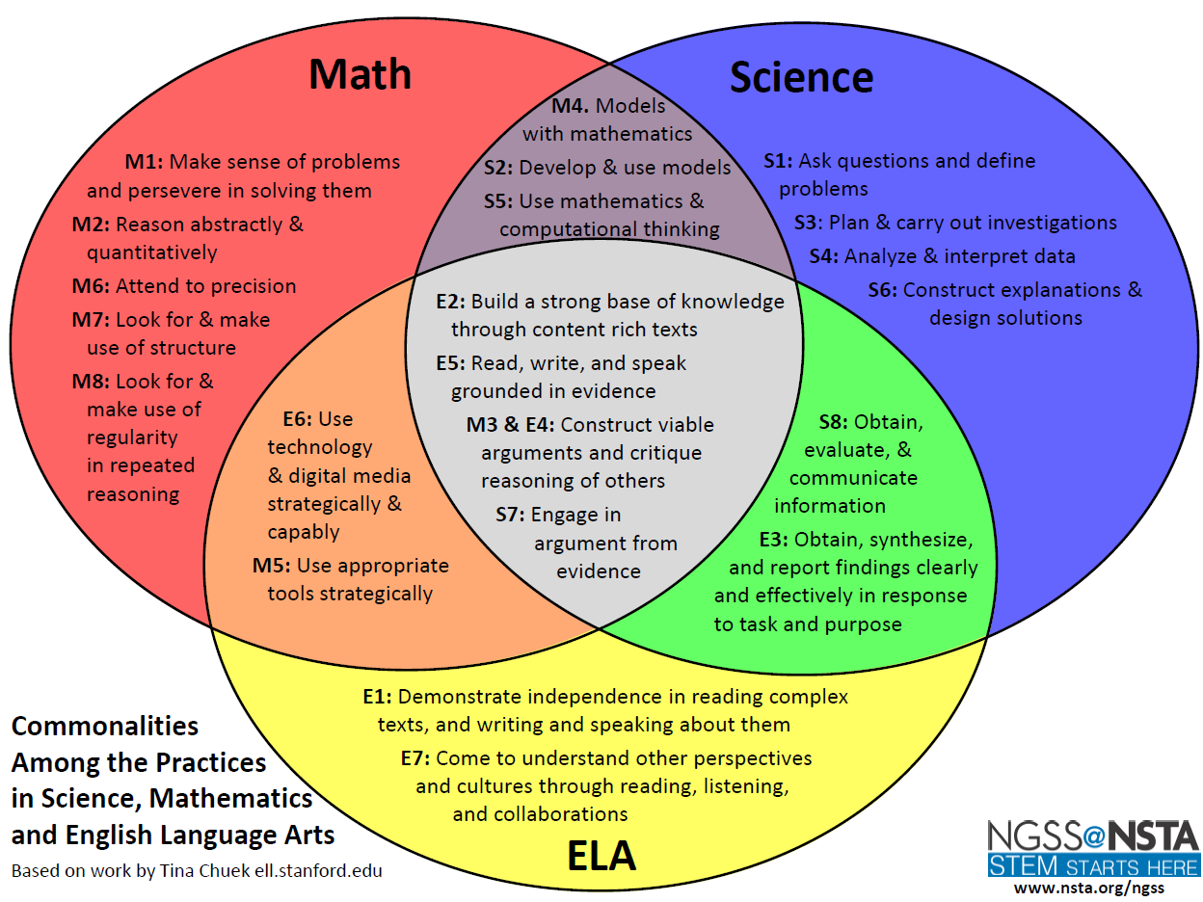
Notes:
Both documents stress the importance of engaging students in learning experiences in which they investigate the world as scientists would to gain scientific knowledge. Designed to build integrated units.

