Slide 1
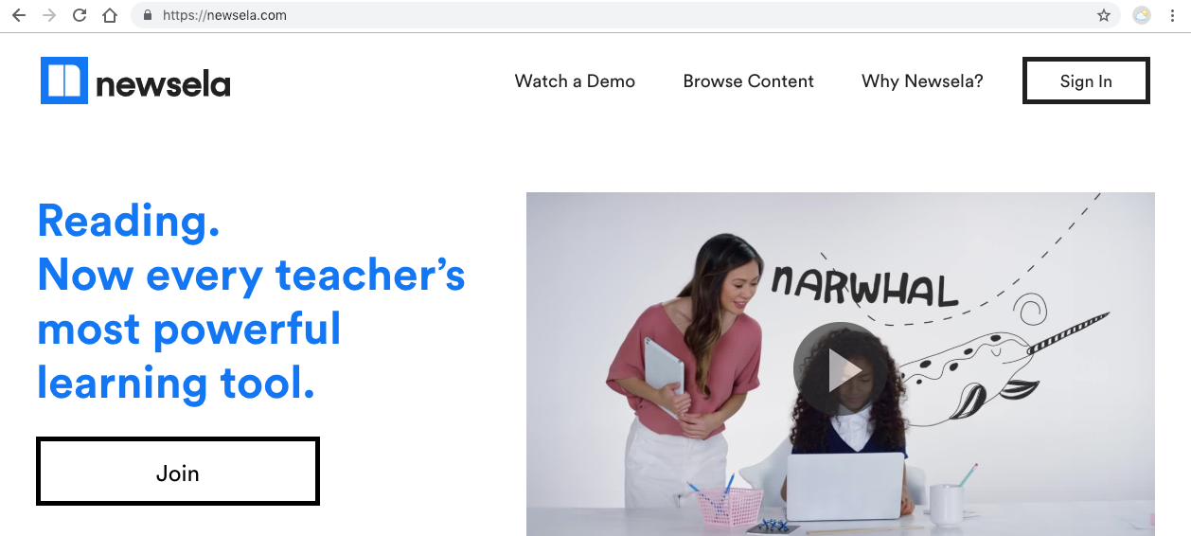
Getting the Most Out of NewsELA & ReadWorks
Monday, March 4, 2019
Lauren Covington &
Denise Reid

Slide 2
Importance of Nonfiction
Common Core expectations 50/50
Essential questions or student-based questions drive instruction
Build basic knowledge of events and facts
Provide opportunities for meaningful connections

Slide 3
NewsELA
Free to sign up for website
Differentiation done for you
Aligned to the standards

Slide 4
NewsELA
Search by category (Example: health, sports, science, etc. )
Search by topic (Example: refugees)
Search articles by grade level or standard (Example: Standard 8)
Articles can be saved on NewsELA

Slide 5
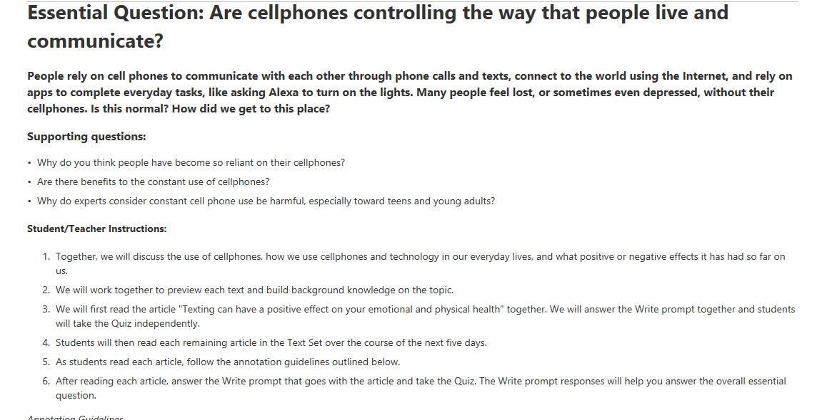
NewsELA Text Sets

Slide 6
Article of the Week
Idea from Kelly Gallagher and David Stuart Jr.
Used to build student prior knowledge
Students read and annotate
Write a summary
Answer a text-based question or give evidence-based opinion
Students work on reading and writing skills
Build background knowledge of events and information

Slide 7
Student Sample of Annotations

Slide 8
Student Writing Sample

Slide 9
Readworks.org

Slide 10
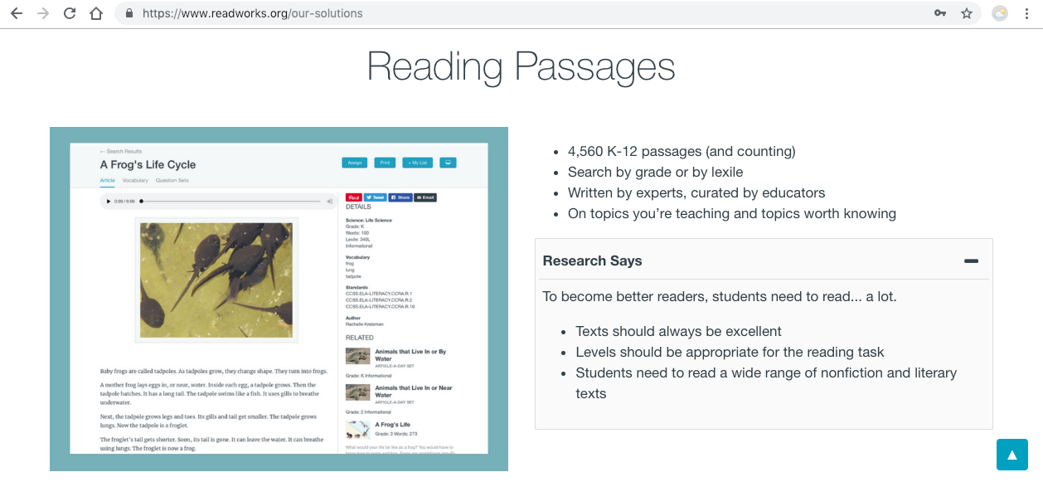

Slide 11
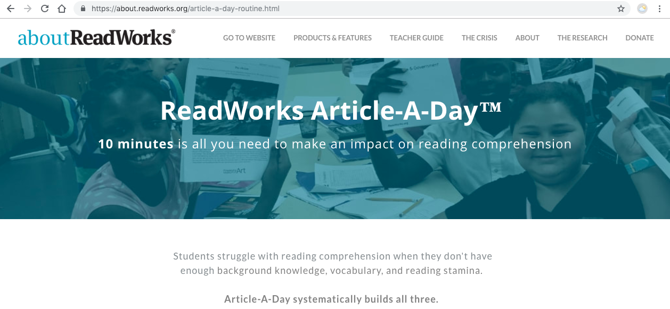
ReadWorks Article-A-Day

Slide 12
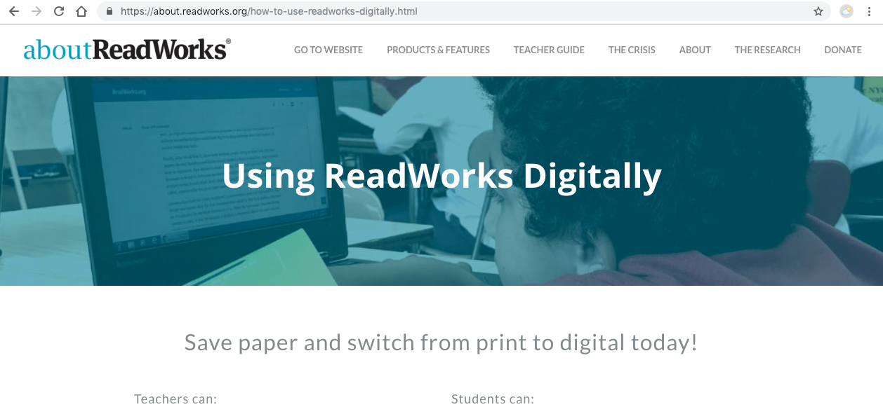
Using ReadWorks Digitally

Slide 13
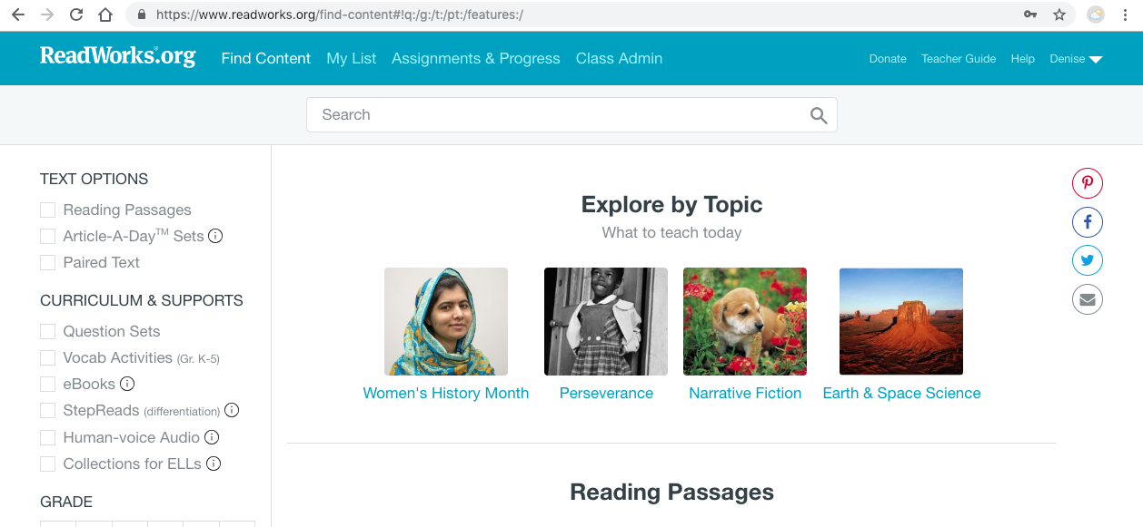
Searching the Features

Slide 14
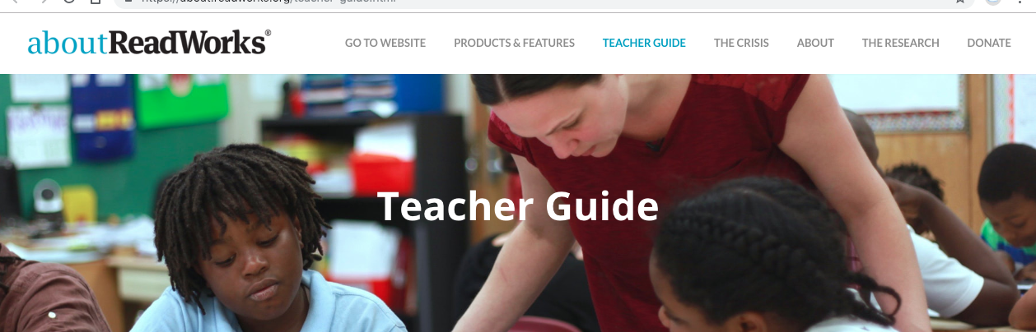
Teacher Guide

