Slide 1
Reading Your Textbook Effectively
Student Success Center, Eastern Illinois University
Brian Gorman, Assistant Director

Slide 2
Sound familiar?
I don’t have enough time to do all of my readings.
Sometimes I read an entire assignment and have no idea what it was talking about.
When I am reading I find my mind wandering and thinking about something else entirely.
My textbooks are too difficult to understand.
I often fall asleep when reading my textbook.
I get poor grades in classes that require reading.
I do poorly on tests even if I think I know the material.
I spend several hours rereading a chapter in a textbook.

Slide 3
Pre-Assessment
How many apply to you?
I read the assigned readings before class of the same topic.
I skim for main points before jumping into reading assignments.
I access prior knowledge of the topic I am reading before I read.
I can determine the meaning of a word from the words surrounding it.
I read all portions of a reading assignment (case studies, summary, etc.)
I take effective notes from my readings.
I use my reading notes to help with class discussions.
I review my reading notes immediately after completing my reading assignment.
I revisit my reading notes regularly.

Slide 4
Return on Investment
How much return are you getting on your investment of attending college?
Are you investing enough time?
What is the return you get for the time you invest now?

Slide 5
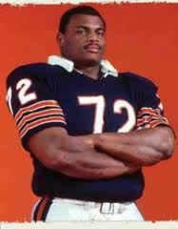
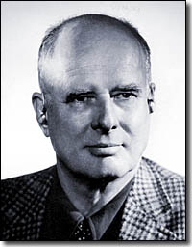
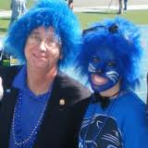
Textbook Reading – The Harvard Report
Obedient Purposelessness- doing something simply because it’s the way you’ve been told to do, even if it is without purpose and/or isn’t working.

Slide 6
Common Reading Myths
I have to read every word of an assignment.
Many words even in individual sentences have no meaning. Focusing on these unimportant words slows down speed and comprehension.
Reading once is enough.
Most people cannot soak in all information just by reading once. Repetition is key in moving information from short to long term memory.

Slide 7
Common Reading Myths
It is sinful to skip passages while reading.
Many textbooks are bursting with information to a point that there is no way to retain all of it. Good reading is selective reading.
Textbooks used as a reference is okay!
If I skim or read too rapidly my comprehension will drop.
Research shows very little relationship between speed and comprehension.
What really matters is your ability to take in important ideas.

Slide 8
General Reading Tips
Have a goal
Have the right mindset
Start reading early
Skim – Read – Skim
Understand the vocabulary
Take notes
Make the material your own
Know when to stop
Have a discussion buddy
Repetition/Review
Read for pleasure

Slide 9
Before Reading
Limit Distractions
No TV, no windows, no outside movement
Proper Lighting and Temperature
Too much or too little light causes strain = fatigue
Too warm = sleepy; Too cool = distraction
Reading Position
Have an available distraction
We all need breaks – most can’t physically handle long periods of time without difference
Positive Attitude
Goals

Slide 10
Before Reading - Explore Your Textbook
How is the book organized?
How are chapters/units divided?
Is there a glossary, index, table of contents that may be beneficial?
Concentration specific resources?
Maps, primary sources, tables, charts, graphs, case studies?
Are there section/chapter summaries, study aides, exercises, activities? Where are they located?
Answer Key?

Slide 11
Outline Method
Same format as if you were taking notes in a lecture
Main Topic
Section Heading 1
Write 1-5 sentences summarizing the main idea AND/OR
Vocabulary, important dates, data, etc.
Sub-Topic 1
1-5 sentence summary/vocab, dates, data, etc.
Section Heading 2
Same as above
Concluding summary/statement

Slide 12
SQ3R
Survey – “birds eye view”
Scan headings for topics and organization
Write headings down!
Skim and Scan
Question
form questions to answer later after reading
Read!
Search for your answers!
Usually about a section at a time
Ask more questions
How can this relate to me?
Are you convinced?
Were you right?
Take notes

Slide 13
SQ3R
Rehearse
Interpret your notes in your own words, make them personal to you
Answer your questions without looking
Check your answers
Review
Go through your notes, again answering questions, paying attention to organization

Slide 14
Mind Mapping
Once again you need to become familiar with your text
Mind map your thoughts and what you already know
Mind map an overview
The middle image represents the central topic
Create “section branches” off the central image
Create “sub-topic branches” off the “section branches”
Start reading and adding “detail branches” off the “sub-topic branches” as you go

Slide 15
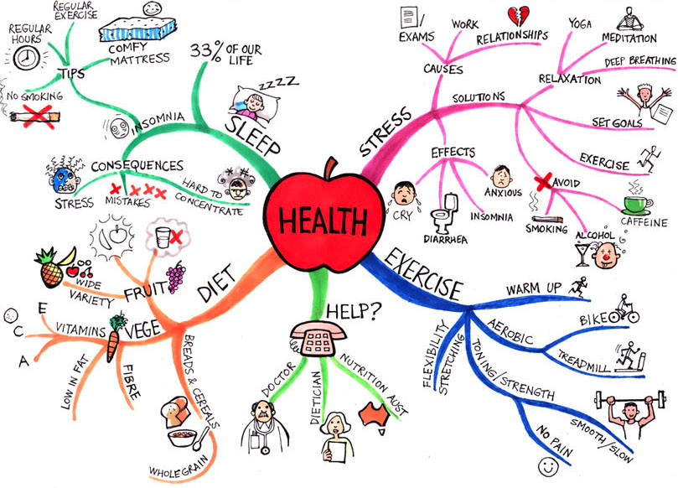

Slide 16
Skim and Divide
Skim the entire chapter
Easy and effective way to get the ball rolling
Provides a background of the information and organization
Activates prior knowledge
Skim an individual section
Repetition!
Read the section; highlighting/underlining/note-taking as you do
Look for definitions, cause and effect, comparison, examples
REPEAT STEPS 2 AND 3 FOR EVERY SECTION
Review and Recite your notes

Slide 17
Helpful Resources
How to improve your reading comprehension
http://www.youtube.com/watch?v=dNlgRoNa16o
EIU Student Success Center
http://www.eiu.edu/success/
EIU Reading Center
http://www.eiu.edu/readctr/

Slide 18
Works Cited
Steven Moneyworth, Yahoo.com contributor, Jul 21, 2009
honorsblog.tcu.edu
Fridge72.com
Leadershipnow.com
Unigo.com
Usingmindmaps.com
University of Wisconsin-Green Bay Tutoring Services
Academic Skills Center, Dartmouth College
Cornell College Academic Support and Advising

