Slide 1
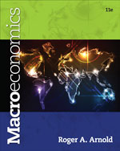
Chapter 10: Keynesian Macroeconomics and Economic Instability: A Critique of the Self-Regulating Economy
© 2014 Cengage Learning. All Rights Reserved. May not be copied, scanned, or duplicated, in whole or in part, except for use as permitted in a license distributed with certain product , service, or otherwise on password-protected website for classroom use

Slide 2

In This Lecture…..
Keynes on Wage Rates and Prices
Keynes on Say’s Law
Consumption Function
The Multiplier
The Simple Keynesian Model in the AD-AS Framework
The Simple Keynesian Model in the TE-TP Framework
A Keynesian Theme
To select a topic, click on its link above
© 2014 Cengage Learning. All Rights Reserved. May not be copied, scanned, or duplicated, in whole or in part, except for use as permitted in a license distributed with certain product , service, or otherwise on password-protected website for classroom use

Slide 3
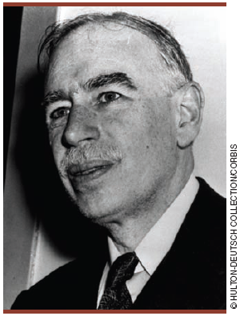
Keynes Challenged Classical Macroeconomics
Keynes challenged all four of the following classical position beliefs:
(1) Say’s law holds, so that insufficient demand in the economy is unlikely.
(2) Wages, prices, and interest rates are flexible.
(3) The economy is self-regulating. (4) Laissez-faire is the right and sensible economic policy.
To learn more about John Maynard Keynes, click his photo above.
Click to return to “In this Lesson”
© 2014 Cengage Learning. All Rights Reserved. May not be copied, scanned, or duplicated, in whole or in part, except for use as permitted in a license distributed with certain product , service, or otherwise on password-protected website for classroom use

Slide 4
Keynes’s View of Say’s Law in a Money Economy
According to Keynes, a decrease in consumption and subsequent increase in saving may not be matched by an equal increase in investment. Thus, a decrease in total expenditures may occur.
Click to return to “In this Lesson”

Slide 5
Classical Economists on Savings and Investment
According to classical economists and Say’s law, if consumption spending falls because saving increases, then total spending will not fall, because the added saving will simply bring about more investment spending. This will happen through changes in the interest rate. The added saving will put downward pressure on the interest rate, and at a lower interest rate businesses will borrow and invest more. Through changes in the interest rate, the amount of saving will always equal the amount invested.
Click to return to “In this Lesson”

Slide 6

Keynes’s View of Say’s Law in a Money Economy
Click to return to “In this Lesson”
© 2014 Cengage Learning. All Rights Reserved. May not be copied, scanned, or duplicated, in whole or in part, except for use as permitted in a license distributed with certain product , service, or otherwise on password-protected website for classroom use

Slide 7
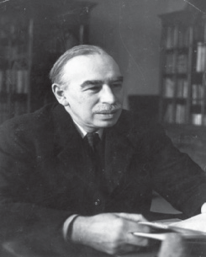
Keynes on Savings and Investment
Keynes held that saving is more responsive to changes in income than to changes in the interest rate and that investment is more responsive to technological changes, business expectations, and innovations than to changes in the interest rate.
Click to return to “In this Lesson”
© 2014 Cengage Learning. All Rights Reserved. May not be copied, scanned, or duplicated, in whole or in part, except for use as permitted in a license distributed with certain product , service, or otherwise on password-protected website for classroom use

Slide 8
Keynes on Wages
The labor market may adjust slowly. In particular, a lowered demand for labor may not be met with a declining wage rate. Wage rates might be inflexible downward (at least for some time).
If wage rates are inflexible downward, then the self-regulating properties of an economy are in question. Specifically, an economy might get stuck in a recessionary gap.
Click to return to “In this Lesson”
© 2014 Cengage Learning. All Rights Reserved. May not be copied, scanned, or duplicated, in whole or in part, except for use as permitted in a license distributed with certain product , service, or otherwise on password-protected website for classroom use

Slide 9
The Economy Gets “Stuck” in a
Recessionary Gap
If the economy is in a recessionary gap at point 1, Keynes held that wage rates may not fall.
The economy may be stuck in the recessionary gap.
Click to return to “In this Lesson”
© 2014 Cengage Learning. All Rights Reserved. May not be copied, scanned, or duplicated, in whole or in part, except for use as permitted in a license distributed with certain product , service, or otherwise on password-protected website for classroom use

Slide 10
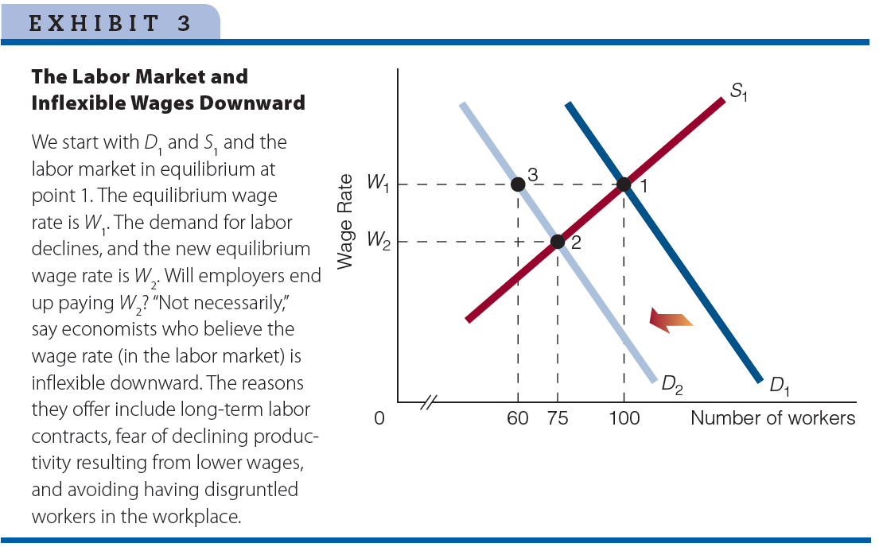
Labor Market and Inflexible Wages Downward

Slide 11
Efficiency Wage Models
Efficiency Wage Models are models that hold it is sometimes in the best interest of business firms to pay their employees higher-than-equilibrium wage rates.
A cut in wages can cause a decline in labor productivity, which in turn raises the firm’s cost.
By paying an above-equilibrium wage, firms provide an incentive to workers to be productive and do less shirking among other things. If shirking declines, so do the monitoring (management) costs of the firm.
Click to return to “In this Lesson”

Slide 12
Keynes on Prices
Keynes said that the internal structure of an economy is not always competitive enough to allow prices to fall.
Keynes suggested that anticompetitive or monopolistic elements in the economy sometimes prevent price from falling.
Click to return to “In this Lesson”

Slide 13
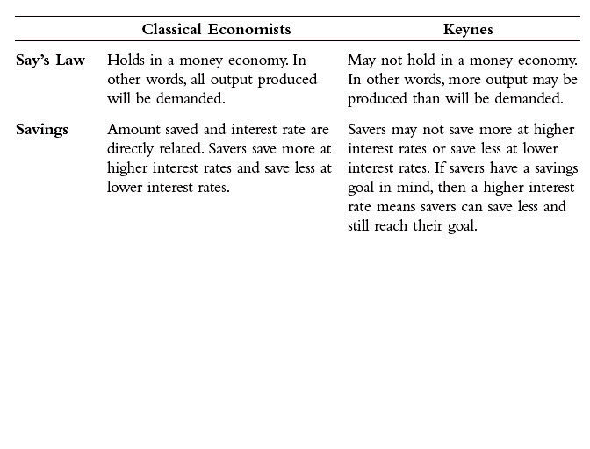
Classical vs. Keynes I
Click to return to “In this Lesson”

Slide 14
A Question of How Long It Takes for
Wage Rates and Prices to Fall
Suppose the economy is in a recessionary gap at point 1.
Wage rates are $10 per hour, and the price level is P₁.
The issue may not be whether wage rates and the price level fall, but how long they take to reach long-run levels
(continued)
Click to return to “In this Lesson”

Slide 15
A Question of How Long It Takes for
Wage Rates and Prices to Fall
If they take a short time, then classical economists are right: the economy is self-regulating.
If they take a long time—perhaps years—then Keynes is right: the economy is not self-regulating over any reasonable period of time
Click to return to “In this Lesson”

Slide 16
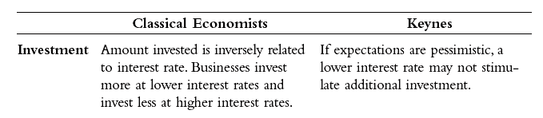
Classical vs. Keynes II
Click to return to “In this Lesson”
© 2014 Cengage Learning. All Rights Reserved. May not be copied, scanned, or duplicated, in whole or in part, except for use as permitted in a license distributed with certain product , service, or otherwise on password-protected website for classroom use

Slide 17
Self-Test
What do Keynesians mean when they say the economy is inherently unstable?
Keynesians mean that an economy may not self-regulate at Natural Real GDP (Q_{N}). Instead, an economy can get stuck in a recessionary gap.
Click to return to “In this Lesson”
© 2014 Cengage Learning. All Rights Reserved. May not be copied, scanned, or duplicated, in whole or in part, except for use as permitted in a license distributed with certain product , service, or otherwise on password-protected website for classroom use

Slide 18
Self-Test
2. “What matters is not whether the economy is self-regulating or not, but whether prices and wages are flexible and adjust quickly.” Comment.
To say that the economy is self-regulating is the same as saying that prices and wages are flexible and adjust quickly. They are just two ways of describing the same thing.
Click to return to “In this Lesson”
© 2014 Cengage Learning. All Rights Reserved. May not be copied, scanned, or duplicated, in whole or in part, except for use as permitted in a license distributed with certain product , service, or otherwise on password-protected website for classroom use

Slide 19
Self-Test
3. According to Keynes, why might aggregate demand be too low?
The main reason is that Say’s law may not hold in a money economy. The question is why doesn’t Say’s law hold in a money economy? Keynes argued that an increase in saving (which leads to a decline in demand) does not necessarily bring about an equal amount of additional investment (which would lead to an increase in demand), because neither saving nor investment is exclusively affected by changes in the interest rate.
Click to return to “In this Lesson”

Slide 20
The Simple Keynesian Model
Assumptions:
First, the price level is assumed to be constant until the economy reaches its full-employment or Natural Real GDP level.
Second, there is no foreign sector. In other words, the model represents a closed economy, not an open economy. It follows that total spending in the economy is the sum of consumption, investment, and government purchases (GDP=C+I+G).
Third, the monetary side of the economy is excluded.
Click to return to “In this Lesson”

Slide 21
Consumption Function I
The consumption function is the relationship between consumption (household sector spending) and disposable income.
In the consumption function, consumption is directly related to disposable income and is positive even at zero disposable income:
C= C₀ + (MPC) (Y_{d}).
Click to return to “In this Lesson”

Slide 22
Consumption Function II
C= C₀ + (MPC) (Y_{d})
C – Total consumption
C₀ – Autonomous consumption - The part of consumption that is independent of disposable income.
MPC – Marginal propensity to consume - The ratio of the change in consumption to the change in disposable income: MPC = ΔC / ΔYd.
Y_{d} – Disposable income – Income received less taxes.
Click to return to “In this Lesson”

Slide 23
Consumption Function III
Consumption depends on disposable income.
Consumption and disposable income move in the same direction.
Yd ↑ C↑
3. When disposable income changes, consumption changes by less (MPC).
Click to return to “In this Lesson”

Slide 24

Savings and MPS
Saving = Disposable Income less Consumption
Marginal propensity to save (MPS) is the ratio of the change in saving to the change in disposable income:
MPS ΔS / ΔY_{d}
Click to return to “In this Lesson”

Slide 25
C and S at Different Levels of Disposable Income
MPC = .80
⇧
S = Y_{d} – C
⇧
Click to return to “In this Lesson”

Slide 26
Multiplier
The number that is multiplied by the change in autonomous spending to obtain the overall change in total spending.
The multiplier (m) is equal to 1 / (1 - MPC).
If the economy is operating below Natural Real GDP, then the multiplier turns out to be the number that is multiplied by the change in autonomous spending to obtain the change in Real GDP
Change in total spending = Multiplier x Change in autonomous spending
Click to return to “In this Lesson”

Slide 27



An Example of the Multiplier at Work
Initial rise in autonomous spending = $40
Marginal Propensity to Consume = .80
Multiplier = 1/(1-.80) = 1/.2 = 5
Change in total spending = 5 x $40 = $200
Click to return to “In this Lesson”

Slide 28
Self-Test
How is autonomous consumption different from consumption?
Autonomous consumption is one of the components of overall consumption. To illustrate, look at the consumption function: C = C₀ +(MPC)(Y_{d}). The part of overall consumption (C ) that is autonomous is C₀. This part of consumption does not depend on disposable income. The part of consumption that does depend on disposable income (i.e., the part that changes as disposable income changes) is the (MPC )(Y_{d}) part. For example, assume the MPC = 0.80. If Y_{d} rises by $1,000, then consumption goes up by $800.
Click to return to “In this Lesson”

Slide 29
Self-Test
2. If the MPC = 0.70, what does the multiplier equal?
1/(1- 0.70) = 1/0.30 =3.33.
Click to return to “In this Lesson”

Slide 30
Self-Test
3. What happens to the multiplier as the MPC falls?
The multiplier falls. For example, if MPC = 0.20, then the multiplier is 1.25, but if MPC = 0.80, then the multiplier is 5.
Click to return to “In this Lesson”

Slide 31
The Multiplier and Aggregate Demand
An initial increase in autonomous consumption raises total spending and shifts the aggregate demand curve from AD1 to AD2.
Because of the multiplier, the increase in autonomous spending generates additional incomes and additional spending, shifting the aggregate demand curve to AD3.
Click to return to “In this Lesson”

Slide 32
Keynesian Aggregate Supply Curve
The AS curve in the simple Keynesian model is horizontal until QN (Natural Real GDP) and vertical at QN.
Any changes in aggregate demand in the horizontal section do not change the price level, but any changes in aggregate demand in the vertical section do change the price level.
Click to return to “In this Lesson”

Slide 33
Can the Private Sector Remove the Economy from a Recessionary Gap?
The economy is at point A producing Q1. Q1 is less than QN, so the economy is in a recessionary gap.
Can private sector spending (consumption and investment) move the economy from the recessionary gap by increasing spending enough to shift the aggregate demand curve rightward to go through point B?
Click to return to “In this Lesson”
© 2014 Cengage Learning. All Rights Reserved. May not be copied, scanned, or duplicated, in whole or in part, except for use as permitted in a license distributed with certain product , service, or otherwise on password-protected website for classroom use

Slide 34
Can the Private Sector Remove the Economy from a Recessionary Gap?
Keynes believed that sometimes it could not.
No matter how low interest rates fell, investment spending would not rise because of pessimistic business expectations with respect to future sales.
Click to return to “In this Lesson”

Slide 35
Simple Keynesian Model I
The price level is constant until Natural Real GDP is reached.
The AD curve shifts if there are changes in C, I, or G.
According to Keynes, it is possible for the economy to be in equilibrium and in a recessionary gap too.
Click to return to “In this Lesson”
© 2014 Cengage Learning. All Rights Reserved. May not be copied, scanned, or duplicated, in whole or in part, except for use as permitted in a license distributed with certain product , service, or otherwise on password-protected website for classroom use

Slide 36

Simple Keynesian Model II
The private sector may not be able to get the economy out of a recessionary gap. In other words, the private sector (households and businesses) may not be able to increase C or I enough to get the AD curve in to intersect the AS curve at the Natural Level of Real GDP.
The government may have a management role to play in the economy. it to its Natural Real GDP level.
Click to return to “In this Lesson”
© 2014 Cengage Learning. All Rights Reserved. May not be copied, scanned, or duplicated, in whole or in part, except for use as permitted in a license distributed with certain product , service, or otherwise on password-protected website for classroom use

Slide 37
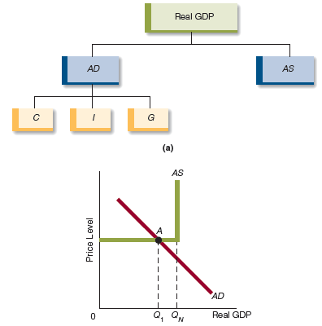
Simple Keynesian Model in the AD-AS Framework
The purpose of the simple Keynesian model is to explain changes in Real GDP.
In (a) the model is presented as a flowchart. Real GDP is determined by aggregate demand and aggregate supply. Aggregate demand depends on C, consumption; I, investment; and G, government purchases.
In (b) we show a diagrammatic exposition of the model in the ADAS framework.
Click to return to “In this Lesson”
© 2014 Cengage Learning. All Rights Reserved. May not be copied, scanned, or duplicated, in whole or in part, except for use as permitted in a license distributed with certain product , service, or otherwise on password-protected website for classroom use

Slide 38
Self-Test
What was Keynes’s position with respect to the self-regulating properties of an economy?
Keynes believed that the economy may not always self regulate itself at Natural Real GDP. In other words, households and businesses (the private sector of the economy) are not always capable of generating enough aggregate demand in the economy so that the economy equilibrates at Natural Real GDP.
Click to return to “In this Lesson”

Slide 39
Self-Test
2. What will happen to real GDP if autonomous spending rises and the economy is operating at the horizontal section of Keynesian AS curve? Explain your answer.
The increase in autonomous spending will lead to a greater increase in total spending and to a shift rightward in the AD curve. If the economy is operating in the horizontal section of the Keynesian AS curve, Real GDP will rise, and there will be no change in prices.
Click to return to “In this Lesson”

Slide 40
Self-Test
3. An economist who believes the economy is self-regulating is more likely to advocate laissez- faire than an economist who believes the economy is inherently unstable. Do you agree or disagree? Explain your answer.
Agree. The economist who believes the economy is inherently unstable sees a role for government. Government is supposed to stabilize the economy at Natural Real GDP. The economist who believes the economy is self-regulating (capable of moving itself to Natural Real GDP) sees only a small, if any, role for government in the economy because the economy is already doing the job government would supposedly do.
Click to return to “In this Lesson”

Slide 41
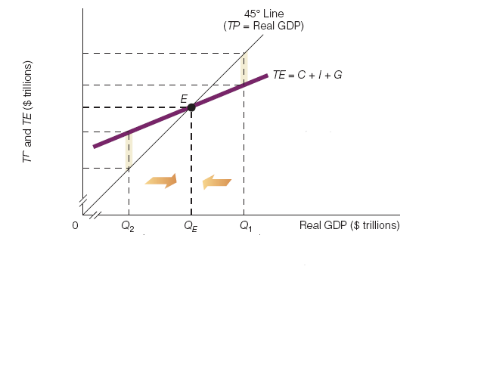
The Keynesian Cross
Total Expenditures and Total Production
Click the graph above for a tutorial
on this subject.
Click to return to “In this Lesson”
© 2014 Cengage Learning. All Rights Reserved. May not be copied, scanned, or duplicated, in whole or in part, except for use as permitted in a license distributed with certain product , service, or otherwise on password-protected website for classroom use

Slide 42
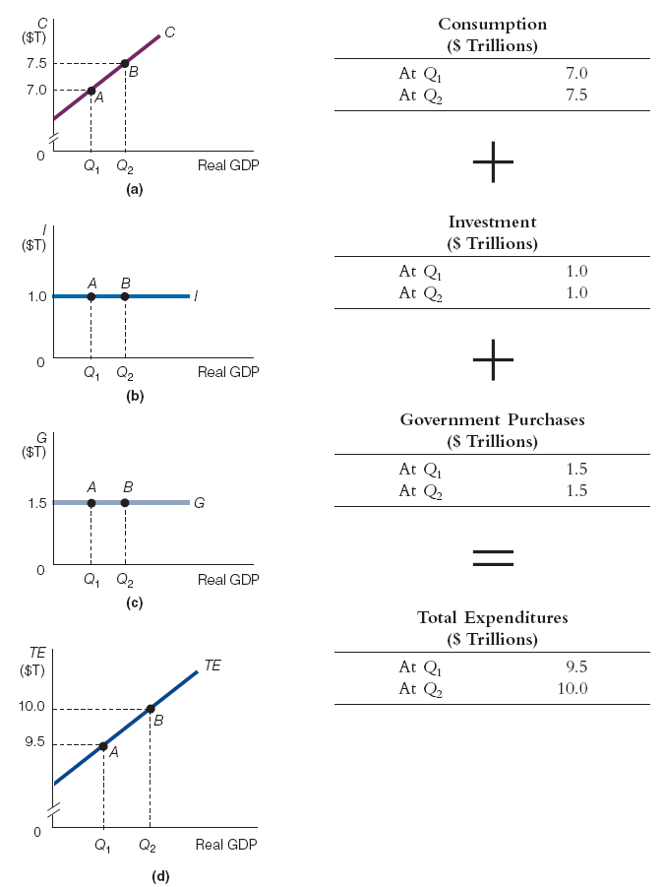
The Derivation of the Total Expenditures (TE) Curve
At different levels of Real GDP, we sum consumption (a), investment (b), and government purchases (c) to derive TE curve (d).
Click to return to “In this Lesson”
© 2014 Cengage Learning. All Rights Reserved. May not be copied, scanned, or duplicated, in whole or in part, except for use as permitted in a license distributed with certain product , service, or otherwise on password-protected website for classroom use

Slide 43
Total Production Curve
TP curve, which is simply a 45-degree line. (It is called a 45-degree line because it bisects the 90-degree angle at the origin.)
It is important to notice that at any point on the TP curve, total production is equal to Real GDP (TP Real GDP).
This is because TP and Real GDP are different names for the same thing.
Click to return to “In this Lesson”
© 2014 Cengage Learning. All Rights Reserved. May not be copied, scanned, or duplicated, in whole or in part, except for use as permitted in a license distributed with certain product , service, or otherwise on password-protected website for classroom use

Slide 44
Three States of the Economy in the TE-TP Framework I
At Q_{E}, TE = TP and the economy is in equilibrium.
At Q₁, TE < TP. This results in an unexpected increase in inventories, which signals firms that they have overproduced, which leads firms to cut back production.
The cutback in production reduces Real GDP. The economy tends to move from Q₁ to Q_{E}.
Click to return to “In this Lesson”

Slide 45
Three States of the Economy in the TE-TP Framework II
At Q₂, TE > TP. This results in an unexpected decrease in inventories, which signals firms that they have under produced, which leads firms to raise production.
The increased production raises Real GDP. The economy tends to move from Q₂ to Q_{E}.
Click to return to “In this Lesson”

Slide 46
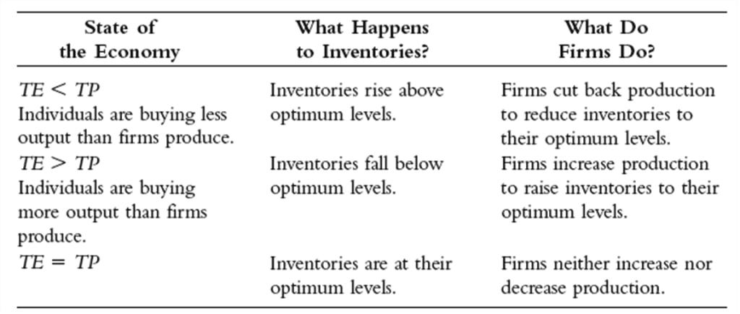
Three States of the Economy in the TE-TP Framework III
Click to return to “In this Lesson”

Slide 47
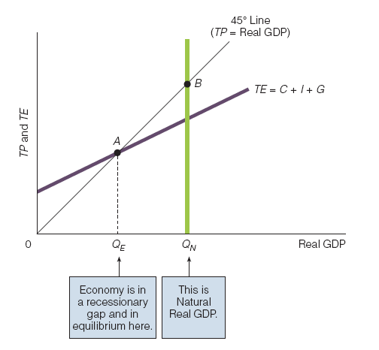
The Economy: In Equilibrium, and in a Recessionary Gap, Too
Using the TE-TP framework, the economy is currently in equilibrium at point A, producing QE.
Natural Real GDP, however, is greater than QE, so the economy is in a recessionary gap as well as being in equilibrium.
Click to return to “In this Lesson”

Slide 48
The Simple Keynesian Model
As portrayed in terms of Total Expenditure and Total Production, the essence of the simple Keynesian model is:
1. The price level is constant until Natural Real GDP is reached.
2. The TE curve shifts if there are changes in C, I, or G.
3. It is possible for the economy to be in equilibrium and in a recessionary gap too.
Click to return to “In this Lesson”

Slide 49
The Simple Keynesian Model
4. The private sector may not be able to get the economy out of a recessionary gap.
5. The government may have a management role to play in the economy. According to Keynes, government may have to raise TE enough to stimulate the economy out of the recessionary gap and move it to its Natural Real GDP level.
Click to return to “In this Lesson”

Slide 50
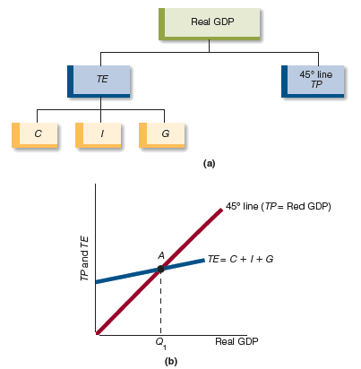
The Simple Keynesian Model in the TE–TP Framework
The purpose of the simple Keynesian model is to explain changes in Real GDP.
In (a) the model is presented as a flowchart. Real GDP is determined by total expenditures (TE) and total product (TP). Total expenditure (TE) depend on C, consumption; I, investment; and G, government purchases.
In (b) is a diagrammatic exposition of the model in the TETP framework.
Click to return to “In this Lesson”

Slide 51
Self-Test
1. What happens in the economy if total production (TP ) is greater than total expenditures (TE )?
When TP is greater than TE, firms are producing and offering for sale more units of goods and services than households and government want to buy. As a result, business inventories rise above optimal levels. In reaction, firms cut back on their production of goods and services. This leads to a decline in Real GDP, which stops falling when TP equals TE.
Click to return to “In this Lesson”

Slide 52
Self-Test
2. What happens in the economy if total expenditures (TE ) are greater than total production (TP )?
When TE is greater than TP, households and businesses want to buy more than firms are producing and offering for sale. As a result, business inventories fall below optimal levels. In reaction, firms increase their production of goods and services. This leads to a rise in Real GDP, which stops rising when TP equals TE.
Click to return to “In this Lesson”

Slide 53

Wall Street Journal
The Wall Street Journal is a is a rich source of information which provides real life examples of micro- and macro economic activities. Check today’s issue to see the most current news.
http://www.wsj.com
Click to return to “In this Lesson”

