Slide 1

Chapter 11: Fiscal Policy and the Federal Budget
© 2014 Cengage Learning. All Rights Reserved. May not be copied, scanned, or duplicated, in whole or in part, except for use as permitted in a license distributed with certain product , service, or otherwise on password-protected website for classroom use
Notes:
1

Slide 2

In This Lecture…..
To select a topic, click on its link above
Government Spending
Taxes
Deficits, Surpluses, and the Public Debt
Fiscal Policy: General Remarks
Demand-Side Fiscal Policy: A Keynesian Perspective
Crowding Out
Why Demand Side Fiscal Policy May be Ineffective
Supply Side Fiscal Policy
© 2014 Cengage Learning. All Rights Reserved. May not be copied, scanned, or duplicated, in whole or in part, except for use as permitted in a license distributed with certain product , service, or otherwise on password-protected website for classroom use

Slide 3
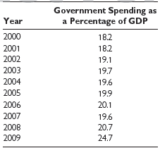
Government Expenditures*
*Government expenditures are the sum of government purchases (G) and (government) transfer payments.
© 2014 Cengage Learning. All Rights Reserved. May not be copied, scanned, or duplicated, in whole or in part, except for use as permitted in a license distributed with certain product , service, or otherwise on password-protected website for classroom use
Click to return to “In this Lesson”

Slide 4
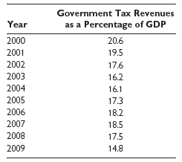
Government Tax Revenues
© 2014 Cengage Learning. All Rights Reserved. May not be copied, scanned, or duplicated, in whole or in part, except for use as permitted in a license distributed with certain product , service, or otherwise on password-protected website for classroom use
Click to return to “In this Lesson”

Slide 5
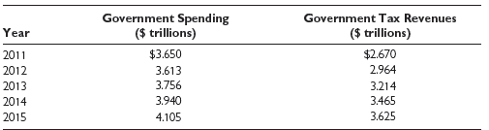
Government Budget Projections
© 2014 Cengage Learning. All Rights Reserved. May not be copied, scanned, or duplicated, in whole or in part, except for use as permitted in a license distributed with certain product , service, or otherwise on password-protected website for classroom use
Click to return to “In this Lesson”

Slide 6
Three Income Tax Structures
Progressive Income Tax - An income tax system in which one’s tax rate rises as taxable income rises (up to some point).
Proportional Income Tax An income tax system in which a person’s tax rate is the same regardless of taxable income.
Regressive Income Tax - An income tax system in which a person’s tax rate declines as his or her taxable income rises.
© 2014 Cengage Learning. All Rights Reserved. May not be copied, scanned, or duplicated, in whole or in part, except for use as permitted in a license distributed with certain product , service, or otherwise on password-protected website for classroom use
Click to return to “In this Lesson”

Slide 7
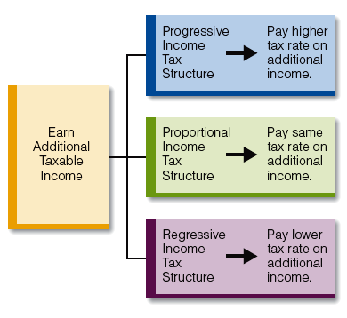
Three Income Tax Structures
© 2014 Cengage Learning. All Rights Reserved. May not be copied, scanned, or duplicated, in whole or in part, except for use as permitted in a license distributed with certain product , service, or otherwise on password-protected website for classroom use
Click to return to “In this Lesson”

Slide 8
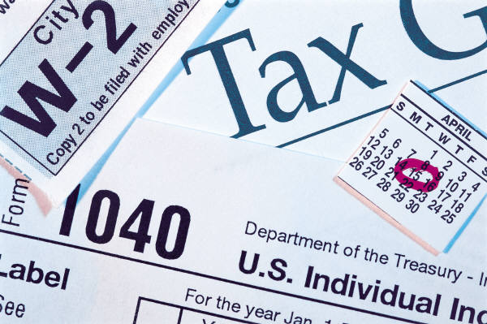
Marginal Tax rate
The change in a person’s tax payment divided by the change in his or her taxable income:
Δ Tax Payment / Δ Taxable Income
© 2014 Cengage Learning. All Rights Reserved. May not be copied, scanned, or duplicated, in whole or in part, except for use as permitted in a license distributed with certain product , service, or otherwise on password-protected website for classroom use
Click to return to “In this Lesson”

Slide 9
Federal Tax Rate Schedules
Schedule X — Single 2009
taxable income is over-- | But not over-- | The tax is:
$0 | $8,350 | 10% of the amount over $0
$8,351 | $33,950 | $835.00 plus 15% of the amount over $8,350
$33,951 | $82,250 | $4,675.00 plus 25% of the amount over $33,950
$82,251 | $171,550 | $16,750.00 plus 28% of the amount over $82,250
$171,551 | $372,950 | $41,754.00 plus 33% of the amount over $171,550
$372,951 | no limit | $108,216.00 plus 35% of the amount over $372,950
© 2014 Cengage Learning. All Rights Reserved. May not be copied, scanned, or duplicated, in whole or in part, except for use as permitted in a license distributed with certain product , service, or otherwise on password-protected website for classroom use
Click to return to “In this Lesson”

Slide 10

Progressive Income Tax
To learn more about the progressive income tax click the IRS logo below.
© 2014 Cengage Learning. All Rights Reserved. May not be copied, scanned, or duplicated, in whole or in part, except for use as permitted in a license distributed with certain product , service, or otherwise on password-protected website for classroom use
Click to return to “In this Lesson”

Slide 11
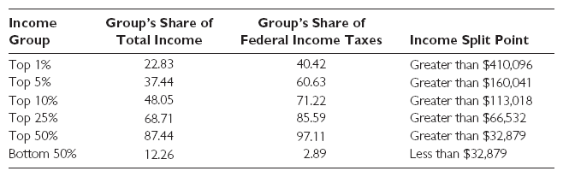
WHO PAYS THE INCOME TAX?
© 2014 Cengage Learning. All Rights Reserved. May not be copied, scanned, or duplicated, in whole or in part, except for use as permitted in a license distributed with certain product , service, or otherwise on password-protected website for classroom use
Click to return to “In this Lesson”

Slide 12
Deficits, Surplus, and the Public Debt
Budget Deficit - Government expenditures greater than tax revenues.
Budget Surplus - Tax revenues greater than government expenditures.
Balanced Budget - Government expenditures equal to tax revenues.
© 2014 Cengage Learning. All Rights Reserved. May not be copied, scanned, or duplicated, in whole or in part, except for use as permitted in a license distributed with certain product , service, or otherwise on password-protected website for classroom use
Click to return to “In this Lesson”

Slide 13
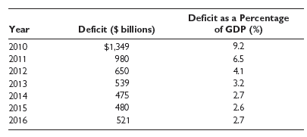
Projected Budget Deficits
In 2009, the budget deficit was $1,414 billion
© 2014 Cengage Learning. All Rights Reserved. May not be copied, scanned, or duplicated, in whole or in part, except for use as permitted in a license distributed with certain product , service, or otherwise on password-protected website for classroom use
Click to return to “In this Lesson”

Slide 14
Congressional Budget Office U.S. Budget Revenue Projections
Click Below fort CBO Projections
© 2014 Cengage Learning. All Rights Reserved. May not be copied, scanned, or duplicated, in whole or in part, except for use as permitted in a license distributed with certain product , service, or otherwise on password-protected website for classroom use
Click to return to “In this Lesson”

Slide 15

Budget of the United States Government
Fiscal Year 2008
To view the Budget of the U.S. Government for 2009, click the banner below.
© 2014 Cengage Learning. All Rights Reserved. May not be copied, scanned, or duplicated, in whole or in part, except for use as permitted in a license distributed with certain product , service, or otherwise on password-protected website for classroom use
Click to return to “In this Lesson”

Slide 16
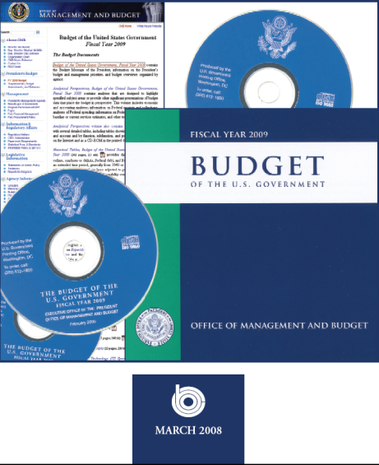
CBO Budget
To view the CBO’s Analysis of the Budget of the U.S. Government for 2009, click the link below.
© 2014 Cengage Learning. All Rights Reserved. May not be copied, scanned, or duplicated, in whole or in part, except for use as permitted in a license distributed with certain product , service, or otherwise on password-protected website for classroom use
Click to return to “In this Lesson”

Slide 17
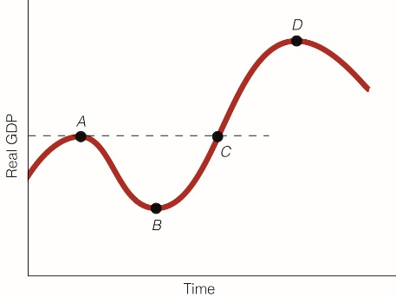
Structural and Cyclical Deficits
Structural Deficit - The part of the budget deficit that would exist even if the economy were operating at full employment.
Cyclical Deficit - The part of the budget deficit that is a result of a downturn in economic activity.
© 2014 Cengage Learning. All Rights Reserved. May not be copied, scanned, or duplicated, in whole or in part, except for use as permitted in a license distributed with certain product , service, or otherwise on password-protected website for classroom use
Click to return to “In this Lesson”

Slide 18

Public Debt
The total amount the federal government owes its creditors. Click the Bureau of Public Debt to learn how much the U.S. Government owes.
The Bureau of the Public Debt borrows the money needed to operate the Federal Government. It administers the public debt by issuing and servicing U.S. Treasury marketable, savings and special securities.
© 2014 Cengage Learning. All Rights Reserved. May not be copied, scanned, or duplicated, in whole or in part, except for use as permitted in a license distributed with certain product , service, or otherwise on password-protected website for classroom use
Click to return to “In this Lesson”

Slide 19
Value Added Tax
THE VALUE-ADDED PART: Value added is the difference between what a producer sells a (final) good for and what it pays for an (intermediate) good.
THE TAX PART: VAT is a tax applied to the value added at each stage of production.
VAT (1) generates tax revenue and (2) raises prices.
The VAT is nothing more than a less visible sales tax.
© 2014 Cengage Learning. All Rights Reserved. May not be copied, scanned, or duplicated, in whole or in part, except for use as permitted in a license distributed with certain product , service, or otherwise on password-protected website for classroom use
Click to return to “In this Lesson”

Slide 20
Self-Test
Explain the differences among progressive, proportional, and regressive income tax structures.
With a proportional income tax, the tax rate is constant as a taxpayer’s income rises. With a progressive income tax, the tax rate rises as income rises (up to some point). With a regressive income tax, the tax rate falls as income rises.
© 2014 Cengage Learning. All Rights Reserved. May not be copied, scanned, or duplicated, in whole or in part, except for use as permitted in a license distributed with certain product , service, or otherwise on password-protected website for classroom use
Click to return to “In this Lesson”

Slide 21
Self-Test
2. What percentage of all income taxes was paid by the top 5 percent of income earners in 2007? What percentage of total income did this income group receive in 2007?
© 2014 Cengage Learning. All Rights Reserved. May not be copied, scanned, or duplicated, in whole or in part, except for use as permitted in a license distributed with certain product , service, or otherwise on password-protected website for classroom use
Click to return to “In this Lesson”

Slide 22
Self-Test
3. What three taxes account for the bulk of federal tax revenues?
Individual income tax, corporate income tax, and Social Security taxes.
© 2014 Cengage Learning. All Rights Reserved. May not be copied, scanned, or duplicated, in whole or in part, except for use as permitted in a license distributed with certain product , service, or otherwise on password-protected website for classroom use
Click to return to “In this Lesson”

Slide 23
Self-Test
4. What is the cyclical budget deficit?
The cyclical budget deficit is that part of the budget deficit that is the result of a downturn in economic activity.
© 2014 Cengage Learning. All Rights Reserved. May not be copied, scanned, or duplicated, in whole or in part, except for use as permitted in a license distributed with certain product , service, or otherwise on password-protected website for classroom use
Click to return to “In this Lesson”

Slide 24

Fiscal Policy
Changes in government expenditures and/or taxes to achieve particular economic goals, such as low unemployment, stable prices, and economic growth.
© 2014 Cengage Learning. All Rights Reserved. May not be copied, scanned, or duplicated, in whole or in part, except for use as permitted in a license distributed with certain product , service, or otherwise on password-protected website for classroom use
Click to return to “In this Lesson”

Slide 25
Fiscal Policy
Expansionary Fiscal Policy - Increases in government expenditures and/or decreases in taxes to achieve particular economic goals.
Contractionary Fiscal Policy - Decreases in government expenditures and/or increases in taxes to achieve particular economic goals.
Discretionary Fiscal Policy- Deliberate changes of government expenditures and/or taxes to achieve particular economic goals.
Automatic Fiscal Policy - Changes in government expenditures and/or taxes that occur automatically without (additional) congressional action.
© 2014 Cengage Learning. All Rights Reserved. May not be copied, scanned, or duplicated, in whole or in part, except for use as permitted in a license distributed with certain product , service, or otherwise on password-protected website for classroom use
Click to return to “In this Lesson”

Slide 26

Fiscal Policy Assumptions for this Presentation
Consider discretionary fiscal policy only
Government spending is due to a change in government purchases and not to a change in transfer payments
© 2014 Cengage Learning. All Rights Reserved. May not be copied, scanned, or duplicated, in whole or in part, except for use as permitted in a license distributed with certain product , service, or otherwise on password-protected website for classroom use
Click to return to “In this Lesson”

Slide 27
Demand Side Fiscal Policy
How government spending and taxes—fiscal policy—can affect the demand side of the economy, that is, aggregate demand.
A change in consumption, investment, government purchases, or net exports can change aggregate demand and therefore shift the AD curve.
A decrease in government purchases (G) decreases aggregate demand and shifts the AD curve to the left. An increase in G increases aggregate demand and shifts the AD curve to the right.
A change in taxes (T ) can affect consumption, investment, or both, and they therefore can affect aggregate demand.
A decrease in T increases aggregate demand and shifts the AD curve to the right. An increase in T decreases aggregate demand and shifts the AD curve to the left.
© 2014 Cengage Learning. All Rights Reserved. May not be copied, scanned, or duplicated, in whole or in part, except for use as permitted in a license distributed with certain product , service, or otherwise on password-protected website for classroom use
Click to return to “In this Lesson”

Slide 28
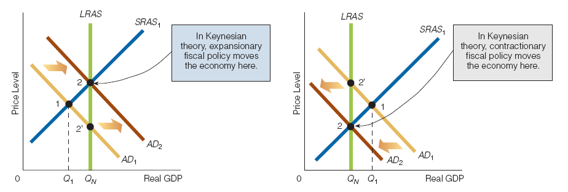
Expansionary Fiscal Policy for a Recessionary Gap
Increased government purchases, decreased taxes, or both lead to a rightward shift in the aggregate demand curve from AD₁ to AD₂, restoring the economy to the natural level of Real GDP, Q_{N}
© 2014 Cengage Learning. All Rights Reserved. May not be copied, scanned, or duplicated, in whole or in part, except for use as permitted in a license distributed with certain product , service, or otherwise on password-protected website for classroom use
Click to return to “In this Lesson”

Slide 29
Contractionary Fiscal Policy for an Inflationary Gap
Decreased government purchases, increased taxes, or both lead to a leftward shift in the aggregate demand curve from AD₁ to AD₂, restoring the economy to the natural level of Real GDP, Q_{N}.
© 2014 Cengage Learning. All Rights Reserved. May not be copied, scanned, or duplicated, in whole or in part, except for use as permitted in a license distributed with certain product , service, or otherwise on password-protected website for classroom use
Click to return to “In this Lesson”

Slide 30
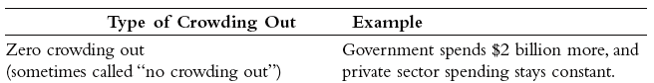
Crowding Out I
The decrease in private expenditures that occurs as a consequence of increased government spending (direct effect) or the financing needs of the Federal budget deficit (indirect effect).
© 2014 Cengage Learning. All Rights Reserved. May not be copied, scanned, or duplicated, in whole or in part, except for use as permitted in a license distributed with certain product , service, or otherwise on password-protected website for classroom use
Click to return to “In this Lesson”

Slide 31

Crowding Out II
Complete Crowding Out - A decrease in one or more components of private spending completely offsets the increase in government spending.
Incomplete Crowding Out - The decrease in one or more components of private spending only partially offsets the increase in government spending.
© 2014 Cengage Learning. All Rights Reserved. May not be copied, scanned, or duplicated, in whole or in part, except for use as permitted in a license distributed with certain product , service, or otherwise on password-protected website for classroom use
Click to return to “In this Lesson”

Slide 32
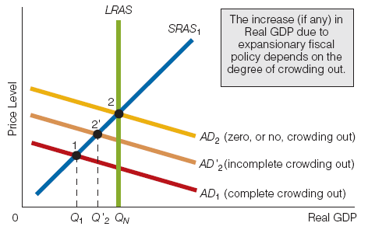
Crowding Out III
© 2014 Cengage Learning. All Rights Reserved. May not be copied, scanned, or duplicated, in whole or in part, except for use as permitted in a license distributed with certain product , service, or otherwise on password-protected website for classroom use
Click to return to “In this Lesson”

Slide 33
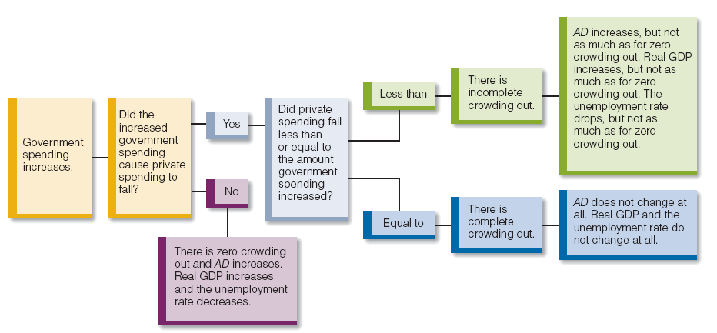
Expansionary Fiscal Policy
Crowding Out, and Changes in Real GDP and the Unemployment Rate
© 2014 Cengage Learning. All Rights Reserved. May not be copied, scanned, or duplicated, in whole or in part, except for use as permitted in a license distributed with certain product , service, or otherwise on password-protected website for classroom use
Click to return to “In this Lesson”

Slide 34
Lags and Fiscal Policy
The data lag. Policymakers are not aware of changes in the economy as soon as they happen.
The wait-and-see lag. After policymakers are aware of a downturn in economic activity they rarely enact counteractive measures immediately. They want to be sure that the observed events are not just short-run phenomena.
© 2014 Cengage Learning. All Rights Reserved. May not be copied, scanned, or duplicated, in whole or in part, except for use as permitted in a license distributed with certain product , service, or otherwise on password-protected website for classroom use
Click to return to “In this Lesson”

Slide 35
Lags and Fiscal Policy
The legislative lag. After policymakers decide that some type of fiscal policy measure is required, Congress or the president will have to propose the measure, build political support for it, and get it passed.
The transmission lag. After enacted, a fiscal policy measure takes time to be put into effect.
The effectiveness lag. After a policy measure is actually implemented, it takes time to affect the economy.
Click to return to “In this Lesson”
© 2014 Cengage Learning. All Rights Reserved. May not be copied, scanned, or duplicated, in whole or in part, except for use as permitted in a license distributed with certain product , service, or otherwise on password-protected website for classroom use

Slide 36
Fiscal Policy May Destabilize the
Economy
In this scenario, the SRAS curve is shifting rightward (healing the economy of its recessionary gap), but this information is unknown to policymakers.
Policymakers implement expansionary fiscal policy, and the AD curve ends up intersecting SRAS₂ at point 2instead of intersecting SRAS₁ at point1'.
© 2014 Cengage Learning. All Rights Reserved. May not be copied, scanned, or duplicated, in whole or in part, except for use as permitted in a license distributed with certain product , service, or otherwise on password-protected website for classroom use
Click to return to “In this Lesson”

Slide 37
Fiscal Policy May Destabilize the
Economy
Policymakers thereby move the economy into an inflationary gap, thus destabilizing the economy.
© 2014 Cengage Learning. All Rights Reserved. May not be copied, scanned, or duplicated, in whole or in part, except for use as permitted in a license distributed with certain product , service, or otherwise on password-protected website for classroom use
Click to return to “In this Lesson”

Slide 38
Self-Test
How does crowding out question the effectiveness of expansionary demand-side fiscal policy?
If there is no crowding out, expansionary fiscal policy is predicted to increase aggregate demand and, if the economy is in a recessionary gap, either reduce or eliminate the gap.
However, if there is, say, complete crowding out, expansionary fiscal policy will not meet its objective. The following example illustrates complete crowding out: If government purchases rise by $100 million, private spending will decrease by $100 million so that there is no net effect on aggregate demand.
© 2014 Cengage Learning. All Rights Reserved. May not be copied, scanned, or duplicated, in whole or in part, except for use as permitted in a license distributed with certain product , service, or otherwise on password-protected website for classroom use
Click to return to “In this Lesson”

Slide 39
Self-Test
2. How might lags reduce the effectiveness of fiscal policy?
Suppose the economy is currently in a recessionary gap at time period 1. Expansionary fiscal policy is needed to remove the economy from its recessionary gap, but fiscal policy lags (data lag, wait-and-see lag, etc.) may be so long that, by the time the fiscal policy is implemented, the economy has moved itself out of the recessionary gap, making the expansionary fiscal policy not only unnecessary but potentially capable of moving the economy into an inflationary gap.
© 2014 Cengage Learning. All Rights Reserved. May not be copied, scanned, or duplicated, in whole or in part, except for use as permitted in a license distributed with certain product , service, or otherwise on password-protected website for classroom use
Click to return to “In this Lesson”

Slide 40
Self-Test
3. Give an example of the indirect effect of crowding out.
The federal government spends more on a given program. As a result, the budget deficit grows, and the federal government increases its demand for loanable funds (or credit) to finance the larger deficit. Because of the greater demand for loanable funds, the interest rate rises in response to the higher interest rate, and business firms cut back on investment. An increase in government spending has indirectly led to a decline in investment spending.
© 2014 Cengage Learning. All Rights Reserved. May not be copied, scanned, or duplicated, in whole or in part, except for use as permitted in a license distributed with certain product , service, or otherwise on password-protected website for classroom use
Click to return to “In this Lesson”

Slide 41
Marginal Tax rate
The change in a person’s tax payment divided by the change in his or her taxable income:
Δ Tax Payment / Δ Taxable Income
© 2014 Cengage Learning. All Rights Reserved. May not be copied, scanned, or duplicated, in whole or in part, except for use as permitted in a license distributed with certain product , service, or otherwise on password-protected website for classroom use
Click to return to “In this Lesson”

Slide 42
Supply-Side Fiscal Policy
A cut in marginal tax rates increases the attractiveness of productive activity relative to leisure and tax avoidance activities and
shifts resources from the latter to the former, thus shifting both the short-run and the long-run aggregate supply curves rightward.
© 2014 Cengage Learning. All Rights Reserved. May not be copied, scanned, or duplicated, in whole or in part, except for use as permitted in a license distributed with certain product , service, or otherwise on password-protected website for classroom use
Click to return to “In this Lesson”

Slide 43
Laffer Curve
The curve, named after Arthur Laffer, that shows the relationship between tax rates and tax revenues.
According to the Laffer curve, as tax rates rise from zero, tax revenues rise, reach a maximum at some point, and then fall with further increases in tax rates.
© 2014 Cengage Learning. All Rights Reserved. May not be copied, scanned, or duplicated, in whole or in part, except for use as permitted in a license distributed with certain product , service, or otherwise on password-protected website for classroom use
Click to return to “In this Lesson”

Slide 44

Laffer Curve
When the tax rate is either 0 or 100 percent, tax revenues are zero.
Starting from a zero tax rate, increases in tax rates first increase (region A to B) and then decrease (region B to C) tax revenues
© 2014 Cengage Learning. All Rights Reserved. May not be copied, scanned, or duplicated, in whole or in part, except for use as permitted in a license distributed with certain product , service, or otherwise on password-protected website for classroom use
Click to return to “In this Lesson”

Slide 45
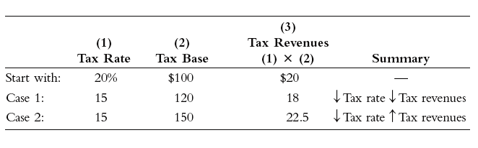
Tax Rates, the Tax Base, and Tax Revenues
Tax revenues equal the tax base times the (average) tax rate.
If the percentage reduction in the tax rate is greater than the percentage increase in the tax base, tax revenues decrease (Case 1).
If the percentage reduction in the tax rate is less than the percentage increase in the tax base, tax revenues increase (Case 2). All numbers are in billions of dollars.
© 2014 Cengage Learning. All Rights Reserved. May not be copied, scanned, or duplicated, in whole or in part, except for use as permitted in a license distributed with certain product , service, or otherwise on password-protected website for classroom use
Click to return to “In this Lesson”

Slide 46
Self-Test
Give an arithmetic example to illustrate the difference between the marginal and average tax rates.
Let’s suppose that a person’s taxable income rises by $1,000 to $45,000 and that her taxes rise from $10,000 to $10,390 as a result. Her marginal tax rate—the percentage of her additional taxable income she pays in taxes—is 39 percent. Her average tax rate—the percentage of her (total) income she pays in taxes—is 23 percent.
© 2014 Cengage Learning. All Rights Reserved. May not be copied, scanned, or duplicated, in whole or in part, except for use as permitted in a license distributed with certain product , service, or otherwise on password-protected website for classroom use
Click to return to “In this Lesson”

Slide 47
Self-Test
2. If income tax rates rise, will income tax revenues rise too?
Not necessarily. It depends on whether the percentage rise in tax rates is greater or less than the percentage fall in the tax base. Here’s a simple example: Suppose the average tax rate is 10 percent and the tax base is $100. Tax revenues then equal $10. If the tax rate rises to 12 percent (a 20 percent rise) and the tax base falls to $90 (a 10 percent fall), tax revenues rise to $10.80. In other words, if the tax rate rises by a greater percentage than the tax base falls, tax revenues rise. But then suppose that the tax base falls to $70 (a 30 percent fall) instead of to $90. Now tax revenues are $8.40. In other words, if the tax rate rises by a smaller percentage than the tax base falls, tax revenues fall.
© 2014 Cengage Learning. All Rights Reserved. May not be copied, scanned, or duplicated, in whole or in part, except for use as permitted in a license distributed with certain product , service, or otherwise on password-protected website for classroom use
Click to return to “In this Lesson”

Slide 48

Wall Street Journal
The Wall Street Journal is a is a rich source of information which provides real life examples of micro- and macro economic activities. Check today’s issue to see the most current news.
http://www.wsj.com
© 2014 Cengage Learning. All Rights Reserved. May not be copied, scanned, or duplicated, in whole or in part, except for use as permitted in a license distributed with certain product , service, or otherwise on password-protected website for classroom use
Click to return to “In this Lesson”

