Slide 1
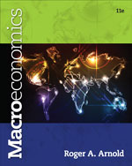
Chapter 12: Money, Banking, and the Financial System
© 2014 Cengage Learning. All Rights Reserved. May not be copied, scanned, or duplicated, in whole or in part, except for use as permitted in a license distributed with certain product , service, or otherwise on password-protected website for classroom use

Slide 2

In This Lecture…..
Money Defined
The Money Supply
Reserves, Required and Excess
The Financial System
A Bank’s balance Sheet
To select a topic, click on its link above
© 2014 Cengage Learning. All Rights Reserved. May not be copied, scanned, or duplicated, in whole or in part, except for use as permitted in a license distributed with certain product , service, or otherwise on password-protected website for classroom use

Slide 3

Money vs. Barter
Money - Any good that is widely accepted for purposes of exchange and in the repayment of debt.
Barter - Exchanging goods and services for other goods and services without the use of money.
Click to return to “In this Lesson”
© 2014 Cengage Learning. All Rights Reserved. May not be copied, scanned, or duplicated, in whole or in part, except for use as permitted in a license distributed with certain product , service, or otherwise on password-protected website for classroom use

Slide 4
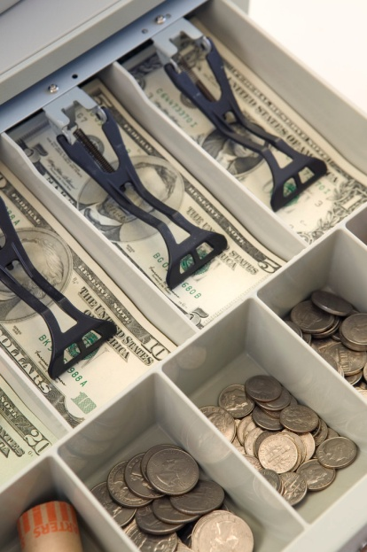
Functions of Money
Money as a Medium of Exchange - Anything that is generally acceptable in exchange for goods and services.
Money as a Unit of Account - A common measure in which relative values are expressed.
Money as a Store of Value - The ability of an item to hold value over time.
Click to return to “In this Lesson”
© 2014 Cengage Learning. All Rights Reserved. May not be copied, scanned, or duplicated, in whole or in part, except for use as permitted in a license distributed with certain product , service, or otherwise on password-protected website for classroom use

Slide 5
From Barter to a Money Economy
Money evolved out of a barter economy as traders attempted to make exchange easier.
In a barter economy, before a trade can be made, a trader must find another trader who is willing to trade what the first trader wants (Double Coincidence of Wants) and at the same time wants what the first trader has.
Click to return to “In this Lesson”
© 2014 Cengage Learning. All Rights Reserved. May not be copied, scanned, or duplicated, in whole or in part, except for use as permitted in a license distributed with certain product , service, or otherwise on password-protected website for classroom use

Slide 6
From Barter to a Money Economy
Exchanges take less time in a money economy than in a barter economy because a double coincidence of wants is unnecessary: Everyone is willing to trade what he or she has for money. The movement from a barter to a money economy therefore frees up some of the transaction time, which people can use in other ways.
A few goods that have been used as money include gold, silver, copper, cattle, rocks, and shells.
Click to return to “In this Lesson”
© 2014 Cengage Learning. All Rights Reserved. May not be copied, scanned, or duplicated, in whole or in part, except for use as permitted in a license distributed with certain product , service, or otherwise on password-protected website for classroom use

Slide 7

What Gives Money Its Value?
Our money today has value because of its general acceptability.
Click to return to “In this Lesson”
© 2014 Cengage Learning. All Rights Reserved. May not be copied, scanned, or duplicated, in whole or in part, except for use as permitted in a license distributed with certain product , service, or otherwise on password-protected website for classroom use

Slide 8
Money Supply – M1
M1 = Currency held outside banks
+ Checkable deposits
+ Traveler’s checks
Currency includes coins and paper money (Federal Reserve notes)
Checkable deposits are deposits on which checks can be written
Traveler's checks are internationally redeemable drafts purchased in various denominations from a bank or traveler's aid company.
Click to return to “In this Lesson”
© 2014 Cengage Learning. All Rights Reserved. May not be copied, scanned, or duplicated, in whole or in part, except for use as permitted in a license distributed with certain product , service, or otherwise on password-protected website for classroom use

Slide 9
Money Supply – M2
M2 = M1
+Savings deposits (including money market accounts)
+ Small denomination time deposits
+ Money market mutual funds (retail)
Savings Deposit is an interest-earning account at a commercial bank or thrift institution.
Money Market Deposit Account is an interest-earning account at a bank or thrift institution. Most offer limited check writing privileges.
Time Deposit is an interest-earning deposit with a specified maturity date.
Money Market Mutual Fund is an interest-earning account at a mutual fund company.
Click to return to “In this Lesson”
© 2014 Cengage Learning. All Rights Reserved. May not be copied, scanned, or duplicated, in whole or in part, except for use as permitted in a license distributed with certain product , service, or otherwise on password-protected website for classroom use

Slide 10

Money Supply Data
For current and historical data
on the money supply click either
table above
Click to return to “In this Lesson”
© 2014 Cengage Learning. All Rights Reserved. May not be copied, scanned, or duplicated, in whole or in part, except for use as permitted in a license distributed with certain product , service, or otherwise on password-protected website for classroom use

Slide 11
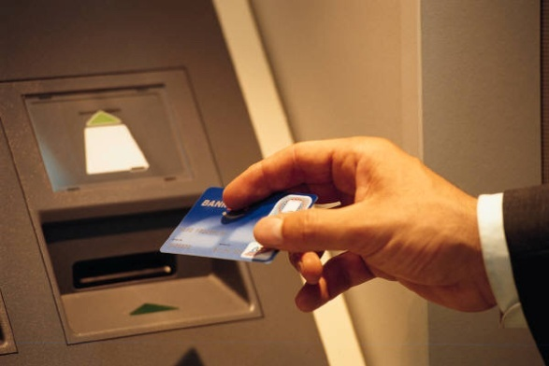
Are Credit and Debit Cards Money?
Credit card use represents loans which must be repaid. They represent the use of someone else's money.
Debit cards give access to checkable deposits which are already part of the money supply.
Click to return to “In this Lesson”
© 2014 Cengage Learning. All Rights Reserved. May not be copied, scanned, or duplicated, in whole or in part, except for use as permitted in a license distributed with certain product , service, or otherwise on password-protected website for classroom use

Slide 12
Self-Test
Why (not how) did money evolve out of a barter economy?
Money evolved because individuals wanted to make trading easier (i.e., less time-consuming). In a barter economy, this need motivated people to accept the good with relatively greater acceptability than all other goods. In time, the effect snowballed, and finally the good with initially relatively greater acceptability emerged into a good that was widely accepted for purposes of exchange. At this point, the good became money.
Click to return to “In this Lesson”
© 2014 Cengage Learning. All Rights Reserved. May not be copied, scanned, or duplicated, in whole or in part, except for use as permitted in a license distributed with certain product , service, or otherwise on password-protected website for classroom use

Slide 13
Self-Test
2. If individuals remove funds from their checkable deposits and transfer them to their money market accounts, will M1 fall and M2 rise? Explain your answer.
No. M1 will fall, but M2 will not rise; it will remain constant. To illustrate, suppose M1 is $400 and M2 is $600. If people remove $100 from checkable deposits, M1 will decline to $300. For purposes of illustration, think of M2 as equal to M1 money market accounts. The M1 component of M2 falls by $100, but the money market accounts component rises by $100; so there is no net effect on M2. Thus M1 falls and M2 remains constant.
Click to return to “In this Lesson”
© 2014 Cengage Learning. All Rights Reserved. May not be copied, scanned, or duplicated, in whole or in part, except for use as permitted in a license distributed with certain product , service, or otherwise on password-protected website for classroom use

Slide 14
Self-Test
3. How does money reduce the transaction costs of making trades?
In a barter (moneyless) economy, a double coincidence of wants will not occur for every transaction. When it does not occur, the cost of the transaction increases because more time must be spent to complete the trade. In a money economy, money is acceptable for every transaction; so a double coincidence of wants is not necessary. All buyers offer money for what they want to buy, and all sellers accept money for what they want to sell.
Click to return to “In this Lesson”
© 2014 Cengage Learning. All Rights Reserved. May not be copied, scanned, or duplicated, in whole or in part, except for use as permitted in a license distributed with certain product , service, or otherwise on password-protected website for classroom use

Slide 15
Early Banking
Gold coin was used as a medium of exchange.
Goldsmiths, equipped with safe storage facilities, stored other people’s gold for them, issuing warehouse receipts.
Receipts, being more convenient, were used to make purchases and pay debts.
These paper receipts circulated as money.
Click to return to “In this Lesson”
© 2014 Cengage Learning. All Rights Reserved. May not be copied, scanned, or duplicated, in whole or in part, except for use as permitted in a license distributed with certain product , service, or otherwise on password-protected website for classroom use

Slide 16
Fractional Banking
On an average day, very few people came to redeem their gold receipts.
Some goldsmiths began lending out some of the stored gold, issuing additional receipts instead of gold, and earning interest.
This was the beginning of “fractional reserve banking*.”
* A banking arrangement that allows banks to hold reserves equal to only a fraction of their deposit liabilities.
Click to return to “In this Lesson”
© 2014 Cengage Learning. All Rights Reserved. May not be copied, scanned, or duplicated, in whole or in part, except for use as permitted in a license distributed with certain product , service, or otherwise on password-protected website for classroom use

Slide 17
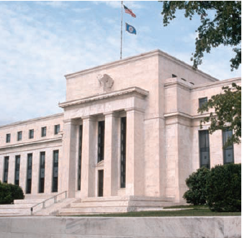
The Federal Reserve System
The central bank of the United States
Chief function is to control the money supply
Click to return to “In this Lesson”
© 2014 Cengage Learning. All Rights Reserved. May not be copied, scanned, or duplicated, in whole or in part, except for use as permitted in a license distributed with certain product , service, or otherwise on password-protected website for classroom use

Slide 18
Bank Reserves
Reserves - The sum of bank deposits at the Fed and vault cash.
Required Reserve Ratio (r) - A percentage of each dollar deposited that must be held on reserve (at the Fed or in the bank’s vault).
Required Reserves - The minimum amount of reserves a bank must hold against its checkable deposits as mandated by the Fed.
Excess Reserves - Any reserves held beyond the required amount. The difference between (total) reserves and required reserves.
Click to return to “In this Lesson”
© 2014 Cengage Learning. All Rights Reserved. May not be copied, scanned, or duplicated, in whole or in part, except for use as permitted in a license distributed with certain product , service, or otherwise on password-protected website for classroom use

Slide 19
Bank Reserves
Reserves =
Bank deposits at the Fed + Vault cash
Required reserves =
r x Checkable deposits
Excess reserves =
Reserves - Required reserves
Click to return to “In this Lesson”
© 2014 Cengage Learning. All Rights Reserved. May not be copied, scanned, or duplicated, in whole or in part, except for use as permitted in a license distributed with certain product , service, or otherwise on password-protected website for classroom use

Slide 20
Self-Test
A bank reduces its deposits at the Fed by $5 million and increases its vault cash by $5 million. What happens to the bank’s reserves?
The bank’s reserves remain constant. Since reserves equal bank deposits at the Fed plus vault cash, removing $5 million from bank deposits at the Fed and adding the $5 million to vault cash keeps the total dollar amount of reserves constant.
Click to return to “In this Lesson”
© 2014 Cengage Learning. All Rights Reserved. May not be copied, scanned, or duplicated, in whole or in part, except for use as permitted in a license distributed with certain product , service, or otherwise on password-protected website for classroom use

Slide 21
Self-Test
2. If a bank has $87 million in checkable deposits, and it is required to hold $6 million in reserves (required reserves $6 million), what is the required reserve ratio equal to?
Required reserves = r × Checkable deposits, where r = required reserve ratio. If checkable deposits equal $87 million and required reserves equal 6 million, then r equals the required reserves divided by checkable deposits: $6 million ÷ $87 million = a required reserve ratio of 6.89.
Click to return to “In this Lesson”
© 2014 Cengage Learning. All Rights Reserved. May not be copied, scanned, or duplicated, in whole or in part, except for use as permitted in a license distributed with certain product , service, or otherwise on password-protected website for classroom use

Slide 22
Self-Test
3. If excess reserves are $4 million and (total) reserves are $6 million, what do required reserves and checkable deposits equal? Assume the required reserve ratio is 8 percent.
Required reserves: Reserves = Required reserves + Excess reserves. If reserves are $6 million and excess reserves are $4 million, then required reserves are $2 million.
Checkable deposits: Required reserves = r × Checkable deposits, where r = required reserve ratio. If required reserves are $2 million and r = 8 percent, then checkable deposits must equal $25 million; 8 percent of $25 million is $2 million.
Click to return to “In this Lesson”
© 2014 Cengage Learning. All Rights Reserved. May not be copied, scanned, or duplicated, in whole or in part, except for use as permitted in a license distributed with certain product , service, or otherwise on password-protected website for classroom use

Slide 23
The Financial System
A financial system is essentially a means of getting people with surplus funds together with people who have a shortage of funds. Stated differently, it is a means of getting savers and borrowers together.
Click to return to “In this Lesson”
© 2014 Cengage Learning. All Rights Reserved. May not be copied, scanned, or duplicated, in whole or in part, except for use as permitted in a license distributed with certain product , service, or otherwise on password-protected website for classroom use

Slide 24
Direct and Indirect Finance
Direct Finance - Borrowers and lenders come together in a market setting, such as in the bond market.
Indirect Finance - Funds are loaned and borrowed through a financial intermediary.
Financial Intermediary - A financial intermediary transfers funds from those who want to lend funds to those who want to borrow them.
Click to return to “In this Lesson”
© 2014 Cengage Learning. All Rights Reserved. May not be copied, scanned, or duplicated, in whole or in part, except for use as permitted in a license distributed with certain product , service, or otherwise on password-protected website for classroom use

Slide 25
Adverse Selection and moral Hazard
Asymmetric Information - Relates to an economic agent on one side of a transaction having information that an economic agent on the other side of the transaction does not have.
Adverse Selection - A phenomenon that occurs when the parties on one side of the market, who have information not known to others, self-select in a way that adversely affects the parties on the other side of the market.
Moral Hazard - A condition that exists when one party to a transaction changes his or her behavior in a way that is hidden from and costly to the other party.
Click to return to “In this Lesson”
© 2014 Cengage Learning. All Rights Reserved. May not be copied, scanned, or duplicated, in whole or in part, except for use as permitted in a license distributed with certain product , service, or otherwise on password-protected website for classroom use

Slide 26
Adverse Selection and moral Hazard
Lending and borrowing often present the risk of adverse selection and a moral hazard problem often arise, both of which are the result of asymmetric information.
However lending and borrowing not only provide the financing for new businesses and the production of new products, production techniques, and so on, but they also permit individuals to enjoy the benefits of certain goods and services for a greater number of years than would be possible without lending and borrowing.
Click to return to “In this Lesson”
© 2014 Cengage Learning. All Rights Reserved. May not be copied, scanned, or duplicated, in whole or in part, except for use as permitted in a license distributed with certain product , service, or otherwise on password-protected website for classroom use

Slide 27
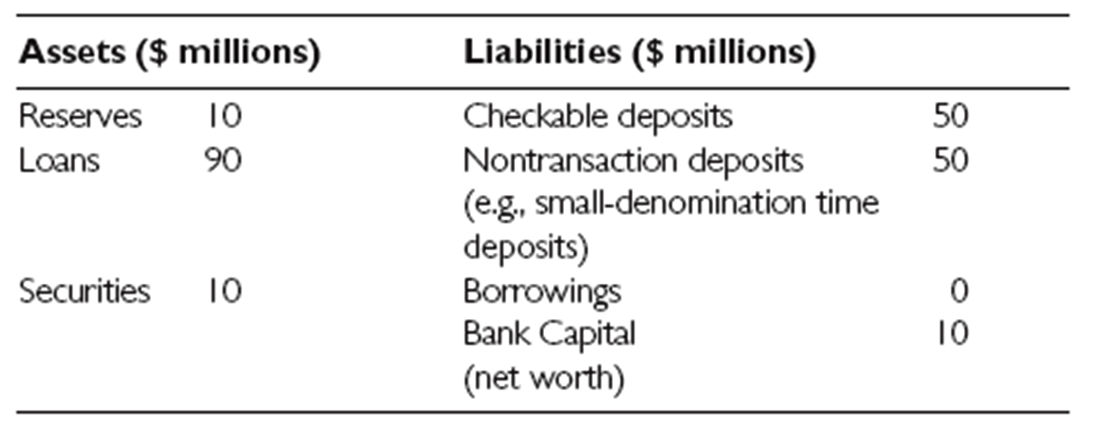
A Bank’s Balance Sheet I
Here we show a bank’s balance sheet. On the left-hand side, assets (what others owe to the bank): reserves (equal to bank deposits at the Fed plus vault cash), any loans it has made to others (e.g., a car loan the bank gave to someone), and any securities it owns.
Click to return to “In this Lesson”
© 2014 Cengage Learning. All Rights Reserved. May not be copied, scanned, or duplicated, in whole or in part, except for use as permitted in a license distributed with certain product , service, or otherwise on password-protected website for classroom use

Slide 28
A Bank’s Balance Sheet II
On the right-hand side are liabilities (what the bank owes to others): checkable deposits (held for its customers), non-transaction deposits (e.g., small-denomination
time deposits), borrowings of the banks (i.e., any loans the bank may have taken out), and bank capital (or net worth).
Click to return to “In this Lesson”
© 2014 Cengage Learning. All Rights Reserved. May not be copied, scanned, or duplicated, in whole or in part, except for use as permitted in a license distributed with certain product , service, or otherwise on password-protected website for classroom use

Slide 29
A Bank’s Balance Sheet III
In this balance sheet, assets are $110 million and liabilities are $100 million; so bank capital (or net worth) is $10 million. Customarily, bank capital (or net worth) is
shown on the right-hand side of the balance sheet.
Click to return to “In this Lesson”
© 2014 Cengage Learning. All Rights Reserved. May not be copied, scanned, or duplicated, in whole or in part, except for use as permitted in a license distributed with certain product , service, or otherwise on password-protected website for classroom use

Slide 30
A Bank’s Balance Sheet IV
The bank’s capital can be viewed as a cushion against insolvency, which exists when a bank’s liabilities are greater than its assets. An insolvent bank has failed and can be shutdown.
Insolvency → Liabilities > Assets
The larger the bank’s capital, the bigger the cushion against bank failure or insolvency; the smaller the bank’s capital, the smaller the cushion against bank failure or insolvency.
Click to return to “In this Lesson”
© 2014 Cengage Learning. All Rights Reserved. May not be copied, scanned, or duplicated, in whole or in part, except for use as permitted in a license distributed with certain product , service, or otherwise on password-protected website for classroom use

Slide 31
Self-test
Jack promises Samantha that he will pay for any expenses she has on her trip beyond $1,000. Does this create an adverse selection or moral hazard problem? Explain your answer.
It is a moral hazard problem. A moral hazard problem exists when one party to a transaction changes his or her behavior in a way that is hidden from and costly to the other party. By promising to pay Samantha’s expenses over $1,000, Jack provides Samantha with an incentive to push her expenses beyond $1,000, especially if she thinks her expenses will be close to $1,000. Simply put, Samantha has an incentive to act in a way that is hidden from and potentially costly to Jack. How might Jack lessen the moral hazard problem? Perhaps he could promise to pay a certain percentage of each dollar of Samantha’s expenses over $1,000 instead of promising to pay every dollar of them.
Click to return to “In this Lesson”
© 2014 Cengage Learning. All Rights Reserved. May not be copied, scanned, or duplicated, in whole or in part, except for use as permitted in a license distributed with certain product , service, or otherwise on password-protected website for classroom use

Slide 32
Self-test
2. Bank A finds that many of the loans it extended to individuals are not being paid back. How do the defaults affect bank A’s capital or net worth?
A bank’s capital or net worth is equal to the difference between its assets and liabilities. As bank A’s assets decline in value (because some loans are not being repaid), the difference between its assets and liabilities diminishes; so its bank capital diminishes. If assets fall below liabilities, the bank will end up with negative bank capital or net worth.
Click to return to “In this Lesson”
© 2014 Cengage Learning. All Rights Reserved. May not be copied, scanned, or duplicated, in whole or in part, except for use as permitted in a license distributed with certain product , service, or otherwise on password-protected website for classroom use

Slide 33
Self-test
Financial intermediaries essentially bring lenders and borrowers together. For example, Smith wants to lend $100 and Jones wants to borrow $100, but neither Smith nor Jones is in contact with the other. Instead of dealing with each other directly, both Smith and Jones go to a bank. Smith deposits $100 into the bank, and then the bank lends some of the $100 to Jones.
3. What do financial intermediaries do?
Financial intermediaries essentially bring lenders and borrowers together. For example, Smith wants to lend $100 and Jones wants to borrow $100, but neither Smith nor Jones is in contact with the other. Instead of dealing with each other directly, both Smith and Jones go to a bank. Smith deposits $100 into the bank, and then the bank lends some of the $100 to Jones.
Click to return to “In this Lesson”
© 2014 Cengage Learning. All Rights Reserved. May not be copied, scanned, or duplicated, in whole or in part, except for use as permitted in a license distributed with certain product , service, or otherwise on password-protected website for classroom use

Slide 34

Wall Street Journal
The Wall Street Journal is a is a rich source of information which provides real life examples of micro- and macro economic activities. Check today’s issue to see the most current news.
http://www.wsj.com
Click to return to “In this Lesson”
© 2014 Cengage Learning. All Rights Reserved. May not be copied, scanned, or duplicated, in whole or in part, except for use as permitted in a license distributed with certain product , service, or otherwise on password-protected website for classroom use

