Slide 1
Economic Growth and the Wealth of Nations
24
Notes:
Pre-class music: “Video Killed the Radio Star” by The Buggles (See Tip #393)
This song laments the end of the radio era, as the launch of MTV in the early 1980s meant most of the popular acts of the era were unable to transition to the new visual media. Therefore, this song is a good introduction to the concepts of technology and innovation.
Was the advent of music video a step forward or backward?

Slide 2
Previously
Indirect finance is when savers and lenders utilize banks in the market for loans.
Direct finance is when borrowers go directly to lenders (for example, offers of stocks and bonds)
Bonds are loan contracts that are typically traded in secondary markets.
Stocks are ownership shares in firms.
U.S. Treasury securities are the bonds used by the federal government to finance debt.

Slide 3
Big Questions
Why does economic growth matter?
How do resources and technology contribute to economic growth?
What institutions foster economic growth?

Slide 4
Wealth Matters
GDP
  Basic measure of a nation’s income
  Value of all final goods and services produced in a country
  GDP per capita is a basic measure of average living standards
Economic growth
  The growth rate of GDP per capita
Notes:
Lecture notes:
Students should recall that:
GDP = Gross Domestic Product
GDP = Y = C + I + G + NX

Slide 5
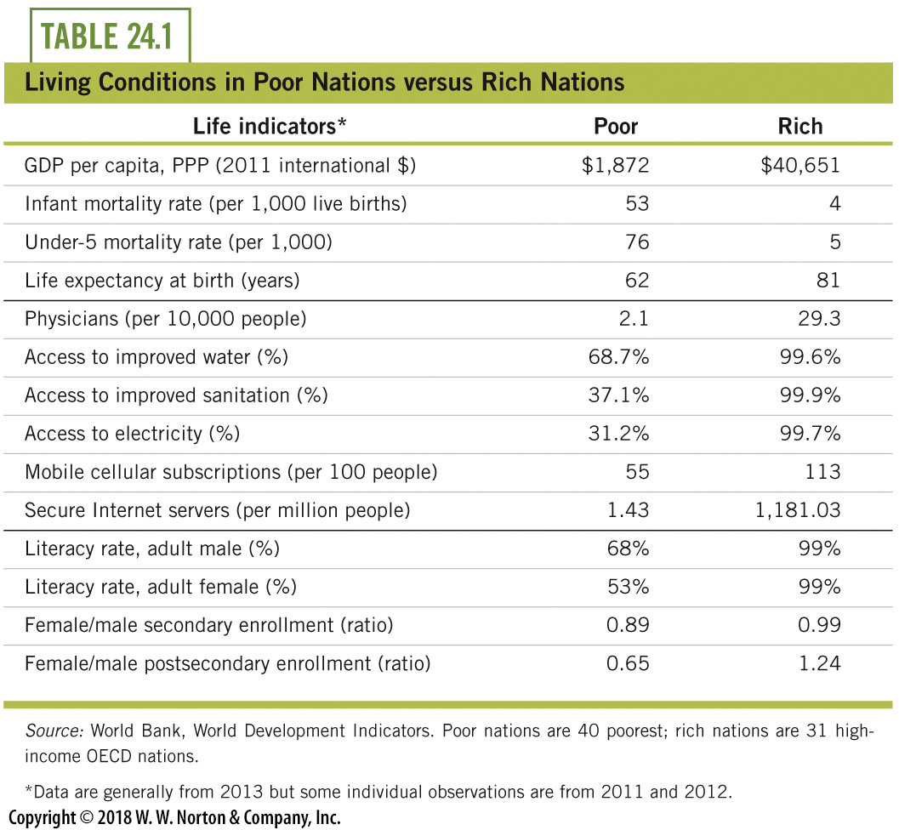
Human Welfare in Nations,
Poor vs. Rich
Notes:
Lecture notes:
Table 24.1 presents human welfare indicators for a selection of rich and poor countries.
From the text:
Among the poor nations are:
Bangladesh
Haiti
North Korea
Niger
Liberia
Tanzania
Nepal
Ethiopia
Zimbabwe
The wealthy nations include:
Australia
Denmark
Israel
Japan
Germany
South Korea
the United States
(among others)
Consider the first group of indicators, which are related to mortality.
In poor countries, 53 out of every 1,000 babies die at birth or in the first year of life, while in rich nations the number is only 4 out of every 1,000.
This means that infants are 13 times more likely to die in poor nations. Those that survive one year in poor nations are about 15 times more likely to die before their fifth birthday, as indicated by the under-5 mortality rates.
Overall, life expectancy in poor nations is 62 years, while in wealthy nations it is 81 years. Just being born in a wealthy nation adds almost 20 years to an individual’s life.
The second group of indicators in Table 24.1 helps to explain the mortality data.
Rich nations have about 14 times as many doctors per person: 29 physicians per 10,000 people versus 2 per 10,000.
Clean water and sanitation are available to only a fraction of people in poor nations, while these are generally available to all in rich nations.
Children in poor nations die every year because they can’t get water as clean as the water that comes out of virtually any faucet in the United States. This leads to common ailments like tapeworms and diarrhea that are life-threatening in poor nations. In fact, in 2010, the World Health Organization estimated that 3.6 million people died each year from waterborne diseases.
The last group of indicators in Table 24.1 tells the sobering story about education.
First, notice that literacy rates in poor countries are significantly lower than literacy rates in wealthy countries. But there is also a significant difference in literacy rates between men and women in poor nations.
Furthermore, women have less access to both secondary and postsecondary education than men in poor nations; equal access would imply an enrollment ratio of 100 percent.
So while educational opportunities are rarer for all people in poor nations, women fare the worst.
The data in Table 24.1 support the contention that per capita GDP matters—not for the sake of more income per se, but because it correlates
with better human welfare conditions, which matter to everyone.
The table is split into four groups (from top to bottom):
Life expectancy
Health
Technology
Education
Overall, life expectancy in poor nations is just 57 years, while it is 80 years in wealthy nations. Just being born in a wealthy nation adds almost a quarter century to your life.
Per capita GDP matters, not for the sake of per capita GDP, but because per capita GDP is correlated with human conditions we all care about.

Slide 6
Historical Growth
Economic historian Angus Maddison estimated GDP levels for many nations back to the year AD 1.
Notes:
  For most of human history, the average person’s life was one of subsistence living
  There were global variations noticeable around 1700, but everyone was still very poor
  Industrial Revolution: rapid technological progress outpaced population growth
Notes:
Lecture notes:
Robert Fogel on the Industrial Revolution:
“Modernization was a mixed blessing for those who lived through it. However, the industrial and scientific achievements of the nineteenth century were a precondition for the remarkable achievements of the twentieth century, including the unprecedented improvements in the conditions of life experienced by ordinary people.”
The Industrial Revolution of the 1800s, during which many economies moved away from agriculture and toward manufacturing, is at the very center of the big break in world income growth. Beginning with the Industrial Revolution, the rate of technical progress became so rapid that it was able to outpace population growth. The foundation for the Industrial Revolution was laid in the preceding decades, and this included private property protection and several technological innovations.

Slide 7
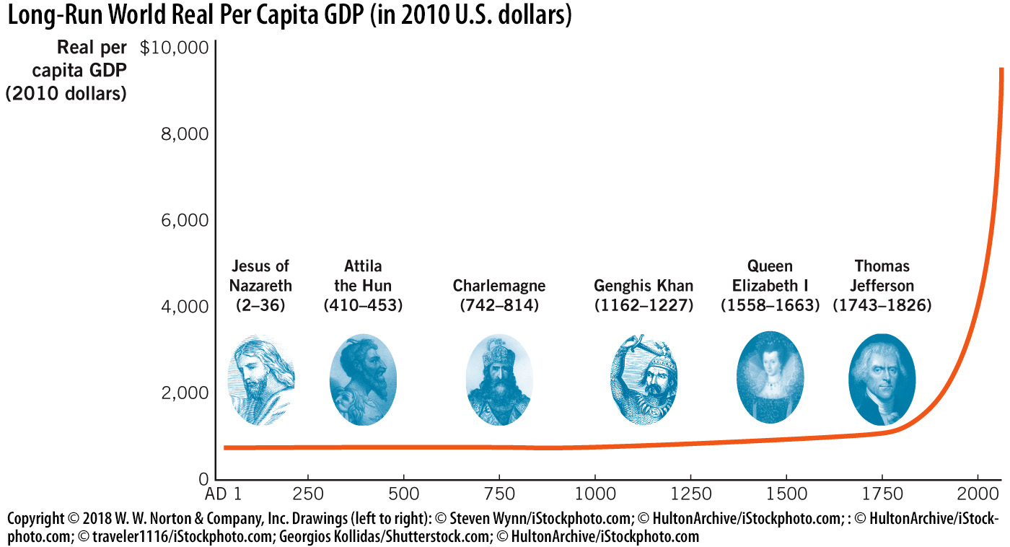
World Per Capita GDP: “The Hockey Stick”
Notes:
Image: Figure 24.1
Lecture notes:
History books often focus on prominent historical figures like kings and queens who were quite wealthy, especially in comparison to their contemporaries. But the experience of average people was much less glorious.
Understanding this gives us a different perspective on modern wealth, and clarifies possible policy alternatives going forward.
On the graph on the slide:
For 1,700 years, the standard of living for the average person didn’t really change.
It was finally during the Industrial Revolution (where technology grew faster than the population) that per capita GDP began to rise very rapidly.

Slide 8
Practice What You Know—1
When economists use the phrase “economic growth,” what are they referring to?
  percentage changes in real GDP per capita
  nominal GDP growth
  real GDP growth
  average GDP across nations
Notes:
Clicker question:
Correct answer: A, percentage changes in real GDP per capita
It’s important to distinguish between growth and per capita growth.

Slide 9
Practice What You Know—2
The period in time in which per capita GDP for the world started to increase faster than it had in the rest of history began during what years?
  800s
  1490s
  1800s
  1950s
Notes:
Clicker question:
Correct answer: C, 1800s
The 1800s and the Industrial Revolution were the time period of explosive economic growth (compared to the rest of history). This growth rate continues today.

Slide 10


Some Got Rich,
Others Stayed Poor
On average, we are all wealthier than earlier centuries
However, wealth is not distributed evenly
  United States, year 1800
    Average income is $2,000 (in 2010 dollars)
  Liberia, year 2012
    Average income is $1,200 (in 2010 dollars)
Notes:
Lecture notes:
It’s important to note that while there is still income inequality today, we are ALL better off than we were hundreds of years ago.
In other words, today’s poor are better off than the poor of the 1800s.
Today’s wealthy are better off than the wealthy of the 1800s.
Notice that the USA was wealthier 200 years ago than Liberia is today.

Slide 11
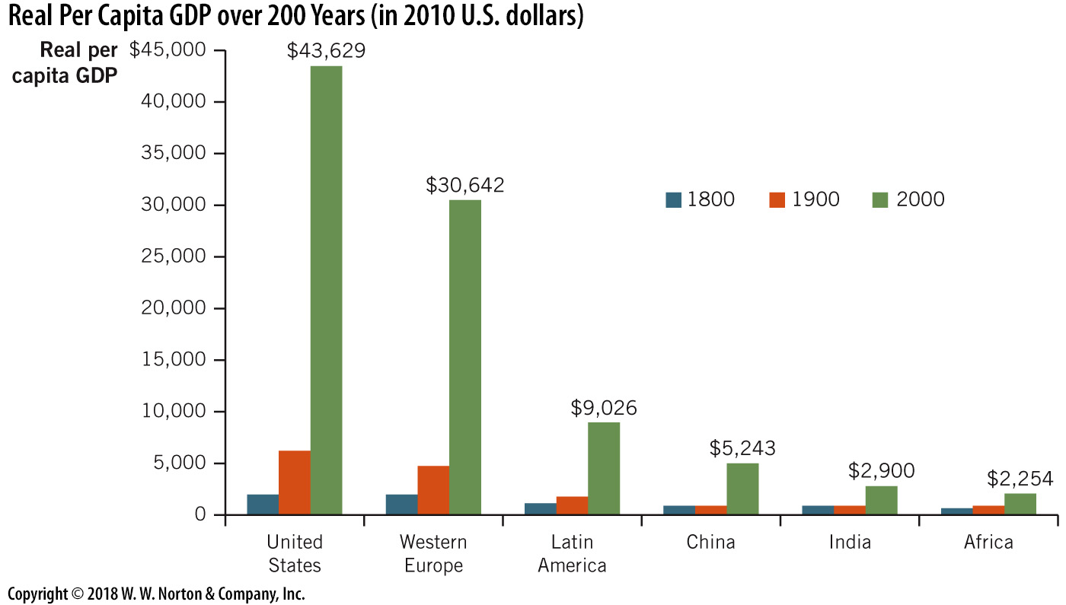
Per Capita Real GDP over 200 Years
Notes:
Image: Figure 24.2
Lecture notes:
Both wealthy and poor nations are better off today compared to 200 years ago.
While many of the current disparities between rich and poor nations began about 200 years ago, some nations have moved from poor to rich as recently as the past few decades.
In 1950, Liberia was richer than Taiwan.
Today, Taiwan is one of the wealthiest countries in the world, while Liberia is near $1,200 in per capita income.
Americans today are much wealthier than most others in the world, but this prosperity did not come overnight.
Americans are wealthier because their incomes grew each year, but just by a little bit.

Slide 12
Mathematics of Growth—1
Wealth of the United States didn’t happen overnight.
  Growth rates grew each year a little bit.
Break out of poverty began in the 19th century
Years | Growth Rate
0–1800 | 0.02%
1800–1900 | 0.64%
1900–1950 | 1.04%
1950–2000 | 2.12%
Notes:
Lecture notes:
The difference between zero and 1 percent might seem trivial (it certainly doesn’t seem like much if your exam grade goes from 85 to 86), but this small increase in economic growth was historically unprecedented.
The mathematics of growth show that a small change in the growth rate can make a HUGE difference over time (especially when this growth is compounded. Think about compounding interest at a bank).

Slide 13
Mathematics of Growth—2
Growth rate of real GDP per capita
  The most important growth rate we consider
  Change in average person’s income, adjusting for inflation
Economic growth
Notes:
Lecture notes:
By far the most important growth rates we consider are economic growth rates.
The term “economic growth” means something very specific.
Economic growth is the annual growth rate of per capita real GDP.
It is the measure of how an average person’s income changes over time, including an allowance for price changes.

Slide 14
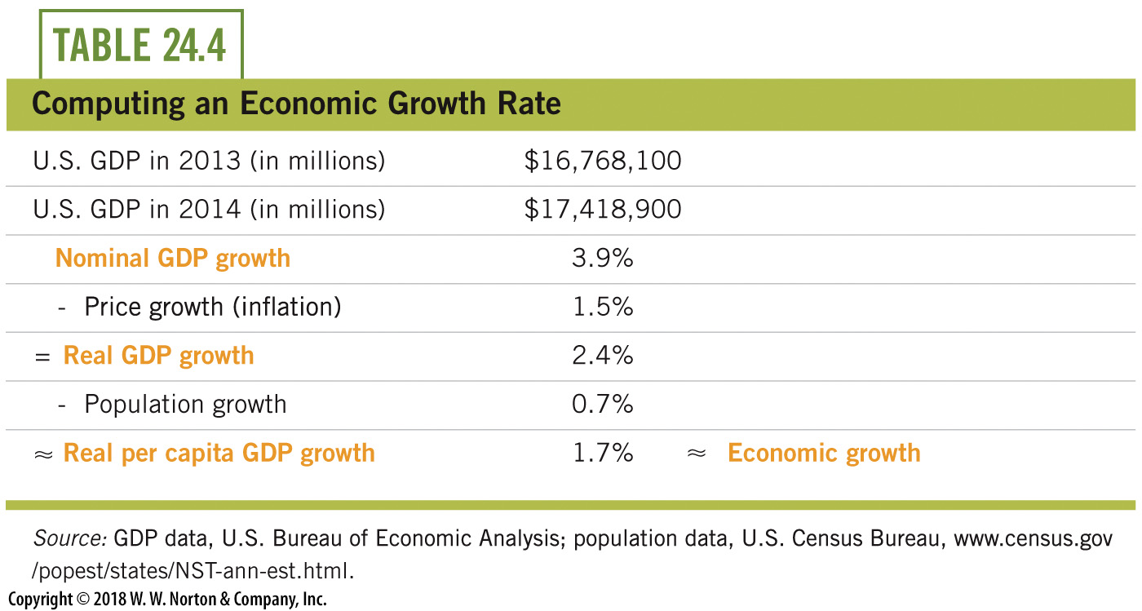
Computing Economic
Growth Example
Notes:
Lecture notes:
Explanation of the math:
Starting with nominal GDP data for 2010 and 2011, we compute nominal GDP growth as 3.8 percent. But part of the increase in nominal GDP is due to inflation. In 2011, the price level, as measured by the GDP deflator, grew by 2.1 percent.
We subtract this inflation from nominal GDP growth to get real GDP growth of 1.7 percent. This number applies to the entire nation, but population also increased by 1 percent in 2011.
When we subtract population growth, we are left with 0.7 percent as the rate of economic growth for the United States in 2011.
This growth rate was lower than normal: since 1950, average economic growth per year in the United States has been about 2.1 percent.

Slide 15
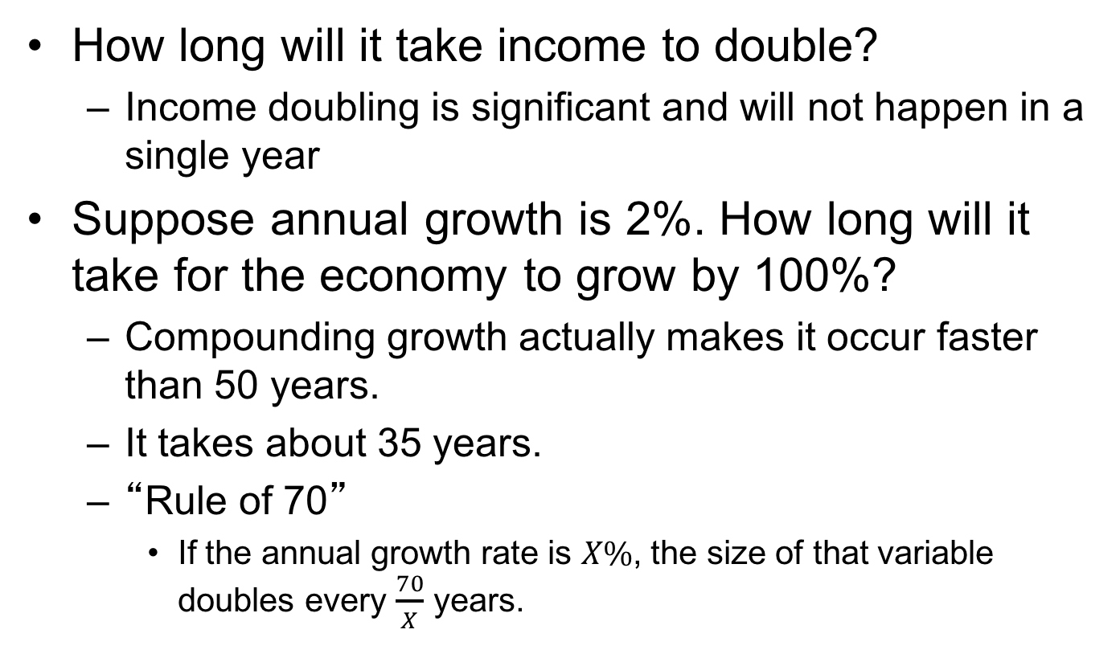
Growth and Income Levels over Time
How long will it take income to double?
  Income doubling is significant and will not happen in a single year
Suppose annual growth is 2%. How long will it take for the economy to grow by 100%?
  Compounding growth actually makes it occur faster than 50 years.
  It takes about 35 years.
  “Rule of 70”
    If the annual growth rate is $X\%$, the size of that variable doubles every $\frac{70}{X}$ years.
Notes:
Lecture notes:
Doubling implies growing by 100 percent.
The “Rule of 70” shows why the growth rate is so important. Even a small change in the growth rate will significantly change the amount of time it shows for income to grow.
If the growth rate is 2 percent, income roughly doubles every 35 years.
If the growth rate is 3 percent, income roughly doubles every 23 years.
This seemingly small increase in the growth rate makes a huge difference in the amount of income a society has over time.

Slide 16
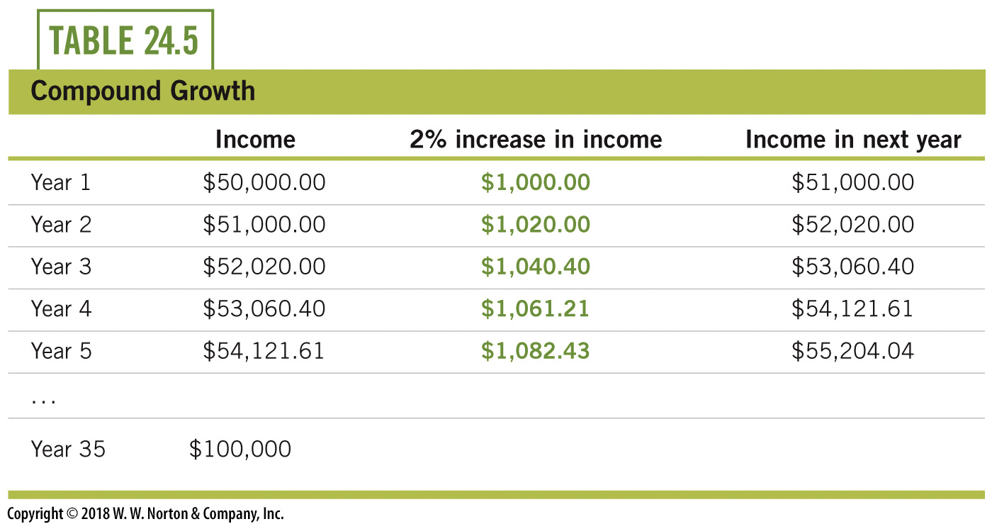
Exponential Growth
Notes:
Lecture notes:
Small consistent growth rates, if sustained for a decade or two, can greatly impact living standards.

Slide 17
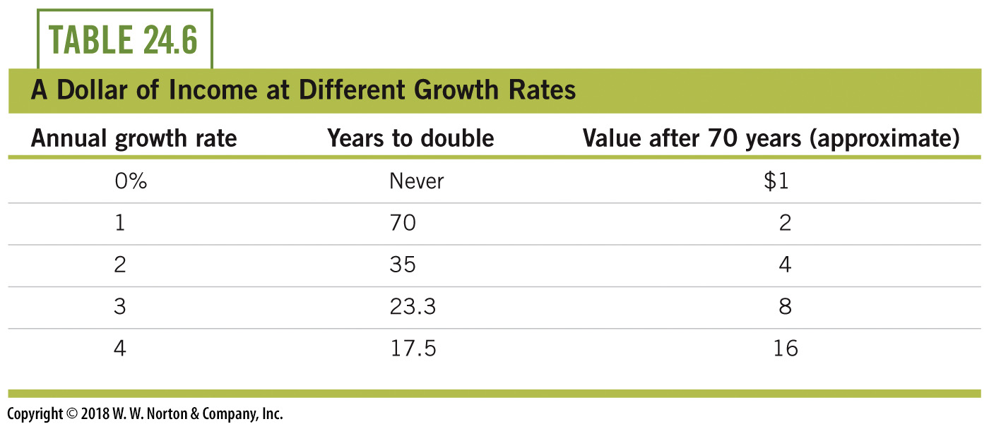
Rule of 70, Illustrated for $1
Notes:
Lecture notes:
What can we learn from the Rule of 70?
Small consistent growth rates, if sustained for a decade or two, can greatly impact living standards.
Over the long course of history, growth rates were essentially zero and man’s experience was poverty.
The growth rate was zero because although there were technological advances, they were met with population growth.
The difference over the past two centuries has been small, consistent growth rates. The Rule of 70 illustrates that living standards can double in less than a century at even just 1 percent growth.

Slide 18
Practice What You Know—3
If the annual growth rate of an economy is 7%, how long will it take for income to double?
  5 years
  6 years
  8 years
  10 years
Notes:
Clicker question:
Correct answer: D, 10 years
This illustrates the Rule of 70; take 70 divided by the growth rate percent to see how long it takes for the variable growing at that rate to double its original value. When explaining the rule of 70 to students, make sure to point out that it is an approximation.

Slide 19
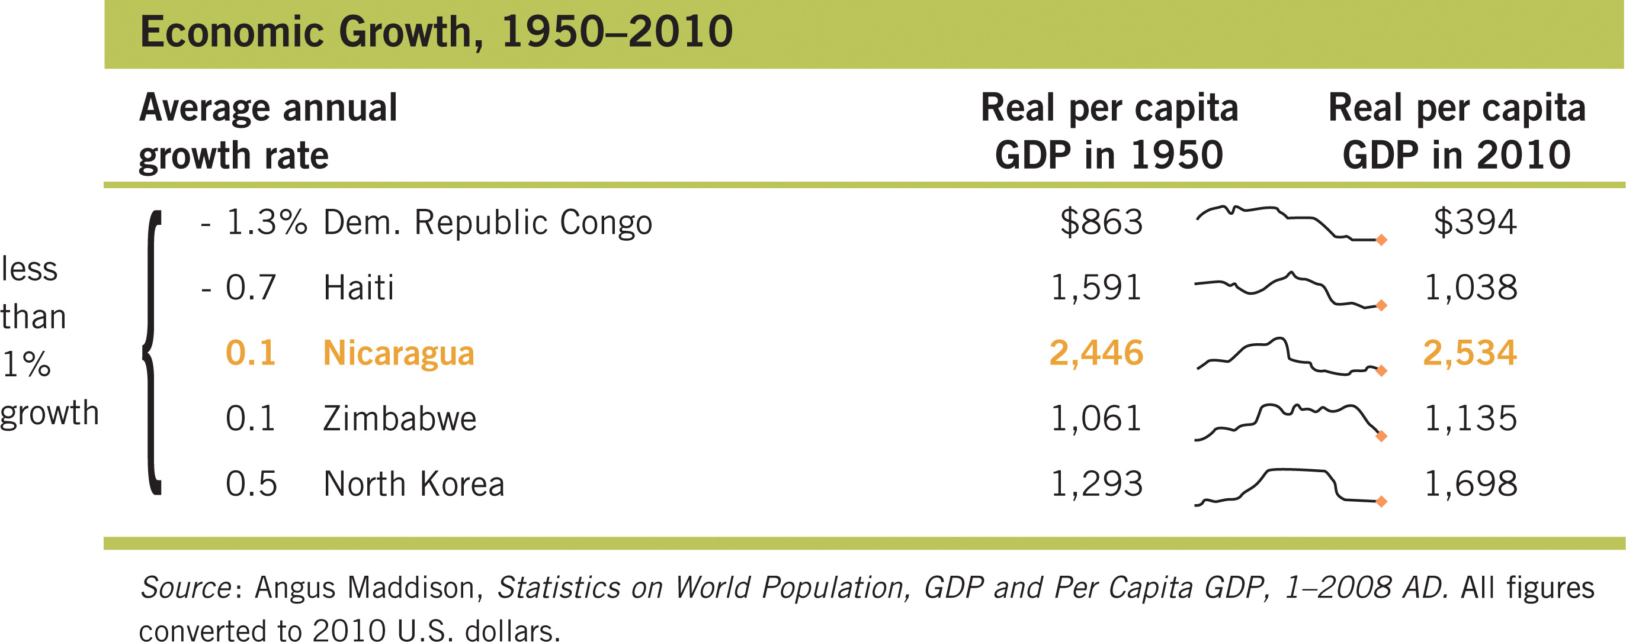
Living Standards: 1950 to 2010
Notes:
Lecture notes:
We can look at actual growth rates of various countries over a long period to see the impact on income levels. This table presents growth rates of several countries over 58 years, from 1950 to 2008.
This portion of the table shows countries with growth rates near 0 percent. It means these nations are no better than they were in 1950.

Slide 20
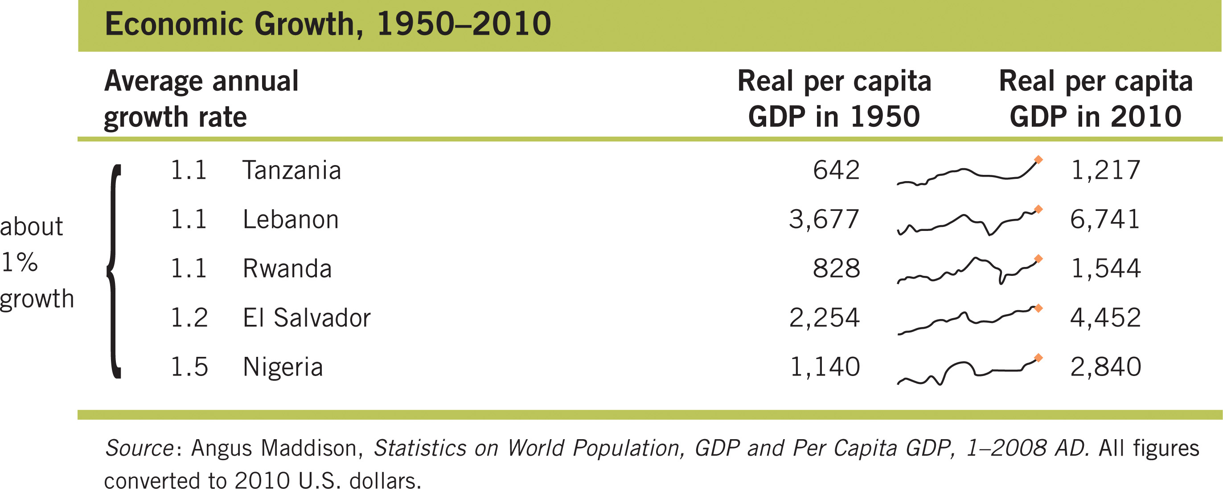
Economic Growth Rates Since 1950—1
Notes:
Lecture notes:
Using the Rule of 70, countries with a 1 percent growth rate will have almost doubled in income over 58 years.
It takes 70 years for a country to double its income with a 1 percent growth rate.

Slide 21
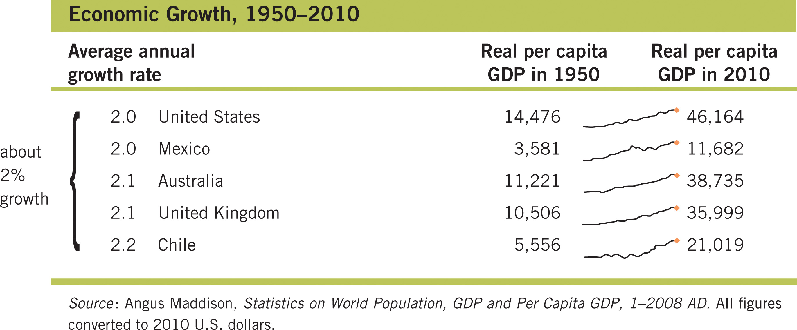
Economic Growth Rates Since 1950—2
Notes:
Lecture notes:
Growth near 2 percent means living standards almost quadruple in 58 years.

Slide 22
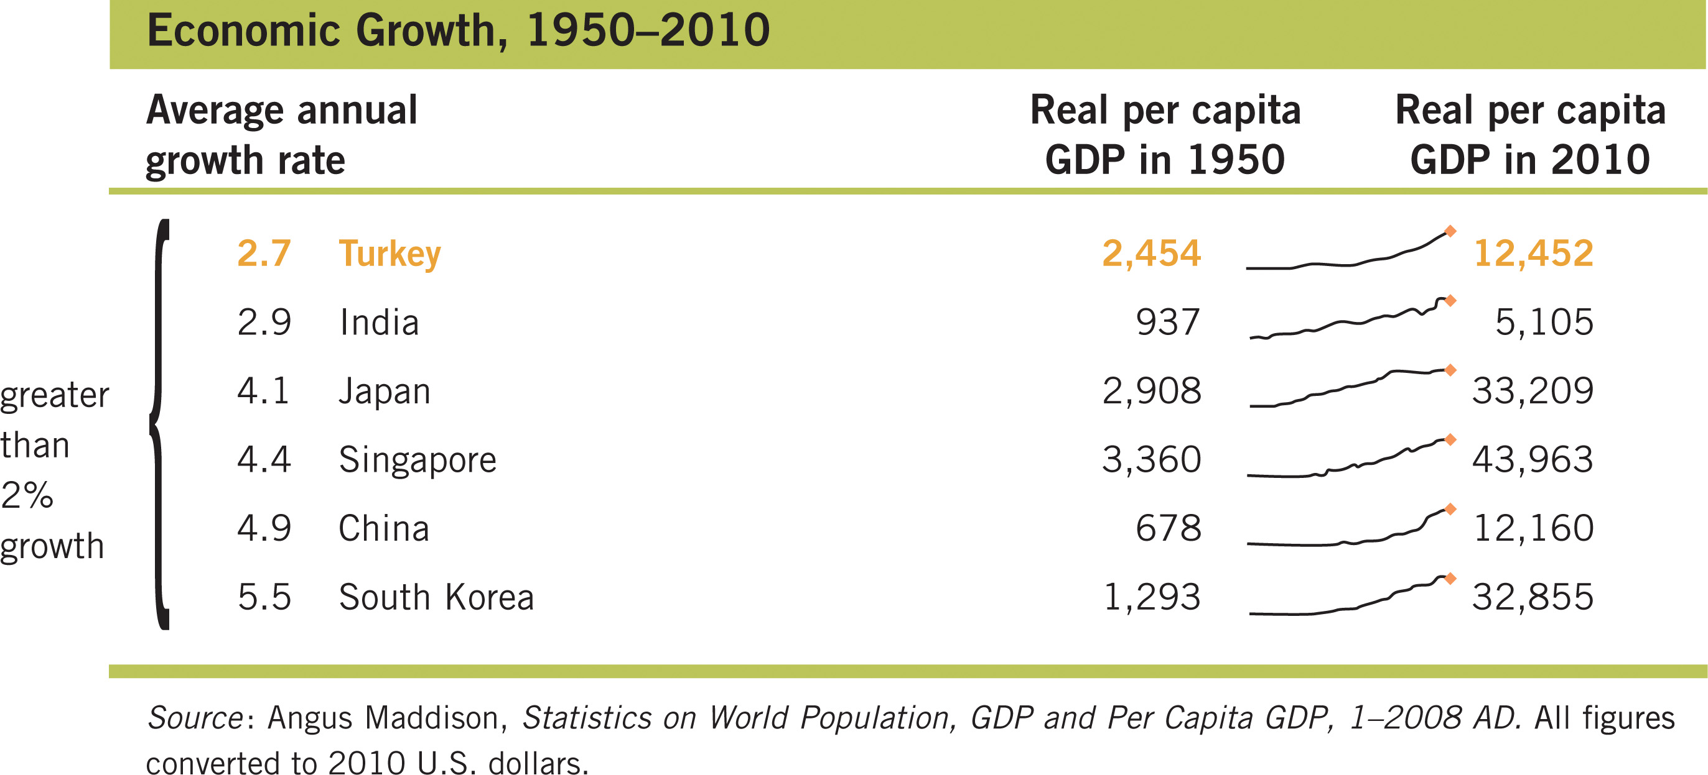
Economic Growth Rates Since 1950—3
Notes:
Lecture notes:
Growth of 3 percent or more over 58 years is enough to move some nations from the world’s poorest to among the richest. This occurred with the explosive growth in Japan, Malaysia, Singapore, and China.

Slide 23
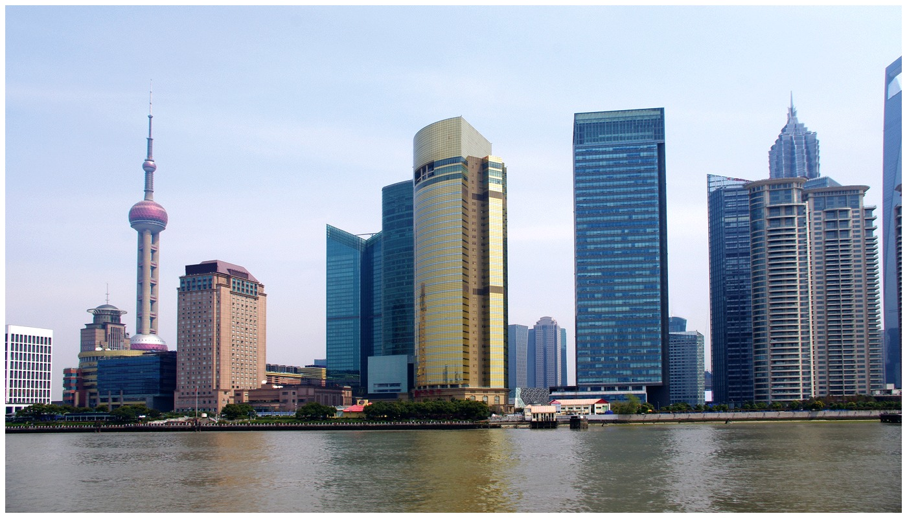
Twenty Years of Growth in Shanghai
Notes:
Lecture notes:
From the text:
Over the past 20 years, China has grown at about 9 percent. This is simply staggering and, even if it slows to half that rate, it will certainly vault China into the group of wealthiest nations in the coming decades.
But China was very poor just 25 years ago.
Figure 11.3 shows two pictures of Shanghai, the “New York City” of China. The bottom picture is from 2010, but the top picture is from 1990—just 20 years earlier! This is a picture of economic growth.

Slide 24
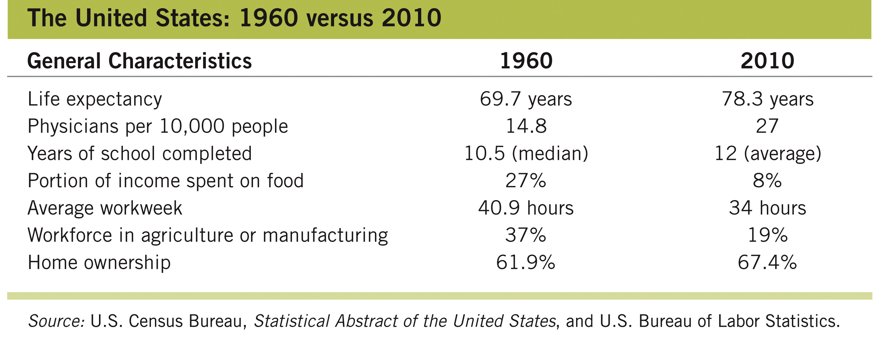
Economic Growth Rates Since 1960—1

Slide 25
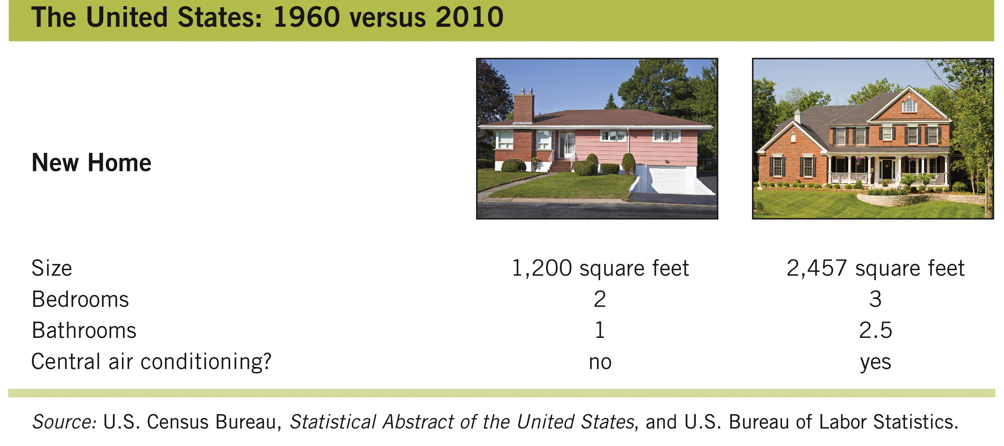
Economic Growth Rates Since 1960—2

Slide 26
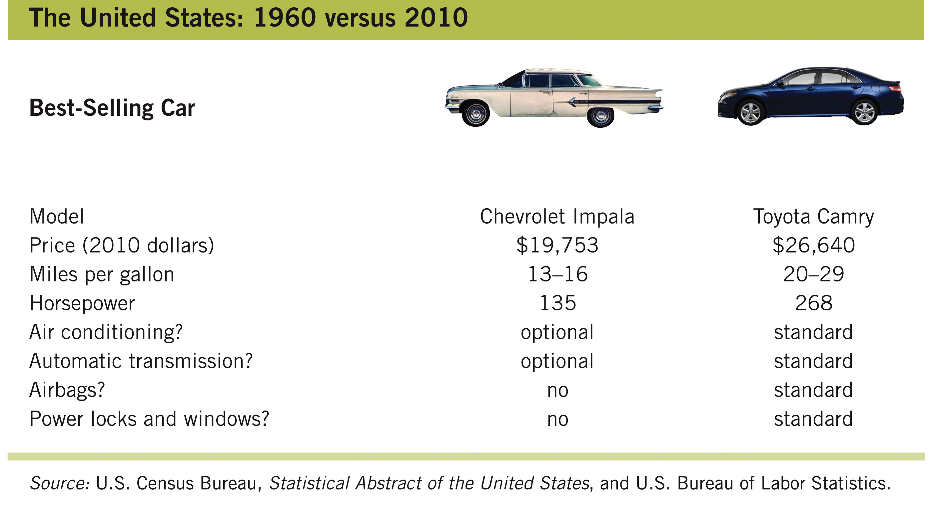
Economic Growth Rates Since 1960—3

Slide 27
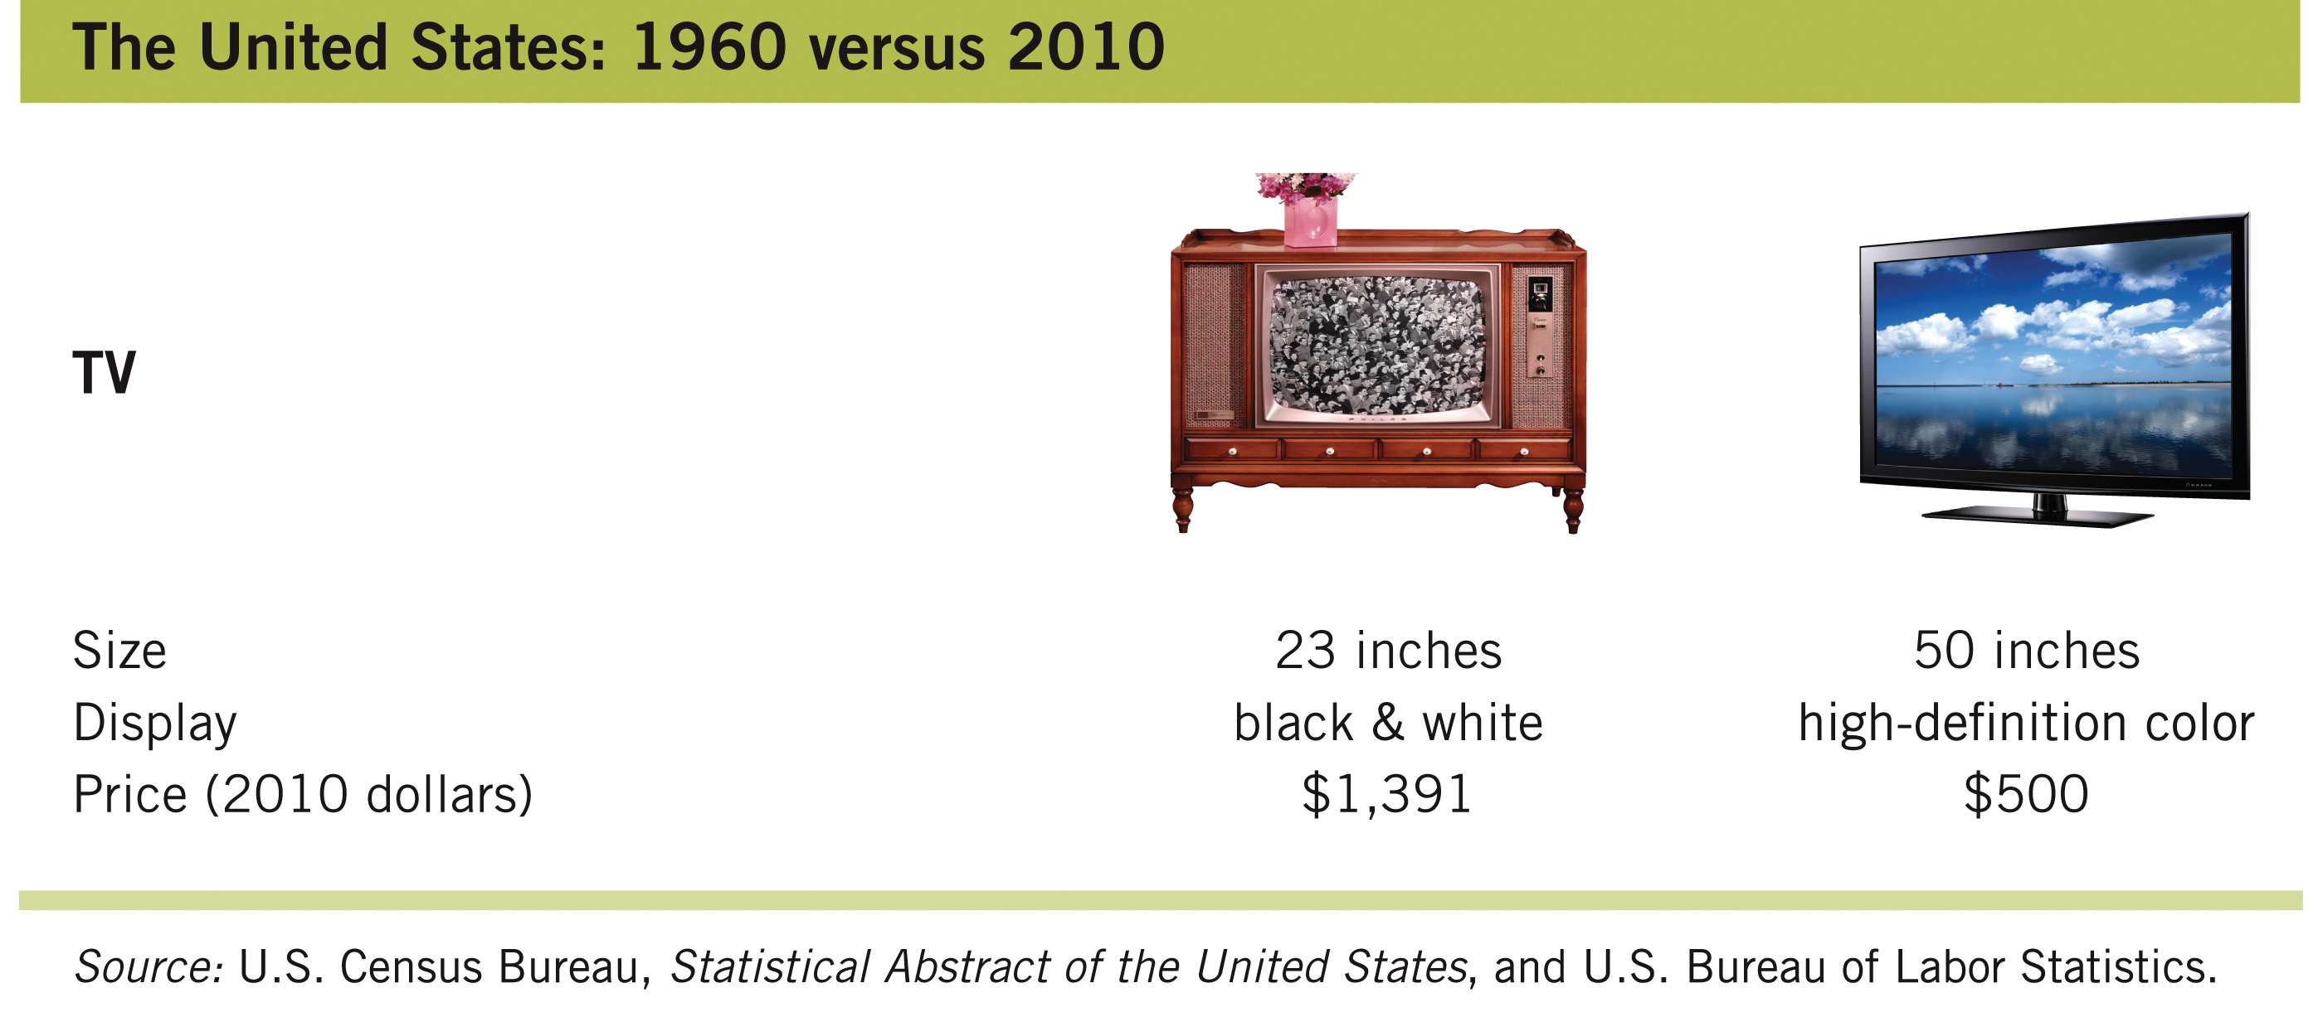
Economic Growth Rates Since 1960—4

Slide 28
Life Span and Wealth
200 countries, 200 years
  This video also shows the relationship between income and life span
Notes:
“Economics in the Media” Slide
Lecture tip:
The clip mentioned on the slide can be found in the Interactive Instructor’s Guide. Access the direct link by clicking the icon in the PowerPoint above.

Slide 29
The Causes of Economic Growth
Economic growth affects income, life expectancy, and standards of living.
  The sources of economic growth are:
    Resources
    Technology
    Institutions
Notes:
Lecture notes:
So far, we’ve seen that economic growth is extremely important.
We’ll see that all three of these sources are necessary for growth.

Slide 30
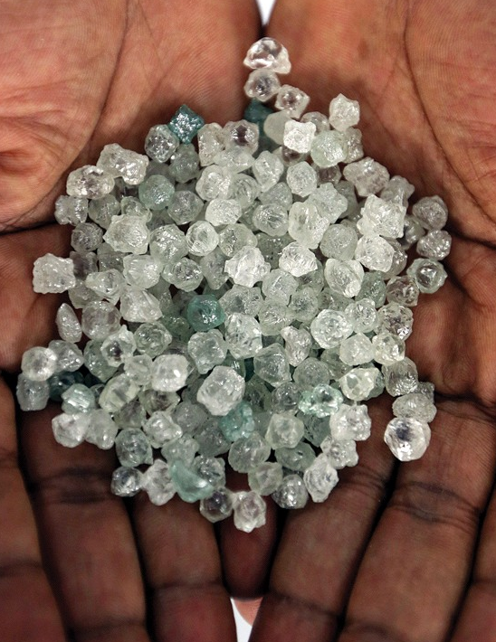
Resources—1
Resources are the inputs used to produce goods and services.
Land
  Physical land, natural resources
    Coal in United States
    Oil in Saudi Arabia
    Lumber in Canada
  Geography affects weather,
  disease, and trade possibilities
  Land is not enough for growth
Notes:
Lecture notes:
Saudi Arabia produces about 10 million barrels of oil a day, which is 12 percent of the world output and 15 gallons of oil per Saudi every day.
At $100 per barrel, this means oil alone generates $365 billion in Saudi GDP per year.
Oil is a natural resource, and this clearly contributes to economic prosperity.
The United States has fertile farmland, forests, coal, iron ore, and even oil (the United States supplies about 12 percent of the world’s oil).
Other “land”:
Coal
Iron ore
Diamonds
Lumber
Natural gas
Geography is sometimes thought of a variation on land.
Land is not enough for growth
Liberia has diamonds and forests

Slide 31
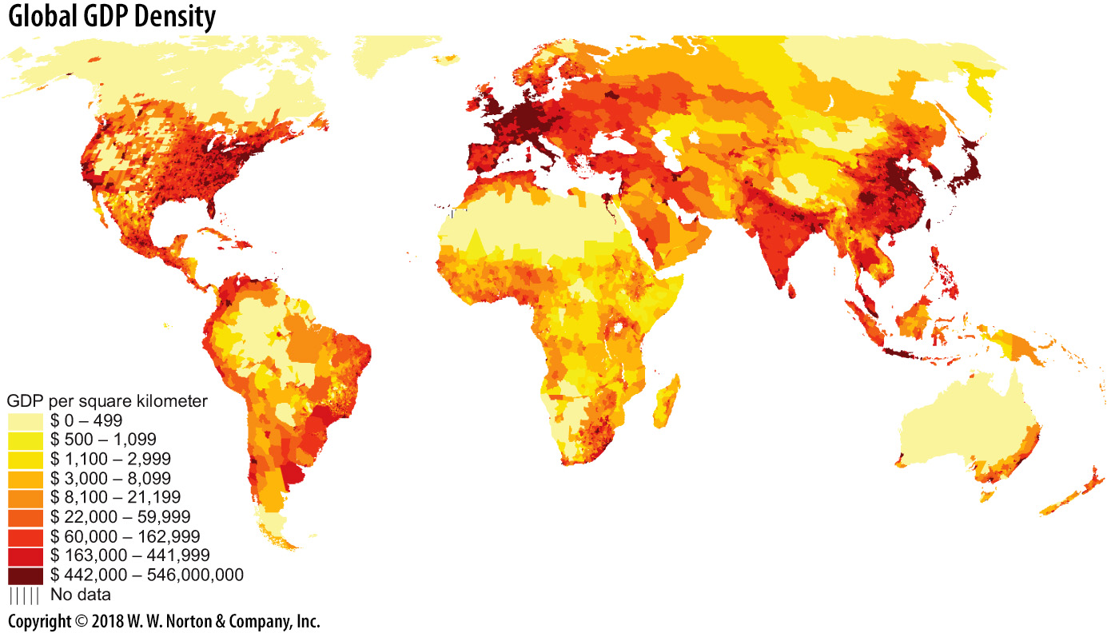
Global GDP Density
Notes:
Lecture notes:
Locations on coasts or along rivers (like the Amazon in South America) developed early and have continued to develop more rapidly than areas inland.
The picture on the slide indicates the importance of both geography and international trade to economic growth.
But land resources alone do not make a nation wealthy. Many poor nations are rich in natural resources.
Liberia has mahogany forests, iron ore deposits, rubber-tree forests, diamonds, and a beautiful coastline along the Atlantic Ocean.
Yet, with all these natural resources, Liberia is still poor.

Slide 32
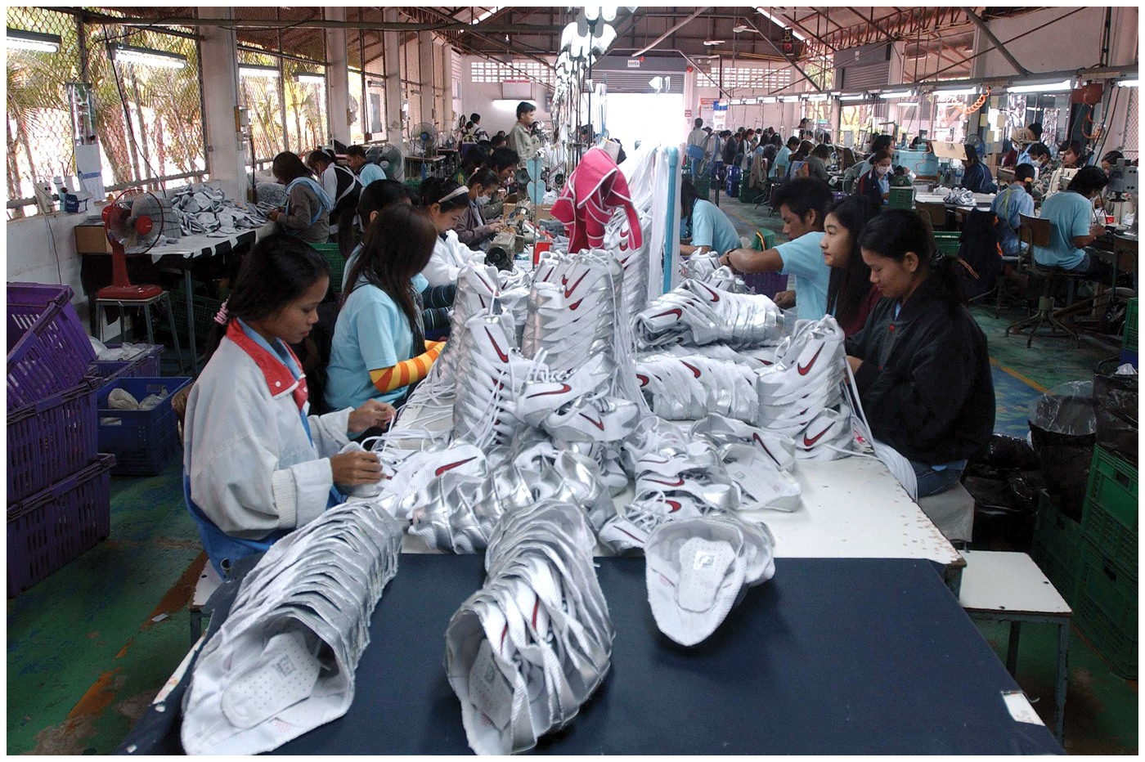
Resources—2
Labor
  Represents workers
  in an economy
Effective labor
  Labor adjusted for
  training and education
  Training includes everything from literacy to specific job training
  A more educated workforce is generally more productive
Notes:
Lecture notes:
Recall that more women entering the workforce greatly increased U.S. GDP.
While many women worked at home in the mid-1950s, this work was typically not counted in GDP (childcare, house cleaning, meal preparation, etc.)
Effective labor adjusts for training and education, and is perhaps a better measure of the labor resource in a country.
Training includes everything from basic literacy to college education to software competencies to specific job training.
The labor resource can increase either by increasing the number of workers available or by educating the existing labor force (or both).
Not many would doubt that a more educated labor force is more productive.
However, India struggled for many years even with one of the most educated labor forces.

Slide 33
Brain Drain
Brain drain
  Economically defined, brain drain occurs when skilled professionals emigrate out of a country.
Why does it happen?
  People may want to move to a country with more opportunities or higher pay.
  Regulations or laws may force people to move away.
Result of brain drain
  A country might lose its most productive workers and suffer slowed growth as a result.
  America’s brain drain (article)
Notes:
“Beyond the Book” Slide
Lecture tip:
Discuss the article that’s referenced on the slide with your students.

Slide 34
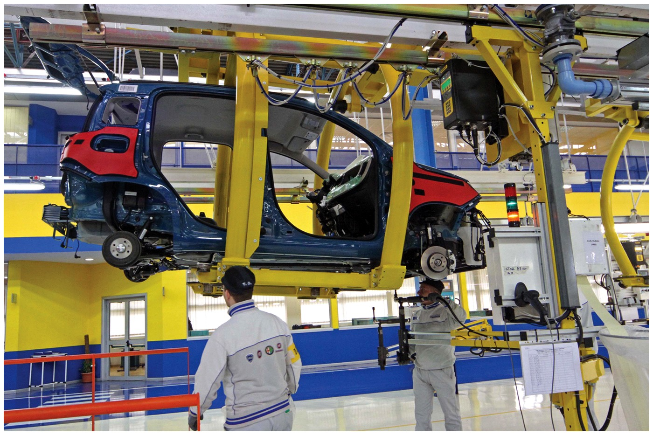
Resources—3
Capital
  Tools and equipment used in the production of goods and services
  Factories, computers, roads
  Example: the standardized shipping container revolutionized world trade
  The most developed countries have impressive roads, bridges, tools, and computer networks
Notes:
Lecture notes:
The purpose of capital is to aid in the construction of future output. In this sense, it’s like land and labor: more tools make it possible for a nation to produce more output.
Workers are more productive if they have better roads, factories, and tools to work with.
In poor nations, paved roads are nonexistent or in disrepair, vehicles are lower quality, and computers are a luxury.
Even public electricity and sewage treatment facilities are rare in many developing nations.

Slide 35
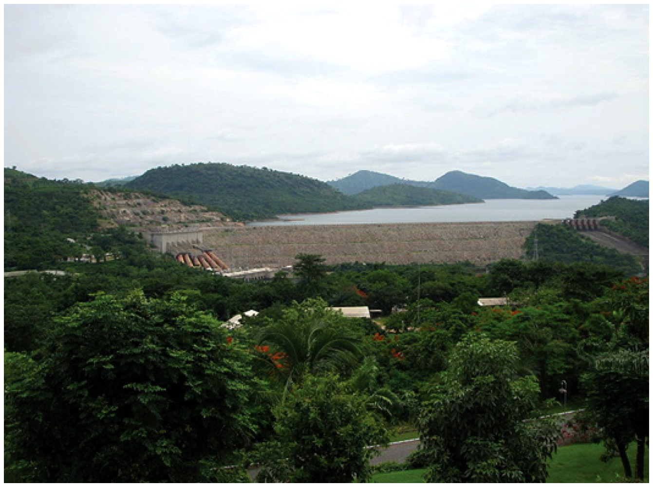
Capital and Growth
Early contributions to growth theory focused on the role of physical capital.
We thought we could just build a bunch of roads and factories to help countries grow.
  However, factories, dams,
  and other large capital
  projects fell into disrepair.
  They did not mesh well with
  rest of economy.
  There must be other factors
  of economic growth as well.
Notes:
Lecture notes:
The Elusive Quest for Growth by economist William Easterly:
“The World Bank helped finance the Morogoro Shoe Factory in Tanzania in the 1970s. This shoe factory had labor, machines, and the latest in shoe-making technology. It had everything except—shoes. It never produced more than 4 percent of its installed capacity. The factory, which had planned to supply the entire Tanzanian shoe market and then export three-quarters of its planned production of 4 million shoes to Europe, never exported a single shoe . . . Production finally ceased in 1990.”
The lesson from this quote: Capital (by itself) is not enough either!
Image on the slide: Akosombo dam in Ghana

Slide 36
Technology—1
Technology
  Knowledge available for use in production
Technological advance
  Introduction of new knowledge or production techniques
  “Produce more for less”
  Classic example: Henry Ford’s assembly line
  Agricultural advances allow us to grow more food per acre
Notes:
Lecture notes:
Technological advances in farming mean that over time we get more corn per acre of land.
In fact, in the United States, corn yield per acre is now six times what it was in 1930.
In 1930, we produced about 25 bushels of corn per acre, but now the yield is consistently over 150 bushels per acre.
This is possible because of new technology; technology embodied in hybrid seeds, herbicides, and fertilizers.

Slide 37
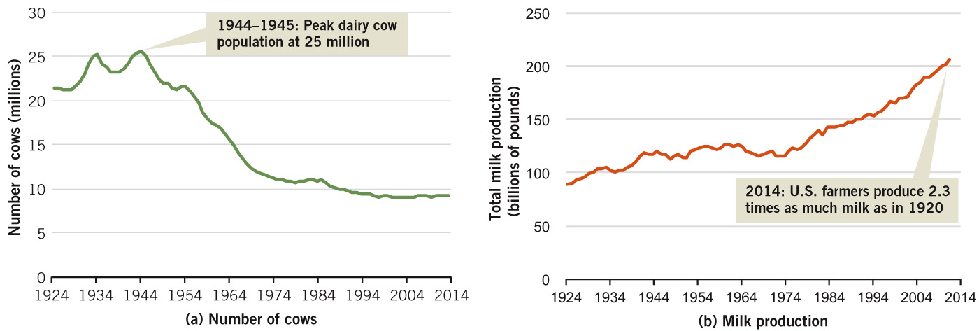
Fewer Cows, More Milk
Notes:
Image: Figure 24.4
Lecture notes:
The figure on the slide shows another agricultural example of technological advancement:
We now have significantly fewer milk cows in the United States than at any time since 1920.
But total milk output is at historical highs because we now get about four times as much milk out of each cow.
Technological advancements allow us to produce more while using fewer resources.

Slide 38
Technology—2
Economic growth occurs when the resources and technology work together.
Still a question, though: Why do some areas innovate (and grow) more than others?
  Why did the United States grow and innovate while Africa didn’t?
Notes:
Lecture notes:
Innovations do not occur randomly across the globe.
Some places produce large clusters of such innovations.
Information technology comes from MIT and Silicon Valley; movie and television ideas come from Hollywood; and new fashion designs come from Paris and Milan.
Technological innovations tend to breed more innovations.
This leads us to reword an earlier question: Why do some regions innovate (and grow) more than others? Part of the answer lies in institutions.

Slide 39
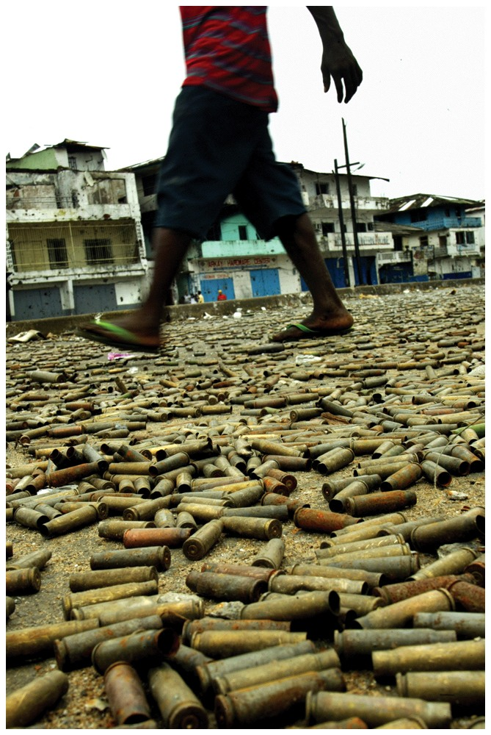
Institutions—1
1950
  Liberia wealthier than Taiwan
Today
  GDP per capita in Taiwan is more than 20 times greater than Liberia
Why?
  Political stability in Taiwan, along with well-defined property rights protection
  Coercion, corruption, and instability in Liberia; nondependable system of ownership
  Where do you want to invest?
Notes:
Lecture notes:
From the text:
Before 2006, it had been 35 years since a Liberian president assumed office by peaceful means without bloodshed.
Both the previous two national leaders (Charles Taylor and Samuel Doe) consistently used the coercive power of government to eradicate opposition.
On the other hand, Taiwan’s political climate has been relatively stable since 1949.
The image on the slide: The ground is riddled with bullet casings. Sound like a good place to build a business?

Slide 40
Institutions—2
Institutions
  Significant practice, relationship, or organization
  Conditions in which decisions are made
  Include laws, regulations, and government
  Also include work habits, expectations, and political behavior
Notes:
Lecture Notes:
Institutions are not always tangible physical items that we can look at or hold.
There might be a physical representative of an institution, such as the U.S. Constitution or the Federal Reserve Board, but the essence of the institution is comprised of expectations and habitual practices, not anything physical.
The rules and the mindset within the Federal Reserve Board are what is important, not the building or the chairs.

Slide 41
Institutions—3
Important institutions for economic growth
  Political stability and rule of law
  Private property rights
  Stable money and prices
  Competitive markets
  Efficient taxes
  International trade
  Flow of funds across borders
Notes:
Lecture tip:
We discuss some of these institutions with more detail here.

Slide 42
Political Stability and
Rule of Law
Liberia, 1980—2003
  Staged elections, rebel takeovers, violent upheavals, violence against citizens
  About $4 billion in international aid given, meant for industry and medical infrastructure (think of this as a “blind” application of Solow)
    Most aid was seized by force by whoever thought they needed it
    Blanket aid does not by itself provide incentives for education and investment
  Nothing was done to eliminate instability to create an environment for economic growth!
Notes:
Lecture notes:
From 1980 to 2003, Liberia received $4 billion in international aid (about $75 per person per year, or 10 percent of an average person’s income during that period).
More details on Liberia:
In 1980, a rebel leader named Samuel Doe charged into the office of the sitting president (William Tolbert) and brutally killed him, right on the spot.
Samuel Doe then became the leader of Liberia, even winning a staged election in 1986. Doe led Liberia until he was also captured, tortured, and killed by another group of rebels in 1990.
After this coup, Charles Taylor was installed as the leader of Liberia, himself becoming “president” through staged elections in 1995.
Taylor’s regime in Liberia was one of constant battles, even in the capital city of Monrovia. By the summer of 2003, five rebel groups had converged on the capital from different directions. The Meserado River served as a dividing line between the rebel groups and the territory held by Taylor’s militia.
Everything that stood in the way of both sides was riddled with bullets.

Slide 43
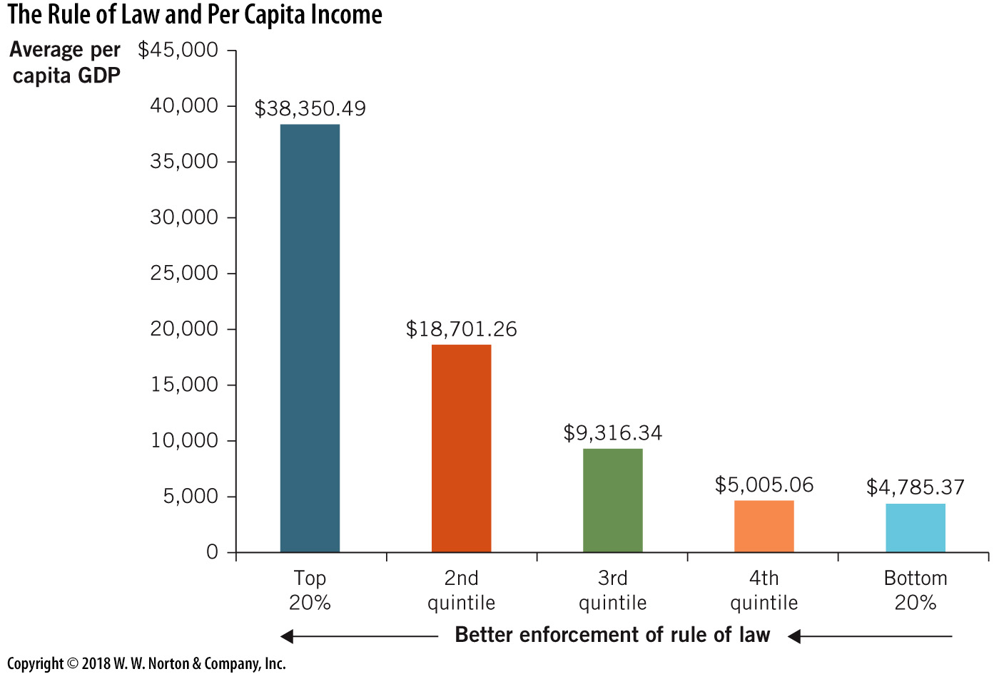
Rule of Law and Income
Notes:
Image: Figure 24.5
Lecture notes:
The World Justice Project has collected data on the rule of law across the world. Their rule of law index is positively correlated with levels of income.
The figure on the slide shows the nations broken down into five quintiles, based on their score from the rule of law index.
Note that, in the figure, better enforcement of the rule of law increases as you move from right to left.
Nations that scored in the top quintile on this index are also the nations with the highest levels of per capita GDP.
Nations that score the lowest on their index also have the lowest levels of income.

Slide 44
Private Property Rights
Individuals can own property and resources and the resulting output created by those resources.
  Perhaps the single greatest incentive for voluntary production
  Workers and producers can own a share of what they produce, so there is an incentive to produce more and grow
Great example: Xiaogang, China, 1978
  Farmers split commune into family-owned plots and agreed to keep surplus agricultural output beyond government quota
Notes:
Lecture notes:
Private property rights are perhaps the most important institution to foster growth. This institution creates the incentive for people to be innovative and expand production.

Slide 45
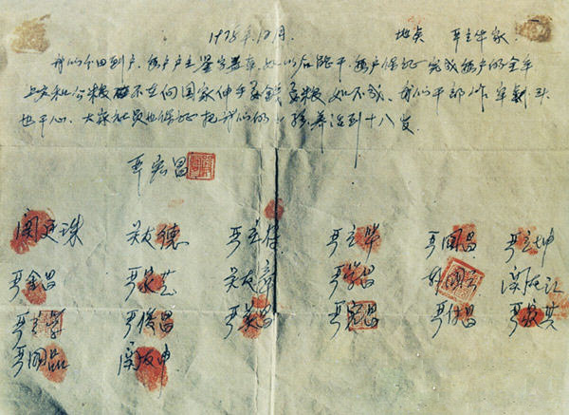
The Xiaogang Agreement
Notes:
Lecture notes:
Literal Translation:
December 1978 Mr. Yan’s Home
We divide the field (land) to every household. Every leader of the household should sign and stamp. If we are able to produce, every household should promise to finish any amount they are required to turn into the government, no longer asking the government for food or money. If this fails, even if we go to jail or have our heads shaved, we will not regret. Everyone else (the common people who are not officers and signees of this agreement) also promise to raise our children until they are eighteen years old.
First signer: Hong Chang Yan
Translated by: Chuhan Wang

Slide 46
Result of the Agreement
Agreement:
  Keep all output above government quota
  No longer take money or food from government
Result
  Agricultural boon in Xiaogang
  More output than previous five years combined
  Chinese leaders instituted agricultural reforms in 1980s and manufacturing reforms in 1990s
Lesson?
  China grew not because of new resources or technology, but because of the institution of private property rights
Notes:
Lecture notes:
This agreement was dangerous in 1978, so dangerous that one part of the agreement stipulated that they would raise one another’s children if any of the signees were put in jail!
Why was it dangerous?
It was just the institution.
The people didn’t own the property, the GOVERNMENT did.
Thus, the people had no incentive to work hard and produce, because they didn’t get to keep any of it! Keeping property that belonged to the government could have gotten them jailed.

Slide 47
Stable Money and Prices
Uncertainty about future prices
  Makes people reluctant to invest
  Decreases future growth possibilities
In the United States
  The Fed is charged with administering monetary policy
  The Fed is designed to be largely politically independent
  Governor terms at the Fed are staggered so that no president can appoint more than two governors
Notes:
Lecture notes:
The Fed = the Federal Reserve
Recall that monetary policy can shape inflation rates and interest rates. Inflation rates can be changed by adjusting the rate at which new money is printed.

Slide 48
Competitive Markets
Characteristics of competitive markets
  It is easy for firms to enter and exit with few licensing or regulatory hurdles.
  Buyers can expect to find low prices and wide availability of goods.
Benefits to society
  Creative destruction occurs and new technologies replace outdated methods. This fuels economic growth.
  Only the fittest firms survive, so inefficiency is eliminated over time.
  Innovation is encouraged.
Notes:
Lecture notes:
It may hurt some people (the ones who go out of business or lose money), but it benefits society as a whole.
These societal benefits are greater than the cost of a small number of people losing.
The car replaced the buggy, the DVD and Blu-ray replaced the VCR, and digital cameras replaced older versions.
Innovation is encouraged since lower-cost methods will give firms higher profits and a better chance to survive and prosper. The incentive for growth and innovation is there.

Slide 49
Efficient Taxes
Taxes represent a trade-off
  They must be high enough to support effective government.
  Taxes change incentives by doing less of the activity that is taxed. Often, wages and output are taxed.
  Import tariffs also impede growth.
Challenge:
  Find a tax level that will support the government without crippling economic growth.
Notes:
Lecture notes:
The government provides services (law enforcement, for example) and infrastructure. The revenue for funding comes from taxes.
If we tax activities that are fundamental to economic growth, economics theory predicts we’ll see less of these activities.
In particular, when income-producing activities are taxed (via income taxes), this reduces incentives for earning income.
Think of it this way: output and income are inexplicably linked in a market economy. If we tax income, we are taxing output, and that is GDP.

Slide 50
International Trade
Specialization and trade
  Creates value and allows countries to consume goods they cannot produce on their own.
  Output (GDP) increases when countries produce goods in which they have the comparative advantage (lowest opportunity cost).
Without trade?
  Many countries would not be able to produce many resources necessary for production, and growth would stop.
Notes:
Lecture notes:
The tragic story of Easter Island illuminates another institution critical to economic growth: international trade.
The island population grew to 15,000 when they were able to trade for chickens and vegetables with other islands.
But once the trees were cut down and oceanic travel became impossible, the end was just a matter of time.

Slide 51
Flow of Funds across Borders
Investment requires savings
  Opportunities for investment expand if you have access to savings from around the globe
  If foreigners can funnel their savings into your economy, your firms can use these funds to expand
Restrictions on the flow of capital across borders
  Hurt domestic firms as they are relegated to seeking funds from solely domestic savers
Notes:
Lecture notes:
Basically, you can think of getting funds from a small group of savers and investors (domestic only) or a much larger group (international).

Slide 52
Institutions—4
Moscow on the Hudson
  This clip shows the importance of institutions such as political stability in the creation of a prosperous economy.
Notes:
“Economics in the Media” Slide
Lecture tip:
The clip mentioned on the slide can be found in the Interactive Instructor’s Guide. Access the direct link by clicking the icon in the PowerPoint above.

Slide 53
Economics in The Hunger Games
Economic freedom and the quality of life
  This video shows that there is a direct relationship between economic freedom and quality of life.
  Economic freedom is determined by institutions.
Notes:
“Economics in the Media” Slide
Lecture tip:
The clip mentioned on the slide can be found in the Interactive Instructor’s Guide. Access the direct link by clicking the icon in the PowerPoint above.

Slide 54
Practice What You Know—4
Land, labor, and capital are considered
  resources.
  technology.
  institutions.
  investments.
Notes:
Clicker question:
Correct answer: A, resources.
Resources are the inputs used to produce goods and services. Resources are in important factor (but not the only factor) which affects economic growth.

Slide 55
Practice What You Know—5
Why is technological advancement important for economic growth?
  It increases leisure time.
  It increases prices, helping producers.
  It allows us to produce more output while using fewer resources.
  It allows us to sustain a population while consuming fewer amounts of goods and services.
Notes:
Clicker question:
Correct answer: C, It allows us to produce more output while using fewer resources.
When we can make MORE output with LESS capital, labor, and land, growth occurs and quality of life improves. In addition, you could imagine that inputs can go on to produce other goods that we never produced before because fewer goods are needed to produce certain goods.

Slide 56
Conclusion
This chapter makes the argument that economic growth is important to average people.
It gives a historical perspective on growth, and we’ve seen that only recently have we improved our standards of living.
Economic growth is central to modern macroeconomics, and it also helps us understand how living standards might be improved around the world.
Notes:
Lecture notes:
You can conclude the lecture on economic growth and the wealth of nations by also reiterating the following points:
Economic growth is measured as percentage changes in per capita real GDP.
Due to compounding growth, relatively small growth rates lead to significant changes in living standards if they are maintained over time.
The Rule of 70 is a helpful tool for determining the effects on income from a given growth rate.
Changes in per capita real GDP affect many human welfare conditions. These include mortality rates and health conditions.
Historically, world economic growth rates were approximately zero prior to the Industrial Revolution. Over the past two centuries, world per capita real GDP has increased to about 10 times any levels experienced prior.
The first factor that influences economic growth is the resources available to a nation.
Land (natural resources)
Labor (both quantity and quality of workers)
Capital (the tools available for production)
Technological innovations are the second factor that contributes to growth.
The third and final growth factor is institutions. Without proper institutions, neither resources, technology, or their combination are enough to produce sustained economic growth.

