Slide 1
The Aggregate Demand–Aggregate Supply Model
26
Notes:
Pre-class music: “I Get Paper” by Drake and Kevin Cossom (Link to Tip #461)
This song is a good way to introduce aggregate demand, as Drake and Kevin Cossom sing about how they contribute to aggregate demand in the hook (by spending money on goods and services: “I get money, I get paper, and I get girls, all different flavors. I buy Gucci, I buy Prada, I spend dolla’ after dolla’.”).

Slide 2
Previously
The original Solow model focused on capital investment as the main source of economic growth.
Modern growth theory now recognizes that institutions are also essential for growth.
Modern growth theory also treats technological advancements in a society as endogenous.

Slide 3
Big Questions
What is the aggregate demand–aggregate supply model?
What is aggregate demand?
What is aggregate supply?
How does the aggregate demand–aggregate supply model help us understand the economy?

Slide 4
Here’s a question for you…
What factors influence the price level and amount of output in the entire economy?
Notes:
Lecture notes:
This is similar to the question asked in the microeconomics chapter on supply and demand (Chapter 3).
In order to get students thinking about factors that affect the overall price level in the economy, you can ask the following questions:
Where does inflation come from?
Students will likely respond by talking about increases in the cost of production; make sure they understand it can come from the demand side as well.
How is GDP determined?
Here, students will likely focus on demand. After learning that GDP = C + I + G + NX, they will focus on increases in those variables.
Therefore, it will be useful to help them realize that the capacity of the economy is also an issue.

Slide 5
Macroeconomics
Two major paths of study:
  Exploring long-run growth and development
  Examining short-run fluctuations (business cycles)
Business cycle
  Most evident in real GDP growth and unemployment rates
Notes:
Lecture notes:
The two paths:
Are complementary.
Differ in length of time in focus.
Growth: Generally 5–10+ years
Business cycles: Generally <5 years
Business cycles:
Remind students of the phases of the business cycle (from Chapter 19).
Remind students how real GDP and unemployment fluctuate over the business cycle.

Slide 6
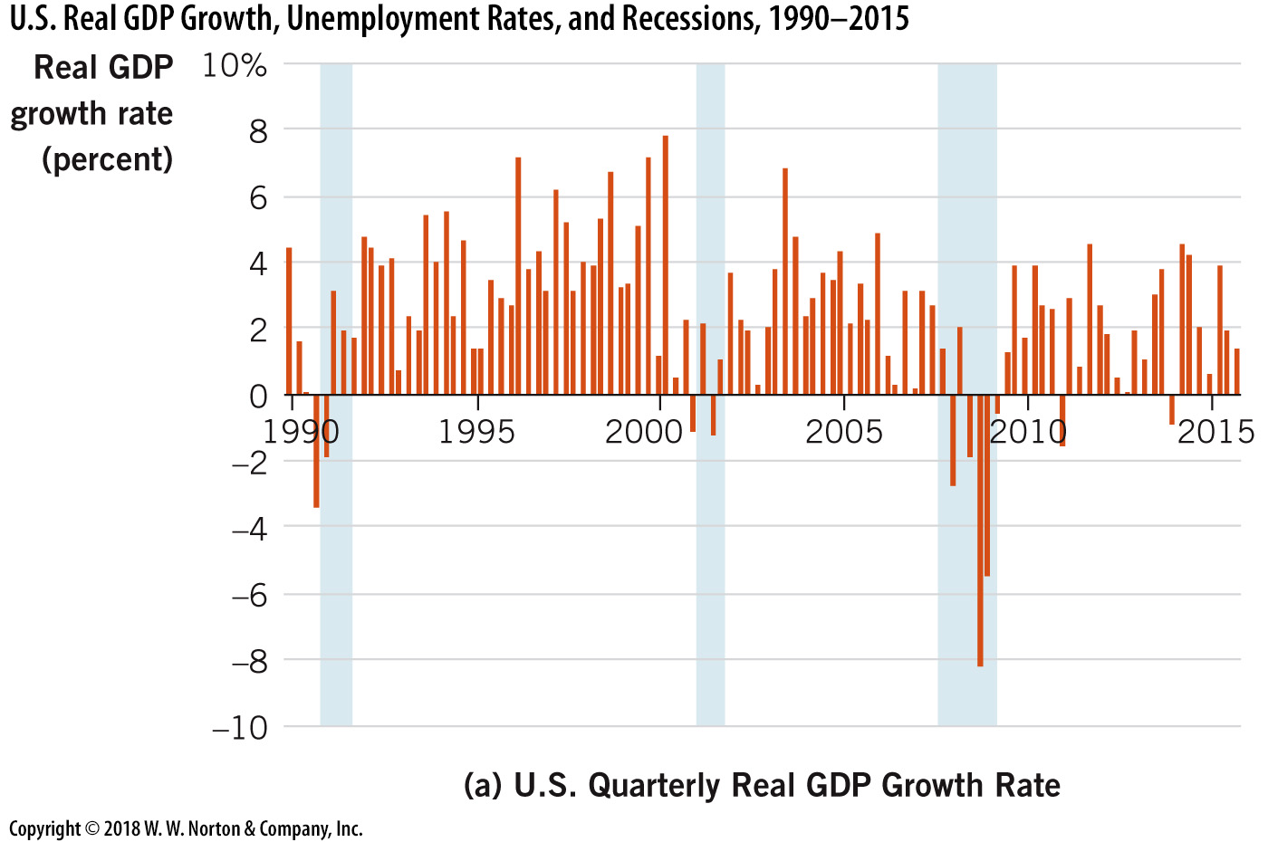
U.S. Real GDP and Recessions, 1990–2015—1
Notes:
Image: Figure 26.1
Lecture notes:
The diagram above shows the following:
Quarterly real GDP growth declined during the shaded periods, which indicate recessions.
Real GDP growth also increased during the nonrecessionary periods.

Slide 7
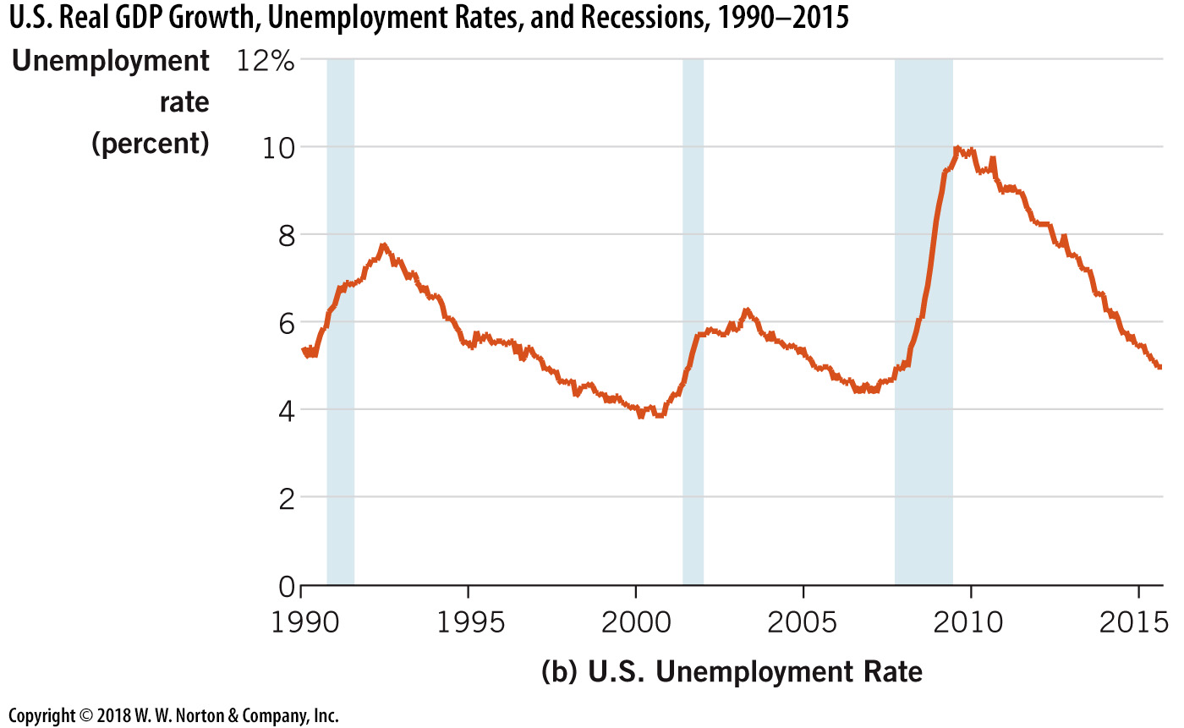
U.S. Real GDP and Recessions, 1990–2015—2
Notes:
Image: Figure 26.1
Lecture notes:
The diagram above shows:
Unemployment rate spiked up during each of the three recessions.
Unemployment gradually fell following the recessions.

Slide 8
Aggregate Demand and Aggregate Supply Model
Aggregate demand (AD)
  Total demand for final goods and services in the economy
Aggregate supply (AS)
  Total supply of final goods and services in the economy
Notes:
Lecture notes:
This is just another supply and demand model, similar to the basic model learned in macroeconomics.
The differences are:
We are aggregating, so instead of getting the price and quantity of one good, we are looking at the supply and demand for all goods in our economy.
Explain to students that aggregate = total.
We are not looking at a single price but at the price level. This will be on the vertical axis just like price was in the original model.
It is the average price level in the economy (measured by the GDP deflator, which was discussed in Chapter 19).
Overall output (or quantity) is real GDP (or Y). Remind students they learned how to calculate GDP in Chapter 19 as well.

Slide 9
Aggregate Demand—1
AD = C + I + G + NX
Aggregate demand is the sum of spending in the economy.
  Consumption (C)
  Investment (I)
  Government spending (G)
  Net exports (NX)
Notes:
Lecture notes:
The equation will be a review from Chapter 19.
To determine aggregate demand, we sum up spending from different sources in the economy.
[C] These sources include private domestic consumers who buy cars, food, clothing, education, and many other goods and services.
[I] Business firms are another major group; they buy resources needed to produce output.
[G] The government is a large purchaser of labor and other resources used to produce government services.
[NX] (net exports) Finally, foreign consumers buy many goods and services produced in the United States.
Remind students that NX = X – M.

Slide 10
Aggregate Demand—2
Notes:
Image: Animated Figure 26.2
Lecture tip:
First click:
Real GDP = $16 trillion dollars
Price level = 100 (base year)
Any change from the base year indicates inflation or deflation
Lecture notes:
The diagram above shows the aggregate demand curve for the economy.
It is drawn with the price level on the vertical axis and real GDP on the horizontal axis.
Point out that the demand curve has a negative slope, but for reasons other than the law of demand (these will be covered in the following slides).
An increase in the price level lowers aggregate quantity demanded.
A decrease in the price level raises aggregate quantity demanded.
The aggregate demand curve depicts the quantity of goods and services demanded in the economy at any given price level. For example, when the price level rises from P₁₀₀ to P₁₀₅, the quantity of aggregate demand falls from $16 to $15.5. Lower nominal price levels result in increased values of real GDP.

Slide 11
Aggregate Demand—3
There is a negative relationship between quantity of aggregate demand and the price level because of the following:
  Wealth effect
  Interest rate effect
  International trade effect
Notes:
Lecture notes:
The three effects listed are distinct, but they are interrelated and reinforcing. Each of these effects is covered in its own slide.

Slide 12

The Wealth Effect
Wealth
  Value of an individual’s
  accumulated assets
Wealth effect
  The change in the quantity of aggregate demand that results from wealth changes due to price-level changes
Notes:
Lecture notes:
Some examples of wealth that you can bring up to students include:
Currency
Stocks
Bonds
Artwork
Real estate
Bank accounts
If the price level rises:
The purchasing power of wealth falls
People cannot buy as much
The quantity of aggregate demand falls
If the price level falls:
The purchasing power of wealth rises
People are able to buy more
The quantity of aggregate demand rises
The wealth effect is related to consumption (C) in the GDP or AD equation.
Remind students how wealth and income are different.

Slide 13
The Interest Rate Effect—1
Interest rate effect
  Occurs when a change in the price level leads to a change in interest rates and therefore in the quantity of aggregate demand
This occurs through the loanable funds market.
  Changes in the price level affect saving.
  This directly impacts the supply of loanable funds.
Notes:
Lecture notes:
There is an opportunity cost of borrowing. Higher interest rates make loans more expensive and decrease economic activity in sectors that are interest rate-sensitive.
As the price level rises:
The ability to save falls, lowering the supply of loanable funds
The interest rate rises
Purchases of goods on credit decline
This is mainly a drop in investment (I) but some large-ticket consumer goods as well
As the price level falls:
The ability to save rises, increasing the supply of loanable funds
The interest rate falls
Purchases of goods on credit increase
This is also mainly investment (I) but some large-ticket consumer goods as well

Slide 14
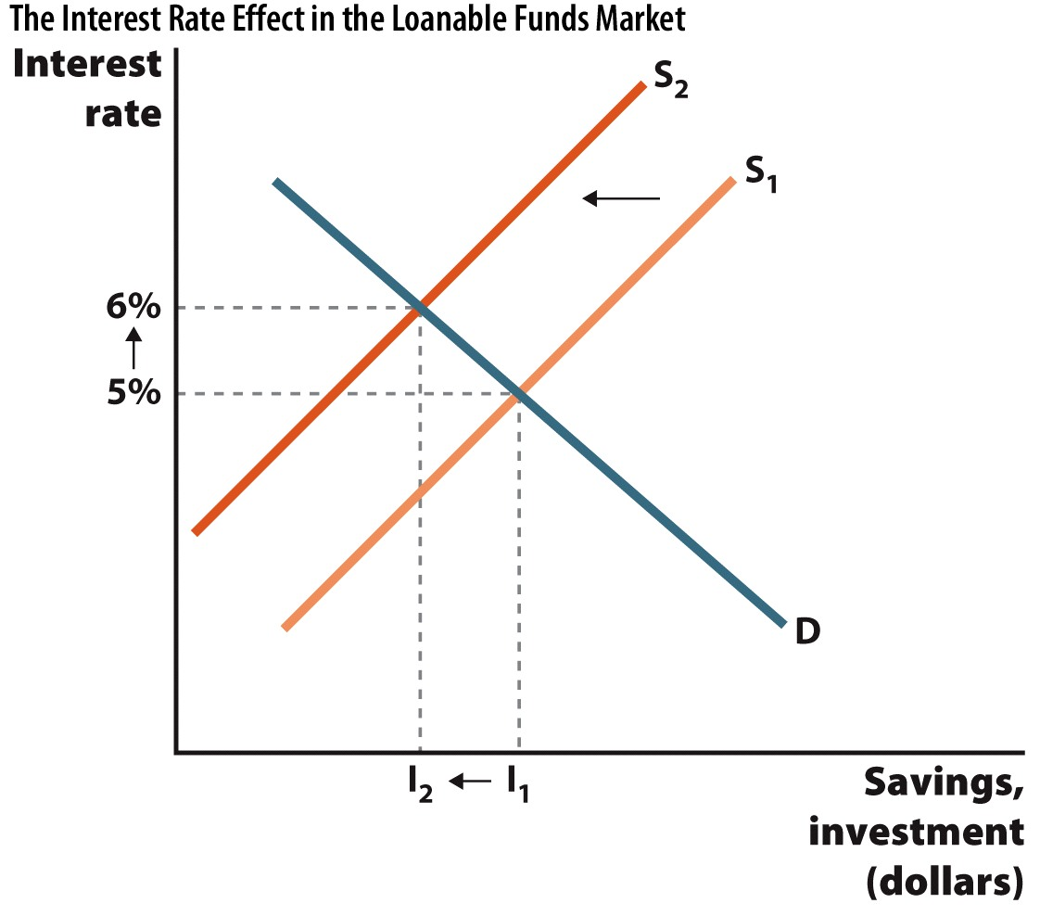
The Interest Rate Effect—2
Notes:
Image: Figure 26.3
Lecture notes:
Remind students that they have seen this before (in Chapter 9).
The loanable funds market is just another market with supply and demand.
The demand for loanable funds represents investment spending.
The supply of loanable funds represents saving.
The interest rate is the price of borrowing and lending, so it is on the vertical axis.
The quantity of loanable funds (measured by saving or investment) is in the horizontal axis.
In this diagram:
An increase in the price level has lowered the amount of saving in the economy.
The supply of loanable funds has declined.
The interest rate rises as a result.
Increased interest rates dampen investment spending because they dramatically increase the cost of borrowing.
Investment purchases will be postponed or scrapped altogether.

Slide 15

International Trade Effect
International trade effect
  Occurs when a change in the price level leads to a change in the quantity of net exports demanded
Notes:
Lecture notes:
We are considering the domestic (U.S.) market.
Changes in the U.S. price level mean the prices of U.S. goods change relative to the prices of goods from other nations.
This will affect both imports and exports.
Suppose the U.S. price level increases (assume all other countries’ price levels remain the same):
The prices of U.S.-made goods are now relatively more expensive.
Exports will fall.
The prices of foreign goods are now relatively cheaper.
Imports will rise.
Both effects mean that net exports will fall.
The international trade effect is related to the NX in the GDP equation.

Slide 16
Slope of the AD Curve
Notes:
Image: Animated Figure 26.4
Lecture notes:
First click:
At a price level of 100, the quantity of aggregate demand is $16 trillion.
Second click:
When the price level rises from 100 to 110, the quantity of aggregate demand falls from $16 trillion to $15 trillion.
Third click:
This negative relationship is due to three different effects:
The wealth effect implies a lower quantity of consumption (C) demand because real wealth (the purchasing power of wealth) falls at higher price levels.
The interest rate effect implies a lower quantity of investment (I) demand due to higher interest rates.
The international trade effect implies a lower quantity of net export (NX) demand due to relatively higher domestic prices.
Each effect focuses on a different component of aggregate demand.

Slide 17
Movements Along the AD Curve Versus Shifts in the AD Curve
Movements along the AD curve
  Start with a change in the price level
  Affect the quantity of aggregate demand through the three effects
    Wealth effect, interest rate effect, international trade effect
Shifts in the AD curve
  Occur when something other than the price level changes
Notes:
Lecture notes:
This will also be a review for students, but it is still a good idea to remind them of the ceteris paribus assumption.
When we draw the AD curve, we are assuming that the only things that are changing are the price level and the quantity of aggregate demand.

Slide 18
Shifts in Aggregate Demand
To determine what shifts the AD curve, we should consider the different types of spending in the economy.
AD = C + I + G + NX
Consumption (C)
Investment (I)
Government spending (G)
Net exports (NX)
Notes:
Lecture notes:
When people demand more goods and services at all price levels, AD shifts to the right.
When people demand fewer goods and services at all price levels, AD shifts to the left.
Anything that changes C, I, G, or NX (other than a change in the price level) will cause the AD curve to shift.

Slide 19
Shifts in Consumption
Changes in real wealth
  Stock market rises or falls
  Widespread change in real estate values
General expectations about the future
  Changes in expected income
  Change in consumer confidence
Changes in taxes
Notes:
Lecture tip:
Go through each of these and provide an example. Some possible examples could include:
The stock market rises
People feel wealthier
They buy more goods
Consumption rises
AD rises
Consumers worry about the future
They increase saving
They buy fewer goods
Consumption falls
AD falls
Taxes increase
After-tax income falls
People cannot afford to purchase as much
Consumption falls
AD falls
Suggested video clips: The following media clips could be shown in class to show the effect of changes in wealth.
Dumb and Dumber (Link to Tip #463)
First clip: 01:04:20–01:06:22
Second clip: 01:39:40–01:40:25
Blank Check (Link to Tip #466)
First clip: 00:16:00–00:18:05
Second clip: 00:30:17–00:35:50

Slide 20
Shifts in Investment
General expectations about the future
  Investor confidence
Interest rates
Changes in the quantity of money in the economy
  Alters the interest rate
Notes:
Lecture tip:
Investor confidence:
Explain why firms need to consider the future for any investment project.
Long-term nature of benefits from investment
Follow up this explanation by asking students why a firm would build a new factory.
Interest rates:
Make sure students know that this is a change in interest rates caused by something other than a change in the price level.
Quantity of money:
Explain in brief terms how more money reduces interest rates (this will be examined in further detail in Chapter 31).

Slide 21

Shifts in Government Spending
Influenced by policy
  These changes may be made in response to economic conditions.
Notes:
Lecture notes:
Government spending is the component of aggregate demand that economic theory has the least to say about.
It is influenced by government policy that may or may not be driven by economic concerns.
Sometimes the government creates policies to counteract current economic issues.
This will be discussed in further detail in Chapter 29.

Slide 22
Shifts in International Trade
Income of individuals in other countries
Exchange rates
Notes:
Lecture notes:
Foreign income:
If foreign nations become wealthier:
Demand for U.S. goods increases
NX increases
AD increases
If a foreign nation goes into recession:
Demand for U.S. goods decreases
NX decreases
AD falls
Exchange rates:
Make sure students understand that this is a change in exchange rates not caused by a change in the U.S. price level.
If the value of the U.S. dollar ($) rises:
The United States can buy more imports
Other countries can buy less U.S. goods (decreasing exports)
NX falls
AD falls
If the value of the U.S. dollar ($) falls:
The United States cannot afford as many imports
Other countries can buy more U.S. goods (increasing exports)
NX rises
AD increases
Refer to Figure 26.5 for a summary of all things that shift AD.

Slide 23
Practice What You Know—1
The wealth effect can help explain
  the positive slope of the AS curve.
  the negative slope of the AD curve.
  the difference between real and nominal GDP.
  the rate of economic growth.
Notes:
Clicker question:
Correct answer: B, the negative slope of the AD curve.
The wealth effect refers to the change in the purchasing power of money when the price level changes. If the price level falls, we can afford to buy more goods with the same number of dollars.

Slide 24
Practice What You Know—2
Consider just the AD curve. Suppose consumption (C) broadly increases across the entire economy. This will cause
  a movement along the AD curve.
  the AD curve to shift outward.
  the slope of the AD curve to get steeper.
  a decrease in the price level of the economy.
Notes:
Clicker question:
Correct answer: B, the AD curve to shift outward.
If everyone spends more (perhaps due to higher consumer confidence), the AD curve will shift. Specifically, it will shift outward (to the right). Combined with the AS curve, the model shows that this will result in higher real GDP and a higher price level.

Slide 25
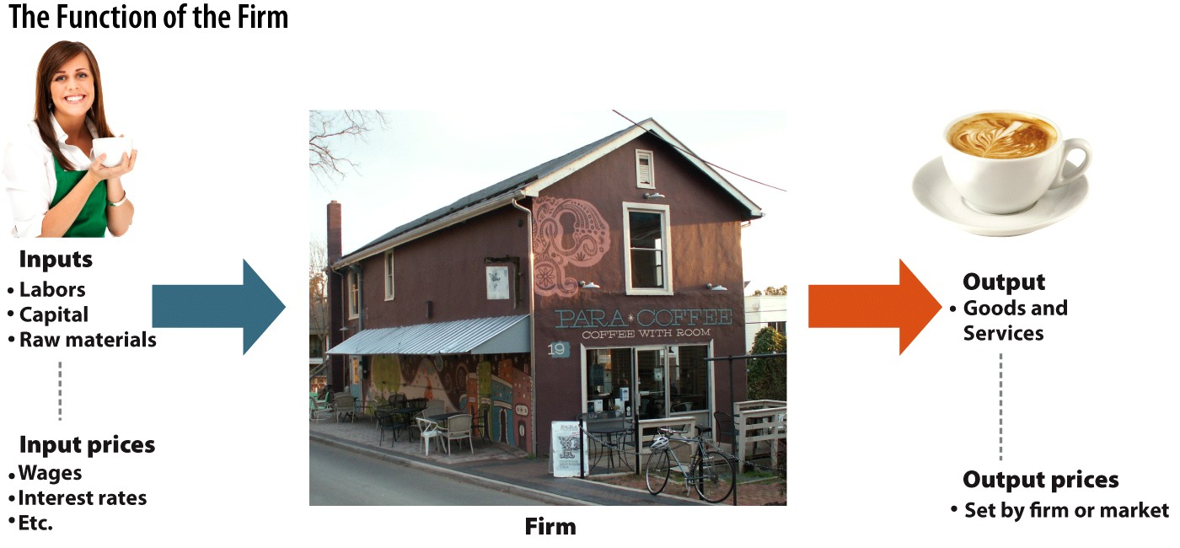
The Function of the Firm
Notes:
Image: Figure 26.6
Lecture notes:
Keep in mind that it can be difficult for students to put themselves in the mindset of a producer.
Basic function of the firm:
Convert inputs (resources) into outputs (goods and services)
Input prices determine the firm’s costs
Output prices determine the firm’s revenues

Slide 26
Aggregate Supply
How do changes in the price level affect the supply decisions of the firm?
The answer depends on the time frame examined.
  Long run
    A period of time sufficient for all prices to adjust
  Short run
    The period of time in which some prices have not yet adjusted
Notes:
Lecture notes:
When we draw an aggregate supply curve, we hold everything constant except the price level and the quantity of aggregate supply.
So, what happens to the quantity of aggregate supply as the price level changes?
It depends on the time horizon.

Slide 27
Long-Run Aggregate Supply
The long-run output of an economy depends on resources, technology, and institutions.
  It is not affected by the price level.
In the long-run, the economy moves toward full-employment output (Y*).
  The level of output produced when an economy is at the natural rate of unemployment (u*).
Notes:
Lecture notes:
Example:
Assume two identical economies, A and B.
A has twice as much money as B.
Long-run result: Same amount of L, K, resources and technology in A and B, but goods are twice as expensive in A.
Implication: Different price level, same output
Remind students what is meant by the “natural rate of unemployment.”

Slide 28
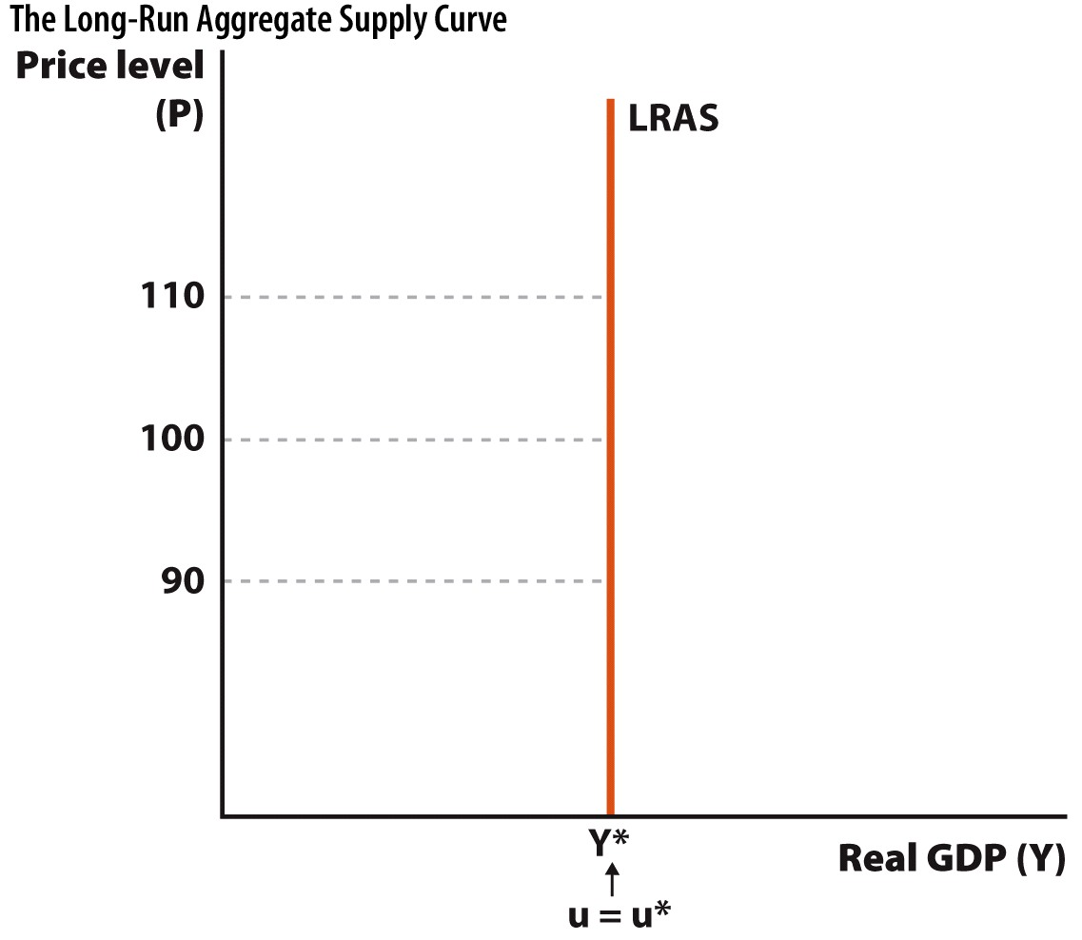
The Long-Run Aggregate Supply Curve
Notes:
Image: Figure 26.7
Lecture notes:
The long-run AS is vertical at Y*.
As the price level changes, the long-run quantity of aggregate supplied does not change.
It is always at the full-employment level of output.

Slide 29
Shifts in Long-Run AS—1
Changes in resources
  Both quality and quantity
Changes in technology
Changes in institutions
Notes:
Lecture notes:
Anything that alters full-employment output (Y*) will shift the long-run AS curve.
Examples of changes in resources:
More (or less) resources
Growth in labor force
Early retirement
Newly discovered natural resources
Better resources
Effects of human capital investment
Examples of changes in technology:
Growth of the Internet
Growth in telecommunications
Robotics
Examples of institutional changes:
Changes in tax rates
Affect the after-tax return on investments
Government research into new technologies

Slide 30
Shifts in Long-Run AS—2
Notes:
Image: Animated Figure 26.8
Lecture notes:
The LRAS curve is currently at full-employment output Y*.
First click:
An increase in LRAS means that we can now produce more at full employment.
Y** > Y*
LRAS shifts to the right
Second click:
A decrease in LRAS means that we can now produce less at full employment.
Y*** < Y*
LRAS shifts to the left

Slide 31
Practice What You Know—3
Why is the LRAS curve vertical?
  The short run sets a given output that will remain in the long run.
  Long-term output can only increase at a specific equilibrium price level.
  Prices have nothing to do with long-term output.
  Unemployment is zero in the long run.
Notes:
Clicker question:
Correct answer: C, Prices have nothing to do with long-term output.
In the long run, all prices have time to fully adjust. If two economies have identical goods, services, populations, skills, and resources, they will have the same real output even if one economy has twice as much money (and prices that are twice as high).

Slide 32
Short-Run Aggregate Supply
There are 3 reasons why there is a positive relationship between the price level and the quantity of aggregate supply:
  Sticky input prices
  Menu costs
  Money illusion
Notes:
Lecture tip:
The next few slides will discuss the three explanations.
Lecture notes:
Each of the three theories share a common thread:
When the price level deviates from what society expects, this causes real effects on output in the short run.

Slide 33
Short-Run AS Curve
Notes:
Image: Animated Figure 26.9
Lecture notes:
The positive slope of the short-run aggregate supply curve indicates that increases in the economy’s price level lead to an increase in the quantity of aggregate supply in the short run.
If the price level rises from 100 to 110, the quantity of aggregate supply rises from $16 trillion to $17 trillion in the short run.

Slide 34
Sticky Input Prices
Resource prices
  Tend to be sticky (not as flexible)
Output prices
  More flexible, easier to change
A change in the aggregate price level (output prices) affects firm revenues
  Costs stay the same
Notes:
Lecture notes:
Resource (input) prices tend to be sticky.
Output prices can be changed easier and are more flexible.
Not all prices adjust at the same rate.
Suppose the aggregate price level is increasing (but input prices are fixed for the period):
Higher output price increases profit potential for firm.
Costs are not changing.
Firm responds by producing more output.
Suppose the aggregate price level is falling (but input prices are fixed for the period):
Lower output prices reduce profit potential for firm.
Costs are not changing.
Firm responds by producing less output.

Slide 35
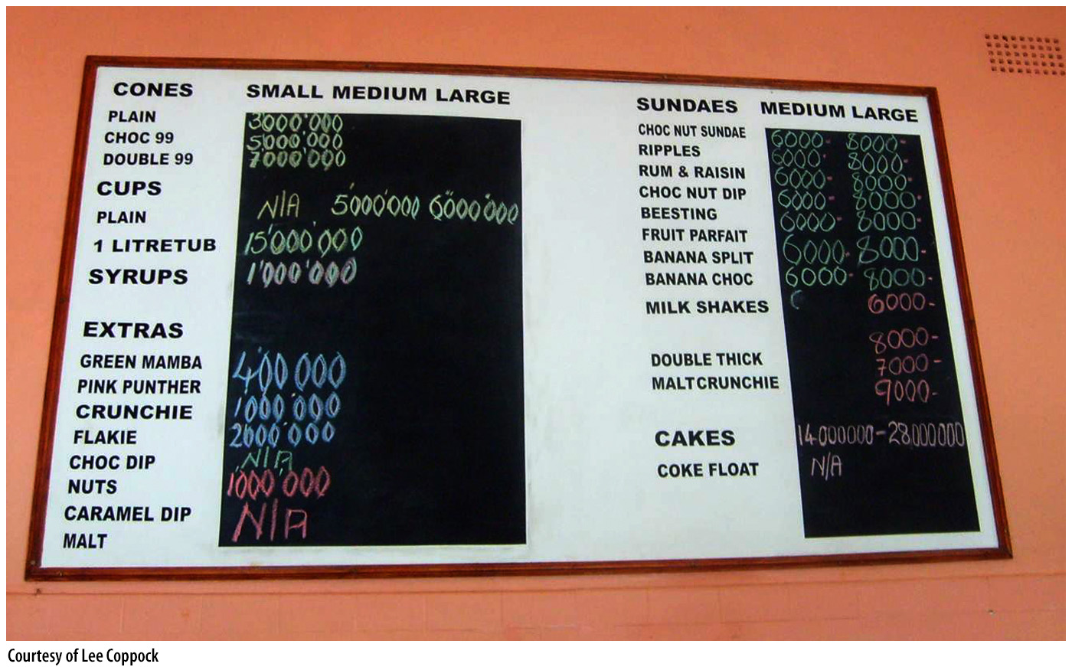
Menu Costs
Menu costs
  The costs of changing prices
Because of this expense, firms do not adjust their output price when the price level changes.
  This will impact the amount customers will want.
  The quantity of aggregate supply will adjust to meet this change in the quantity of aggregate demand.
Notes:
Lecture notes:
Suppose the price level rises (but that the firm doesn’t want to change its output price due to menu costs):
Buying from the firm is now relatively cheaper.
Consumers will want to buy more.
The quantity of aggregate supply will rise to satisfy what consumers want.
In the short run, the quantity of aggregate supply rises.
Suppose the price level falls (but that the firm doesn’t want to change its output price due to menu costs):
Buying from the firm is now relatively more expensive.
Consumers will want to buy less.
The quantity of aggregate supply will fall since fewer people want to buy the products.
In the short run, the quantity of aggregate supply falls.

Slide 36
Money Illusion
Money illusion
  Occurs when people interpret nominal changes in wages or prices as real changes
Workers are very reluctant to accept pay decreases, even if the pay decrease is nominal.
  Firms will reduce output in response to decreases in the price level rather than cut wages.
Notes:
Lecture notes:
You can discuss money illusion using the following scenario:
If price level inflation is 10 percent and your wage goes up by just 5 percent, you may be tempted to view that as a real raise, but it’s only a nominal raise.
In real terms, your wage falls in this example because you won’t be able to buy the same quantity of real goods and services since your wage rose by less than the price level.
If the price level falls:
Workers don’t want to accept a nominal wage cut (even if it is less than the level of deflation).
Firms see revenues fall (reduced output prices) with no change in costs.
They reduce output.
The quantity of aggregate supply falls

Slide 37
Shifts in Short-Run Aggregate Supply
Whenever the long-run AS curve shifts, it takes the short-run AS curve with it.
Factors that shift only the short-run AS curve
  Changes in resource prices
  Changes in expectations of prices
  Supply shocks
    Surprise events that change a firm’s production costs
Notes:
Lecture notes:
It is important to note that the SRAS curve always shifts when there is a shift in the LRAS curve.
Anything that shifts the LRAS curve also shifts the SRAS curve (in the same direction).
But, SRAS can shift by itself
Usually due to a change in the cost of producing goods
Most often, this means a change in resource prices.
Examples of resource prices:
Wages
Gasoline
Electricity
Raw materials
How expected future price levels affect SRAS:
If workers and firms expect higher prices tomorrow, they negotiate those expectations into today’s contracts.
Costs are higher, and the short-run AS shifts left.
However, it does not affect long-run production possibilities, so the long-run AS doesn‘t change.
Examples of supply shocks:
Freeze on crops
Jump in the price of oil
It is also a good idea to emphasize that supply shocks can be positive or negative, but when reading about just a “supply shock,” it means negative.

Slide 38
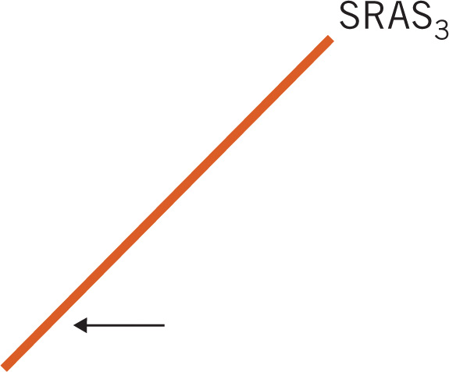
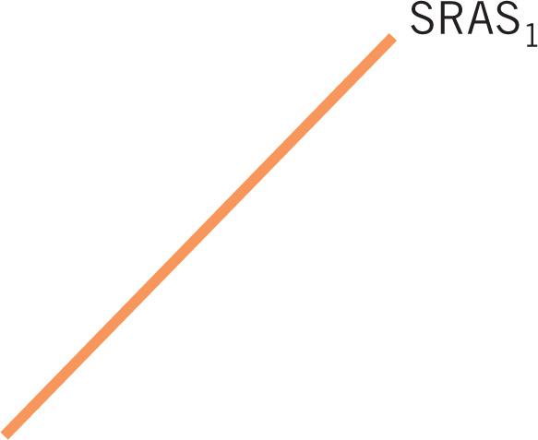
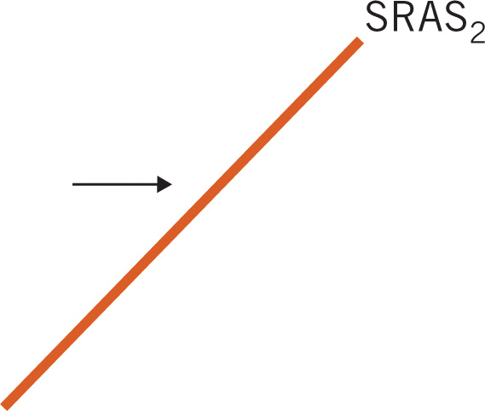
Factors That Shift the SRAS
Notes:
Image: Animated Figure 26.11
Lecture notes:
As you go through this diagram, ask students to provide examples of factors that would cause these shifts.
First click:
An increase in SRAS is a shift to the right.
The quantity of aggregate supply is greater at all price levels.
Second click:
A decrease in SRAS is a shift to the left.
The quantity of aggregate supply is lower at all price levels.

Slide 39
Long-Run Equilibrium in the Economy—1
Long-run equilibrium
  The quantity of aggregate demand is equal to the quantity of aggregate supply.
  The economy is at full employment.
    The unemployment rate is equal to the natural rate.
LRAS = SRAS = AD
Notes:
Lecture notes:
Remind students that an equilibrium occurs when there is no natural tendency for anything to change.
Lecture tip:
It is easiest to discuss this with the diagram in the next slide.

Slide 40
Long-Run Equilibrium in the Economy—2
Notes:
Image: Animated Figure 26.12
Lecture tip:
Start at equilibrium:
Note that the quantity of AD is equal to the quantity of AS.
Point out that the economy’s output is Y*.
Then click.
Start with P_{L}:
Here, the quantity of AD > the quantity of AS.
Prices will get pushed up so the price level rises until it gets to P*.
Go to P_{H}:
Here, the quantity of AS > the quantity of AD.
Goods are sitting around so prices begin to fall.
The price level will fall until it is P*.

Slide 41
Practice What You Know—4
With the AD-AS graph, what variable is on the vertical axis?
  national income
  the price of the good we are studying
  the price of labor
  the price level
Notes:
Clicker question:
Correct answer: D, the price level
The price level is the overall level of prices for goods and services in the economy; remind students that we’re not looking at the price of a single good with this model.

Slide 42
Using the AD and AS Model
To determine how the economy moves from one long-run equilibrium to another:
  Begin with the model in long-run equilibrium.
  Determine which curve(s) are affected by the change(s) and the direction(s) of the change(s).
  Shift the curve(s) in the appropriate direction(s).
  Determine the new short-run and/or long-run equilibrium points.
  Compare the new equilibrium(s) with the starting point.
Notes:
Lecture notes:
Basically, we can say the following for determining this:
Start with your graph in LR equilibrium.
Graph the changes.
Find a new equilibrium.
Examine the graph you just drew.
Reiterate that it’s not about memorizing ups and downs; just draw your graph carefully and correctly, and then analyze it.
We will be working through shifts in each of the curves.

Slide 43
Adjustments to Shifts in Long-Run AS
Suppose we have a technology shock
  Which curves shift?
    Both LRAS and SRAS
  In what direction?
    To the right (increase)
  What happens to the equilibrium price level and real GDP?
    Price level falls
    Real GDP rises
Notes:
Lecture notes:
Work through the five steps with students for each of the following examples:
Begin in L-R equilibrium.
Which curve(s)?
LRAS and SRAS (remind students that SRAS always shifts when LRAS shifts)
A change in technology increases both LRAS and SRAS so they shift to the right.
Draw the new curves on your diagram.
Determine the new short-run and long-run equilibrium points.
Compare the new equilibrium point with the starting point.
The new equilibrium will be a long-run equilibrium at a lower price level and greater level of real GDP.
Output is at the new level of full-employment output.
Unemployment is still at the natural rate.

Slide 44
Increase in Long-Run AS
Notes:
Image: Animated Figure 26.3
Lecture notes:
The diagram starts in long-run equilibrium at a price level of 100 and real GDP of Y*.
Since we’re at full employment, u = u*.
First click:
Both the LRAS and SRAS curves shift to the right.
There a new full-employment output level (Y**).
Second click:
The equilibrium price level falls to 95.
Third click:
The unemployment rate hasn’t changed.
It is still at the natural rate (u*).

Slide 45
Adjustments to Shifts in Short-Run AS—1
Suppose there is a short-run supply shock caused by an oil pipeline break
  Which curves shift?
    Just SRAS
  In what direction?
    To the left (decrease)
  What happens to the equilibrium price level and real GDP in the short run?
    Price level rises
    Real GDP falls
Notes:
Lecture notes:
Work through the five steps with students for each of the examples. Ask students to draw this on their own and then compare their answers with the diagram on the next slide.
Only SRAS shifts because the level of output at full employment doesn’t change.

Slide 46
Adjustments to Shifts in Short-Run AS—2
Is that the end of the story?
  We are not in long-run equilibrium any longer.
  Unemployment rate > u*
Because the supply shock is temporary, eventually the SRAS will shift back to the right again.
  Price level, real GDP, and unemployment all return to original levels.
Notes:
Lecture tip:
It’s good to point out to students that an economy can be away from long-run equilibrium for a period of time.
This is when we see u > u*.
The key point here is that the economy’s productive capacity will eventually return to the prior level. Thus, the shift is only temporary.

Slide 47
An Unexpected Decline in SRAS
Notes:
Image: Animated Figure 26.14
Lecture notes:
The diagram starts in long-run equilibrium.
First click:
The SRAS curve shifts to the left due to the oil shock.
Second click:
The new short-run equilibrium occurs at a price level of 105 and a real GDP of Y₁.
Third click:
At the new short-run equilibrium, u > u*.
Fourth click:
Eventually, the SRAS curve will shift back to its original position.

Slide 48
Adjustments to Shifts in AD—1
Suppose that consumer confidence rises and people start spending more
  Which curves shift?
    AD
  What direction?
    To the right (increase)
  What happens to the equilibrium price level and real GDP in the short run?
    Price level rises
    Real GDP rises
Notes:
Lecture tip:
Work through the five steps with students for each of the examples. Ask students to draw this on their own and then compare their answers with the diagram on Slide 50.
Discuss the changes in short-run equilibrium and point out to students that u < u*.
Follow up this explanation by asking them why they think this is.
For example, people don’t quit jobs they’d like to or work more hours than they’d like.

Slide 49
Adjustments to Shifts in AD—2
Is that the end of the story?
  We are not in long-run equilibrium any longer.
  Unemployment rate < u*
In the long run, all prices adjust.
  As they do, SRAS shifts left.
  We end up back at full-employment output.
  But we have a higher price level.
Notes:
Lecture tip:
Discuss the changes in short-run equilibrium and point out to students that u < u*.
Follow up this explanation by asking them why they think this is.
For example, people don’t quit jobs they’d like or work more hours than they’d like.
Over time, they are going to expect more pay.
Higher input prices lead to lower SRAS.

Slide 50
Unexpected Increase in Aggregate Demand
Notes:
Image: Animated Figure 26.15
Lecture notes:
The diagram starts in long-run equilibrium.
First click:
The AD curve shifts to the right as buyers start purchasing more.
Second click:
The new short-run equilibrium occurs at a price level of 105 and a real GDP of Y₁.
Third click:
At the new short-run equilibrium, u < u*.
Fourth click:
Over time prices (especially resource prices) adjust and SRAS moves back to the left.
The economy returns to full employment with real GDP = Y*.
But now there is a higher price level.
The key point to make for students is:
Demand changes have no real effects in the long run; only the price level is affected.
Real-world example: Cash for Clunkers (Link to Tip #487)
Show students the video from CBS news from July 31, 2009
“Cash for Clunkers in Need of Repair?” on cbs.com
Ask students to read a follow-up blurb from the Freakonomics blog from September 14, 2010.
“The Verdict on Cash for Clunkers: A Clunker” on freakonomics.com
Follow up by asking students why they think the policy did not have the intended effects.

Slide 51
Practice What You Know—5
Suppose there is an increase in AD, causing a price level increase; what will happen in the long run as prices adjust?
  The price level will go back to its previous level.
  The price level will rise even further.
  The price level will fall to a level below its previous level.
  The price level will fall slightly to a level somewhere between its current level and the original level.
Notes:
Clicker question:
Correct answer: B, The price level will rise even further.
Over time, as prices adjust, the SRAS will shift back left such that the equilibrium between AD and SRAS will once again intersect LRAS. This left shift of SRAS will make the price level rise further.

Slide 52
Conclusion
Recessions are unpredictable and can be caused by a variety of factors.
The AD-AS model helps us understand the macroeconomic impacts of real world changes.
We can use the AD-AS model to evaluate past recessions or analyze policy remedies to these events.

