Slide 1
The Great Recession, the Great Depression, and Great Macroeconomic Debates
27
Notes:
Pre-class music: “Take a Walk” by Passion Pit (See Tip #493)
In this song, which is especially relevant following a financial crisis, a businessman who works very hard to succeed eventually loses everything to bad investments and becomes overwhelmed with financial troubles. This song is a great introduction to describing exactly what happened during the Great Recession and how families were affected.

Slide 2
Previously
The AD-AS model is a simplified view of the economy that helps us evaluate short-term fluctuations in real GDP and unemployment
The AD-AS model helps us understand the macroeconomic impacts of real-world changes and gives us an important tool to use in government policy analysis

Slide 3
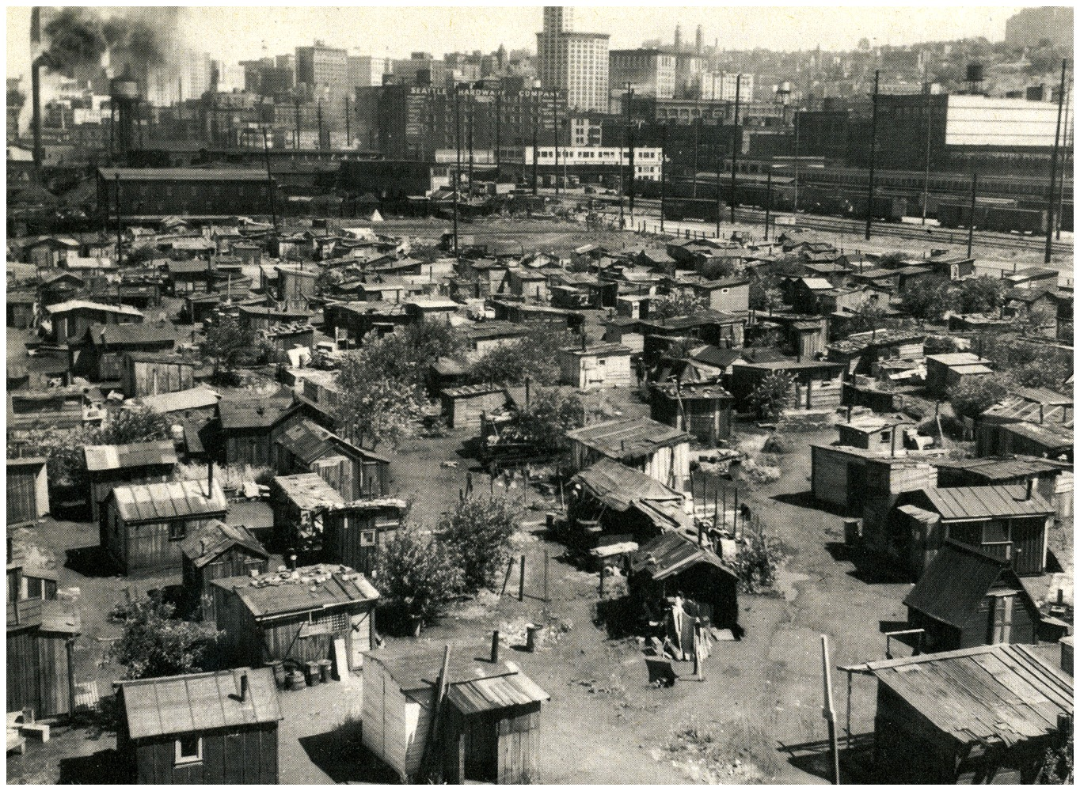
Big Questions
Exactly what happened during the Great Recession and the Great Depression?
What are the big disagreements in macroeconomics?
Notes:
Lecture notes:
The Great Recession and the Great Depression are two of the most significant economic downturns of the past 100 years in the United States.
In this chapter, we will look at various causes and effects of these periods, as well as differing policy viewpoints related to “escaping” from a recession.

Slide 4
The Recession of 2008
Officially from December 2007 to June 2009
  Longest recession since WWII
Named the Great Recession
  Longer in length than other recessions
  Deeper in effects than other recessions
  Significant problems in the financial markets, similar to what happened during the Great Depression
Notes:
Lecture notes:
The Great Recession:
The official duration was 18 months (December 2007 to June 2009), making it the longest of all recessions since World War II
The term Great Recession was coined to describe this period of time
Longer than other recessions
Greater magnitude than other recessions
Characterized by turmoil in financial markets
Recall that a lot of uncertainty about recessions is related to the fact that we often do not know how long they will last.
In addition, there are delays in data collection and we might not know about the recession until two months after it begins.
There are often disagreements about causes and corrective policy measures during a time of recession.

Slide 5
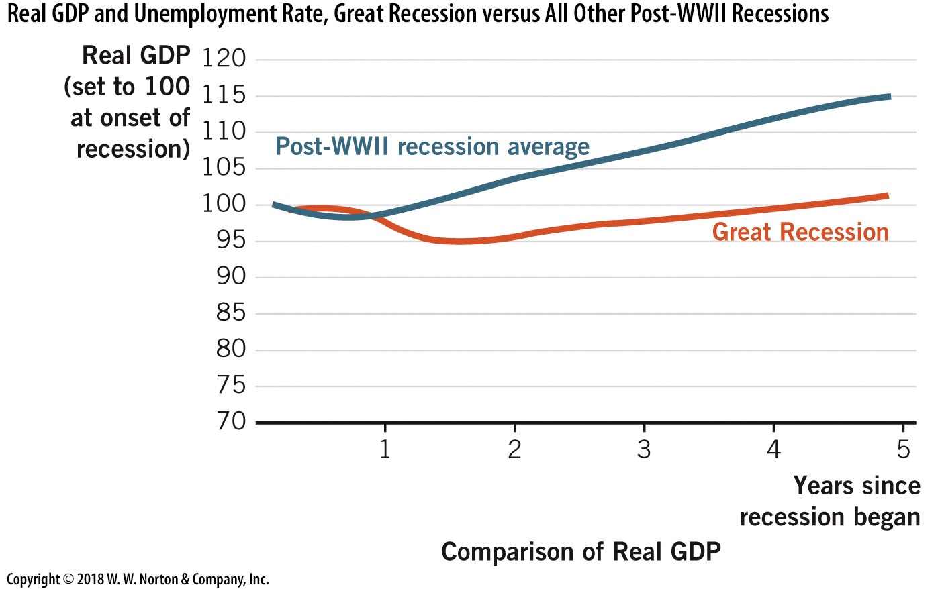
Depth and Duration of the Great Recession—1
Figure 27.1.a here
Notes:
Image: Figure 27.1.a.
Lecture notes:
The figure on the slide shows comparative data on real GDP and the unemployment rate.
This panel compares the pattern of real GDP during the Great Recession and an average pattern of the other recessions since World War II.
To illustrate the two paths of GDP, we set them to 100 at the onset of the contraction.
Notice that during a typical recession, real GDP falls slightly and then comes back to its original level after about a year and a half.
In contrast, during the Great Recession output fell significantly and then recovered more slowly.
In fact, it took nearly four years for real GDP to reach its prerecession level in the third quarter of 2011.

Slide 6
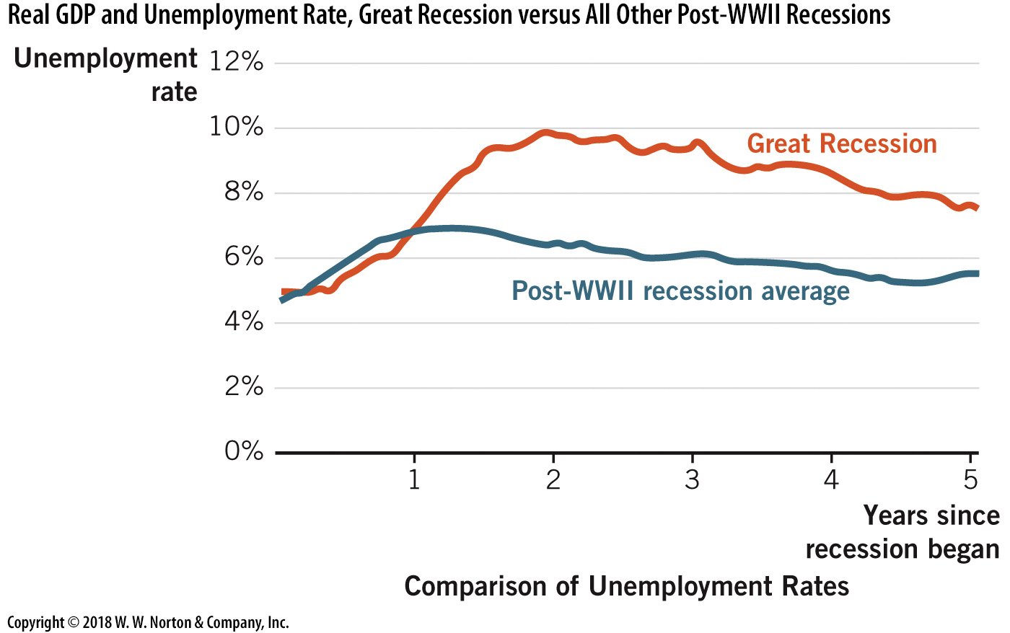
Depth and Duration of the Great Recession—2
Notes:
Image: Figure 27.1.b.
Lecture notes:
This slide shows the monthly unemployment rate for the Great Recession as compared to an average unemployment rate across the other post–World War II recessions.
For a typical recession, the unemployment rate climbed to around 7 percent and then declined after about 12 to 15 months.
But for the Great Recession, the unemployment rate climbed to 10 percent in October 2009 (22 months after the recession began) and remained at or near 8 percent even 60 months after the recession began.
The two panels indicate that the Great Recession was more severe than a typical recession.

Slide 7
Analyzing the Great Recession with AD and AS—1
Trouble in the financial markets in 2007
  Real estate values fell in 2007.
  As a result of securitization, falling real estate values led to a systematic problem in financial markets.
  These markets exhibit international independence, and it became a worldwide problem.
    Breakdown in the loanable funds market
    Institutional breakdown shifts LRAS left
Notes:
Lecture notes:
In considering the causes of the Great Recession, most economists and policymakers initially assumed it was caused by a significant decline in aggregate demand.
And while aggregate demand did indeed fall, it is clear in hindsight that aggregate supply also fell.
Widespread financial market turmoil is indicated as a decline in long-run aggregate supply.
A decrease in loanable funds means less investment and less capital.
This will cause LRAS to shift left.

Slide 8
Economic Crisis in Wall Street: Money Never Sleeps
Economic Crisis and Too Big to Fail
Notes:
“Economics in the Media” Slide
Lecture tip:
The clip mentioned on the slide can be found in the Interactive Instructor’s Guide. Access the direct link by clicking the icon in the PowerPoint above.
This is a good clip to show when initiating a discussion on the economic crisis of 2008 and the current state of the economy.

Slide 9
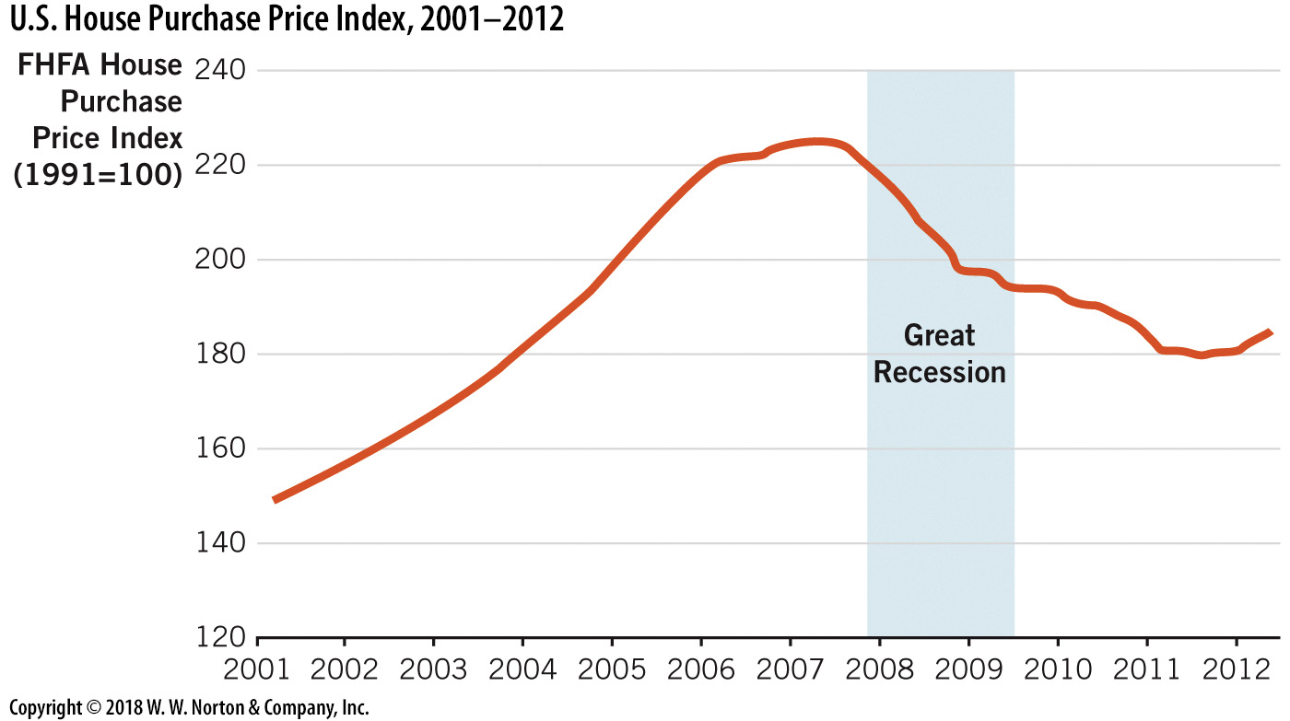
U.S. House Purchase Price Index
Notes:
Image: Figure 27.2
Lecture notes:
Home prices in the United States began falling in mid-2007 and then fell consistently through the Great Recession period.
Note:home prices continued to fall after the recession due to the severity and depth of the recession.

Slide 10
Analyzing the Great Recession with AD and AS—2
While institutional breakdowns affected AS, AD was also affected by:
  Decrease in wealth
    Real estate is often the single largest portion of wealth
    Stocks lost one-third of their value in 2008
  Decrease in expected income
    People realized the economy was faltering
    Consumer spending decreases during times of uncertainty
Notes:
Lecture notes:
Figure 27.2 (on the previous slide) clearly shows the large drop in real estate prices (value).
When stocks fell, for millions of people this meant seeing their retirement savings drop by a full one-third.
Together, these two factors—a decline in wealth and a decline in expected income—led to a decline in aggregate demand.
Thus, there was a decrease in LRAS and a decrease in AD.
Both of these contributed to the recession.

Slide 11
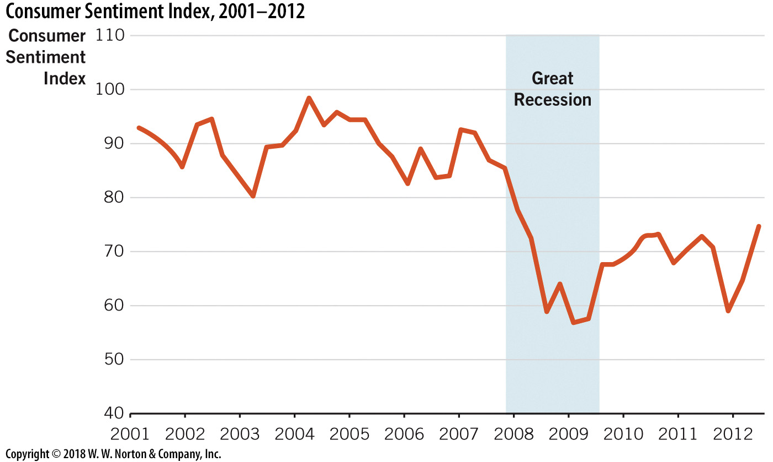
Consumer Sentiment Index
2001–2012
Notes:
Image: Figure 27.3
Lecture notes:
The Consumer Sentiment Index is a measure of consumers’ confidence about their own financial situation and the future direction of the economy.
This index began falling in 2007 and then fell significantly during the Great Recession.

Slide 12
Great Recession, AS and AD Analysis
Notes:
Image: Animated Figure 27.4
Lecture notes:
First click:
LRAS₂₀₀₇
Second click:
AD₂₀₀₇
Point A
Third click:
LRAS₂₀₀₈
Fourth click:
AD₂₀₀₈
Point B
Fifth click:
Arrow from point A to point B, and from Y* to Y**
Financial market turmoil and lower consumer confidence led to decreases in both long-run aggregate supply and aggregate demand.
The result was a new, lower level of real GDP and a higher rate of unemployment.

Slide 13
Great Recession Numbers
Second quarter of 2007 (prerecession):
  Unemployment was below 5%
  Real GDP was growing at 3.6%
Fourth quarter of 2008 (during the recession)
  Unemployment was 10%
  Real GDP declined at an annual rate of 8.9%
In 2012 (recession officially over)
  Real GDP was growing at a rate of less than 2%
  Unemployment remained at 8%
  Government tried to return growth to normal
Notes:
Lecture notes:
One reason this recession has been called “Great” is that the decline in real GDP and the increase in the unemployment rate were large by historical standards.
(Another reason is that the effects persisted for longer than most recessions).
By 2012, the recession had officially ended but the effects still lingered.
The government employed many different tools to try to move the economy back to normal growth and lower levels of unemployment.
We will discuss these tools over the next four chapters.
But, the tools focused primarily on aggregate demand.
In addition, world financial institutions remained in poor health for quite a while, thus impacting aggregate supply—and this outcome kept many economies from returning to normal growth rates.

Slide 14
Practice What You Know—1
What was one of the main catalysts of the Great Recession, which began in December 2007?
  a large tax increase
  falling real estate prices
  bad monetary policy, which increased the money supply too much
  a lack of skilled labor
Notes:
Clicker question:
Correct answer: B, falling real estate prices
Falling real estate prices led to financial collapse since mortgages were securitized and tied to the financial system.

Slide 15
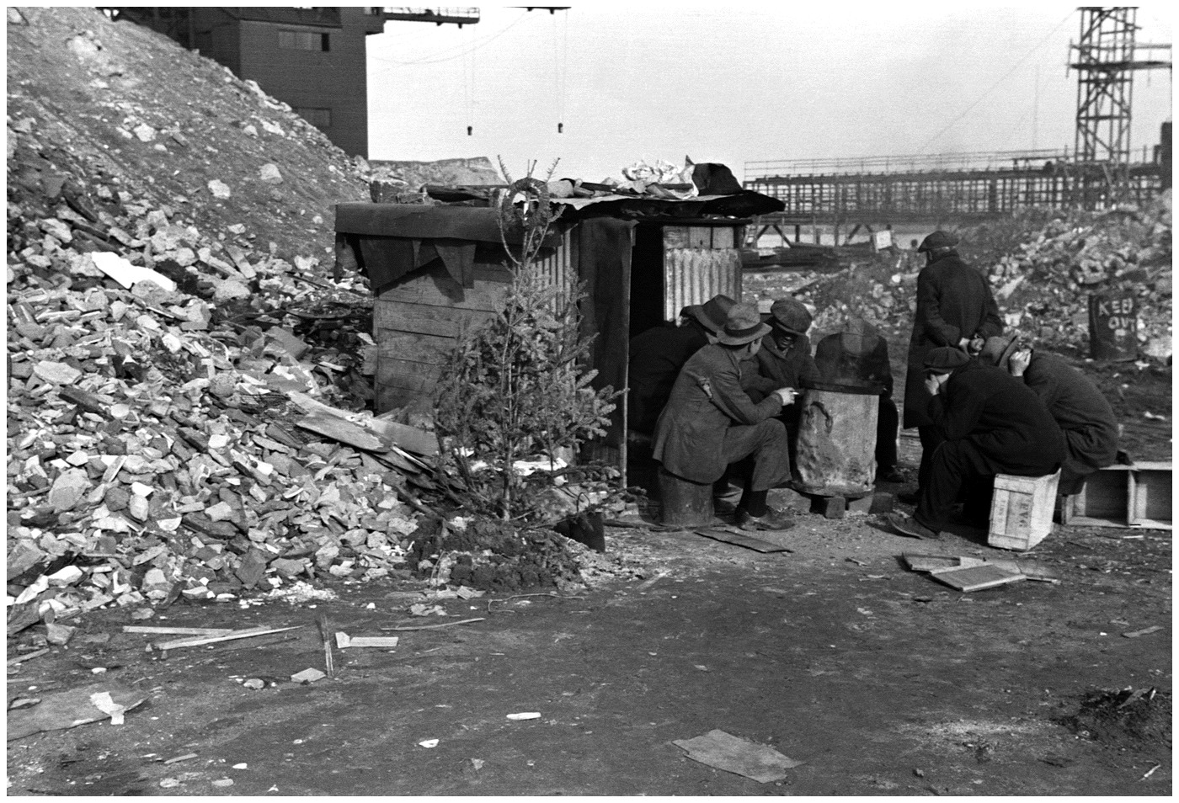
Great Depression
The Great Depression was much worse.
Great Depression statistics:
  Economy contracted by 30% from 1929 to 1933
  It took 7 years for real GDP to return to its prerecession level.
  Unemployment was 2.2% in 1929 and 25% in 1933.
  The unemployment rate was 15% for almost the entire decade of the 1930s.
Notes:
Lecture notes:
While “Great Depression” and “Great Recession” sound similar, the Great Depression was significantly worse.

Slide 16
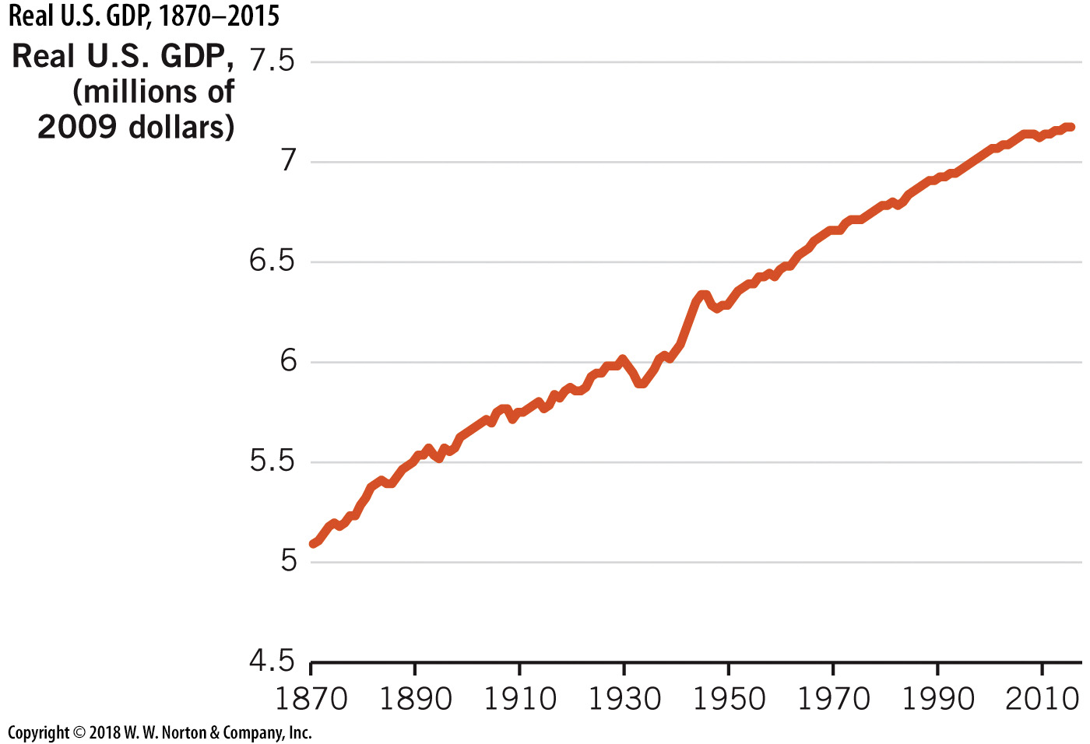
Real U.S. GDP 1870–2015
Notes:
Image: Figure 27.6
Lecture notes:
When we look at real GDP growth in the United States over the long run, the Great Depression is easy to spot, since it is the severe decline that occurred during the 1930s.
To normalize across percentage changes, the plotted data is the log of real GDP.
Recall, a percentage change is the difference in log levels.

Slide 17
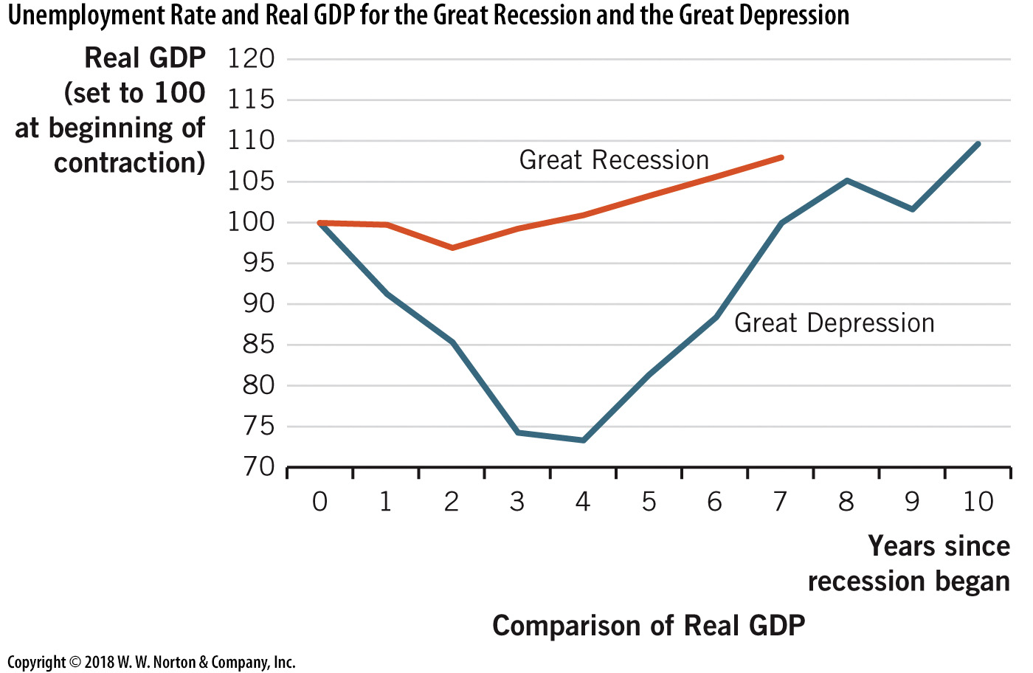
Real GDP Comparison
Notes:
Image: Figure 14.7.a.
Lecture notes:
During the Great Depression, real GDP fell by almost one-third, and it took 7 years to return to its prerecession level.
In comparison, the decline in real GDP during the Great Recession seems meager!

Slide 18
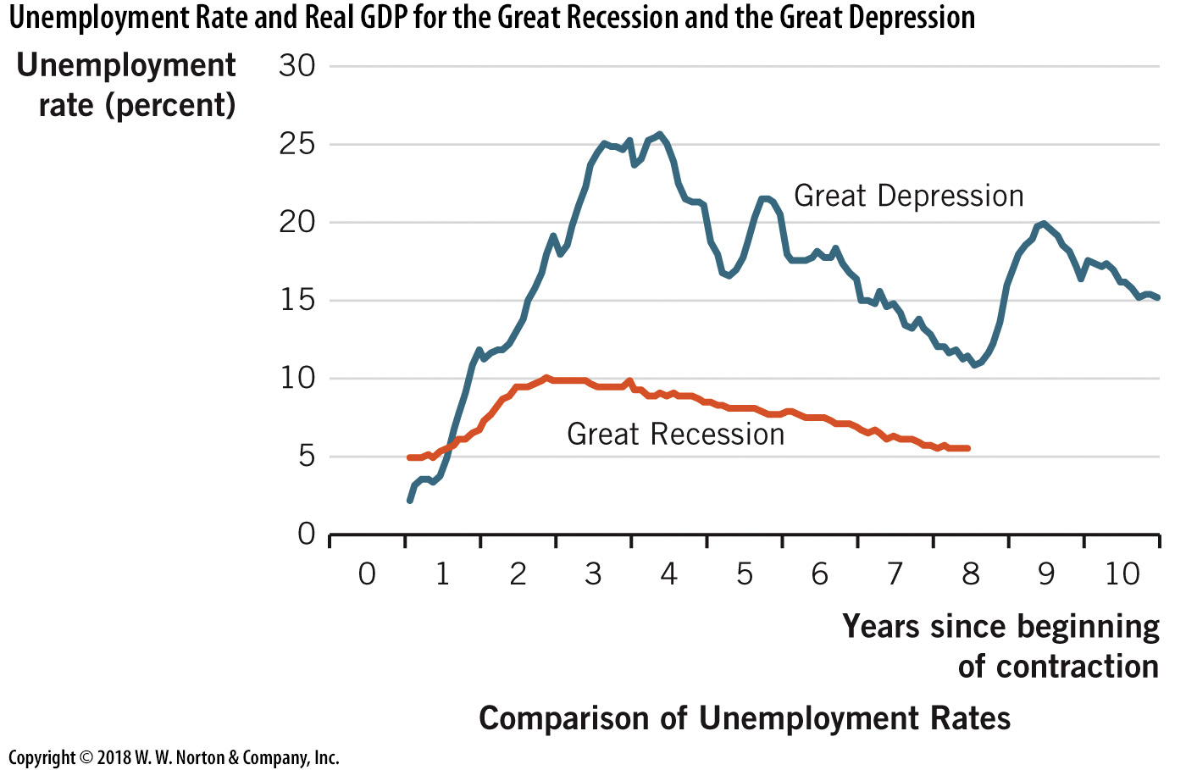
Unemployment Comparison
Notes:
Image: Figure 27.7.b.
Lecture notes:
During the Great Depression, the unemployment rate climbed to over 25 percent and remained over 15 percent for most of the entire decade of the 1930s.
These levels far exceed the unemployment rates experienced during the Great Recession of 2007–2009.

Slide 19
The Great Depression in King Kong
The Great Depression in NYC
Notes:
“Economics in the Media” Slide
Lecture tip:
The clip mentioned on the slide can be found in the Interactive Instructor’s Guide. Access the direct link by clicking the icon in the PowerPoint above.
In this clip, which opens in 1932 New York City, residents of the city are shown downtrodden and struggling to survive. This clip is a powerful visual to use when describing the differences between the Great Depression and Great Recession.

Slide 20
Great Depression,
AS and AD Analysis – 1
The Great Depression was characterized by some unique conditions:
  Effects were deep and long lasting.
  It was actually two separate recessions (1929 to 1933 and 1937 to 1938).
  Most remarkable: prices across the economy fell throughout the decade.
    At the end of the 1930s, the price level was still 20% lower than 1929.
    Indicates that the primary cause of the Great Depression was a decrease in AD.

Slide 21
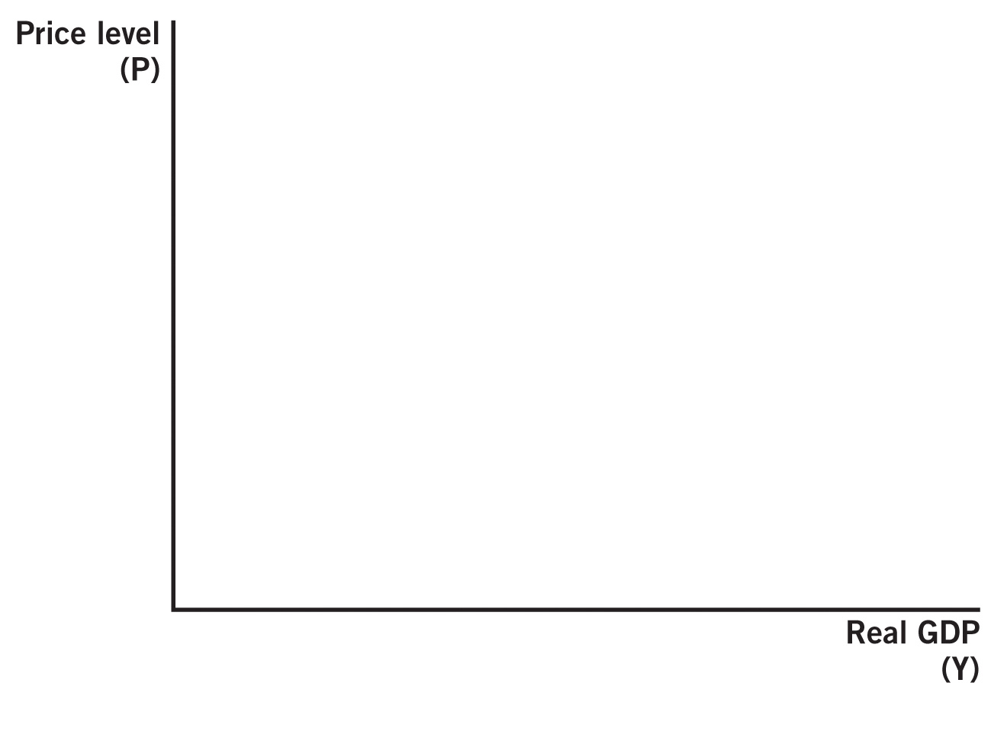

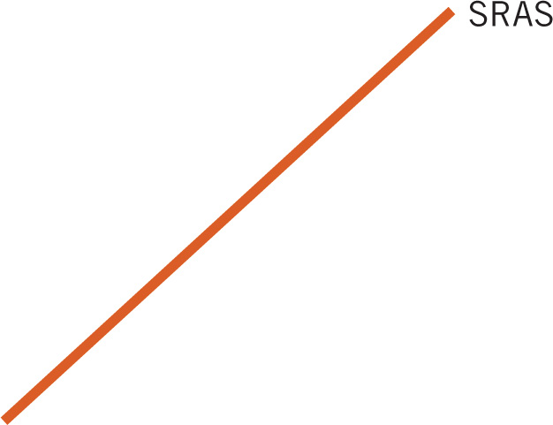
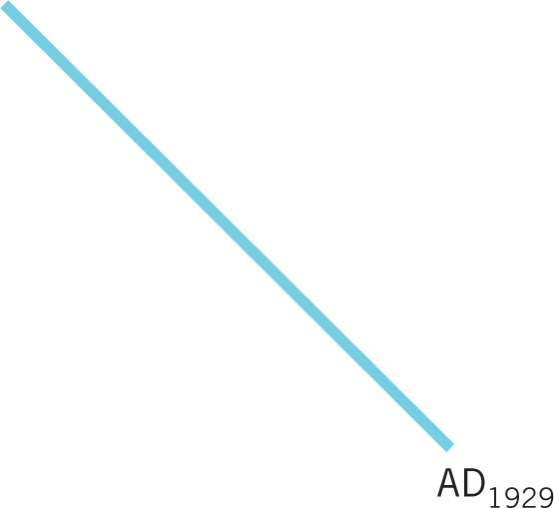
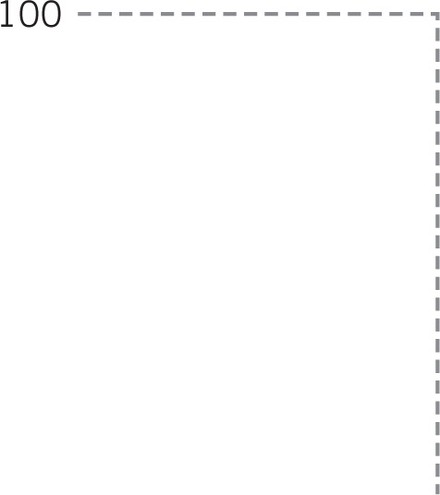
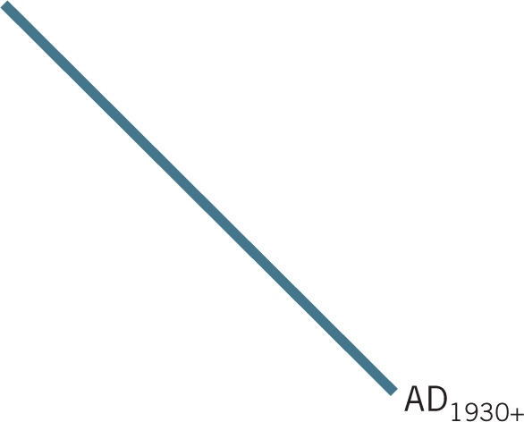
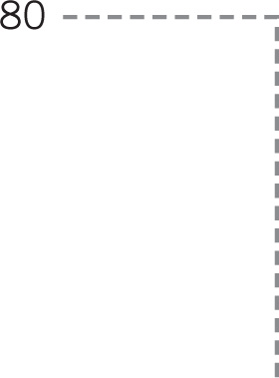
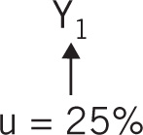


Great Depression, AS and AD Analysis—2
Notes:
Image: Animated Figure 27.8
Lecture notes:
First click:
LRAS
Second click:
In 1929, the economy was in equilibrium at point A, with aggregate demand designated as AD₁₉₂₉.
Third click:
Then, a significant decline in aggregate demand occurred for several years, as indicated by a shift to AD₁₉₃₀₊.
Fourth click:
As we have seen in our study of macroeconomics, lower aggregate demand leads to lower real GDP (shown in the figure as Y₁), higher unemployment rates (25 percent), and a lower price level (shown here as a decline from 100 to 80).
These match the symptoms of the Great Depression.
Fifth click:
Note: In a typical AD-AS model, point B would be considered a short-run equilibrium and designated by a lowercase letter. Here, it is presented as a capital letter, indicating long-run equilibrium.

Slide 22
Practice What You Know—2
What is true about the magnitude of the Great Depression?
  Output fell by 4% during the Depression.
  A large increase in the money supply almost caused hyperinflation.
  Prices rose higher than any time in the previous century.
  Unemployment reached a level of 25%.
Notes:
Clicker question:
Correct answer: D, Unemployment reached a level of 25 percent.
Prices actually fell during the depression.
Unemployment was the worst it has ever been in this country.
Output actually fell by 30 percent.

Slide 23
Causes of the Depression—1
Macroeconomic policy
  Government acts to influence the direction of the overall economy
  Much of the Depression was caused by faulty macroeconomic policy.
Fiscal policy:
  Use of government spending and taxes
Monetary policy:
  Adjusting the money supply
Notes:
Lecture notes:
Economists distinguish two different types of macroeconomic policy: fiscal policy and monetary policy.
Fiscal policy: changes in government spending and taxes to influence the macroeconomy.
Monetary policy: involves adjusting the money supply to manipulate the interest rate and affect inflation, output, and other macroeconomic variables.
The details of macroeconomic policies will be discussed in the subsequent chapters.
However, we will use the basics of fiscal and monetary policy to understand the Great Depression in the context of AS and AD.

Slide 24
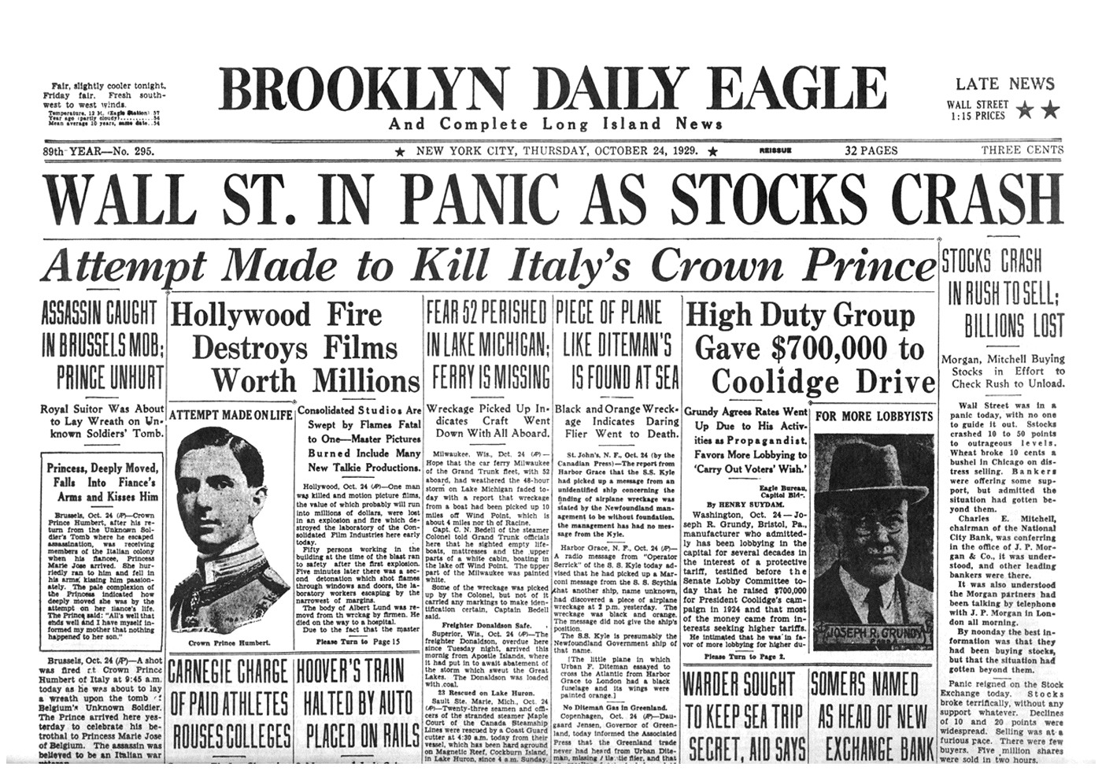
Causes of the Depression—2
Stock market crash (Oct. 29, 1929—Black Thursday)
  Lower expected future income
  AD decreased
  1929–1932: stock prices fell
  by almost 90%
Government policy response
  Policymakers believed stock prices were too high
  1928 and 1929: government reduced the money supply
  Lower money supply caused panic
Notes:
Lecture notes:
The stock market crash in 1929 has become infamous, commonly known as Black Thursday.
There were a string of reactions beyond the decline in the stock market that led to the Great Depression.
Specifically, there was a significant change in people’s expectations for the future.
Expectations can in some cases lead to changes in real macroeconomic variables.
The government policy response and stock market crash led to a decline in expected future income.
Recall, expected future income is a determinant of aggregate demand.
Therefore, aggregate demand also declined.
Government policy response:
Policymakers wanted to control stock prices.
In response to rising stock prices, the government lowered the money supply.
As we will learn in future chapters, reducing the money supply increases the interest rate, causes consumption and investment to decline, which leads to a decrease in aggregate demand.
So, policymakers reduced the money supply in hopes of reducing stock prices.

Slide 25
Causes of the Depression—3
This policy error caused bank problems all over the country as financial panic spread.
  1930–1933: 9,000 banks failed
  Government chose not to lend to these banks.
  Thus, the money supply decreased even further.
  1929–1933: money supply decreased by one-third
Most economists today think that
  the money supply decline and
  the resulting decrease in AD
  were the primary contributors to the beginning of the Great Depression
Notes:
Lecture notes:
The reduction in the money supply and resulting aggregate demand contraction led to financial panic.
The panic among individuals and banks beginning to fail drove savers to withdraw their money from banks, further reducing the money supply.
What does it mean for a bank to fail?
It means that the bank cannot meet all the requests of consumers who want to withdraw cash.
Panicked people lead to “bank runs,” in which large groups of people would literally go to the bank hoping to cash out all of their deposits, due to fear of a money shortage.
If the bank does not have enough reserves to give everyone cash all at the same time, the bank will fail.
Recall, banks do not have to keep 100 percent of deposits in their vaults.
Banks only have the money in vaults to return to depositors upon request; the rest is loaned out to make a profit.
These bank failures and bank runs were a catalyst in the creation of the FDIC.
The FDIC insures a certain amount of deposits will be repaid by the government if banks do not have enough liquidity to satisfy demand.
This helps reduce panic during fragile economic times.

Slide 26
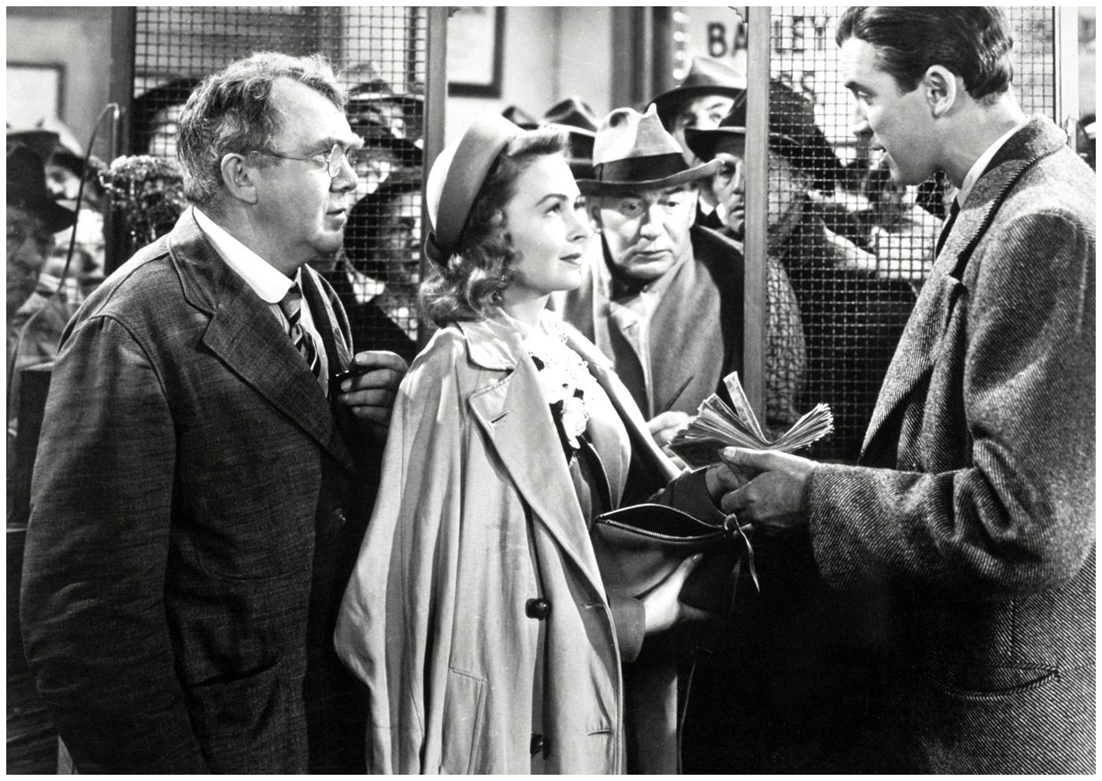
Economics in It’s A Wonderful Life
It’s a Wonderful Life (1946)
  This is the bank run scene.
  During the Depression, bank runs caused the failure of many banks.
Notes:
“Economics in the Media” Slide
Lecture tip:
The clip mentioned on the slide can be found in the Interactive Instructor’s Guide. Access the direct link by clicking the photo in the PowerPoint above.

Slide 27
Great Depression: Other Factors
Taxes
  Early 1930s: Hoover and Roosevelt raised taxes in attempts to balance the budget
  Further reduced AD
Smoot-Hawley Tariff Act
  Imposed tariffs on thousands of imported goods
  Initiated a trade war
    Other countries taxed U.S. exports
    Decreased global demand for U.S. products
Notes:
Lecture notes:
An increase in taxes reduces disposable income (income minus taxes).
Disposable income is a determinant of consumption spending.
Therefore, an increase in taxes reduces consumption and, consequently, aggregate demand.
Tariffs on imported goods began a trade war.
In response, other countries started to tax U.S. exports, which decreased demand for U.S. products.
A decline in exports will reduce net exports (exports minus imports) and decrease aggregate demand further.
Most analysts agree that the economic contraction was primarily characterized by a significant decline in aggregate demand.
In this context, the Great Depression was an event that reshaped the way both economists and noneconomists think about the economy.

Slide 28
Major Macroeconomic Debates—1
Classical economists:
  Adjustment toward long-run equilibrium will happen naturally
  Prices are flexible
  Let the economy go and the market will correct itself
Keynesian economists:
  Adjustment will be long and occur unpredictably with many delays
  Prices are sticky
  Call for government interventions in the market
Notes:
Lecture notes:
Classical economists:
Macroeconomic principles extended from microeconomic analysis.
If prices for individual goods are flexible, then prices across the entire economy are also flexible.
The economy will automatically come back to full employment in the long run.
Lecture tip:
Caution: These classifications (“Classical” and “Keynesian”) are given for simplicity.
Not all economists will fit comfortably in either camp, but these distinctions will help you understand the source of debate.

Slide 29
Classical Economics
Economy is self-correcting.
  Generally believe in the AD–AS framework shown
  Economy comes back to full employment in the long run, no matter what curves shifted
  Adjustments generally occur quickly
Policies
  Pro-market, laissez-faire
  No significant role for government intervention in macroeconomic policy
  Focus on long-run growth (shifting LRAS) rather than AD shifts
Notes:
Lecture notes:
Because prices are flexible, the economy is essentially self-correcting.
This means that no matter what factors change in the economy, no matter what curves shift, the economy automatically comes back to full employment in the long run.
Laissez-faire generally implies a “hands off” approach to the economy.
For example: no intervention, no need for policymakers to focus on short-run fixes when the economy is over- or under-performing.

Slide 30
The Strict Classical View
Notes:
Image: Animated Figure 27.9
Lecture notes:
First click:
LRAS
Second click:
AD₁
Dashed line appears from 100 P, creating point A.
Third click:
AD₂
Dashed line appears from 110 P, creating point B.
Fourth click:
AD₃
Dashed line appears from 90 P, creating point C.
Only the long run matters.
In the classical view, all focus is on affecting this natural rate of output by shifting long-run aggregate supply.
Therefore, savings is a very important positive factor in the economy.
Savings is translated into investment and this increases capital and shifts long-run aggregate supply out.
In the classical view, prices adjust quickly in both directions.
Therefore, shifts in aggregate demand do not lead to changes in output or employment because the output level stays at full employment.
When prices are completely flexible, aggregate demand becomes less relevant, and changes in long-run aggregate supply are primarily considered the source of economic prosperity.

Slide 31
Practice What You Know—3
Classical economists will generally focus on policies that will
  cause short-run AD changes.
  emphasize increasing the LRAS.
  cause people to spend less money.
  prevent GDP from increasing too fast.
Notes:
Clicker question:
Correct answer: B, emphasize increasing the LRAS.
Classical economists would agree on policies that change the institutions (government, technology, resources) that affect long-run growth and the LRAS.

Slide 32
The Great Depression and Economic Theory
The conditions of the Great Depression were bad by almost any measure
  Decade-long recession
  From 1929 to 1933, real GDP fell 30%
  25% unemployment in 1933
  15% unemployment over the 1930s decade
and challenged the view of Classical economics.
Notes:
Lecture notes:
Real GDP fell from $977 billion (in 2005 dollars) in 1929 to $716 billion in 1933.
Imagine an economic contraction so severe that after four years, the economy is producing almost 30 percent less.
The Great Depression fundamentally changed people’s views of the economy and the role of government.
It seemed clear that the economy could not correct itself.
And thus, Keynesian economics was created.

Slide 33
Keynesian Economics—1
John Maynard Keynes, British economist
  The General Theory of Employment, Interest, and Money (1936)
  Theory of persistent cyclical unemployment
  Wages adjust downward slowly due to contracts and salary expectations
  High wages prevent labor markets reaching equilibrium and restoring full employment, creating a prolonged recession
Notes:
Lecture notes:
Keynes believed that wages are “sticky downward,” meaning that wages, by their nature, are very reluctant to ever decrease, even during terrible economic conditions.
There are several causes of sticky downward wages:
Wage agreements by unions (especially in 1930s)
Money illusion: people do not want to take a pay cut, especially in a recession
People are generally not willing to accept any pay cuts.
Ask your students to consider if they would ever want to receive less pay, especially during a recession.
Contracts and salary expectations
Keynes:
Believed that an economy out of long-run equilibrium is not unusual.
Believed that short-run economic circumstances could be improved through government intervention.
Argued that the government should try to shift the aggregate demand curve back to its initial level.
Thought it foolish to wait for long-run adjustments because “In the long run, we are all dead.”
Keynesian economists assume that prices are sticky downward, so they focus on the demand side of the economy as the source of instability.

Slide 34
Keynesian Economics—2
Focus on the demand side of the economy as the source of instability.
Government intervention is needed in prolonged recessions to boost demand and restore the economy to long-run equilibrium.
Keynes:
  “In the long run, we are all dead.”
Notes:
Lecture notes:
The major focus of Keynesian economics is the demand side of the economy, as this is the source of instability.
Keynes believed that short-run economic circumstances could be improved through government intervention (often in the form of a stimulus).
Government can boost AD by increasing government purchases (G), since consumers are reluctant to increase consumption (C) or investment (I).
He thought that waiting for the economy to return to full employment on its own subjected households to an avoidable period of misery.
Keynesian view on savings is reflected in the quote: “In the long run, we are all dead.”
Savings is not helpful in the short run since it reduces AD.
Recall, consumers face a tradeoff between saving and consuming.
When people save more, they consume less, which reduces AD (in the short run).
The short run is a crucial time frame.
The Keynesian view of the economy offered an explanation for the Great Depression.
After the nation emerged from the Great Depression, Keynesian theory became entrenched in economics.

Slide 35
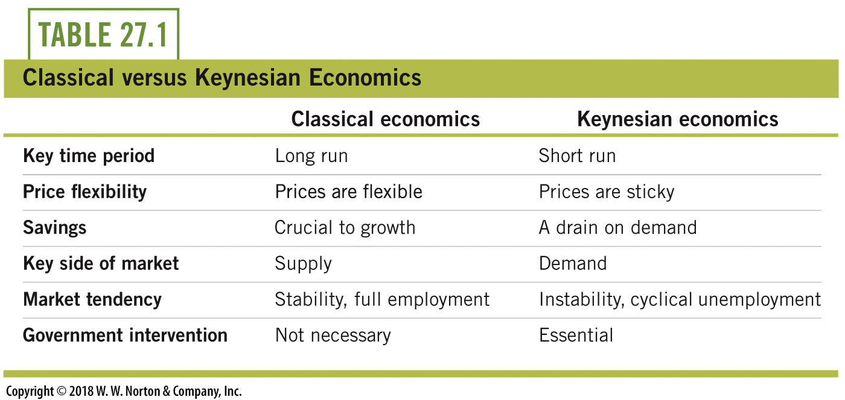
Major Macroeconomic Debates—2
Notes:
Lecture notes:
Today, the profession is mixed on this, as economists debate the continued importance of sticky prices and also debate the merits of government policy based on the Keynesian model.

Slide 36
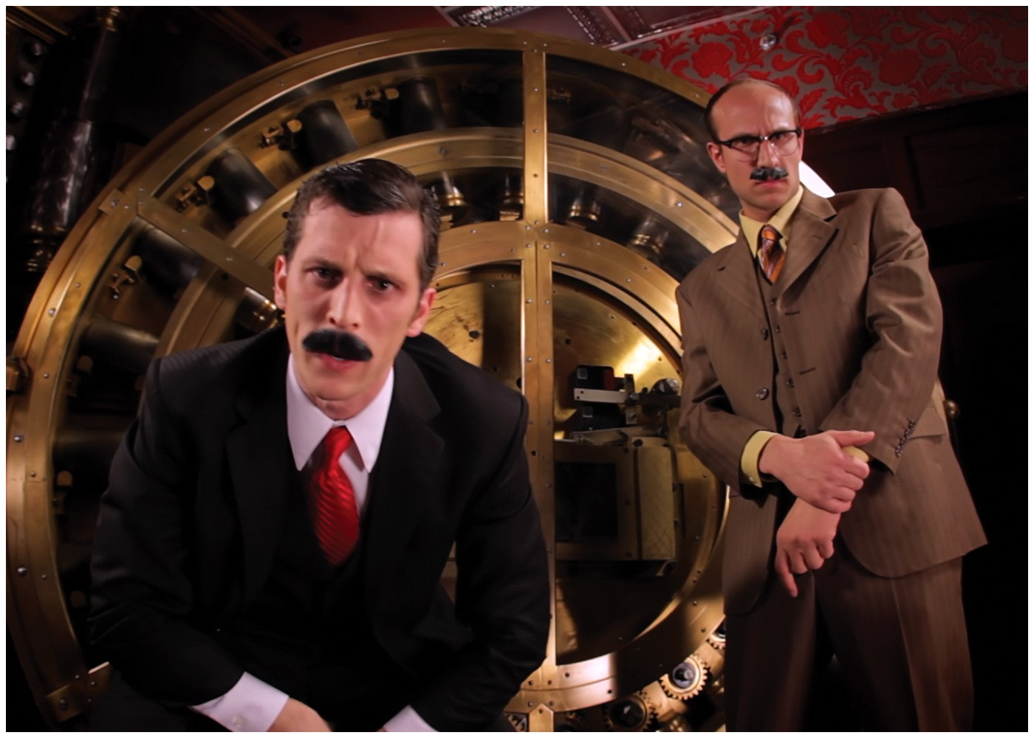
Keynes vs. Hayek
Keynes vs. Hayek
  Keynes: government intervention needed
  Hayek: leave the market alone
Notes:
“Economics in the Media” Slide
Lecture tip:
The clip mentioned on the slide can be found in the Interactive Instructor’s Guide. Access the direct link by clicking the photo in the PowerPoint above.

Slide 37
Practice What You Know—4
The Great Depression led to the creation of what school of thought in economics?
  Classical
  Keynesian
  Ricardian
  Smithian
Notes:
Clicker question
Correct answer: B, Keynesian
John Maynard Keynes is often paraphrased as saying “In the long run, we’re all dead.”
He believed that the government must intervene and steer the economy, and try to boost AD in times of recession.

Slide 38
Practice What You Know—5
What is the main reason Keynes believed that the economy won’t return to equilibrium after a decrease in AD?
  the ineffectiveness of government intervention
  people wanted to remain in the depression because of lower prices
  sticky wages
  imperfect information
Notes:
Clicker question
Correct answer: C, sticky wages
If wages are sticky, there’s no underlying tendency for the economy to return to full employment equilibrium.
Wages are a price—Keynes believed they were “sticky,” meaning they often were resistant to changes and adjustments.

Slide 39
Conclusion
In the recent Great Recession, we experienced lower output and high unemployment
However, the Great Depression in the 1930s was much worse and lasted much longer
Classical economists:
  market is self-correcting
  focus on long-run growth (expanding LRAS)
Keynesian economists:
  market corrections can take a long time due to sticky wages
  focus on policy aimed at AD
Notes:
Lecture notes:
While short-term fluctuations (recessions and expansions) can be painful, the United States spends much less time in recession than in times past.
Economist generally agree that the economy can be self-correcting in the long run, but disagree about the relative importance of the short run and long run.

