Slide 1
Fiscal Policy
29
Notes:
Pre-class music: “War” by Edwin Starr (See Tip #558)
This antiwar protest song from the Vietnam era (“War, huh, yeah. What is it good for? Absolutely nothing.”) is a good introduction to the key concepts of expansionary fiscal policy, government spending, and aggregate demand. The role of war is, however, not as simple as the song implies—an increase in military spending is actually expansionary fiscal policy, which increases aggregate demand.
You can also direct students to read Paul Krugman’s New York Times blog post, where he theorizes that World War II helped the United States emerge from the Great Depression: Paul Krugman, “Economics Is Not a Morality Play,” The Conscience of a Liberal, New York Times, September 28, 2010, NYtimes.com.
You may want to point out that spending on war is not usually defined as fiscal policy, because fiscal policy is defined as policy intended to affect the economy. Yes, military spending will have the same effect on the economy as expansionary fiscal policy, but this is still an important distinction to make.

Slide 2
Previously
Government outlays = government spending + transfer payments
  Government revenues = taxes
The U.S. income tax system is progressive.
Debt is the cumulative sum of all annual deficits.
Largest potion of outlays:
  Social Security
  Medicare
Increased recently due to demographic changes

Slide 3
Big Questions
What is fiscal policy?
What are the shortcomings of fiscal policy?
What is supply-side fiscal policy?

Slide 4
How Does Fiscal Policy Work?
Monetary policy
  Use of the money supply to influence the economy
Fiscal policy
  Use of government spending and taxes to influence the economy
    Must be legislated and approved by Congress and the president
    Can be used with (or instead of) monetary policy

Slide 5
Fiscal Policy
Expansionary fiscal policy
  Government increases spending or decreases taxes to stimulate or expand economy
Contractionary fiscal policy
  Government decreases spending or increases taxes to attempt to slow economy
    Pay off government debt
    Keep economy from expanding beyond long-run capabilities
Notes:
Lecture notes:
Traditional demand-focused fiscal policy is what politicians look toward to counteract the business cycle.
When the economy is slowing, the prescription is for expansionary fiscal policy: increasing government spending or decreasing taxes.
Increasing government spending will increase AD (since G is one component of AD), which increases GDP.
Decreasing taxes will raise disposable income and consumption, which will also increase AD and GDP.
Contractionary fiscal policy is used when the government wants to pay off debt, or slow down an “overheated” economy.
Rapid growth is often unsustainable and fueled by debt, so sometimes the economy needs to be slowed.
The goal is to increase aggregate demand to move the economy to full-employment equilibrium, where real GDP is at its full-employment level, and the unemployment rate is equal to the natural rate.

Slide 6
Expansionary Fiscal Policy
Notes:
Image: Animated Figure 29.1
Lecture notes:
First and second clicks:
The economy begins at the long-run equilibrium point (A) where the price level is 100, Y=Y* (full employment), and u=u* (the natural rate of unemployment).
Third click:
Suppose there is a decrease in AD from AD1 to AD2.
The economy is now at a short-run equilibrium point (b), where Y’<Y* and u’>u*.
Fourth click:
In the long run, prices will adjust and the economy will return to a full-employment equilibrium, point (C).
Prices adjust to being lower than expected (95 instead of 100), firms are able to produce more at lower costs, and SRAS increases to SRAS2.
However, this adjustment process may take time, and recessions cause significant hardship.
Therefore, policymakers may choose to use expansionary fiscal policy to shift AD back to its initial level (shift from AD2 back to AD1).
Government officials could do this by increasing government spending or decreasing taxes.
A successful policy would return the economy to long-run equilibrium point (A).
The goal of countercyclical fiscal policy is to shift aggregate demand back to AD₀ so that the economy is back at full employment without waiting for long-run adjustments.
Lecture tip:
Remember that CAPITAL letters are long-run equilibria; lowercase letters are short-run equilibria.

Slide 7
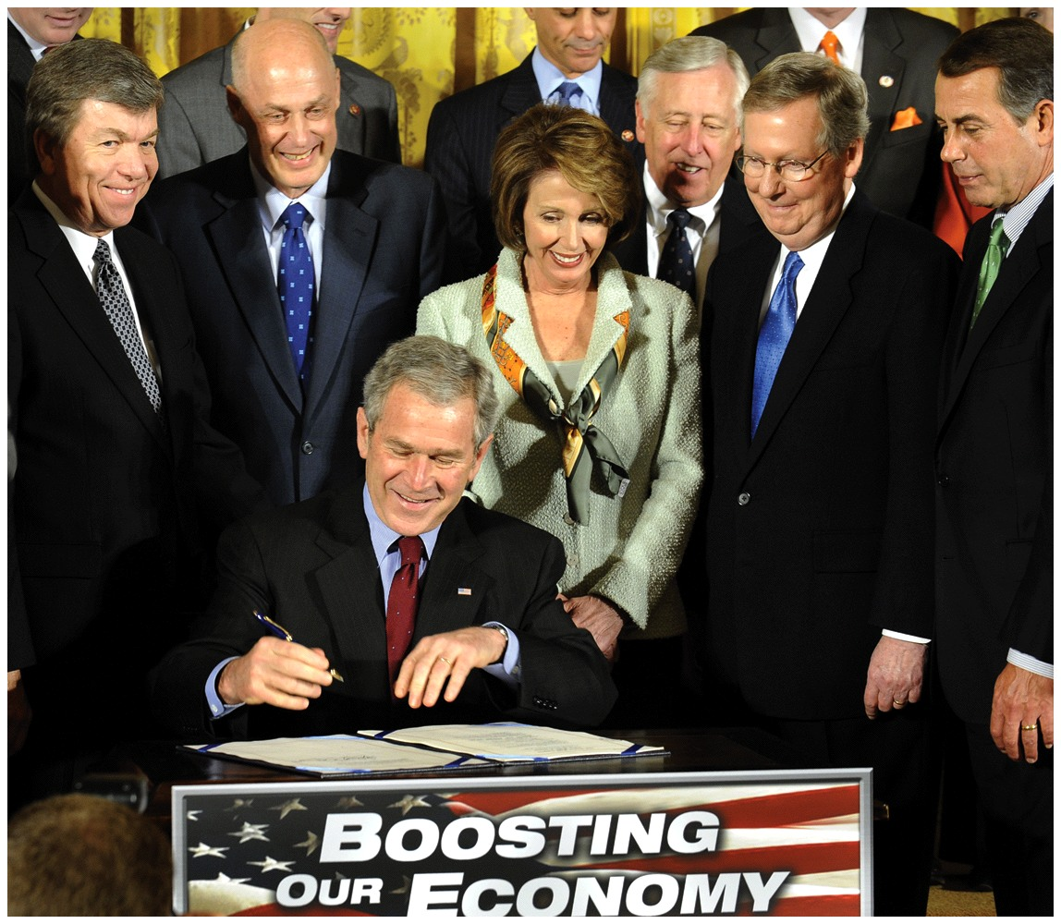
Great Recession Fiscal Policy—1
Economic Stimulus Act 2008
  Tax rebate for Americans
  Totaled $168 billion
  Typical family of four received $1,800
  Goal: increase consumption, stimulate the economy
Notes:
Lecture notes:
In response to the poor economic conditions during the Great Recession, the government enacted two significant fiscal policy initiatives:
The Economic Stimulus Act was signed by President George W. Bush in February 2008.
The primary purpose of this act was to provide a tax rebate for Americans on their 2007 taxes.
The government physically mailed partial tax refund checks to citizens in the amount of about $1,800 for a four-person family ($600 per adult and $300 per child).
This initiative cost the government approximately $168 billion (about 1 of ever 7 dollars paid in 2007 individual income taxes).
Theory would suggest that most of the $168 billion returned to taxpayers would be spent—as opposed to saved—increasing AD and stimulating the economy.
However, after the first fiscal stimulus was passed, economic conditions worsened!

Slide 8
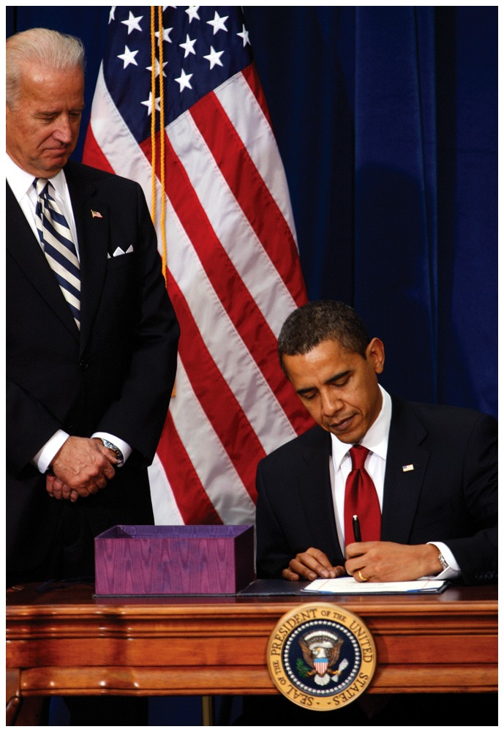
Great Recession Fiscal Policy—2
American Recovery and Reinvestment Act 2009
  Focused on government spending
  $787 billion stimulus
  Goal: increase aggregate demand
Notes:
Lecture notes:
Barack Obama was elected in the 2008 presidential election, shifting party power in Washington.
In February 2009, Obama signed the American Recovery and Reinvestment Act.
This bill was still aimed at expansionary fiscal policy, but with a focus on government spending as opposed to taxes.
In addition, the size of the ARRA was much larger than the Economic Stimulus Act.
Seventy percent of the ARRA cost was attributed to government spending, and the remaining thirty percent went to tax credits.
While seemingly different, both stimulus packages had the goal of increasing aggregate demand.

Slide 9
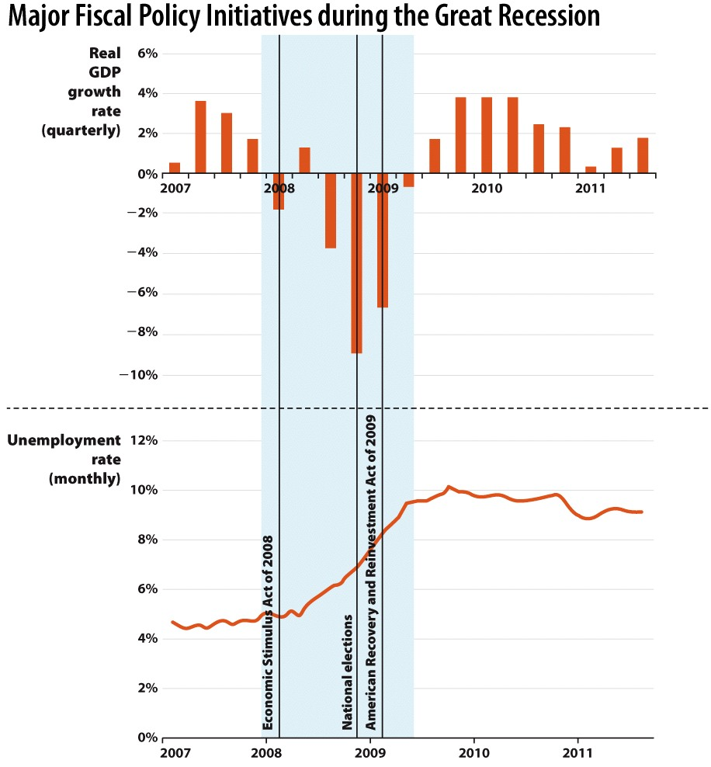
Great Recession Fiscal Policy—3
Notes:
Image: Figure 29.2
Lecture notes:
These two historical fiscal policy initiatives illustrate the tools of fiscal policy: taxes and spending.
The first, enacted in February 2008, focused on taxes (refund of previously paid taxes).
The second, passed one year later, focused on government spending.
The two acts may seem very different, but they are theoretically very similar—both focus on aggregate demand.

Slide 10
Practice What You Know—1
Which of the following is an example of expansionary fiscal policy?
  increase in taxes
  stimulus package
  increasing the money supply
  lowering interest rates
Notes:
Clicker question:
Correct answer: B, stimulus package
Fiscal policy is changing taxes or spending.
A stimulus package will increase spending, expanding the economy; [c] and [d] are both monetary policies.

Slide 11
Deficits and Debt—1
How is an increase in G or a decrease in T financed?
  Borrowing!
Example:
  Government increases [G] by $500 billion to increase AD.
  During a recession, incomes fall and unemployment rises.
  Tax revenues decrease.
  Deficit and debt rise by more than $500 billion.
Notes:
Lecture notes:
When the economy is in a recession, usually the government will try to stimulate the economy by increasing government spending, decreasing taxes, or both.
Recall that during a recession, there is also a natural decrease in tax revenues as incomes fall.
But where does the government get the money to increase G or fund tax rebates?
Usually, the government will sell Treasury bills to fill gaps in the budget.
This is the government’s form of borrowing, as these bonds must be paid back later.
Expansionary fiscal policy leads to increases in deficit and debt during recessions.

Slide 12
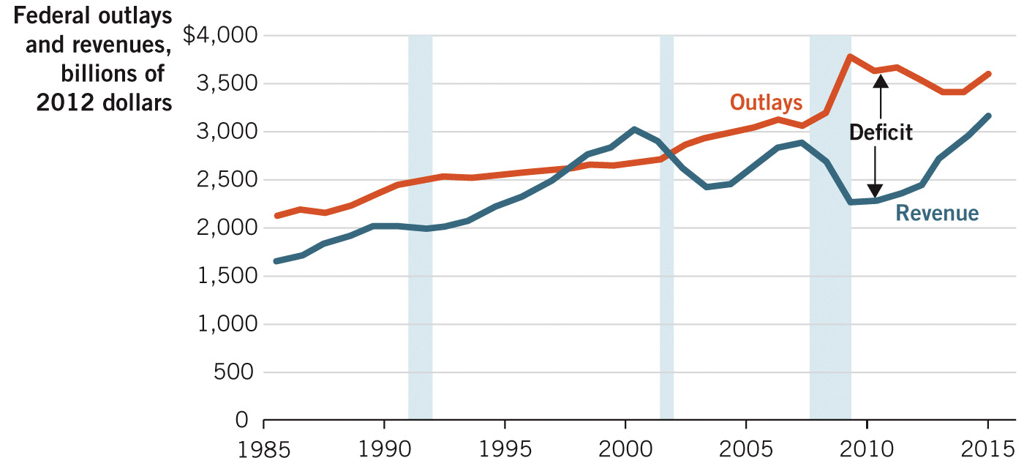
Outlays and Revenue
1985–2015
Notes:
Image: Figure 29.3
Lecture notes:
Using expansionary fiscal policy to counteract economic downturns leads to greater deficits as outlays increase during recessionary periods.
The budget surplus was erased in 2001 as a result of these policies.
In 1990 and 2008 the deficit expanded for the same reasons.
In addition, since revenues are tied closely to payrolls (income), revenue also falls during recessions.
Together, these imply that deficits unequivocally increase during recessions.
Lecture tip:
The vertical blue bars on the graph represent recessions.

Slide 13
Debts and Deficits—2
Expansionary fiscal policy leads to increases in deficit and debt during recessions.
Individual level
  Why would people spend more during a recession?
  Counterintuitive
Macroeconomic level
  One person spending increases income for another
  Recall multipliers: money gets spent multiple times
Notes:
Lecture notes:
Another reason that spending works (according to the Keynesian model) is that fiscal policy theory posits that increased spending helps return the economy to full employment.
The increase in employment will increase revenues.
Keynes says that the quicker we can get back to full employment (with more tax revenues paid in compared to unemployment), the better.
Typically, on an individual level, we would not expect individuals to spend when unemployment is high.
However, on a macroeconomic level, spending by one person generates income for another, which increases spending for that person.
This results in a multiplier effect as that process continues.

Slide 14
Contractionary Fiscal Policy—1
Decrease AD by decreasing G or increasing taxes in order to:
  Pay off debt that was accrued due to expansionary fiscal policy during bad times
  Slow down economy that is “overheated” from too much spending, leading to inflation
    Not sustainable in the long run
    Try to reduce the upward pressure on price level
    Still interested in “smoothing” out cycles
Notes:
Lecture notes:
Debt incurred during deficits can be paid off when the economy turns around and begins expanding.
That’s the countercyclical fiscal policy prescription: budget deficits during contractions and budget surpluses during expansions.
In theory, debt is paid off during good economic times so that it does not become a significant problem in the future.
For example, the U.S. government ran budget surpluses from 1998 to 2001, at the end of an extended economic expansion.
However, the national debt did decrease during this time but was not eliminated completely.
The highest level of sustainable output in the long run is full-employment output (Y*)
It is possible for output to be above Y* if the unemployment drops below its natural rate (u*).
This level of output is not sustainable in the long run.
In addition, at such high levels of aggregate demand, inflation becomes a concern.

Slide 15
Contractionary Fiscal Policy—2
Notes:
Image: Animated Figure 29.4
Lecture tip:
Click through the slide to reveal each part of the graph.
Lecture notes:
Suppose that the economy is a short-run equilibrium (a).
At point (a), real GDP is greater than full-employment output (Y’ > Y*)
Recall that Y* is the output level that the economy can sustain in the long run, so real GDP can only exceed Y* in the short run.
The unemployment rate is below the natural rate (u < u*); again, this is not sustainable for the long run.
In addition, there is upward pressure on the price level (P₁₀₅ > P₁₀₀).
The government has two possible ways to conduct contractionary fiscal policy: decrease government spending or increase taxes (which leads to decreased consumption spending).
Either policy would decrease aggregate demand to AD2, and the economy would reach long-run equilibrium (B).
If the government fails to act, prices will adjust naturally to being higher than anticipated at point (a) (P₁₀₅ > P₁₀₀).
This will cause firms to decrease production and shift SRAS to the left, reaching long-run equilibrium (C).
Long-run equilibrium point (C) is undesirable, as it is inflationary.
The inflationary outcome can be avoided with policy.

Slide 16
Practice What You Know—2
Which of the following is an example of contractionary fiscal policy?
  decreasing the money supply
  increasing the interest rate
  increasing government spending
  increasing taxes
Notes:
Clicker question:
Correct answer: D, increasing taxes
Once again, [a] and [b] are monetary policies

Slide 17
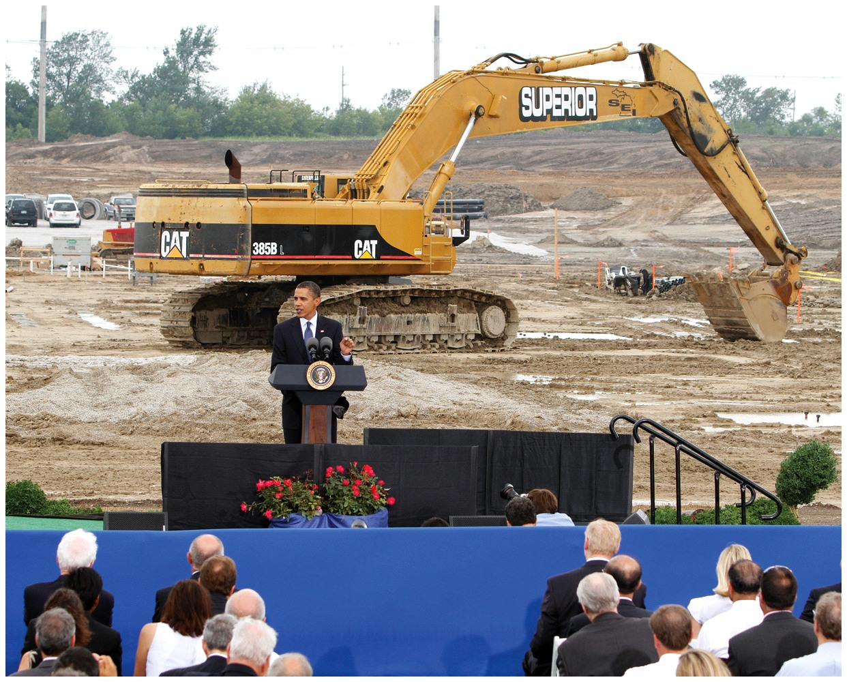
Countercyclical Fiscal Policy
  The use of fiscal policy to “smooth out” cycles
  Expansionary policy during recessions
  Contractionary policy during expansions
Keynesian theory:
  Lower real GDP and higher
  unemployment are caused by lack of
  spending (demand) in the economy
  Provided framework for New Deal
  (Great Depression) and 2008, 2009
  stimulus packages
Notes:
Lecture notes:
Countercyclical policy:
Smooths out cycles
Goal is to decrease “size” of expansions and recessions
The government uses countercyclical policy to try and shift AD back to a long-run equilibrium faster than without government intervention.
An economy that grows at a predictable rate is more favorable than one with a high variance.
Countercyclical policy reduces the size/magnitude of these fluctuations.
The economic theory behind the fiscal policy in both 2008 and 2009 stems from the work of Keynes, who published his book The General Theory of Employment, Interest, and Money in 1936.
Famous quote by John Maynard Keynes: “In the long run, we’re all dead.”
Regarding the image on the slide: AD can be increased by increasing [G], which is often done by expanding public works projects.

Slide 18
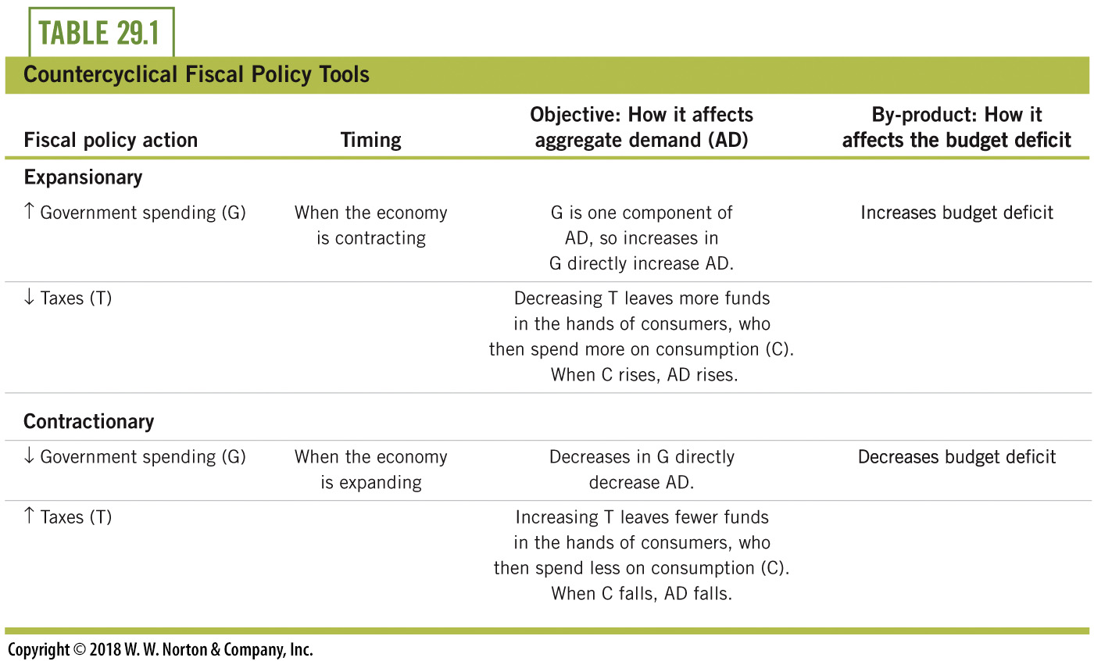
Countercyclical Policy Tools
Notes:
Lecture notes:
The theoretical view is that countercyclical fiscal policy can be used to “smooth out” the business cycle.
All else being equal, people generally prefer smoothness and predictability in life.
Economies that grow at a consistent rate are preferred to economies that grow in an erratic fashion.
In addition, when downturns cause unemployment, people lose their jobs and the negative effects of this are often carried for a long time.
For these reasons, many economists favor activist fiscal policy.

Slide 19
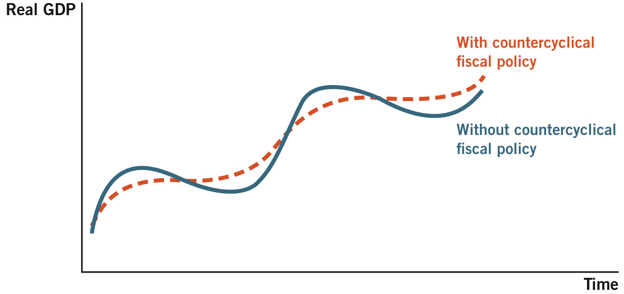
Countercyclical Fiscal Policy and the Business Cycle
Notes:
Image: Figure 29.5
Lecture notes:
The goal of countercyclical fiscal policy is to smooth out the fluctuations in the business cycle.
The blue line represents that natural path of the economy without any policy.

Slide 20
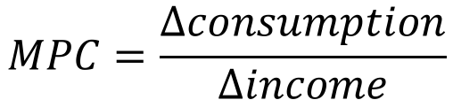
Multipliers—1
Two multiplier concepts:
  Spending by one person becomes income to others
  Increases in income lead to increases in consumption
Marginal propensity to consume (MPC)
  Portion of additional income that is spent on consumption
$$MPC=\frac{∆consumption}{∆income}$$
Notes:
Lecture notes:
Due to multipliers, the initial effects can theoretically snowball into further effects from the policy.
This implies that the tools of fiscal policy are even more powerful than we’ve indicated so far.
Spending by one person becomes income for another; this is true for private and government spending.
In addition, increases in income typically lead to increases in consumption.
An increase in disposable income can either be saved or spent.
The marginal propensity to consume (MPC) is the amount of additional income that is consumed.
Today’s post-Keynesian economists have come to the conclusion that over the long run, MPC is approximately 0.9.
Lecture tips: Remember that when you see the word “marginal,” you’ll see the Greek letter delta (triangle) in the math.
Delta represents a change.

Slide 21
Multipliers—2
Notes about MPC
  MPC is not constant across all people
  0 ≤ MPC ≤ 1
MPC multiplier illustration
  Suppose MPC = 0.75.
  If government increases [G] by $100 billion…
  Workers get $100 billion in income, spend $75 billion
  Other people get $75 billion in income
    They spend $56.25 billion
    …etc.
Notes:
Lecture notes:
This multiplying effect is significant when we focus on aggregate demand in the economy.
Each time someone gets new income, they go out and spend part of it.
After all the dust settles, the total impact is a multiple of the original spending created by the fiscal policy.
The initial $100 billion in government spending increases total income by more than $100 billion.

Slide 22
MPC of the Rich and Poor
Lower-income people and countries have a higher MPC than their wealthier counterparts.
  Higher income usually means your basic needs have been met.
  Additional income is more likely to be saved for the future.
Relationship to multiplier
  If a “stimulus package” is introduced in the form of tax breaks with the goal to boost AD, it will be more effective if it increases the income of people with a higher MPC.
Notes:
“Beyond the Book” Slide
Lecture notes:
Basically, if you are giving people money with the hope that they will spend the money, give the money to people who are more likely to spend the money!!

Slide 23
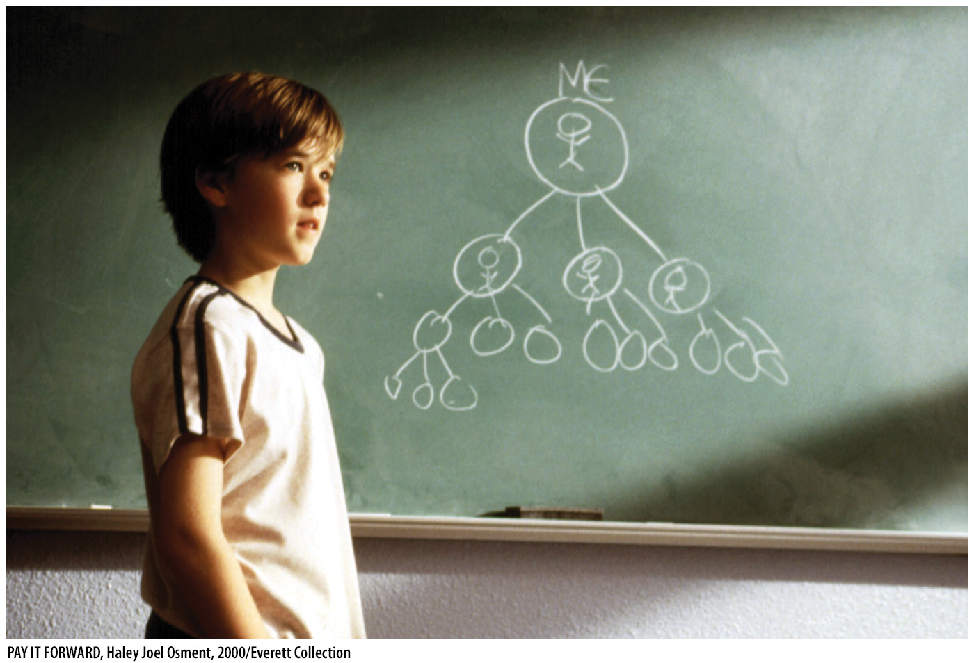
Multiplier in Pay It Forward
Multiplier in Pay it Forward
  This video illustrates the advantages of spending money where it will stay in the community
Notes:
“Economics in the Media” Slide
Lecture tip:
The clip mentioned on the slide can be found in the Interactive Instructor’s Guide. Access the direct link by clicking the icon in the PowerPoint above.

Slide 24
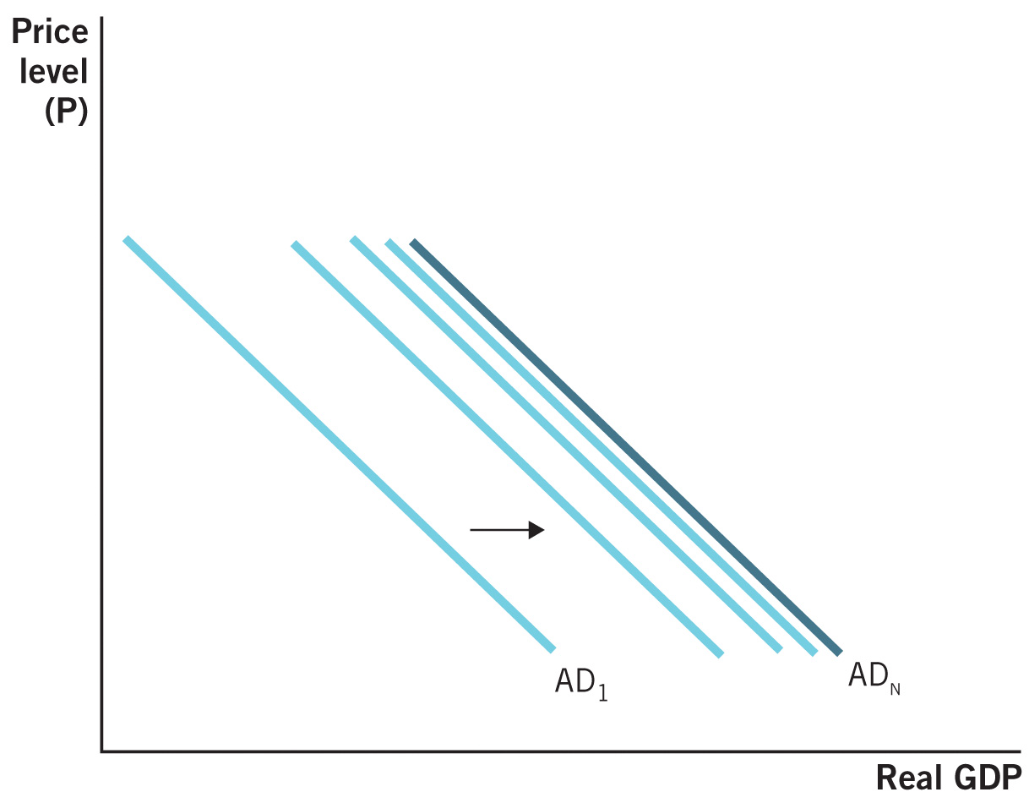
Spending Multiplier Process
Notes:
Image: Figure 29.6
Lecture notes:
The example on this slide assumes that MPC = 0.75, and the increase in G is $100 billion.
You can see how the spending multiplies through the economy, with each round 75 percent of the prior round.
The aggregate demand curve shifts as the spending multiplies through the economy.
In the end, the total increase is four times the initial change in government spending, since the spending multiplier implied by MPC = 0.75 is 4.

Slide 25
Spending Multiplier
Total impact on spending from an initial amount
Previous example, where MPC = 0.75:
Notes:
Lecture notes:
The multiplier depends on the MPC.
Since 0<MPC<1, the larger the MPC, the larger the multiplier.
Multiplier also can be related to taxes.
With less taxes, consumers have more money to spend and more money will enter into the multiplier math.
The multiplier also works in reverse.
Increases in taxes and decreases in [G] can lead to subsequent declines that echo through the economy.
From the previous example:
If the MPC is 0.75, it means that the overall effect of the single fiscal policy stimulus will be four times the size of the original amount.

Slide 26
Shovel-Ready Projects in Shark Tank
“Shovel-Ready” Projects
  Why does the investors’ money have a larger effect on the economy when given to one of these entrepreneurs?
Notes:
“Economics in the Media” Slide
Lecture tip:
The clip mentioned on the slide can be found in the Interactive Instructor’s Guide. Access the direct link by clicking the icon in the PowerPoint above.

Slide 27
Practice What You Know—3
Suppose the MPC is 0.9. What will the total GDP impact be of a $400 billion increase in government spending [G]?
  $360 billion
  $760 billion
  $1 trillion
  $4 trillion
Notes:
Clicker question:
Correct answer: D, $4 trillion
We need to find that the spending multiplier is equal to 1 / (1 – MPC).
Here, the multiplier is 10. We take 10 * $400 billion to get $4 trillion.
It means that everyone spends 90 percent of the dollars they receive.
Iteratively (in billions): 400 + 360 + 324 + 291.6 + 262.44 + …

Slide 28
Issues with Fiscal Policy
Why doesn’t government policy always work?
  Time lags
  Crowding out
  Savings adjustments
Notes:
Lecture notes:
When smoothing out business cycles or trying to recover from a recession, fiscal policy does not always work perfectly.

Slide 29
Time Lags
Recognition lag
  GDP data is released quarterly and revised later
  Unemployment rate data lags even further
  Growth is not constant
Implementation lag
  Fiscal policy must pass as legislation
Impact lag
  Takes time to materialize
  Multiplier effects occur over time
Time lags can be destabilizing!
Notes:
Lecture notes:
Lags:
“Lagging” means that for one reason or another, the impact of the policy can’t instantly fix the economy.
Fiscal policy lags are generally longer than monetary policy lags, often because changes in fiscal policy require legislative approval.
Recognition: Sometimes we don’t even know we had a recession until we’re out of it.
The final revisions of GDP data are not released until three months afterward.
One bad quarter or one good quarter might not mean anything.
Changes in taxes and spending must pass through both houses of Congress and the president.
Often causes a greater delay than monetary policy.
Effects of lags:
Risk of destabilization!
Expansionary policy may hit when the economy is already expanding.
Contractionary policy may hit when economy is shrinking.
This could exacerbate cycles rather than smoothing them out.
Lags can be dangerous.
It may cause the policies to hit at the wrong times, causing damage rather than helping.
Implementation:
The Stimulus Act of 2008 entailed tax rebate checks to U.S. taxpayers.
The act passed in early February, yet most checks were not sent until about six months later.
This delay occurred even though the recipients were known ahead of time.

Slide 30
Fiscal Policy Lags
Automatic stabilizers
  Government programs that naturally implement countercyclical fiscal policy in response to economic conditions
Examples
  Progressive income tax rates: tax bills fall when incomes fall (during recession) and rise when incomes rise (in expansion)
  Corporate profit taxes: lower total tax bills when profits are lower, raise tax bills when profits are higher
  Unemployment compensation: increases government spending automatically when the number of unemployed rises
  Welfare programs: increase government spending during downturns and decrease government spending when the economy is doing better
Notes:
Lecture notes:
Automatic stabilizers:
Useful because they are effective countercyclical policy measures that naturally occur.
They are, for the most part, immune to recognition and implementation lags and political bias.
They remove some concerns about destabilizing policies.

Slide 31
Practice What You Know—4
Which of the following is an example of an automatic stabilizer?
  Federal Reserve interest rates
  discretionary outlays
  progressive income taxes
  education subsidies
Notes:
Clicker question:
Correct answer: C, progressive income taxes
When people make more income, they are “automatically” taxed more, which slows down growth.

Slide 32
Crowding Out—1
Crowding out
  Private spending falls in response to government spending
  Individuals may just let federal spending substitute for their own spending
  If the government buys a good for you, you won’t have to buy it yourself
Implication
  Overall spending may not increase
  Government now has higher deficit and debt
Notes:
Lecture notes:
Crowding out:
“Crowding out” means government spending is sometimes just a substitute for private spending.
This reduces the ability of government spending to stimulate aggregate demand.
For example, if the government increases [G] by paying for everyone’s college tuition, you will no longer pay for the tuition that you would have paid for anyway.
You must just save your money instead.

Slide 33
Crowding Out: Example
[G] increases by $100 billion
  This money is borrowed, so someone had to save it.
Demand increase for loans (due to government borrowing) increases interest rate
  This discourages private spending.
  This encourages private saving.
Where is the crowding out?
  Decrease in private spending [C] as a result of the increase in government spending [G]
Notes:
Lecture notes:
The fact that more people may save (due to the higher interest rate) may decrease the effectiveness of the increase in [G] spending. [G] spent more, but you’re spending less!
The net effect could be zero, but the government now has deficits due to borrowed money.
Basic supply and demand tells us that demand increases lead to price increases.
Remember that in terms of loanable funds, the interest rate is the price of borrowing/saving money.

Slide 34
Crowding Out—2
Notes:
Image: Animated Figure 29.7
Lecture notes:
First click:
Suppose the economy begins at equilibrium point (A) with demand for loans designated as D₀.
The initial interest rate is 5 percent, and at that rate there is $250 billion worth of savings.
This savings funds $250 billion worth of private borrowing (the government starts with a balanced budget).
Second click:
Now, assume [G] increases by $100 billion, and this money is borrowed.
The government enters the loanable funds market and demand increases for loans which increases the interest rate up to 6 percent.
The new equilibrium quantity of loanable funds increases to $300 billion (the new equilibrium is at point (B).
This discourages private spending which encourages private saving.
Crowding out occurs as a result of the increase in private spending [C] due to the increase in government spending [G].
Third click:
Table appears

Slide 35

Savings Shifts
Fiscal policy can also be rendered less effective by individuals’ savings behavior.
When there is an ↑ in G or ↓ T
  Recognize that the government has borrowed funds
  Individuals save to pay for higher future taxes, which reduces consumption
  Mitigates the initial purpose of the ↑ in G or ↓ T.
Notes:
Lecture notes:
When individuals are making decisions about whether to save or spend an increase in income, part of that decision is based on whether or not they will have to pay back that money in the future (i.e., the increase in income was a loan).
People perceive an increase in government spending as coming from borrowed funds, meaning that they will need to be paid back in the future through higher taxes.
Therefore, individuals will save more today to pay for tomorrow’s taxes.
This can slow economic growth that the increase in [G] was designed to speed up.

Slide 36
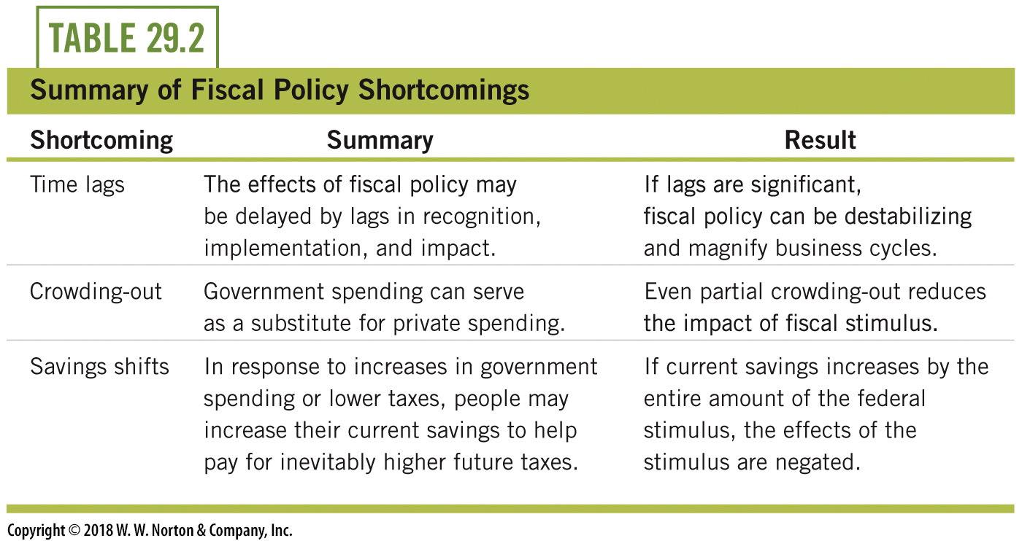
Fiscal Policy Shortcomings
Notes:
Lecture tip:
Rather than “shortcomings,” you can say that this is a summary of why fiscal policy may not work quickly and perfectly.

Slide 37
Supply-Side Fiscal Policy—1
An ↑ in G or ↓ T focus on increasing AD
Supply-side fiscal policy:
  Same tools (government spending and taxes)
  Target the LRAS curve
  Factors that shift LRAS: changes in resources, technology, and institutions
  Policies often take time, so supply proposals are emphasized as long-run solutions for growth
Notes:
Lecture notes:
Fiscal policy discussed thus far (↑ in G or ↓ T) has focused on increasing aggregate demand.
Another kind of fiscal policy targets the supply side.
Supply-side fiscal policy is the use of government spending and taxes to affect the supply side of the economy.
Specifically, supply-side fiscal policy tries to increase long-run aggregate supply (LRAS).
Recall the factors that increase LRAS: changes in resources, technology, and institutions.
Technological advancement allows production of a greater quantity of output using the same (or fewer) resources.
In the long run, much economic growth derives from technological advances.
The government can use the tax code to encourage technological advancement.
For example, since 1981 in the United States, businesses have received tax credits for expenses related to research and development (R&D).
As such, firms that spend on the research and development of new technology pay lower taxes than firms that don’t.
This is a significant incentive that encourages innovation and, ultimately, greater supply of output.

Slide 38
Supply-Side Fiscal Policy—2
Notes:
Image: Animated Figure 29.8
Lecture notes:
First click:
LRAS₁ and AD
Second click:
Supply-side fiscal policy uses government spending and taxes to shift long-run aggregate supply (from LRAS to LRAS₂).
Our previous discussion of changes in taxes and government spending was demand-side fiscal policy, which focused on shifting the AD curve.

Slide 39

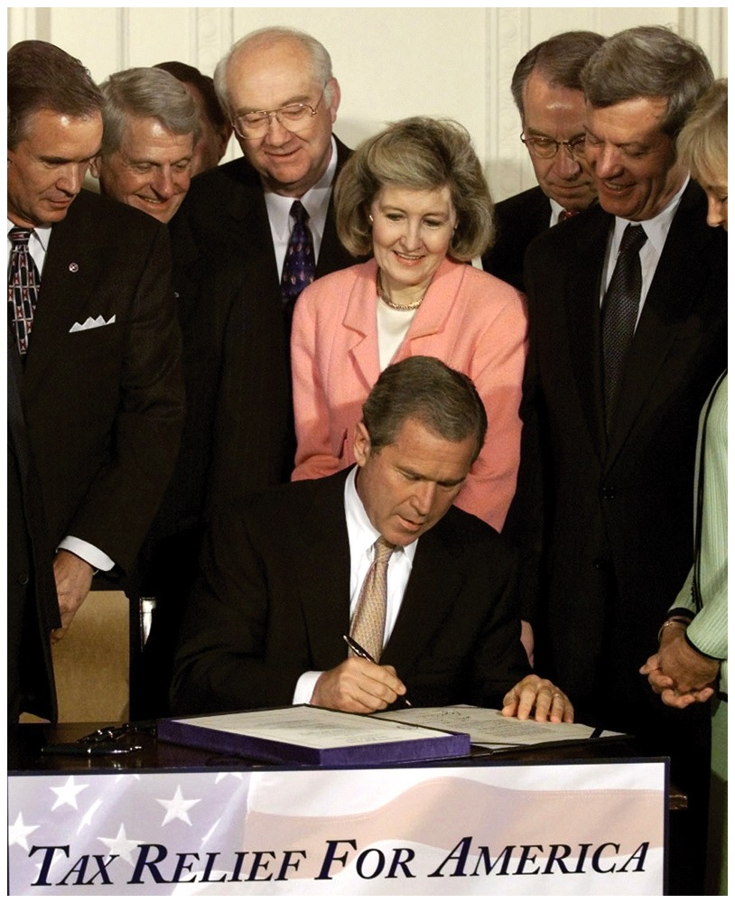
Supply-Side Fiscal Policy—3
Supply-side fiscal policy initiatives
  R&D tax credits
  → increases technology
  Education policies: subsidies or tax breaks
  → increases effective labor resources
  Lower corporate profit tax rates
  → increases efficiency
  Lower marginal income tax rates
  → increases labor productivity
Notes:
Lecture notes:
R&D tax credits give firms an incentive to spend resources on technological advancement.
Policies that focus on education such as subsidies or tax breaks for education (like Pell Grants) create incentives to invest in education, increasing effective labor resources.
Lower corporate profit tax rates provide increased incentives for corporations to undertake activities that add more profit
Lower marginal income tax rates create incentives for individuals to work harder and produce more, since they get to keep a larger share of their income.
The items in the list above share two characteristics:
Supply-side fiscal policy initiatives generally focus on incentives for production. The idea is, the government frames many of the incentives within which people work and produce. Thus, changes in these incentives also change production.
Each of the proposals above takes time to impact aggregate supply. For example, education subsidies may encourage people to go to college and learn skills that help them in the workplace. But the full impact of these won’t be felt until at least four years in the future.

Slide 40
Marginal Tax Rates—1
Some politicians consistently call for tax cuts, even with large deficits.
  Tax cuts can stimulate work effort, employment, and income.
But:
  If the tax rate is too low, the government will not generate enough revenue.
  If the tax rate is too high, people will work less and the tax base will shrink.
Must identify the optimal income tax rate!
Notes:
Lecture notes:
Taxes can increase or decrease government revenues
At low tax rates, increasing the rate will increase overall revenues (for example, going from zero percent income tax in 1912 to positive tax rates in 1913).
If the government wants to maximize revenues, they must identify the optimal/correct income tax rate.
If the tax rate is too low or too high, revenues will be lower.

Slide 41
Marginal Tax Math
Income Tax Revenue = Tax Rate X Income
At low tax rates,
↑ Income Tax Revenue = ↑ Tax Rate X Income
However, if tax rates get too high,
↑ or ↓ Income Tax Revenue = ↑ Tax Rate X ↓ Income
The effect here is ambiguous!
Notes:
Lecture notes:
Tax revenue depends on income and tax rates.
At low tax rates, increasing tax rates leads to increasing overall tax revenues.
If tax rates become too high, increasing them further will decrease income and reduce the tax base.
Why would income tax revenues fall when tax rates get too high?
Disincentives would be created for earning and reporting income.
For example, in 1962 the top marginal tax rate was 91 percent.
That is a good incentive to hide extra income earned!
The overall impact on tax revenue depends on the degree to which income and tax rates are changing—in other words, which is the dominant effect in magnitude.
This math can give a prescription of what to do to tax rates if we want to increase revenue.
The difficulty is finding the “cutoff” between “low” tax rates and “high” tax rates.
Some people believe we have never gotten to the point of “high” tax rates, where increases in tax rates would decrease overall revenues received by the government.

Slide 42
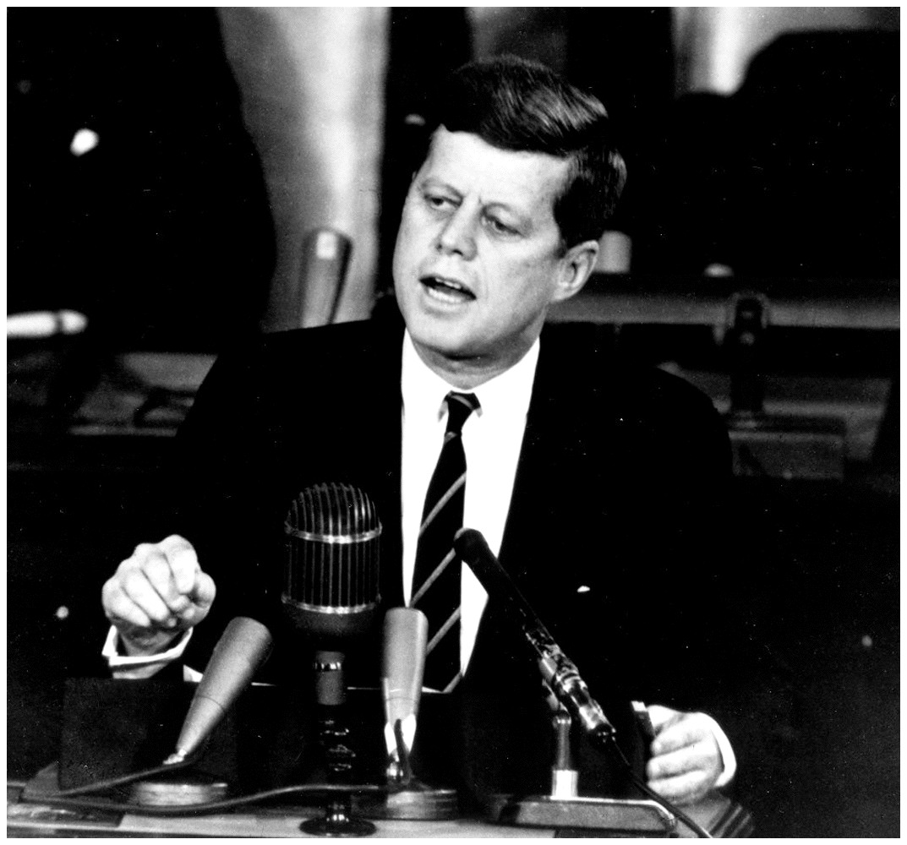
Marginal Tax Rates—2
Notes:
Lecture tip:
Read this quote to your students:
“The worst deficit comes from a recession. And if we can take the proper action in the proper time, this can be the most important step we can take to prevent another recession. That is the right time to make tax cuts, both for your family budget, and the national budget, resulting from a permanent basic reform and reduction in our rate structure. A creative tax cut, creating more jobs and income and, eventually, more revenue.”
Tell them that they may be surprised to learn that JFK, a democrat, spoke that phrase. In 1962, the top marginal tax rate was 91 percent.

Slide 43
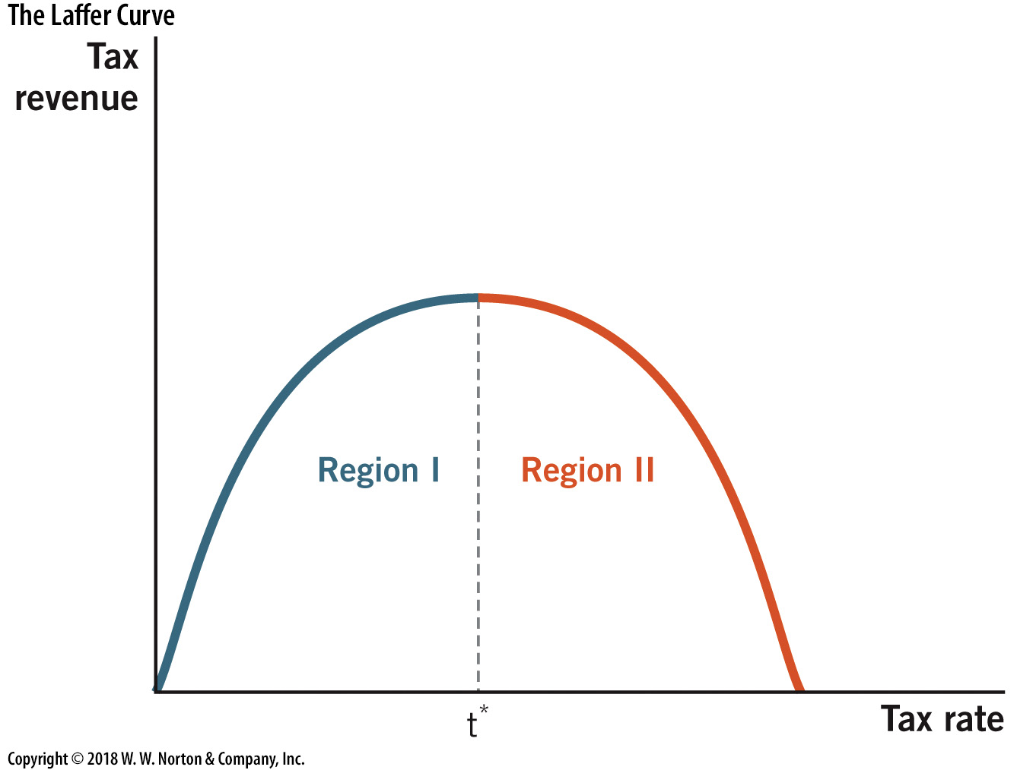
The Laffer Curve
Notes:
Image: Figure 29.9
Lecture notes:
Laffer curve:
Graphical illustration of the relationship between tax rates and tax revenue.
A mathematical relationship that helps us understand how tax rates affect tax revenue.
Economists mainly disagree on what tax rate t* occurs.
Region I:
Here, increases in tax rates lead to increases in tax revenue.
This region is more intuitive and applies for all relatively low tax rates.
In Region II, increases in tax rates decrease tax revenue.
Region II:
Applies to relatively high tax rates, as these higher rates offer severe negative incentives for any activity that is taxed.

Slide 44
Laffer Curve, Politically
Liberals
  Point out the left side of the curve
  Tax rate increases can lead to tax revenue increases
Conservatives
  Point out the right side of the curve
  Tax rate decreases can lead to tax revenue increases
Which part of the curve is more important?
  Both sides are equally important for economic policy
Notes:
Lecture tip:
Make sure to point out that this is a slightly simplistic representation of political beliefs regarding taxes.

Slide 45
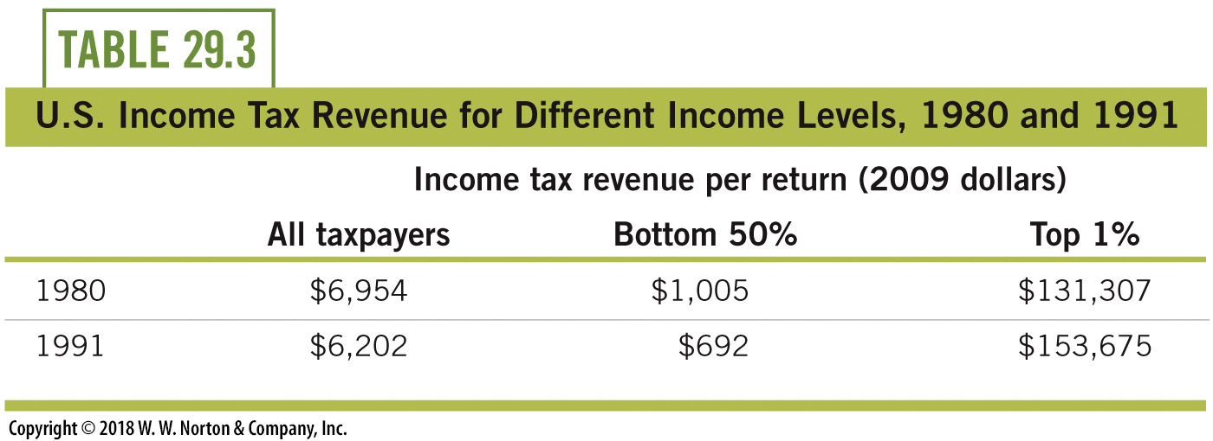
Confirmation of the Laffer Curve’s Existence
Notes:
Lecture notes:
Rate reductions led to greater revenue only for top taxpayers.
Overall, revenues declined when we adjust for both inflation and population.

Slide 46
Conclusion
Fiscal policy:
  Use of government spending and taxes to influence the economy
Countercyclical fiscal policy: goal is to smooth out cycles
Increases in [G] and tax cuts are paid for by borrowing
Fiscal policy is not perfect because of lags, crowding out, and savings adjustments
A higher MPC means a larger spending multiplier
The Laffer curve shows the relationship between tax rates and tax revenues collected

