Slide 1
Monetary Policy
31
Notes:
Pre-class music: Columbia Business School Students’ parody of “Every Breath You Take” by The Police (See Tip #622)
This parody of the famous Police song was created by Columbia Business School students–Glenn Hubbard, the school’s dean, sings about wanting to be the chairman of the Federal Reserve. The music video uses many macroeconomic key terms and is a good way to either start or wrap up a lecture about the Federal Reserve and monetary policy.

Slide 2
Previously
Money includes currency and bank deposits.
Banks can expand the money supply
  By extending loans
  Even though banks do not mint currency
The Fed’s job of monitoring the money supply is difficult.
  Actions taken may be offset by the actions of banks, and even by the actions of individuals

Slide 3
Big Questions
What is the effect of monetary policy in the short run?
Why doesn’t monetary policy always work?
What is the Phillips curve?

Slide 4
Short Run vs. Long Run—1
Short run
  Some prices are inflexible and do not adjust.
    For example, wages and other resource prices are often set by contract and don’t change immediately
Long run
  A period of time long enough for all prices to adjust
Notes:
Lecture tip: This is a quick review of what we have already discussed.
The short run (SR) and long run (LR) results of monetary policy are very different.

Slide 5
Expansionary Monetary Policy
Review of previous topics that will be used in this chapter:
  Open market operations
  Treasury securities are part of the loanable funds market
  The price in the loanable funds market is an interest rate
  Investment is one component of AD
  In the short run, increases in AD increase output and lower the unemployment rate
Notes:
Lecture notes:
The Fed uses open market operations to implement monetary policy where it purchases or sells bonds, normally short-term Treasury securities.
Treasury securities are one important part of the loanable funds market, where lenders buy securities and borrowers sell securities.
In the loanable funds market, the price of loanable funds is the interest rate.
Investment is one component of aggregate demand (AD), and higher investment leads to increases in aggregate demand.
Aggregate demand increases in the short run increase output, lower the unemployment rate, and increase the price level.
The reverse is also true.

Slide 6
Expansionary Monetary Policy: Example
A small business owner is deciding whether to open a second location.
The central bank decides to expand the money supply.
  Central bank buys securities
  → reserves increase
  → interest rates fall
  → business owner decides to take out a loan
  → investment and AD increase
  → real GDP increases and unemployment falls
Notes:
Lecture notes:
When the central bank tries to increase the money supply, it uses open market operations to buy bonds.
This increases the supply of loanable funds, which decreases the interest rate.
The business owner sees that the cost of borrowing is low (interest rates).
As a direct result of monetary policy, firms take out more loans and investment increases.
Aggregate demand increases, real GDP increases, and unemployment falls (the business owner hired some workers).
This is what new money can do in the short run; it expands the amount of credit available and paves the way for economic expansion.
The impact of this monetary policy on the entire macroeconomy occurs on a larger scale, since many firms will be affected.

Slide 7
Expansionary Monetary Policy in the Short Run
Notes:
Image: Animated Figure 31.1
Lecture tip:
Click through the slide to reveal each part of the figure.
Lecture notes:
The central bank buys bonds, which injects new funds directly into the loanable funds market.
This increases the supply of loanable funds and decreases the interest rate from 5 percent to 3 percent.
The lower interest rate leads to an increase in the quantity of investment demand (from 200 to 210) and this increases aggregate demand.
The increase in aggregate demand increases real GDP from $16 trillion to $16.5 trillion, and reduces unemployment in the short run.
The general price level also rises to 105 (but does not fully adjust in the short run).

Slide 8

Expansionary Policy Short-Run Result
Summary
  In the short run, expansionary monetary policy:
    Increases real GDP
    Reduces unemployment
    Raises the price level as flexible prices increase
  Real employment and real output expand as a result of simply increasing the money supply
Notes:
Lecture notes:
The effects of expansionary monetary policy seem positive, right?
After all, unemployment goes down and real GDP goes up.
These are real economic variables, not just nominal.
Real employment and real output expand as a result of simply increasing the quantity of money in the economy.
However, later in the chapter we will see that even though the effects seem positive, there are tradeoffs.
Regarding the image on the slide: If everyone has more money in their purse, price levels rise.

Slide 9
Economics in It’s Always Sunny in Philadelphia, “The Great Recession”
Expansionary monetary policy
Notes:
“Economics in the Media” Slide
Lecture tip:
The clip mentioned on the slide can be found in the Interactive Instructor’s Guide. Access the direct link by clicking the icon in the PowerPoint above.
The other key concepts covered in this clip are:
Economic crisis
Changes in demand
Incentives
Consumption

Slide 10
Real vs. Nominal Effects
If the Fed can increase real employment and output by increasing the money supply, why don’t we just keep printing money?
  Not all prices adjust in the short run
  Eventually, the real value of money will be lower
  In the long run:
    Real impacts of the monetary policy disappear
    Monetary policy does not affect real GDP or unemployment
    The only effect will be on the price level, a nominal variable
Notes:
Lecture notes:
Monetary policy can have immediate and real short-run effects because not all prices have adjusted initially.
Some prices adjust quickly, others do not.
Eventually, by definition of the long run when all prices adjust, the real value of money declines.
As prices adjust, the effects of the new money wear off.
This happens in the long run. After all, money is just paper.
In general, the addition/injection of new money into the economy, over time, devalues the old money.
Eventually, the price of everything (in terms of money) rises.

Slide 11
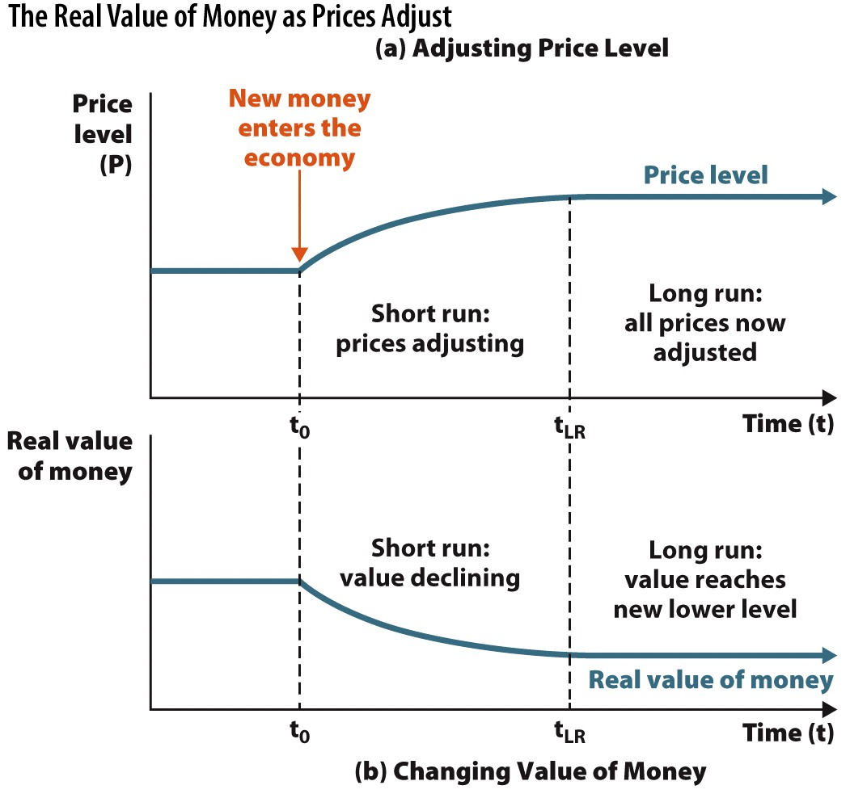
The Real Value of Money as Prices Adjust
Notes:
Image: Figure 31.3
Lecture notes:
Top graph:
If the central bank increases the money supply at time t₀, the price level begins rising in the short run.
In the long run, all prices adjust and the price level reaches its new higher level.
Bottom graph:
As the price level increases, this reduces the real value of money throughout the short run.
In the long run, the real value of money has fallen to a new lower level.

Slide 12
Practice What You Know—1
How does the Fed engage in expansionary monetary policy?
  It buys bonds from financial institutions.
  It sells bonds to financial institutions.
  It lowers the prices of goods.
  It raises the interest rate.
Notes:
Clicker question:
Correct answer: A, It buys bonds from financial institutions.
By buying bonds from banks, money is put directly into the loanable funds market.

Slide 13
Unexpected Inflation Can Hurt—1
If inflation is higher than expected:
  Suppliers with a fixed-price contract
  Workers who signed wage contracts
  Resource suppliers who are contracted to sell goods at a given price
  are hurt by tomorrow’s unexpected inflation
Examples:
  A worker’s paycheck does not buy as many goods
  House builder put a bid price too low on a house, and materials are now too expensive
Notes:
“Beyond the Book” Slide
Lecture notes:
Suppose you are contracted to sell resources (or intermediate goods) at a fixed price of $10.
If inflation occurs and the value of those resources is now $15, but you still have to (by contract) sell them for $10, you are hurt, and your profits will be lowered.
You may have to pay higher prices to make or acquire your resources, but you still must contractually sell them at the low $10 price.

Slide 14
Unexpected Inflation Can Hurt—2
If inflation is lower than expected,
  Demanders who signed a fixed-price contract
  Employers who create wage contracts
  Resource purchasers who signed contracts to buy goods at a certain price
  are hurt by tomorrow’s unexpectedly low inflation
Examples:
  A firm gives a 3% COLA, but inflation was only 1.4%
  A restaurant pays too much for food and cleaning supplies due to a contract it signed
Notes:
“Beyond the Book” Slide
Lecture notes:
When employers create wage contracts, they do so with a certain level of expected inflation.
If you are a BUYER of goods or services, you may sign a long-term contract for a fixed price, which has an inflation expectation built in.
If inflation is lower than expected, you will be overpaying for those goods or services.
Lecture tip: Explain to students that COLA = cost of living adjustment.

Slide 15
Contractionary Monetary Policy
Contractionary monetary policy
  Central bank takes action to reduce the money supply
  Often done during times of rapid expansion in order to curb potential inflation
  Central bank sells securities
  → reserves decrease
  → interest rates rise
  → business owner decides NOT to take out a loan
  → investment and AD decrease
  → real GDP decreases and unemployment rises
Notes:
Lecture notes:
Contractionary monetary policy is performed through open market operations when the central bank sells bonds.
This takes money out of the loanable funds market and raises the interest rate.
At higher interest rates, firms are more hesitant to borrow.
This reduces investment and aggregate demand.
Real GDP falls and unemployment rises.
You can think of this as just the opposite of expansionary policy.

Slide 16
Contractionary Monetary Policy in the Short Run
Notes:
Image: Animated Figure 31.4
Lecture tip:
Click through the slide to reveal each part of the figure.
Lecture notes:
The central bank sells bonds, which pulls funds out of the loanable funds market.
This decreases the supply of loanable funds and increases the interest rate from 5 percent to 6 percent.
The lower interest rate leads to a decrease in the quantity of investment demand (from 200 to 190), and this decreases aggregate demand.
The decrease in aggregate demand decreases real GDP from $15 trillion to $14.5 trillion, and induces unemployment in the short run.
The general price level also falls to 95 (but does not fully adjust in the short run).

Slide 17
Practice What You Know—2
Suppose the Fed engages in contractionary monetary policy to reduce the money supply. What is the result in the loanable funds market?
  There is a shift in the demand for loanable funds.
  The amount of loanable funds increases.
  Bank competition increases.
  The interest rate rises.
Notes:
Clicker question:
Correct answer: D, The interest rate rises.
The leftward shift in the supply of loanable funds causes a decrease in the quantity of loanable funds and an increase in the interest rate.

Slide 18
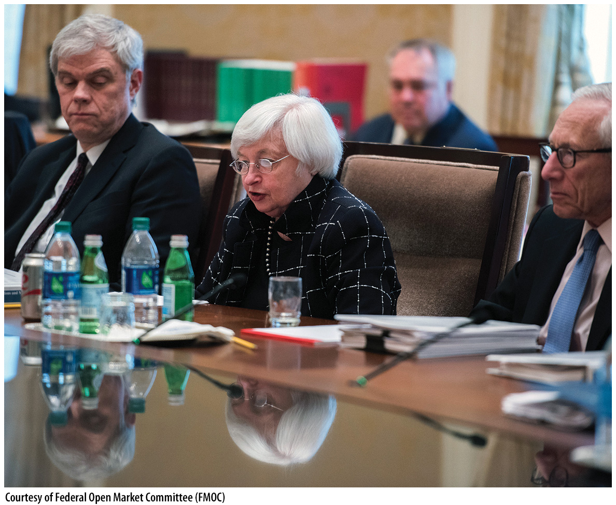
Why Doesn’t Monetary Policy Always Work
Monetary policy has its flaws that can decrease effectiveness, including:
  Diminished effects in the long run
  Expectations reducing the effects of policy
  If downturns are caused by AS rather than AD shifts
Notes:
Lecture notes:
Just like fiscal policy, monetary policy is not perfectly effective.
Lecture tip:
The next few slides walk through each of these shortcomings.
Regarding the image on the slide: The Federal Open Market Committee is the group that determines monetary policy.

Slide 19
Long-Run Effects of Monetary Policy
In the short run, monetary policy allowed a new business to open.
In the long run, resource prices (including wages) rise, and other prices rise as well.
  If demand for the product increases, the business will stay open and compete.
  If demand remains the same, the store may not be able to afford the rising input prices and may close.
Happens throughout the macroeconomy
Notes:
Lecture notes:
Put shortly, two possible outcomes are that businesses succeed because of a demand increase (and can cover their expenses), or businesses fail because they can’t afford rising costs of inputs.
If a business starts to become unprofitable, it may have to reduce output, lay off workers, or perhaps even close a retail location.
In the long run, as prices adjust throughout the macroeconomy, the stimulating effects of expansionary monetary policy wear off.

Slide 20
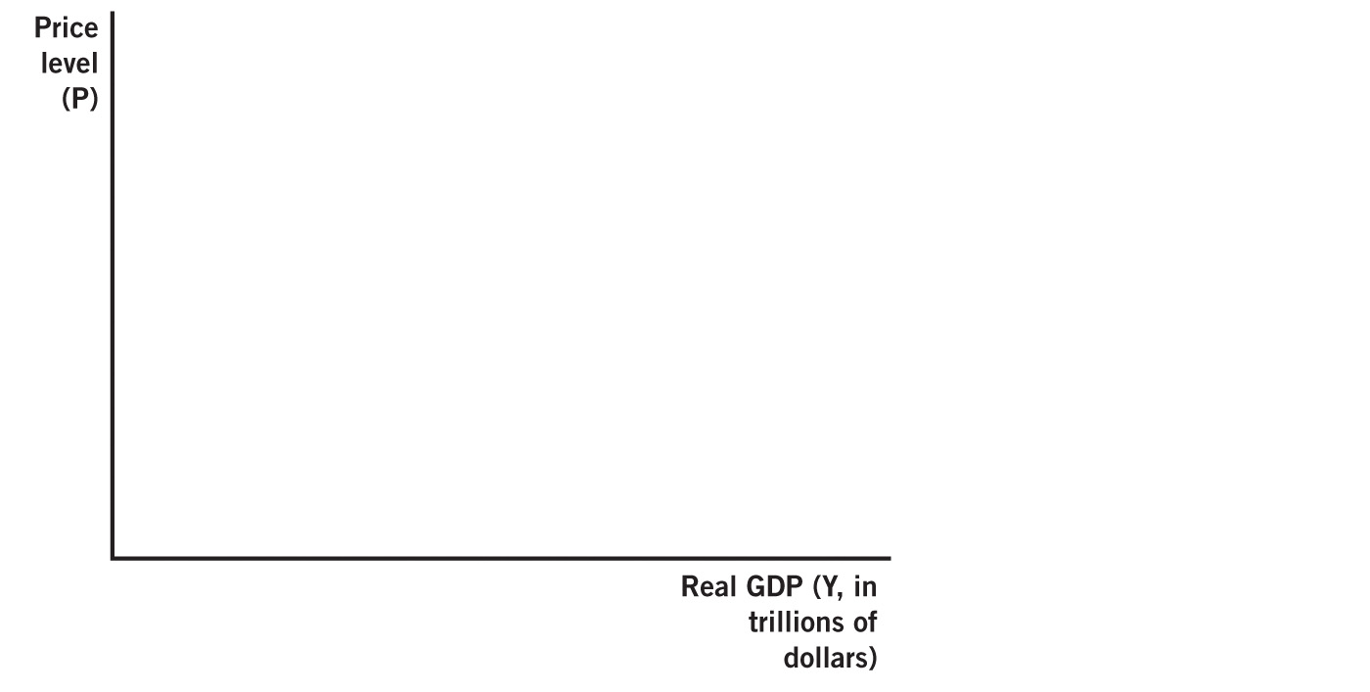
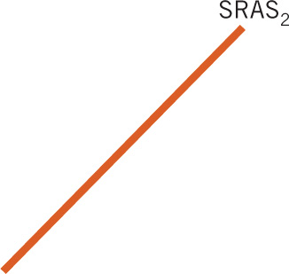

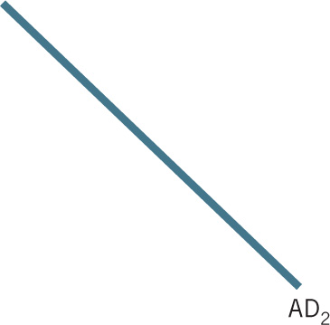
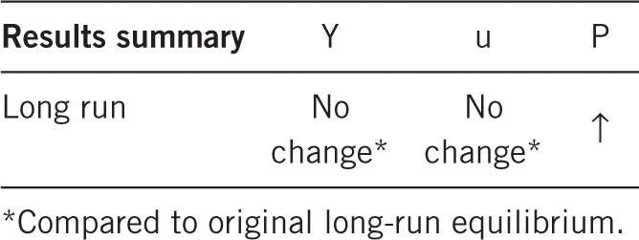

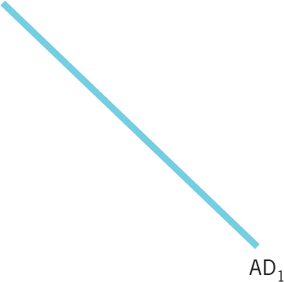
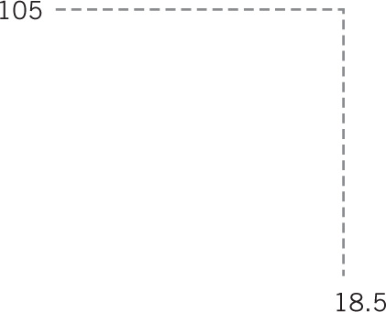



Expansionary Monetary Policy in the Long Run
Notes:
Image: Animated Figure 31.6
Lecture tip:
Click through the slide to reveal each part of the figure.
Lecture notes:
Beginning in equilibrium at point A, an increase in the money supply shifts aggregate demand from AD₀ to AD₁, and this moves the economy to a new short-run equilibrium at point b.
This equilibrium (b) is only relevant in the short run, as all prices have not yet adjusted.
In the long run, resource prices adjust, which shifts SRAS from SRAS₀ to SRAS₁.
This moves the economy to new long-run equilibrium at point C.

Slide 21
Short Run vs. Long Run—2
Long run
  Long-term productivity increases by changes in resources, technology, or institutions, not changes in the money supply
Monetary neutrality
  The idea that the money supply does not affect real economic variables in the long run
Short run
  Real effects
  Recessions and unemployment can be painful
Policy can smooth business cycle fluctuations
Notes:
Lecture notes:
It seems odd that Central Banks can’t do much in the long run to affect real economy.
It makes more sense by realizing that we can increase the money supply by just printing more paper.
Printing money has no effect on long-run productivity.
After all, during recessions people often lose their jobs, which can be a very painful experience.
When the money supply is expanded, firms can get loans more cheaply and then hire more workers.
From this perspective, central banks ought to take a very active role in the macroeconomy: increase the money supply during economic downturns, and contract the money supply during economic expansions.
This activist policy can then potentially smooth out the business cycle.
Other economists discount the short-run expansionary effects of monetary policy and instead focus on the problems of inflation.
Many economists think we should focus on the short run.
Others think that since the long-run effects dominate we should not be concerned with the short run.
Particularly, we should not be concerned with short-run monetary policy because of monetary neutrality.
However, recessions can cause significant distress.
By expanding the money supply, firms can get loans more cheaply and then hire more workers.
From this view, central banks ought to take a very active role in the macroeconomy: increase the money supply in economic downturns and contract the money supply during economic expansions.
This activist policy can then potentially smooth out the business cycle.
This means that expansions and contractions won’t be so large in size.

Slide 22
Adjustments in Expectations
If people expect monetary policy changes, they may anticipate changes in inflation.
  People have time to adjust and prepare
Examples:
  Workers have an incentive to expect some inflation and negotiate wage contracts accordingly.
  Other contracts have COLA clauses.
  In addition, the Fed will often announce its plans with regard to policy.
Notes:
Lecture notes:
Previously, we have seen how unexpected inflation can be harmful.
Workers usually predict a certain level of inflation and expect adjustments in wage.
The Fed being transparent regarding monetary policy helps workers and firms predict inflation.
The key incentive: People are harmed if they do not correctly predict inflation.
Real-world example: Cost-of-Living Adjustment Clauses and the MLB
This could be a good time to discuss the example presented in Tip #635 in the Interactive Instructor’s Guide.
George Steinbrenner, owner of the New York Yankees, made Winfield the highest-paid player in professional baseball by signing him to a ten-year deal worth approximately $15 million.
However, as unlikely as it sounds, Mr. Steinbrenner misunderstood a cost-of-living clause that had been added to the contract before it was finalized, making the deal actually valued around $23 million.
Ask students how Winfield’s adjustment in expectations, which led him to include this clause in the contract, might have affected the real effects of monetary policy actions on the economy.
Source: Jim McLennan, “Baseball’s Greatest Scandals, #10: Steinbrenner vs. Winfield,” AZ Snake Pit, SB Nation, April 18, 2011, azsnakepit.com.

Slide 23
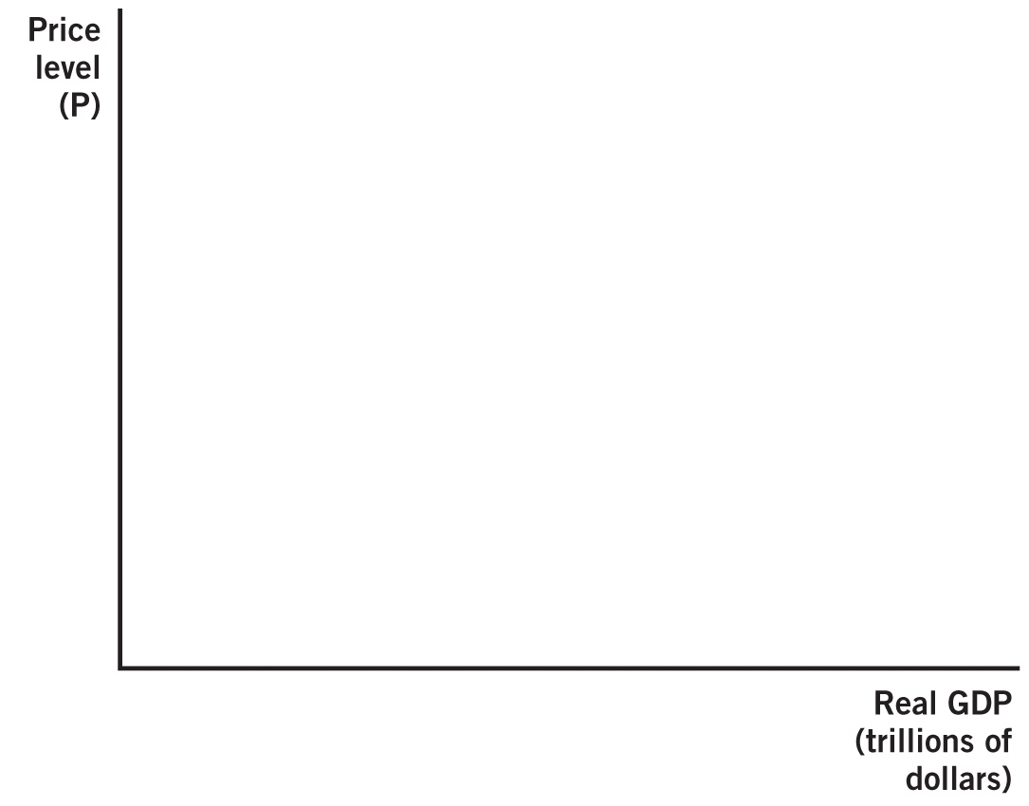


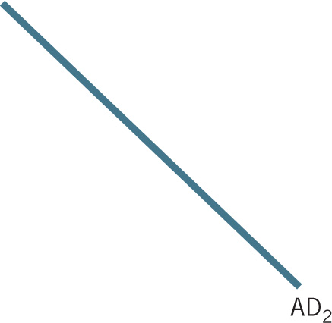

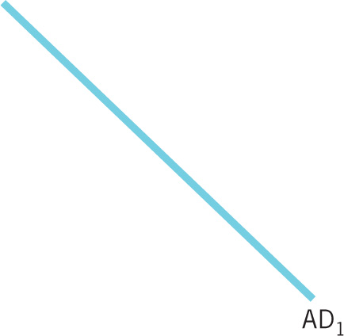

Completely Expected Monetary Policy
Notes:
Image: Animated Figure 31.7
Lecture tip:
Click through the slide to reveal each part of the figure.
Lecture notes:
If expansionary monetary policy is expected, aggregate demand increases.
But, with expected policy, short-run aggregate supply also shifts.
Workers are demanding higher wages to keep up with inflation, and firms have to cut back production.
The economy moves directly from equilibrium at point A to point C.
In this case, there are no real effects from the monetary policy, even in the short run.
The only lasting change is nominal because the price level rises from 100 to 110.

Slide 24
Aggregate Supply Shifts and the Great Recession
Great Recession
  Not all downturns are caused from a decrease in AD.
  LRAS and AD decreased in this recession.
Monetary policy issues:
  Monetary policy wears off in the long run.
  Limited ability to return to the original output level
    Cannot shift LRAS
Notes:
Lecture notes:
In the 2008 recession, LRAS also decreased.
Pervasive problems in the financial system negatively affected key institutions, which decreased LRAS.
In addition, financial regulations restricted lending.
At the same time, people’s wealth and expected future incomes declined, decreasing consumption and AD.
Due to the long-run monetary neutrality and inability of monetary policy to shift LRAS, the economy continued to struggle with slow growth.
Recall that the LRAS shifted due to widespread institutional problems with financial markets.

Slide 25
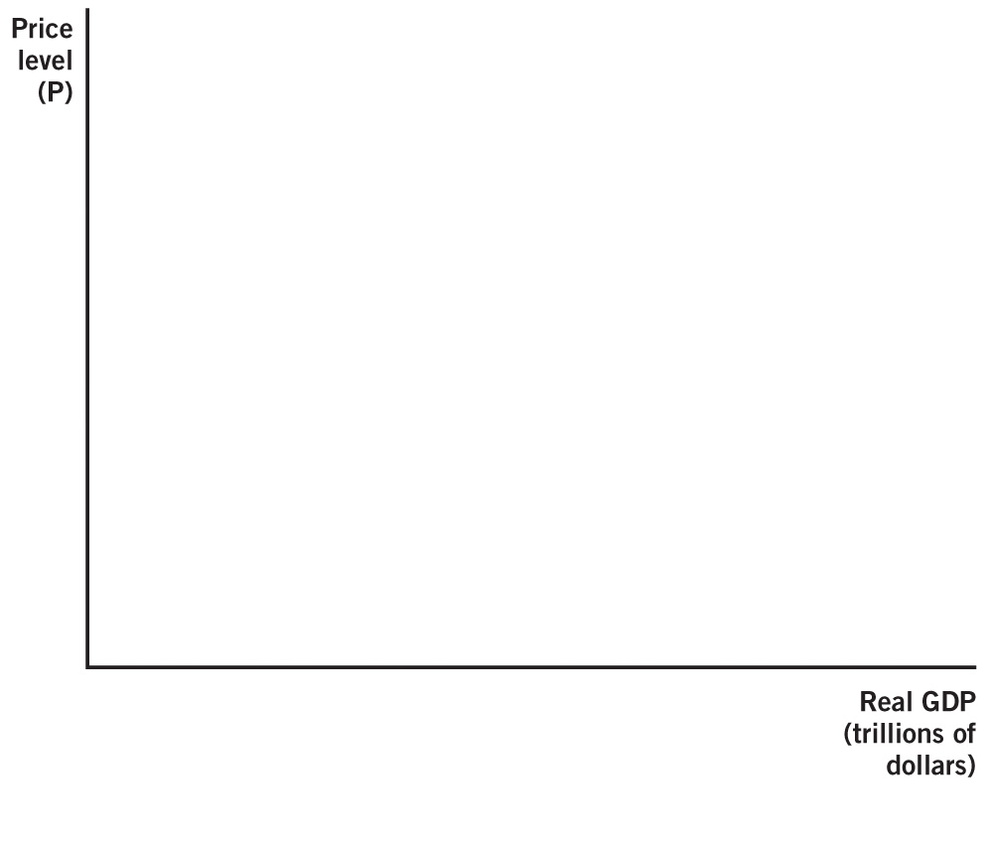


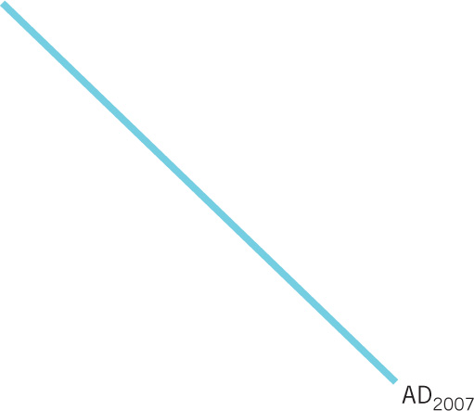
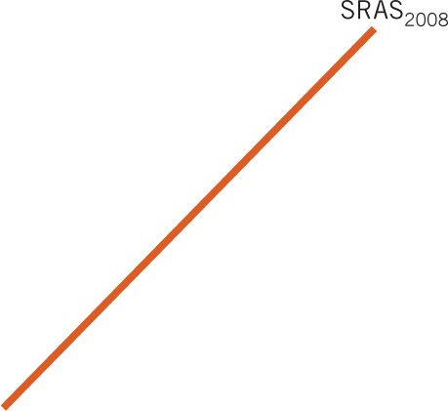
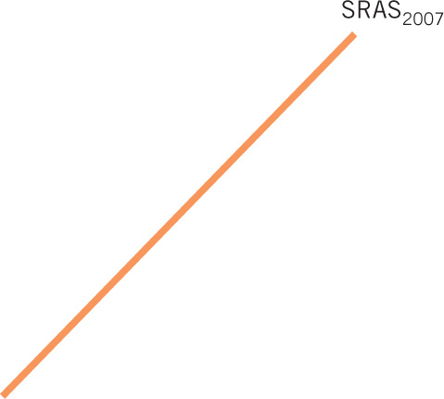
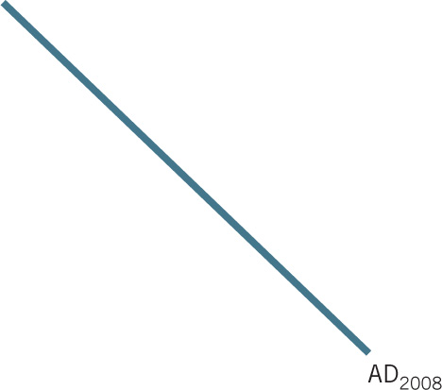



Aggregate Supply Induced Recession
Notes:
Image: Animated Figure 31.8
Lecture tip:
Click through the slide to reveal each part of the figure.
Lecture notes:
Initially, in 2007, the economy is in equilibrium at point A.
Then, the long-run and short-run aggregate supply curves shift to the left, to LRAS₂₀₀₈ and SRAS₂₀₀₈.
In addition, aggregate demand shifts to the left to AD₂₀₀₈.
This combination of shifts takes the economy to a new equilibrium at point B.
At point B, monetary policy is limited in its ability to move the economy back to its original level of real GDP because monetary policy affects the economy through aggregate demand.

Slide 26
Practice What You Know—3
According to the models studied in this chapter, monetary policy is:
  more effective in the long run.
  more effective in the short run.
  equally effective in the long and short run.
Notes:
Clicker question:
Correct answer: B, more effective in the short run.
In the long run (after prices adjust), monetary policy has no real effects; only the price level (a nominal variable) is affected.

Slide 27
The Phillips Curve
In the 1960s:
  Observed inverse relationship between unemployment and inflation
Phillips Curve: Graphic representation
Two-part policy implication:
  Less unemployment ↔ higher inflation
  Lower inflation ↔ higher unemployment
But ignores expectations and the long run
Notes:
Lecture notes:
Phillips curve:
The graphic representation of the inverse relationship between unemployment and inflation is known as the Phillips curve, named after economist A. W. Phillips.
Plotting wage inflation data versus unemployment rates over a long period of time revealed this relationship.
The policy implication here implies a trade-off.
In order to pursue lower unemployment, the cost is higher inflation.
Pursuing a policy prescription for lower inflation is at the cost of higher unemployment.
The logic behind the relationship is clear:
Banks increase money supply (increasing inflation).
More funds are loaned out.
Employers expand production and hire more workers (decreasing unemployment).
The Phillips curve implies the central bank can always steer an economy out of recession, simply through inflation.
This ascribes a great deal of power to central banks.

Slide 28
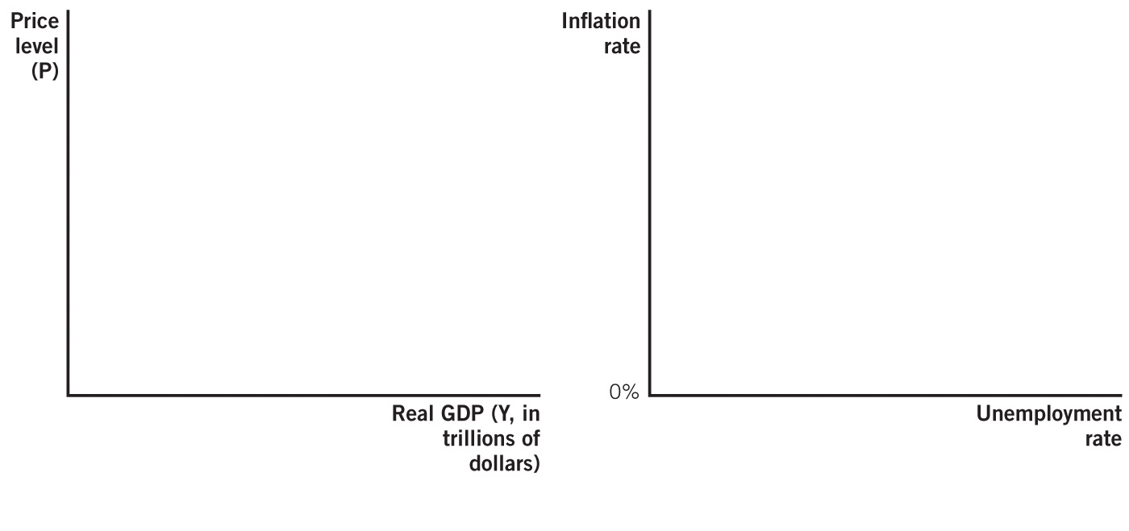

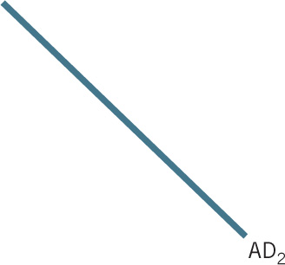
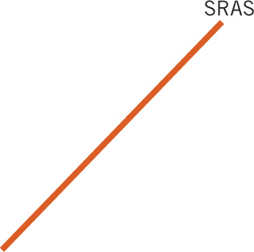
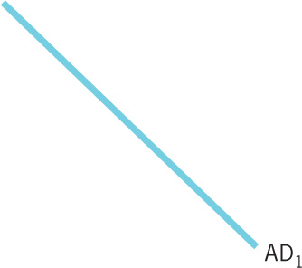

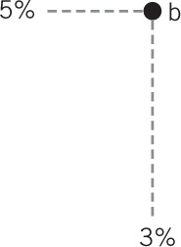



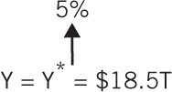


AD, AS, and the Phillips Curve
Notes:
Image: Animated Figure 31.9
Lecture tip:
Click through the slide to reveal each part of the figure.
Lecture notes:
Panel (a):
This graph shows the effect of unexpected monetary expansion in the short run.
Initially, the economy is in equilibrium at point A, with a price level of 100, real GDP of $16 trillion, and an unemployment rate of 5 percent.
Aggregate demand shifts from AD to AD₁, which moves the economy to short-run equilibrium at point b.
The move to point b is brought about by inflation of 5 percent (the price level rises from 100 to 105) but yields a lower unemployment rate of just 3 percent.
Panel (b):
Here we see the two equilibrium points in a new graph that plots the inverse relationship between inflation and unemployment rates.
This graph, known as a Phillips curve, clarifies that higher inflation can lead to lower levels of unemployment in the short run.
The basic Phillips curve embodies the idea that higher inflation leads to lower unemployment and lower inflation leads to higher unemployment.

Slide 29
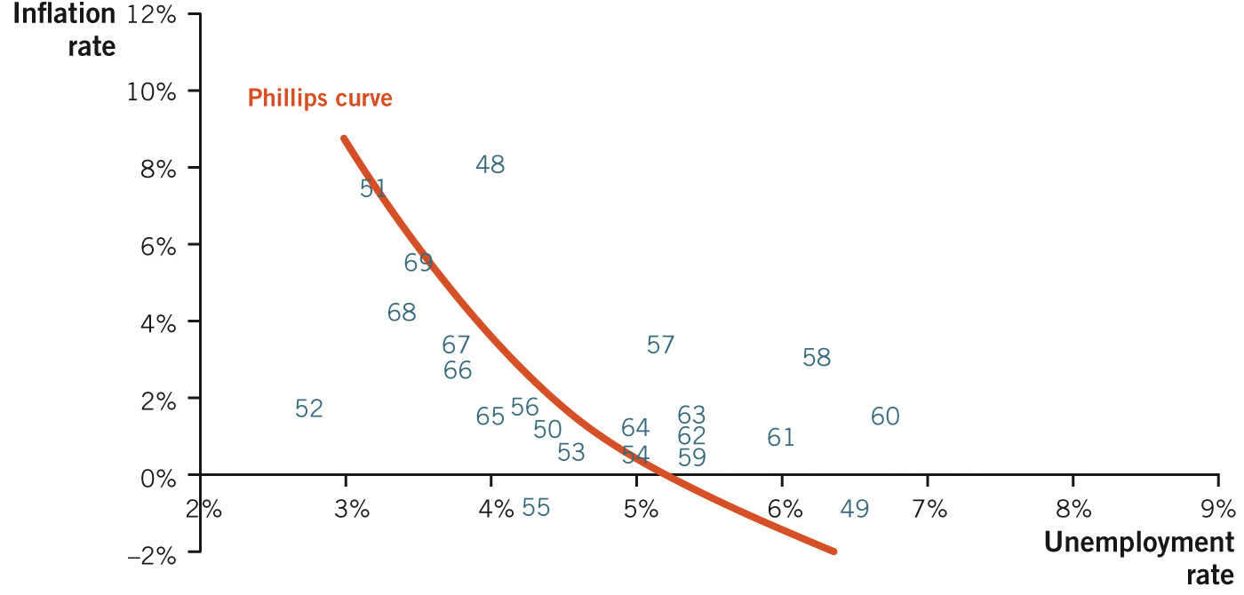
U.S. Inflation and Unemployment Rates 1948–1969
Notes:
Image: Figure 31.10
Lecture notes:
In the 1960s, economists noticed that high unemployment rates occurred when inflation was low and lower unemployment occurred when inflation was higher.
These correlations are evident in the graph above, and the inverse trend line is easily observed.

Slide 30
Long-Run Phillips Curve—1
Recall that in the long run:
  All prices adjust
  No real effects from monetary policy
Long-run Phillips curve
  Vertical, rather than downward-sloping
  Over time:
    Effects of monetary policy wear off
    Unemployment rate will return to its original level

Slide 31
Long-Run Phillips Curve—2
Notes:
Image: Animated Figure 31.11
Lecture tip:
Click through the slide to reveal each part of the figure.
Lecture notes:
In the short run, inflation can lead to lower unemployment, moving the economy from equilibrium at point A to point b.
But in the long run, the effects of monetary policy wear off and the unemployment rate returns to 5 percent at equilibrium point C.
Under normal economic conditions, without inflationary surprises, the economy gravitates back to the natural rate of unemployment.
Here the natural rate is 5 percent.
Therefore, in the long run, the economy comes back to 5 percent unemployment, no matter what the inflation rate is.
This outcome implies a vertical Phillips curve in the long run.
Notice that lowercase b indicates a short-run equilibrium.

Slide 32
Adaptive Expectations—1
Adaptive expectations
  Future expectations are based on recent experience.
  People will consistently under- or overestimate if inflation is accelerating or decelerating, respectively.
People have an incentive to predict inflation.
  Monetary policy can only be effective if it is unexpected.
Milton Friedman and Edmund Phelps
  Late 1960s, the Phillips curve relationship could not last
Stagflation
  Combination of high unemployment and high inflation
  Occurred throughout the 1970s
Notes:
Lecture notes:
In the late 1960s, Nobel Prize-winning economists Edmund Phelps and Milton Friedman started considering macroeconomic expectations.
They saw these as important since unexpected inflation is harmful, and this provides incentives to correctly anticipate inflation.
They hypothesized that people would adapt their inflation expectations to something consistent with prior experience.
People expect next year’s inflation to be the same as this year’s inflation.
For example, if actual inflation is consistently 2 percent year after year, people don’t expect zero inflation, they probably expect 2 percent.
If inflation is 5 percent in 2013, adaptive expectations theory implies that people expect 5 percent in 2014.
Weaknesses: if the rate is accelerating, it means that inflation gets bigger each year.
Adaptive expectations will cause people to underestimate inflation each year.
The basic reasoning of Friedman and Phelps was that people are not quite as simpleminded as the basic Phillips curve implies.
Given that surprise inflation harms people, they have an incentive to anticipate inflation and, at the very least, learn from past experience.
And yet, the data from the 1960s was certainly consistent with the traditional Phillips curve interpretation.
But Friedman and Phelps challenged the accepted wisdom in 1968 and predicted that the Phillips curve relationship would not last.
In particular, they predicted that high inflation could not always deliver low unemployment.
They were correct; their ideas held true in the 1970s.

Slide 33
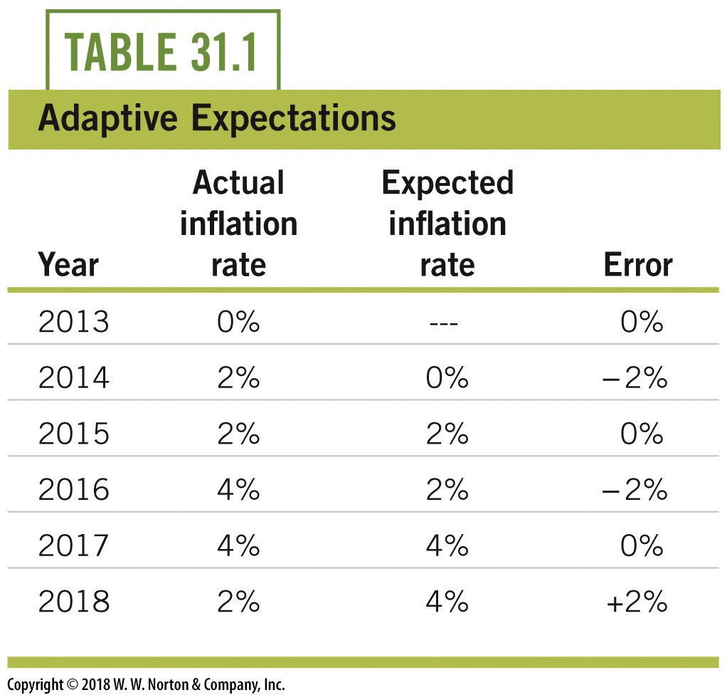
Adaptive Expectations—2
Notes:
Lecture notes:
Inflation starts at zero, but then goes up to 2 percent for two years, then increases again to 4 percent for two years, and then falls to 2 percent in the last year.
With zero inflation expectations (the third and fourth columns), all inflation is unexpected inflation.
The higher the inflation rate, the greater the error in expectations.
With adaptive expectations, actual inflation in the current period becomes expected inflation for the future.
For example, 2 percent actual inflation in 2014 means people will expect 2 percent inflation in the future.
So when actual inflation is 2 percent in 2015, this is not a surprise.
The important point is that, with adaptive expectations, people do not always under- or overestimate inflation.
Note that if next year’s inflation is less than this year’s, adaptive expectations will cause us to actually overestimate inflation.

Slide 34
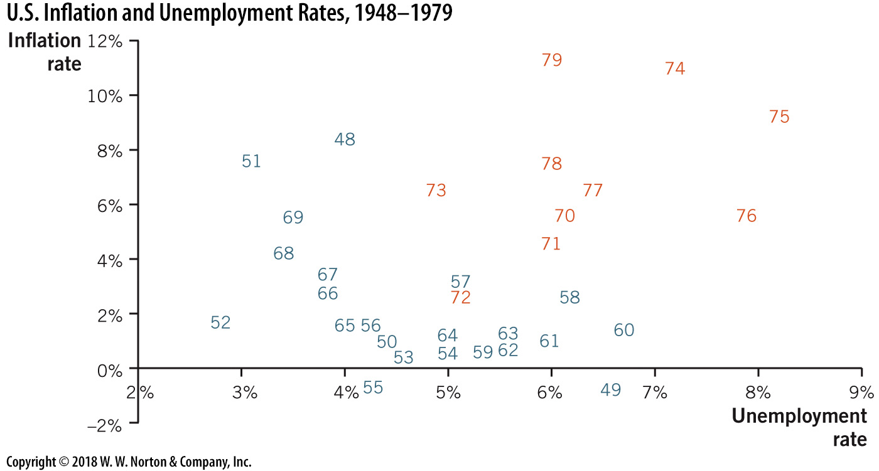
U.S. Inflation and Unemployment, 1948–1979
Notes:
Image: Figure 31.12
Lecture notes:
Data over the long run present a picture of inflation and unemployment rates that look random.
Clearly, the unemployment rate is influenced by factors other than the rate of inflation.

Slide 35
Rational Expectations
Rational expectations
  People form expectations based upon all available information, instead of just using today’s inflation rate.
People have incentives to form correct expectations.
  Expectation errors can be harmful.
  Central bank inflation policies are generally not secret.
  However, errors can still be made.
  Random errors rather than statistically biased errors.
Notes:
Lecture notes:
Rational expectations:
If people form expectations rationally, they use more than just today’s current level of inflation to predict next year’s.
Rational expectations are forward-looking.
If a central bank is intentionally trying to increase the inflation rate in an economy, they are doing it for a reason.
This reason is generally not a secret and people use this information to form expectations.
Market participants can use any information when forming inflation expectations.
Expectational errors are harmful, so people have incentives to understand why inflation is going up or down.
Since expectation errors harm somebody in the macroeconomy, people have incentives to try to predict them correctly.
This is the idea behind rational expectations theory.
Errors are sometimes positive and sometimes negative, as opposed to consistently being underpredicted.

Slide 36
Practice What You Know—4
When people have rational expectations about inflation, it means that they base their inflation predictions on:
  all available information.
  whether or not they have debt.
  the rate of inflation from last year.
  assuming zero inflation.
Notes:
Clicker question:
Correct answer: A, all available information.
People will use yesterday’s inflation level as well as other information available (central bank intentions) to predict tomorrow’s inflation.

Slide 37
The Phillips Curve:
A Modern View
Suppose inflation is 0% and people expect 0% inflation in the future:
  Unemployment is equal to the natural rate.
If inflation rises to 5%:
  Unemployment will fall
However, if people expect 5% inflation:
  Inflation will not reduce unemployment.
  The new levels of inflation shift the Phillips curve.
Notes:
Lecture tip:
This is important for students to understand:
It basically says you cannot “exploit” the relationship of the Phillips curve by trying to change the inflation rate to change unemployment.
People will use rational expectations (they’ll see what the Fed is doing), and they will change expectations.
A “new” Phillips curve will be formed based on these new expectations, and the monetary policy won’t be effective!
Inflation reduces unemployment, but only if it is a surprise.
We can graph a Phillips curve with inflation expectations built into it (see the next couple of slides).

Slide 38
The Phillips Curve with Adjusting Expectations
Notes:
Image: Animated Figure 31.13
Lecture tip:
Click through the slide to reveal each part of the figure.
Lecture notes:
Initially, at point A, inflation is 0 percent and people expect 0 percent inflation going forward.
This means that any positive inflation will reduce the unemployment rate.
If inflation is 5 percent, the unemployment rate falls to 3 percent, as indicated by movement to equilibrium at point b.
But if actual inflation is 5 percent and expected inflation is also 5 percent, the unemployment rate moves to the natural rate at point C.
There is a different short-run Phillips curve (SRPC) for each level of expectations about inflation.

Slide 39
Phillips Curve and Monetary Policy—1
Active monetary policy
  The strategic use of monetary policy to counteract macroeconomic expansions and contractions
  Used in 1960s before expectation theories
  “Use” the Phillips curve
    Inflate during downturns
    Reduce inflation during booming economy
With adaptive expectations
  Reduces unemployment in the short run
With rational expectations
  Potentially no gains at all
Notes:
Lecture notes:
If expectations are adaptive:
This policy reduces the unemployment rate in the short run.
Eventually, expectations adjust and then the central bank has to increase inflation again just to stay ahead of the adjusting expectations.
If monetary policy is to keep the unemployment rate low, inflation has to accelerate, to stay a step ahead of expectations.
Essentially, this leads to more and more inflation.
Worse yet, if the central bank tries to reduce inflation levels, it leads to increases in unemployment rates in the short run, as expected inflation exceeds actual inflation.
Activist monetary policy leads only to temporary short-run gains in employment.
In the long run, it leads to high inflation or unemployment or both (see the 1970s).
If expectations are rational:
Activist monetary policy may yield no gains whatsoever.
Since market participants use all available information when forming inflation expectations, the central bank is unlikely to get any positive results from activist monetary policy, even in the short run!

Slide 40
Phillips Curve and Monetary Policy—2
Passive monetary policy
  Central banks purposefully choose only to stabilize the money supply and price levels
  Does not seek to use inflation to affect real variables
    For example, unemployment and real GDP
  The Fed has moved in this direction since the 1980s
Notes:
Lecture notes:
In the United States, the Federal Reserve has moved markedly in this direction since the early 1980s.
Ben Bernanke, Janet Yellen, and other Federal Reserve chairs have consistently taken actions that lead to fewer surprises in monetary policy.

Slide 41
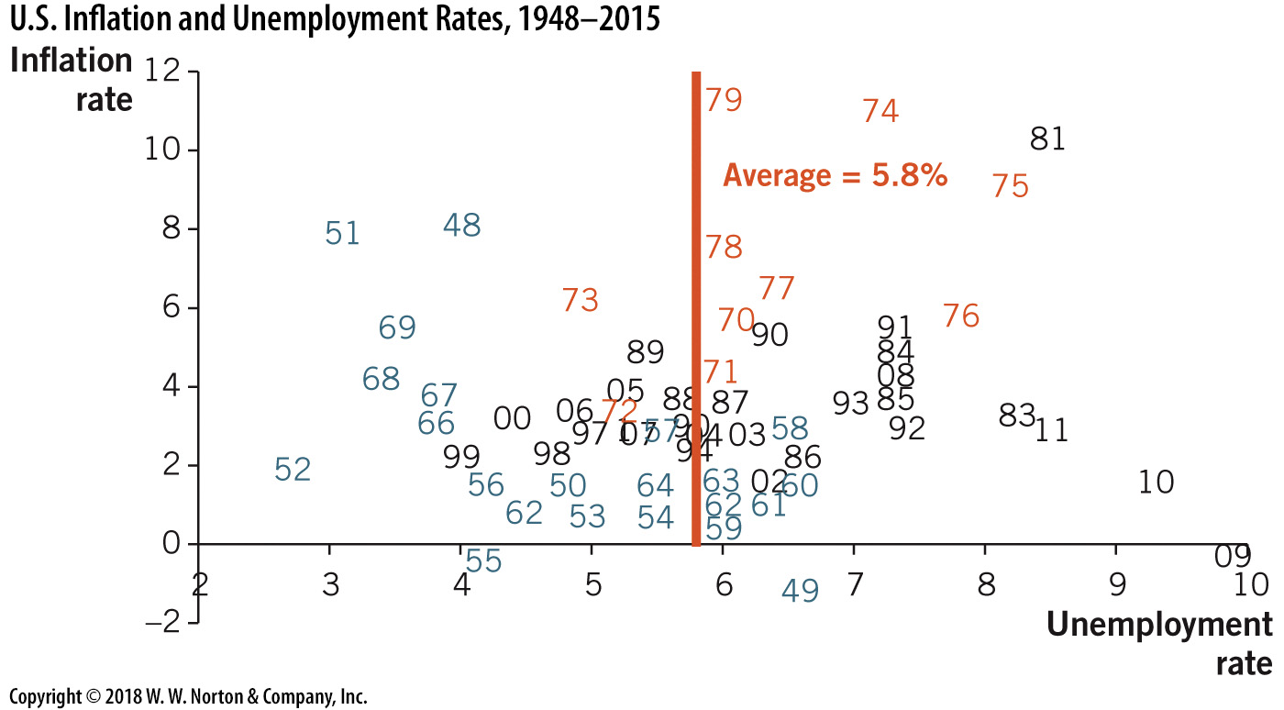
U.S. Inflation and Unemployment, 1948–2015
Notes:
Image: Figure 31.14
Lecture notes:
Data over the long run present a picture of inflation and unemployment rates that look random.
Clearly, the unemployment rate is influenced by factors other than the rate of inflation.
Think-Pair-Share: Federal Reserve Games
If you have access to computers in the classroom, this is a good time to utilize the think-pair-share activity from the Interactive Instructor’s Guide (See Tip #628).
The Federal Reserve of Kansas City manages a web site called FederalReserve-Education.org, which strives to promote education on the Federal Reserve, monetary policy, and the U.S. financial system.
Direct your students to the Multimedia tab on the site, where they can access videos, interactive games, and other helpful information to use when covering this chapter of the textbook.
For example, on the Games and Simulations page, have your students pair up and play the Fed Chairman Game.
This game requires the player to alter interest rates to keep inflation and unemployment in check.
After they complete the game, have each pair announce how they did, and if they did not succeed, have them explain what they could have done better to fight inflation and unemployment.
Ask them to consider what other tools it would have been helpful for them to have.

Slide 42
Practice What You Know—5
The Phillips curve:
  shows that inflation and unemployment are directly related.
  shows that inflation and unemployment are inversely related.
  can be effectively used in the long run.
  guarantees that the Fed can create jobs by changing the money supply.
Notes:
Clicker question
Correct answer: B, shows that inflation and unemployment are inversely related.
The curve is downward-sloping. However, the relationship isn’t necessarily easily “exploitable,” especially in the long run.

Slide 43
Conclusion
Monetary policy can be expansionary or contractionary
  Increasing or decreasing the money supply
In the short run, monetary policy affects real GDP and unemployment
In the long run, monetary policy affects only the price level
Phillips curve: short-run inverse relationship between unemployment and inflation
Rational expectations negate the effects of active monetary policy
Notes:
Lecture notes:
You can also reiterate the following points:
The Phillips curve illustrates the short-run relationship between unemployment and inflation.
Economists tried to “use” this relationship in the 1960s with active monetary policy.
However, if people have rational expectations about inflation, active monetary policy may yield no results, even in the short run.

