Slide 1
Introduction to Macroeconomics and GDP
19
Notes:
Pre-class music: “Ain’t No Rest for the Wicked” by Cage the Elephant (Link to Tip #199)
This song, which was written during the latest U.S. recession, is a good way to introduce business cycle, as it describes three different people and the economic hardships they face due to the downturn in the business cycle. You can use this song to initiate a discussion on the cyclical nature of the business cycle.

Slide 2
Previously
Health expenditures in the United States are 15.8 percent of national economic output (more than any other nation).
Asymmetric information exists when one party in a transaction knows more than the other does. This can take on three forms: adverse selection, moral hazard, and the principal-agent problem.
Rationing medical care is a fact of life since we live in a world of scarcity.
Notes:
Lecture tip:
You may want to edit this slide depending on the course taught and the order in which the chapters are presented.

Slide 3
Misconception
Misconception:
  There is no reliable way to determine how well an entire economy is performing.
Economists often disagree about the state of our economy.
However, there is an objective and reliable measure of macroeconomic performance—and this is the primary focus of this chapter.
Notes:
Lecture notes:
Almost eight years after the official end of the Great Recession, the financial news is still filled with heated debates about the health of the economy. Almost certainly, you will find economists claiming both positive and negative conditions.
You may also recall in the late 2000s recurring discussions about whether the economy was in recession.
So, even economists do not seem to agree on whether the economy is headed in a positive direction or a negative direction. Based on the above perceptions, it may seem like there is no good way of objectively measuring the performance of the macroeconomy.
However, there is a measure of the macroeconomic environment that measures production and income and is used by most economists. This measure is gross domestic product (GDP), which has been used to gauge macroeconomic performance since about the time of the Great Depression (see below, although informal financial accounting has existed for much longer [Guitierrez et al. (2007]).
Suggested reading:
This source discusses some of the history of national income accounting:
Marcuss, Rosemary D. and Richard E. Kane, “U.S. National Income and Product Statistics: Born of the Great Depression and World War II.” Survey 87 (February 2007): 32–46.
Works Cited:
Gutierrez, Carlos M., Cynthia A. Glassman, J. Steven Landefeld, and Rosemary D. Marcuss. “An Introduction to the National Income and Product Accounts.” Methodology Papers: U.S. National Income and Product Accounts (September 2007): 1–27.

Slide 4
Big Questions
How is macroeconomics different from microeconomics?
What does GDP tell us about the economy?
How is GDP computed?
What are some shortcomings of GDP data?

Slide 5
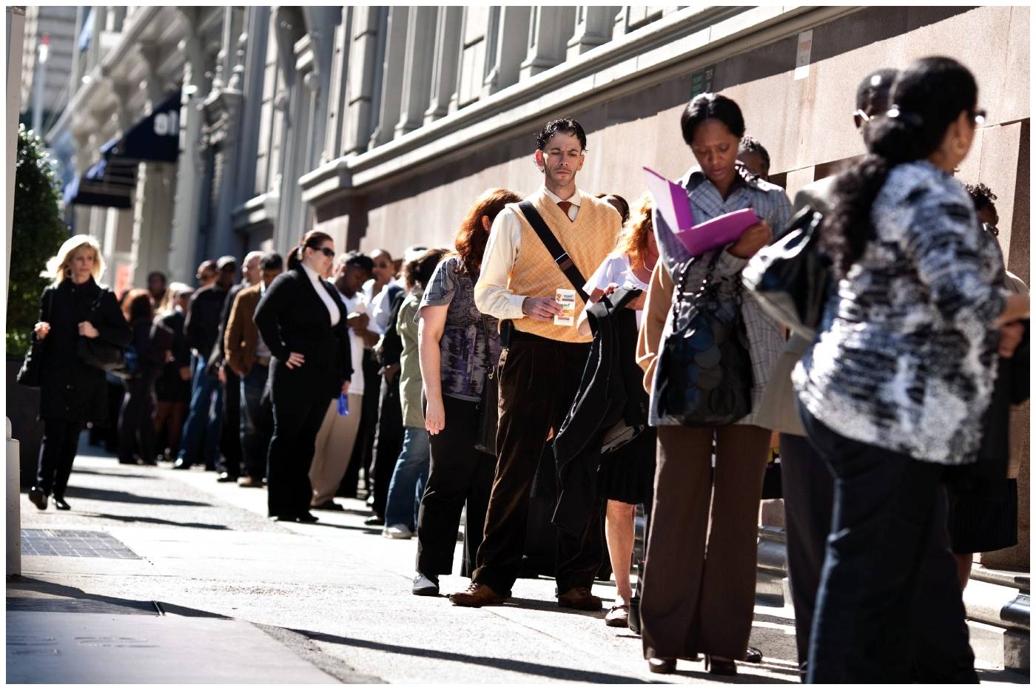

Macroeconomics versus Microeconomics
Macroeconomics
  Economy-wide issues
  Aggregate-level
    Inflation
    Unemployment
    Economic growth
Microeconomics
  Individual-level decisions
  Households or firms
    Individual markets
    Choices
    Implications for P and Q
Notes:
Lecture notes:
Microeconomics:
Much of our lives are spent at the micro level trying to decide how to spend what we make in order to live life to the fullest extent possible. All across the country, individuals like yourself are asking these same questions and making the same calculations.
Likewise, firms across the country are deciding what to produce, how to produce it, and where to make it—all with an eye toward profits.
Microeconomics studies individual-level decision making by households or firms.
It studies performance in particular markets or industries and determination of price and quantity for a particular product.
Macroeconomics:
In macroeconomics, we look at the “big picture.”
Instead of focusing on the success or failure of any one person or firm, we now focus on the overall, or aggregate, success or failure of an entire economy.
By “entire economy,” we might be talking about an entity as large as the economy of the United States, or something more modest like the economy of the state of Illinois or the city of Chicago.
More specifically, macroeconomics concerns the income of people throughout the economy—and whether incomes are rising or falling in general.
Macroeconomics is primarily concerned with aggregate (total) output and overall prices. In addition, macroeconomics studies how the government can influence aggregate variables through monetary and fiscal policy.
Some important questions macroeconomists try to answer include:
Why does the cost of living generally rise over time?
When the economy is booming, why are some people still unemployed?
What causes a recession? Can the government prevent a recession from occurring or stop a recession from getting worse?
What is the government budget deficit? What are the implications of a budget deficit for the macroeconomy?
Why does the United States have such a large trade deficit?
Why are some countries poorer than others? Are there policies that can affect economic growth?

Slide 6
Macroeconomics and GDP
Gross domestic product (GDP)
  Total (gross) amount of everything produced within a specific economy
  Used to analyze economic growth
  Can compare regions or nations
    Note: some quality-of-life measures are not easily captured quantitatively.
Notes:
Classroom activity: Writing to Learn: Discovering Prior Beliefs
This would be a good place to try out the classroom activity from the Interactive Instructor’s Guide (see Tip #210).
Before you begin your lecture on GDP, ask students to write a short paragraph describing what they know about the term GDP.
Lecture notes:
Economists measure economic activity to benchmark performance and better understand how the economy functions.
On the surface, measuring economic performance appears relatively straightforward―but it is not.
GDP is the most widely used measure of production. In addition to measuring total output and income, GDP is also used to measure the welfare of the participants in society.
However, GDP as a proxy for well-being comes with many caveats. So, as you read through this material, be mindful that there is a tension between the desire to make economic measurements simple to understand and the true underlying quality of life that is not easily captured quantitatively.
At the same time, a benchmark with minor inadequacies is better than no benchmark at all.

Slide 7
Defining GDP
Gross domestic product
  The market value of all final goods and services produced in a nation within a specific period of time.
  Sum of output from all economic activity
    Output = GDP = Income
Notes:
Lecture notes:
GDP functions as a barometer for the economy.
But what exactly does that mean?
When GDP goes up, this implies that national output and income are both higher.
When GDP falls, this implies that the economy is producing less than before, and total national income is falling.
Output and income are essentially the same:
Nations that produce a large amount of high-value output are relatively wealthy.
Nations that don’t produce much high-value output are relatively poor.
The output you produce is sold, and you receive income for what you sell.
An example from the text: You can use the following example during your lecture to further explain the concepts above.
Let’s say you open a coffee shop in your college town. You buy resources for producing coffee, everything from coffee beans and espresso bars to workers and electricity. You use these resources to produce output such as cappuccinos, espressos, and draft coffee.
The first day you sell 600 different coffee drinks that average $4 each, so total output is worth $2,400.
This is a measure of your firm’s production or output on that day.
But that $2,400 in sales is also a measure of income.
The income is used to pay for your resources (the beans, bars, workers, and electricity) and to pay yourself.
If you sell even more on the second day, the income generated increases.
But if you sell less on the second day, income goes down.

Slide 8
Measuring GDP in Slate’s “What Is GDP?”
Economic Growth and GDP
  What does GDP represent?
  Can a country’s entire economy be summed up in one number?
Notes:
“Economics in the Media” Slide
Lecture notes:
The clip mentioned on the slide can be found in the Interactive Instructor’s Guide. Access the direct link by clicking the icon in the PowerPoint above. (Link to Tip #211)
The video clip referred to on the slide above could be a useful tool for helping students gain a more intuitive feel for GDP.

Slide 9
Three Uses of GDP Data
Why is GDP useful to examine?
  Estimate living standards across time and nations
  Measure economic growth
  Determine whether an economy is experiencing a short-run expansion or recession
Notes:
Lecture tip:
We will explain each item in depth in the next few slides.

Slide 10
Practice What You Know—1
Gross domestic product (GDP) also measures
  a nation’s exports.
  a nation’s debt.
  a nation’s income.
  a nation’s consumption.
Notes:
Clicker question:
Correct answer: C, a nation’s income.
Output = GDP = Income

Slide 11
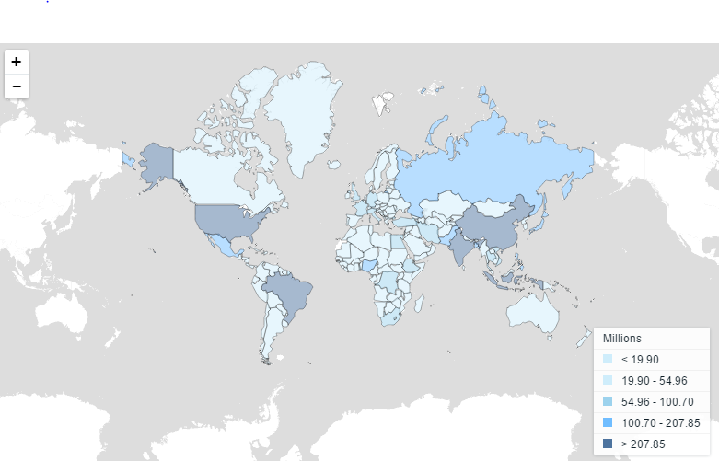
Measuring Living Standards—1
Total GDP:
  Not as accurate for cross-country comparisons
  Does not adjust for population size of country
Notes:
Lecture notes:
The level of GDP may not be the best measure to compare across countries. The population varies dramatically across countries. These differences are displayed on the map. Failing to account for variation in population size when measuring total production could lead to biased results.

Slide 12
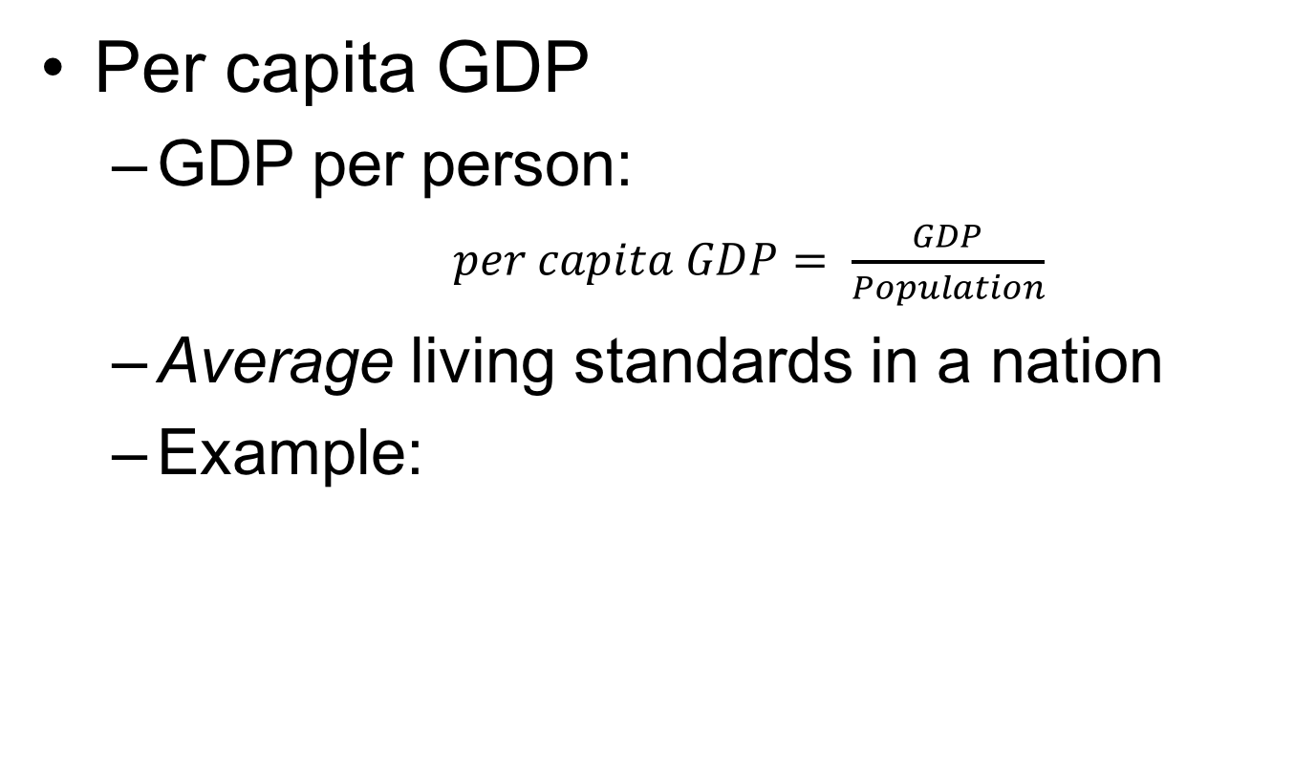
Measuring Living Standards—2
Per capita GDP
  GDP per person:
    $per capita GDP= \frac{GDP}{Population}$
  Average living standards in a nation
  Example:
Country | 2013 GDP (billions of $) | 2013 GDP per capita ($)
China | 9,240 | 6,807
Germany | 3,730 | 46,269

Slide 13
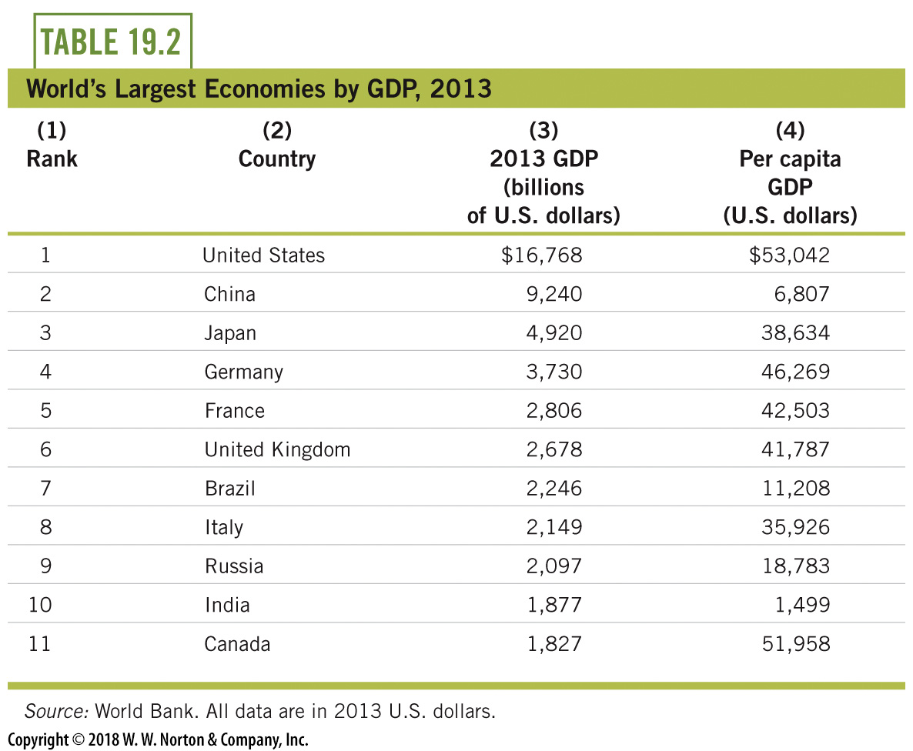
Measuring Living Standards—3
Notes:
Lecture notes:
We start with a look at the nations with the highest GDP in the world.
The table lists the world’s largest economies by GDP in 2013.
The third column shows GDP for the top eleven economies.
This column gives us a picture of the overall output and income of each of these nations.
Total world GDP in 2013 was $76 trillion, which means that the United States produced over 20 percent of all final goods and services in the world.
The most significant movement on this list belongs to China, who ranked only seventh in 1999.
By 2010, China actually surpassed Japan for second highest GDP in the world and remains above Japan in 2013.
If we instead consider GDP per capita, the rankings would be different.
For example, in 2013, there was about $39,000 worth of GDP or income for every person in Japan and only about $7,000 per person in China.
While China produced a larger amount of overall GDP than Japan, the income generated by GDP in China has to be divided over about ten times more than in Japan (the population in China is about 1.4 billion; in Japan, it is about 127 million).
Real-world example: Distribution of Worldwide Real GDP per Capita
This would be a good point in the lecture to discuss the real-world example on distribution of worldwide real GDP per capita, from the Interactive Instructor’s Guide (see Tip #208).

Slide 14
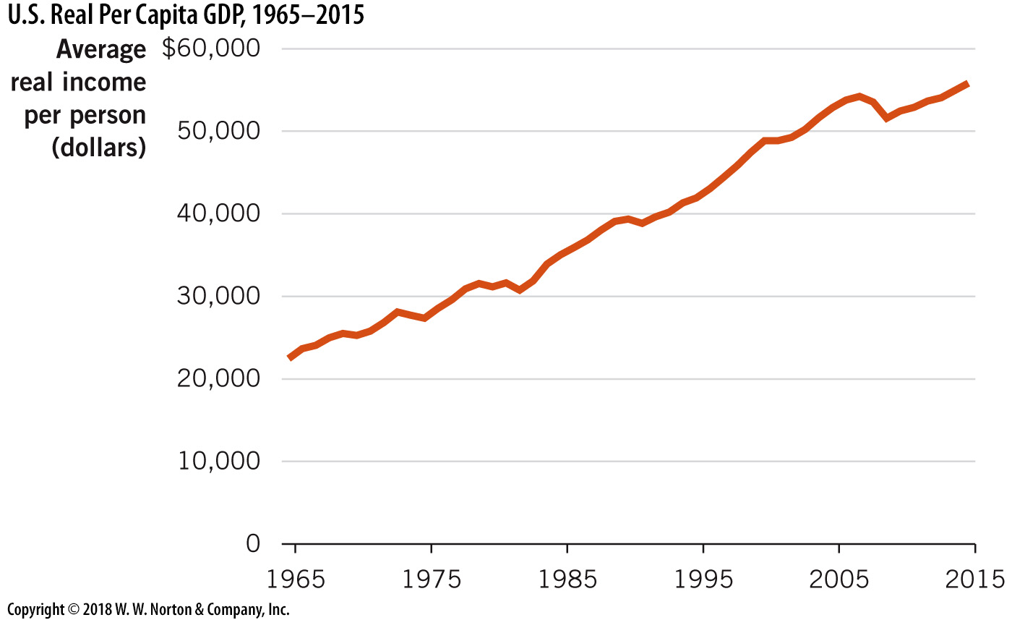
Measuring Economic Growth
U.S. Per Capita Real GDP
Notes:
Image: Figure 19.1
Lecture notes:
We also use GDP data to measure economic growth over time or changes in average living standards.
When economies grow and living standards rise, this is indicated by an increase in real GDP.
The figure above (Figure 19.1) shows the change in inflation-adjusted GDP per capita for the United States from 1965 to 2015. During this time frame, real GDP per capita rose about 2 percent per year, on average.
From this graph, we can infer that living standards rose in the United States over the past 50 years, even though growth was not positive in every year.
When discussing increases in standards of living and long-run economic growth, we are concerned with the overall trend in GDP as opposed to the short-run fluctuations.

Slide 15
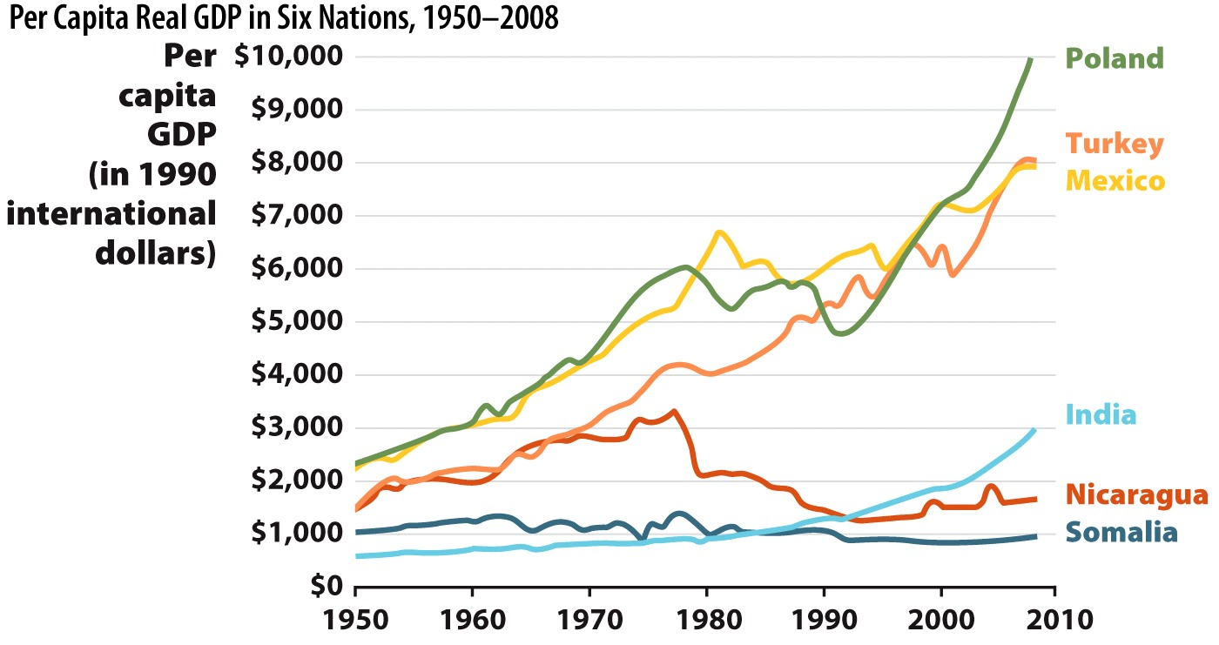
Per Capita Real GDP in Six Nations
Notes:
Image: Figure 19.2
Lecture notes:
Economic growth (or lack thereof) varies dramatically across countries. Not every country grows by the standard annual 2 percent rate of the United States.
The figure above (Figure 19.2) shows the change in GDP per capita for six different countries, all with a variety of growth experiences.
Classroom demonstration:
After discussing the figure, you can try one (or both!) of the following classroom demonstrations from the Interactive Instructor’s Guide:
Think-Pair-Share: Comparison of U.S. GDP with Other Countries’ GDP (see Tip #206)
To help students get an idea of the size of the U.S. economy compared to the economies of other countries of the world, ask them to compare the GDP of their home state with that of other countries around the globe.
Show them the interactive map from The Economist (included in the Interactive Instructor’s Guide), or ask them to research the relevant GDP data to create their own map.
Then ask students to calculate the per capita GDP for their home state and for the country to which their state is compared.
When they finish their calculations, discuss possible reasons for the differences.
Think-Pair-Share: Using GDP to Make Comparisons (see Tip #207)
Ask students to form pairs and work together to rank the four options below from the most appropriate comparison to the least appropriate:
Comparing the United States of 2012 with the United States of 1912
Comparing Greece with Germany
Comparing China and Japan
Comparing the United States and Canada
The answer should be a ranking of 4, 3, 1, 2.

Slide 16
Measuring Business Cycles
Business cycle
  Short-run fluctuations around the long-run trend
Parts of a business cycle:
  Expansion (Trough to Peak)
  Contraction (Peak to Trough)
Notes:
Lecture notes:
Even if an economy is expanding in the long run, it is normal to go through periodic contractions in GDP. Typically, economic growth follows a short-run pattern of alternating periods of expansion and contraction, characterized by changes in employment, productivity, and interest rates known as the business cycle.
A complete business cycle is a period of expansion and contraction.
An expansion is from a trough in GDP to a peak in GDP (see next slide for visualization).
During an expansion, total production and total employment increase.
A contraction (recession) is from a peak in GDP to a trough in GDP.
During a contraction, total production and total employment decrease.
The idealized business cycle is relatively easy to define; however, in real time, the phases of the business cycle are often hard to identify.
The National Bureau of Economic Research (NBER) defines a recession as “a significant decline in economic activity spread across the economy, lasting more than a few months, normally visible in real GDP, real income, employment, industrial production, and wholesale-retail sales” (http://www.nber.org/cycles/jan08bcdc_memo.html).
However, economists often debate this definition along with others.

Slide 17
The Business Cycle
Notes:
Image: Animated Figure 19.3
Lecture notes:
The figure above illustrates the behavior of the business cycle around the long-term trend in real GDP.
Point out to students that the straight blue line (long-run trend of GDP) has a positive slope.
This indicates economic growth (increases in real GDP) over time.
Instead of experiencing changes in real GDP exactly along the trend line of long-run real GDP, the economy experiences fluctuations in short-run output around the long-run trend.
When the level of GDP is higher than usual, the economy climbs to short-run peaks.
When the level of GDP is lower than the trend, the economy falls to short-run troughs.
The peaks and troughs divide the business cycle into two distinct phases:
Expansions
Contractions
Expansions occur from the bottom of a trough to the next peak. After a period of time (the duration varies), the economy enters a contraction, or the period from the peak downward to the trough. During this phase, the economy is growing at a slower rate than normal or experiencing declines in real GDP.
Lecture tip:
Business cycle periods of expansion and contraction vary in length. The NBER provides a table that outlines the business cycle stages from December 1984 (trough) to June 2009 (trough) (http://www.nber.org/cycles.html). It could be a good idea to show this table to students.
Below are averages over all recorded cycles:
Peak to trough Previous trough to this peak Trough from previous trough Peak from previous peak
1854-2009 (33 cycles) 17.5 38.7 56.2 56.4*
1854-1919 (16 cycles) 21.6 26.6 48.2 48.9**
1919-1945 (6 cycles) 18.2 35 53.2 53
1945-2009 (11 cycles) 11.1 58.4 69.5 68.5
Notice that periods of recession have decreased in duration over this time frame.
Source: NBER, http://www.nber.org/cycles.html
* 32 cycles
** 15 cycles

Slide 18
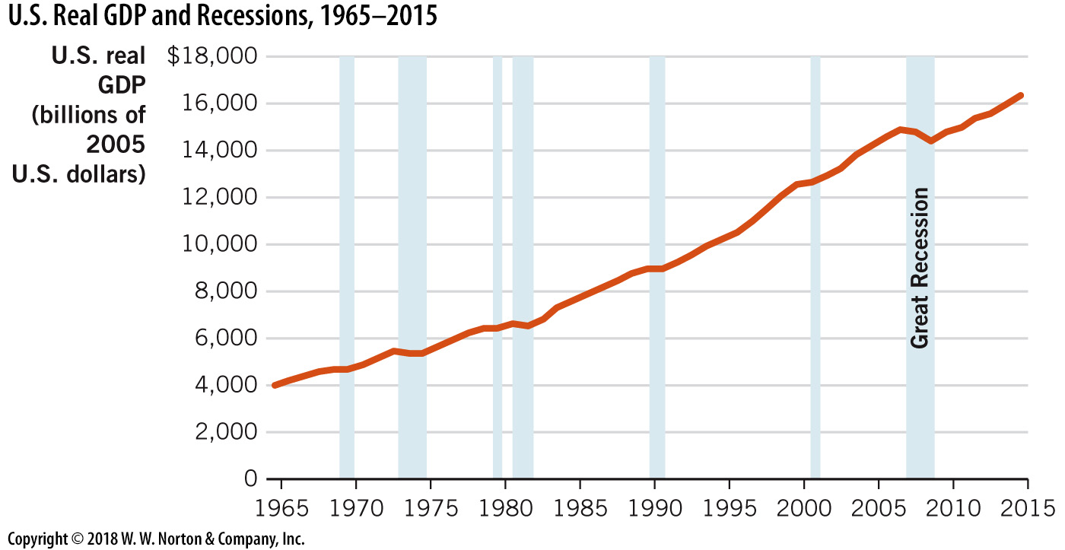
U.S. Real GDP and Recessions, 1965–2015
Notes:
Image: Figure 19.4
Lecture notes:
This figure is a plot of U.S. real GDP over time, with contractionary periods (official recessions) shaded.
Point out to students how real GDP consistently declines in these contractionary periods.
You may recall the recession that began at the end of 2007, known as the Great Recession—this episode shows up clearly in the data.

Slide 19
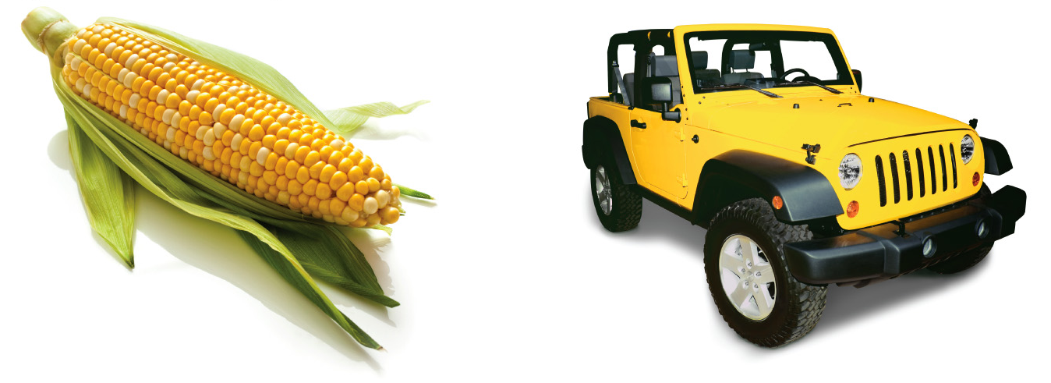
Looking Closely at How We Measure GDP—1
Why does GDP count the “market value”?
  Quantities do not provide enough information
  For example, in 2010, the United States produced
    12 billion bushels of corn
    8 million cars
  Quantities would suggest that corn is more “important” to GDP relative to cars
Notes:
Lecture notes:
We need to compute the market value of goods and services in order to aggregate and form the measure of GDP. Market value of a good or service can be defined as the price per unit multiplied by the quantity produced.
Quantities alone do not provide enough information. The units for various quantities cannot be added together (e.g., gallons of milk, cups of coffee, pounds of steak, bottles of perfume, etc.).
Ask students the following question:
Even though we produced a lot more corn than cars, why might cars be a larger part of our GDP?
The price of a car is much greater than the price of a corn bushel.

Slide 20
Looking Closely at How We Measure GDP—2
 | Quantity | x | Price | = | Market Value
Corn | 12 billion bushels | x | $5 | = | $60 billion
Cars | 8 million vehicles | x | $30,000 | = | $240 billion
 |  |  |  |  | $300 billion
Notes:
Lecture notes:
If bushels of corn sell for $5 each, corn would account for $60 billion of GDP.
If each car sells for about $30,000 each, on average, cars would contribute $240 billion to GDP.
These numbers tell a different story than quantities alone. According to market value, cars account for a larger portion of GDP than corn does.
Note that sometimes prices rise over time due to inflation.
This means that even if production levels stay the same, GDP will increase since prices are higher!
Later, we will adjust for inflation in calculating GDP.

Slide 21
Looking Closely at How We Measure GDP—3
GDP includes both goods and services.
  Goods
    Tangibles
    Food, clothing, cars, houses
  Services
    Intangibles
    Health care, entertainment, advice, travel, banking
  The composition of our industries and economy has greatly changed over the last 50 years.
Notes:
Lecture notes:
GDP measures total production, including both goods and services.
Ask students the following question:
What do you think we produce more today than previously, goods or services?
A higher percentage of our GDP comes from services today than ever before.
Today, services account for over two-thirds of total output.

Slide 22
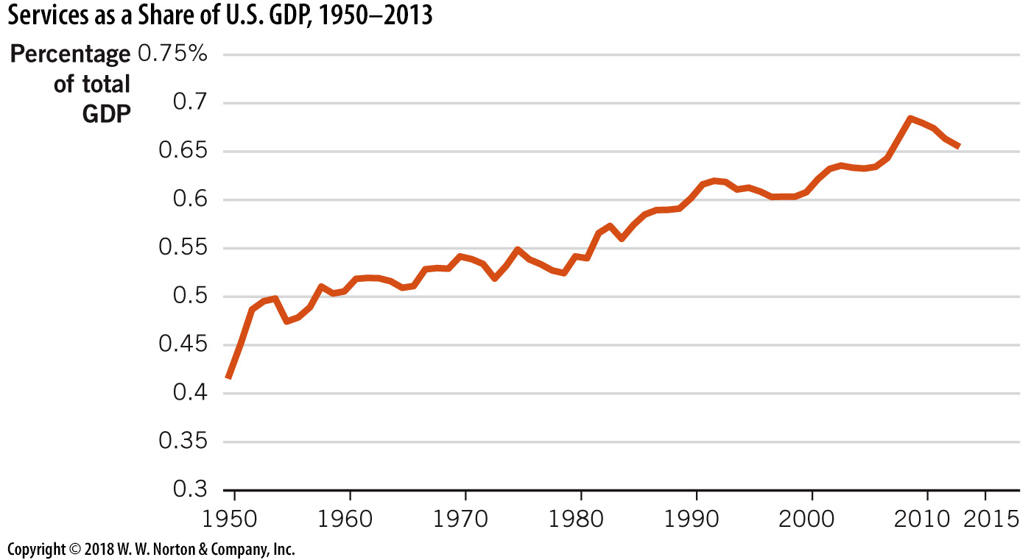
Services as a Share of U.S. GDP
Notes:
Image: Figure 19.6
Lecture notes:
Over the past 50 years, one big shift has been out of manufacturing (goods) and into services.
In the past, the dominant industries in the United States were goods such as automobiles, steel, and household goods.
Now, a majority of U.S. GDP is service output such as financial, transportation, retail, and technology services. Figure 19.6 above shows services as a share of U.S. GDP since 1960, which have grown from 50 percent in 1960 to about 70 percent in 2013.

Slide 23


Intermediate versus
Final Goods—1
Intermediate goods
  Goods that firms repackage or bundle with other goods to be sold at a later stage
    Milk sold to a coffee shop
    Tires sold to a car manufacturer
Notes:
Lecture notes:
The picture on the left shows a customer buying a final good (a latte).
The inputs sold to the coffee shop, milk, and coffee are intermediate goods.
Note: if milk or coffee are sold directly to a consumer (e.g., in a grocery store), the same goods are now considered final goods.
The picture on the right shows a worker at a car manufacturer with a tire.
The tires sold to the car manufacturer are intermediate goods.
The car is the final good.
Note: if tires are sold directly to a consumer from an auto store, they are categorized as final goods.

Slide 24

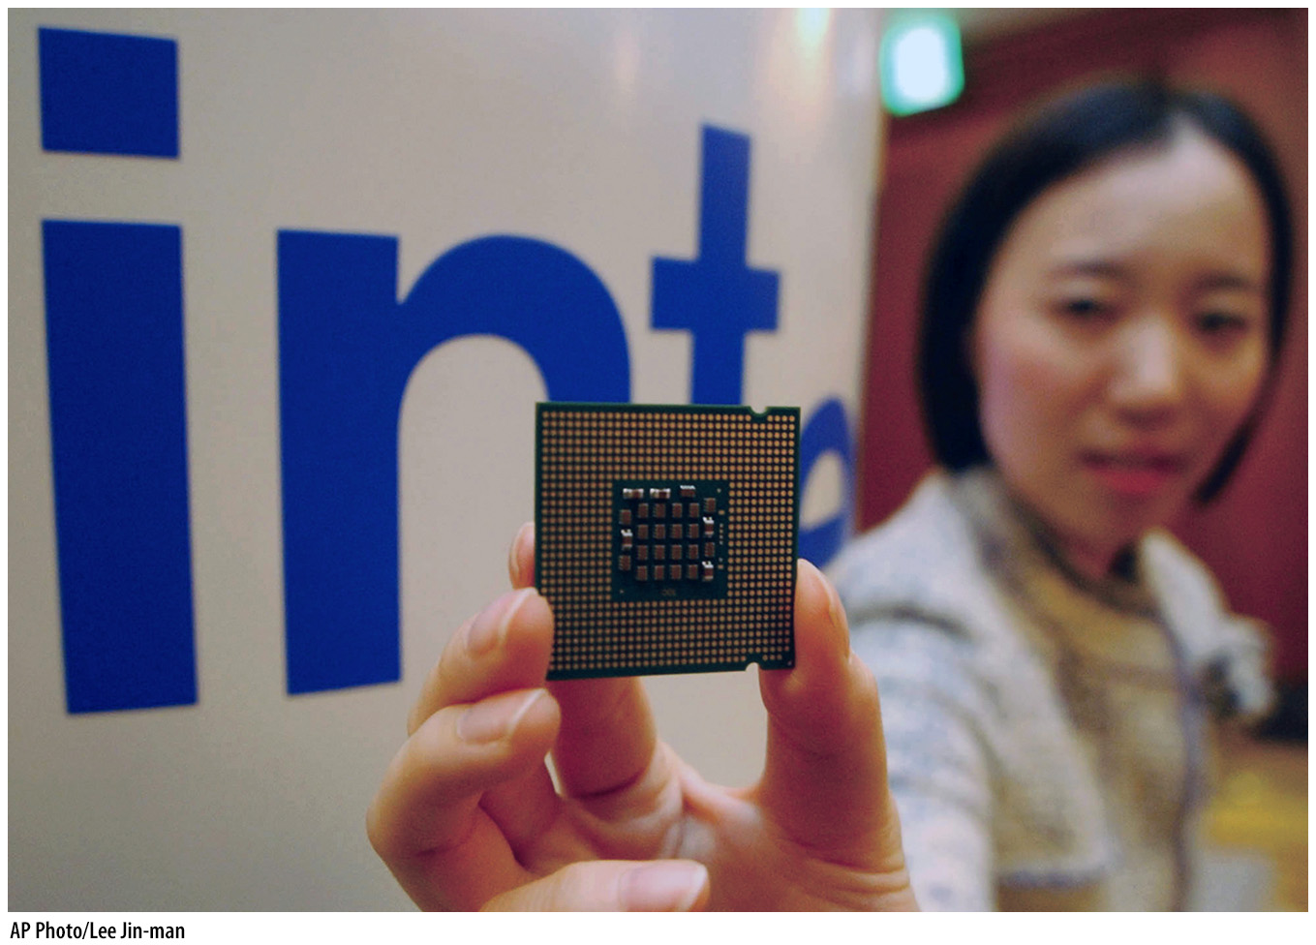
Intermediate versus
Final Goods—2
Final goods
  Goods sold to the final users or consumers
To get an accurate GDP estimate and avoid double counting
  Finals goods are included in GDP
  Intermediate goods are not
Notes:
Lecture notes:
If intermediate goods were counted as part of GDP, they would essentially be counted twice.
Their value also increases the market value of the final good.
Double-counting would bias our measure of GDP upward.

Slide 25
Practice What You Know—2
Why doesn’t GDP count expenditures on intermediate goods?
  to make GDP calculations easier
  because intermediate goods are used by firms instead of consumers
  to avoid double counting
  intermediate goods have no market value
Notes:
Clicker question:
Correct answer: C, to avoid double counting
If we count intermediate goods and then count final goods (which are created from intermediate goods), we are also double counting. We don’t count the cheese, pepperoni, sauce, and also the pizza. We just count the final pizza.

Slide 26
Intermediate Steps in Cell Phone Production
Steps | Value added during step | Prices of completed steps
1. Outer case and keyboard | $ 5 | $ 5
2. Internal hardware | 10 | 15
3. Install operating system | 15 | 30
4. Connect to network | 49 | 79
5. Retail sale | 120 | 199
Sum total | $199 | $338
Notes:
Lecture notes:
The column on the right is a running total of the numbers on the left. The final price of the phone is $199. However, if we count all total values of the intermediate steps as GDP, we will overvalue the phone and say that it contributed $338 to GDP.
Explanation from the text:
It is possible to get an accurate measurement of GDP by taking the sale price of the final good or by taking the value added at each step along the way, but not both. That’s double counting. So, we focus on final goods when determining GDP. You cannot get an accurate measure of GDP by summing up all of the sales made throughout the economy during the year since many of those sales will reflect the intermediate steps in the production process.

Slide 27
Looking Closely at How We Measure GDP—4
Production from a particular period
  Avoids issues with double counting
  Example:
    A new car is produced and sold in 2014.
    Two years later, the owner decides to sell it.
Notes:
Lecture notes:
Usually, we examine GDP figures for a particular year. However, we can also calculate GDP over a month, quarter, or multiple-year period.
GDP only includes production from a specific period, regardless of the length of the period.
Again, this is to avoid issues with double counting.
You can expand on the example presented on the slide:
A new car is produced and sold in 2014.
Two years later, the owner decides to sell it.
We do not want to recount a good that was produced two years ago. Therefore, used cars that are resold do not count in GDP since the used car was previously counted in GDP the year it was produced and sold for the first time.
If we counted the used car when it was resold, we would be counting that car as part of GDP twice, even though it was produced only once.
An important note here: The sale of financial assets such as stocks and bonds do not count toward GDP. These types of sales are a transfer of wealth and do not represent new production.
A couple of important caveats:
Brokerage fees do count as payment for the brokerage service, and they are included in GDP.
If the money from a stock purchase is used by a firm for investment, this amount is included in GDP.
Classroom demonstration: Think-Pair-Share: What’s In and What’s Out?
This is a good place to try the activity from the Interactive Instructor’s Guide on measuring GDP (see Tip #213).
Ask students to pair up (perhaps by pairing with someone who has the same first number or letter +/-1 in his or her student ID).
Ask them to categorize the following items as either included in the calculation of GDP or excluded from it (answers are below):
Buns bought by McDonald’s for making Big Macs
Excluded; intermediate good
A used macroeconomics textbook
Excluded; secondhand good
A new pair of Wrangler jeans
Included; consumption
Newly purchased shares of Google stock
Excluded; not economic investment
A ticket to see Tiesto in October
Included; consumption
A new Lexus SUV
Included; consumption
A newly purchased $10,000 U.S. Treasury bill
Excluded; not economic investment
A cup of coffee purchased at Dunkin’ Donuts
Included; consumption

Slide 28

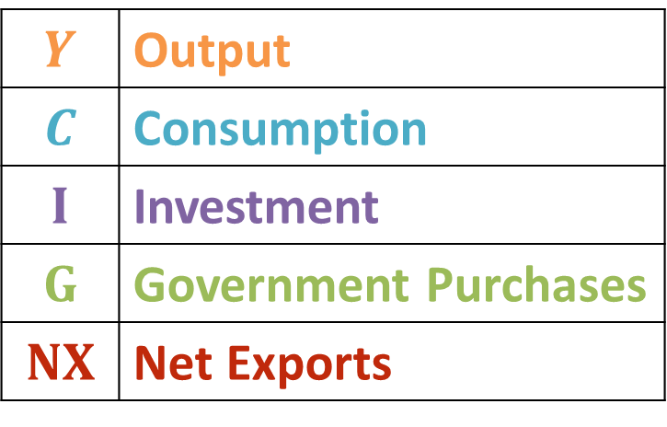
Looking at GDP as Different Types of Expenditures
The Bureau of Economic Analysis (BEA) is the U.S. government agency that tallies GDP data, a task is called national income accounting.
 | Output
 | Consumption
 | Investment
 | Government Purchases
 | Net Exports
Notes:
Lecture tip:
This equation represents the expenditure approach to calculating GDP. The equation states that GDP is the sum of consumption, investment, government purchases, and net exports. We will look at each component individually on the subsequent slides.

Slide 29
Practice What You Know—3
What is the biggest component of GDP?
  consumption [C]
  investment [I]
  government purchases [G]
  net exports [NX]
Notes:
Clicker question:
Correct answer: A, consumption [C]
Consumption is much bigger than the other components at $10 trillion each year. Net exports are actually negative since we import more than we export.

Slide 30
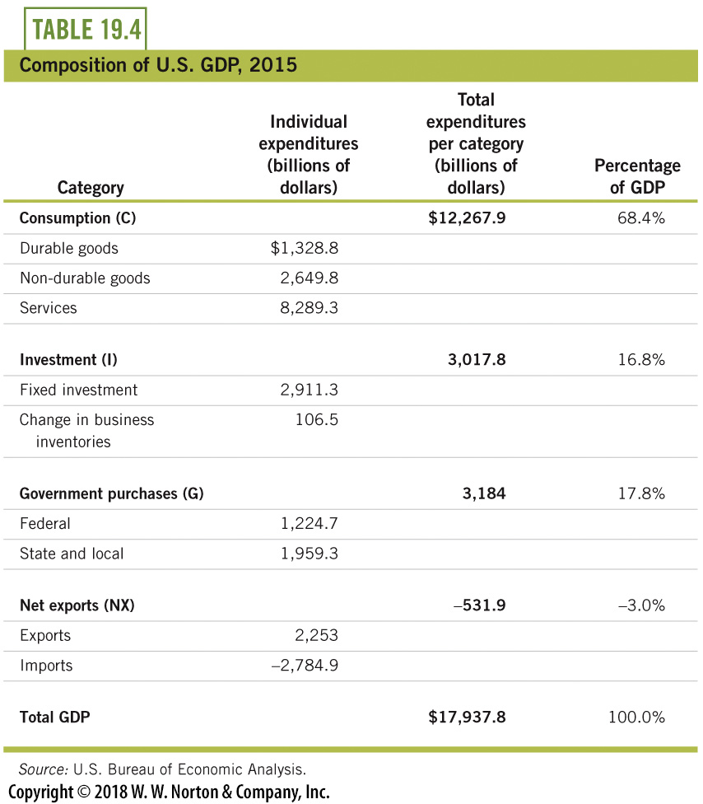
Composition of U.S. GDP, 2015
Billions of Dollars
Notes:
Lecture notes:
The Bureau of Economic Analysis (BEA) is the government agency that calculates GDP statistics. In 2015, U.S. GDP was equal to almost $18 trillion. The largest component of GDP is consumption, followed by government purchases and investment. Net exports are negative, implying that imports are greater than exports.
Example from the text:
To get a sense of what that amount represents, imagine laying 18 trillion one-dollar bills from end to end. That would be enough to cover every U.S. highway, street, and county road more than twice!
Classroom demonstration: Think-Pair-Share: Staying Up-to-Date with GDP
This is a good place to try the activity from the Interactive Instructor’s Guide on measuring GDP (see Tip #226).
Ask students to visit the BEA website (www.bea.gov) on a day that a news release will be posted, and have them review the release before class and to arrive prepared to pair up and discuss their findings with their peers.

Slide 31


Consumption
Consumption
Durable goods
Consumed over a long period
Nondurable goods
Consumed over a short period
Services
Notes:
Lecture notes:
Consumption includes the final purchases of goods and services by households, with the exception of new housing.
Consumption can be subdivided into three categories:
Durable goods
Nondurable goods
Services
Durable goods:
Goods consumed over a long period of time, such as cars and appliances.
They are more subject to cyclical fluctuations, as people tend to postpone buying goods that last for many years when the economy is struggling.
A refrigerator is an example of a durable good.
If economic times are bad (job loss, high levels of uncertainty, lower incomes), you can likely delay the purchase of a new refrigerator and still use your old one for a few more months.
Nondurable goods:
Goods consumed over a short period of time, such as groceries, magazines, and medicines.
They are not affected as much by cyclical fluctuations. Since nondurable goods do not last as long, they are usually purchased irrespective of the economic environment.
Groceries are an example of nondurable goods.
People will always need to eat and will purchase groceries regardless of economic conditions.
However, people may substitute lower-quality (lower-cost) nondurable goods during economic contractions.

Slide 32
Investment
Investment
  Capital purchases
  Changes in business inventories
  New residential housing
Investment does not include purchases of stocks and bonds
Notes:
Lecture notes:
Investment purchases include:
Capital spending
Changes in business inventories
New residential housing
Capital purchases include any private spending on goods used to produce future output.
This includes small purchases such as tools, as well as other more substantial spending such as equipment, computers, and factories.
Inventories are goods that have been produced but not yet sold, representing a future increase in output. An increase in inventory allows the firm to produce more and is an investment for the future. For example:
A large book-printing company is confident that demand for books and magazines will be robust in the months ahead.
It increases its supply of paper so it will not have a shortage when demand increases.
Paper takes a long time to deliver from factories, and if the company does not have the paper on hand when orders come through, it will lose the business, as the book or magazine publisher keeps searching for a printer who has the paper on hand.
The increase in the supply of paper purchased by the printing company represents an increase in inventories and a predicted increase in future production.
New home purchases by consumers are also counted as investment, not consumption.
Note that investment is not “investing” in stocks and bonds. Again, these purchases do not represent new production.
Real-world example: How Lady Gaga Is Changing GDP
Ask students to listen to the podcast linked in Tip #215 in the Interactive Instructor’s Guide, or ask them to read the short synopsis by the Wall Street Journal (both are based on the BEA’s paper outlining the changes that took place during the summer of 2013).

Slide 33

Government Purchases
Government purchases
  Spending by state, local, and federal governments on goods and services
Transfer payments are not included
Notes:
Lecture notes:
Government purchases include spending on goods and service by state, local, and federal governments. This includes employee salaries, public works projects, schools, national defense, and post offices.
Transfer payments are government outlays to households, including welfare and social security. Transfer payments are not included as part of government purchases. While transfer payments do increase household income, this does not fit into the expenditure definition of GDP. However, when households spend this income, it does enter into GDP as part of consumption or investment.

Slide 34
Net Exports
Net Exports (NX)
  Exports minus imports
    If imports > exports → NX < 0 → Trade deficit
    If exports > imports → NX > 0 → Trade surplus
NX represents a small fraction of total GDP
Is it bad to be in a trade deficit?
  Not necessarily
  More imports means more goods and services for people in this country
Notes:
Lecture notes:
Imports are subtracted from the total level of GDP because they were not produced here (even though they are used here). GDP is intended to measure domestic production.
Exports enter positively into the GDP equation because they are part of domestic production.
Imports and exports will be discussed in more detail in Chapter 32.
A trade deficit is not necessarily “bad” for the United States, even though it does decrease GDP. All else equal, a trade deficit implies that people in the United States are consuming more goods and services.
Suggested reading:
This article discusses some of the potential benefits of a trade deficit (related to capital flows) in more detail:
http://www.nytimes.com/2016/12/02/upshot/want-to-rev-up-the-economy-dont-worry-about-the-trade-deficit.html?mwrsm=Email&_r=0

Slide 35
Real GDP: Adjusting GDP for Price Changes
Nominal GDP
  GDP measured in current prices
Real GDP
  GDP measure with prices held constant over time
Price level
  An index to measure prices of goods and services in an economy
    GDP deflator
      Price level index that includes prices of final goods and services in GDP
Notes:
Lecture notes:
Generally, prices rise over time. Therefore, if we do not take this into account when measuring GDP and trying to make historical comparisons, we will likely overestimate increases in GDP. Nominal GDP is calculated by aggregating the market value (price times quantity) of goods and services produced in a country during a given time period. The prices at the time GDP is calculated are used to compute nominal GDP.
GDP is intended to measure changes in production.
So, we want to be sure to hold prices constant over time to be able to differentiate between changes in quantities and changes in prices.
Real GDP is adjusted for inflation.
A particular year is designated as the base year, and then the prices of goods and services in the base year are used to calculate the market value of goods and services.
The GDP deflator is a broad price level index. We can use the GDP deflator to remove inflation from nominal GDP and calculate real GDP.

Slide 36
Practice What You Know—4
How is real GDP different from nominal GDP?
  Real GDP is adjusted for inflation, and nominal GDP is just measured in current prices.
  Real GDP includes goods and services, and nominal GDP only includes goods.
  Real GDP averages income over time, and nominal GDP is just for this year.
Notes:
Clicker question:
Correct answer: A, Real GDP is adjusted for inflation, and nominal GDP is just measured in current prices.
“Real” means inflation adjusted. Real GDP is found by adjusting nominal GDP for inflation.

Slide 37
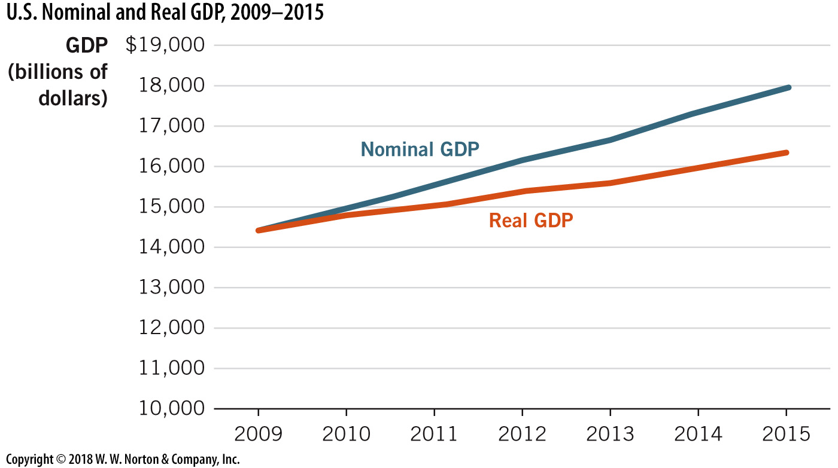
U.S. Nominal and Real GDP
Notes:
Image: Animated Figure 19.7
Lecture notes:
Nominal GDP usually rises faster than real GDP. This is because nominal GDP reflects both an increase in prices over time and an increase in production. For example, nominal GDP rose 24 percent from 2009 to 2015; however, the increase in real GDP over this period was 13 percent. The difference between these two percentages is inflation.
Here is an example you could discuss during your lecture:
Suppose the United States produces 10 million apples in 2010 at a price of $1.00 per apple. GDP from apples is equal to $10 million.
In 2011, the United States produces 10 million apples at a price of $1.10 per apple. The price increase is mainly due to inflation, not an increase in the quality of apples. GDP from apples in 2011 was $11 million dollars.
In this example, production remained the same, but nominal GDP in 2011 was $1 million greater than nominal GDP in 2010, simply because prices rose. However, it would appear that production increased because of the change in nominal GDP. Not accounting for inflation can lead to biased results.
If we examine 2011 output using 2010 prices, real GDP in both years would be equal.

Slide 38
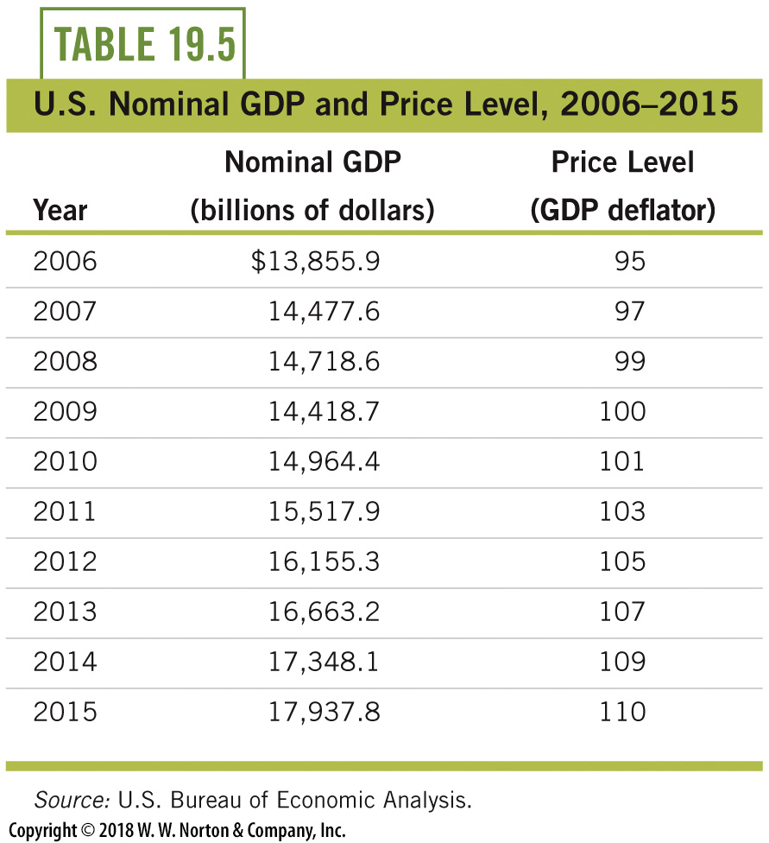
U.S. Nominal GDP and Price Level, 2006–2015
Notes:
Lecture tip:
The next few slides use numbers from this table. Ask students to keep the table handy.
Lecture notes:
To compute real GDP, we ignore the current prices of goods and services and use prices from a common year, or base year, to calculate market value.
In this table, the base year is 2009. First, we measure the nominal output in all years. Then, we find GDP in each year using the price level for 2009. This allows us to find only differences in real output, as opposed to GDP differences caused by price changes.

Slide 39
Finding Real GDP
Remove current prices from nominal GDP data
  Divide nominal GDP by the contemporaneous price level
Convert to constant base year prices
  Multiply by the base year price level (100)
Notes:
Lecture notes:
There are two steps to convert nominal GDP to real GDP:
Divide nominal GDP by the price level in the current year.
Multiply by the price level in the base year (always 100).
Note: Multiplying by 100 does not make this value a percentage. Instead, it converts the unit price to base year prices.
Dividing by the price level adjusts for inflation. In order to compare levels of GDP over time, we want to capture increases in GDP only due to changes in production, not due to changes in prices (inflation). Therefore, we need to compute real GDP to evaluate changes in production across years.

Slide 40

Finding Real GDP:
An Example
Find real GDP for 2014
  Plug numbers from Table 19.5 into the equation
  Use t = 2014
  2014 real GDP in 2009 prices
Notes:
Lecture notes:
Using the numbers from Table 19.5, we can find real GDP in 2014:
First, divide nominal GDP in 2014 ($17,348.1) by the price level in 2014 (109).
Then, in order to convert to base year prices, multiply by the price level in 2009 (100).
The resulting value ($15.9157 trillion) is 2014 real GDP in 2009 prices (adjusted for inflation).

Slide 41
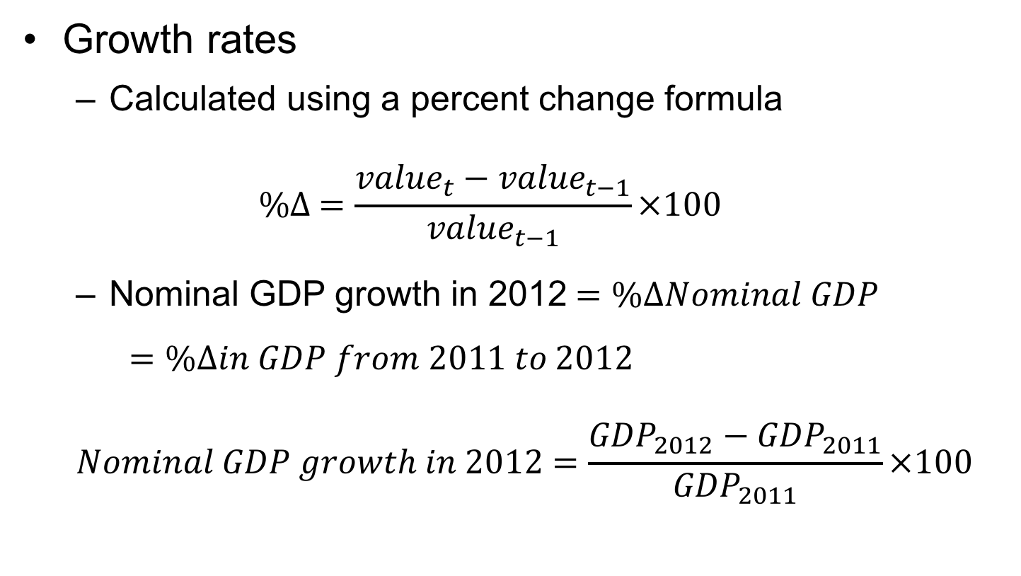
Growth Rates—1
Growth rates
  Calculated using a percent change formula
  $$\%∆ =\frac{{value}_{t}−{value}_{t−1}}{{value}_{t−1}}×100$$
  Nominal GDP growth in 2012$=\%∆Nominal GDP$
  $=\%∆in GDP from 2011 to 2012$
  $$Nominal GDP growth in 2012=\frac{{GDP}_{2012}−{GDP}_{2011}}{{GDP}_{2011}}×100$$
Notes:
Lecture notes:
The ∆ means change.
Here, we use the percentage change formula = “new value minus old value all divided by the old value.”
A negative growth rate means the economy is contracting. A positive growth rate means the economy is expanding.
Note: Multiplying by 100 here is not the same as before. Here, 100 is used to convert the decimal to a percentage.

Slide 42
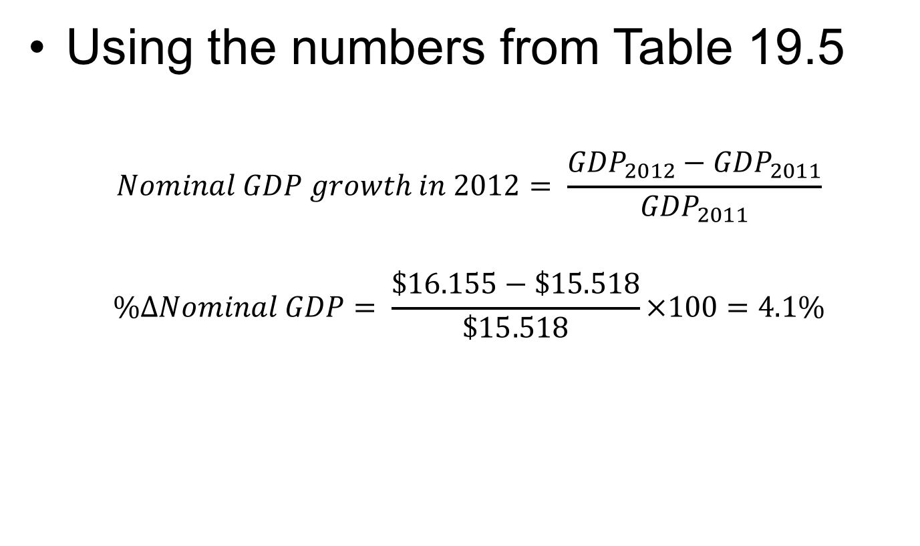
Growth Rates: An Example
Using the numbers from Table 19.5
$$Nominal GDP growth in 2012= \frac{{GDP}_{2012}−{GDP}_{2011}}{{GDP}_{2011}}$$
$$\%∆Nominal GDP= \frac{\$16.155−\$15.518}{\$15.518}×100=4.1\%$$

Slide 43
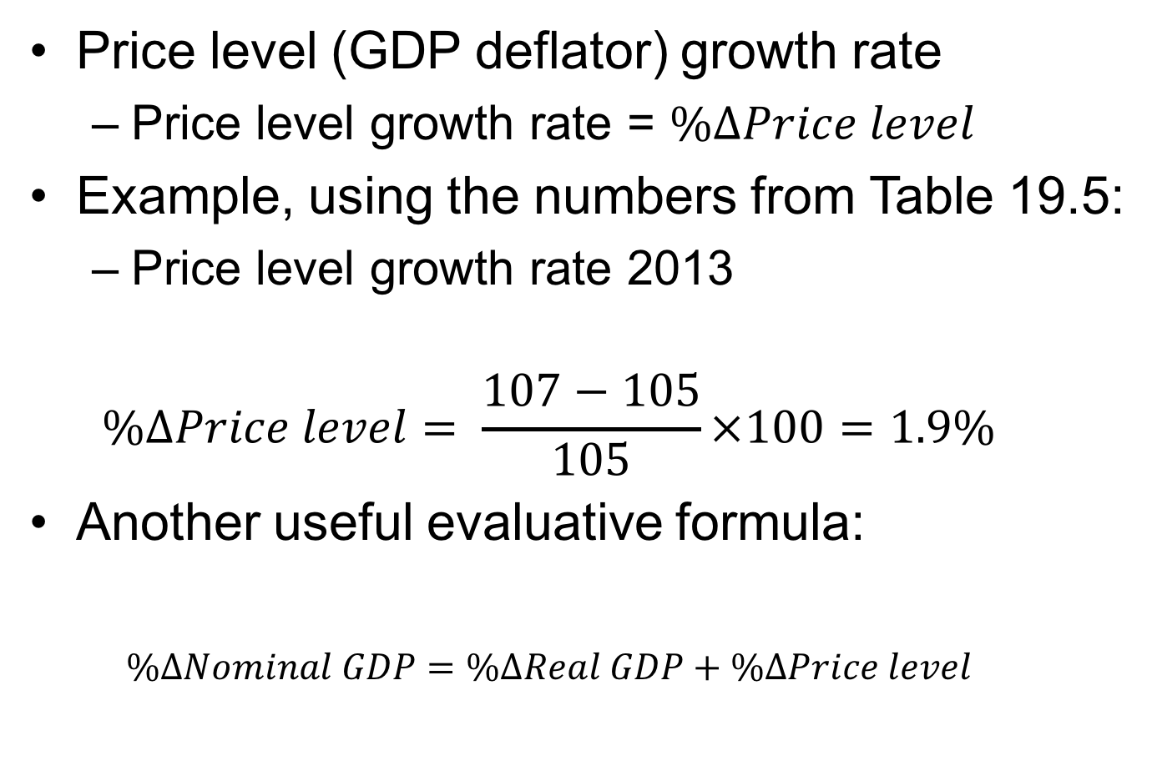
Growth Rates—2
Price level (GDP deflator) growth rate
  Price level growth rate = $\%∆Price level$
Example, using the numbers from Table 19.5:
  Price level growth rate 2013
  $$\%∆Price level= \frac{107−105}{105}×100=1.9\%$$
Another useful evaluative formula:
  $$\%∆Nominal GDP=\%∆Real GDP+\%∆Price level$$

Slide 44
Shortcomings of GDP—1
GDP is a measure of production
It is often used as a proxy for well-being
But, there are several shortcomings of this measure including:
  Nonmarket goods
  Underground economy
  Environmental quality
  Leisure

Slide 45

Shortcomings of GDP—2
Nonmarket goods
  Goods and services produced but not sold
  Uncompensated household activities:
    Washing dishes
    Mowing lawns
    Cleaning
Notes:
Lecture notes:
GDP is unable to distinguish how goods are produced. For example:
Nonmarket goods still create value for society.
Nonmarket goods include any type of household production that is not directly compensated.
When the nonmarket segment of an economy is large, this can led to a dramatic undercounting of the annual output being produced. This is more prevalent in less-developed countries.
Therefore, in less-developed societies where houses produce many of their own goods, GDP may be a poor measure of economic output.

Slide 46

Shortcomings of GDP—3
Environment quality
  Country A
    10 million units of output
    Clean energy, clean air
  Country B
    10 millions unit of output
    No environmental standards
  Equal GDP, but is well-being the same?
Notes:
Lecture notes:
Environmental quality is not included in GDP; however, low environmental standards can lead to health issues and other undesirable features.
Generally, we assume that people assign a positive value to beautiful scenery, clean air, and clean water, but these are not counted in GDP. In fact, it is often the case that countries with greater GDP (production) also have more pollution. In this way, GDP may not be an accurate measure of well-being.

Slide 47
Economics in Superbad
Underground economy
Notes:
”Economics in the Media” Slide
Lecture notes:
The clip mentioned on the slide can be found in the Interactive Instructor’s Guide. Access the direct link by clicking the icon in the PowerPoint above. (Link to Tip #212)
In this film, the main characters (three high school seniors) are trying to purchase liquor for a high school party in order to impress a girl. One of them, Fogell, participates in the underground economy by purchasing a fake ID. To his friends’ chagrin, he chose the fake name “McLovin” for the ID.
You can use this clip to explain to your students that many purchases, such as fake identification cards, do not count toward U.S. GDP.
Alternatively, ask students read the article about the bust of a fake-identification ring at the University of Georgia several years ago. Fake IDs are a part of the underground economy that students can relate to. (Joe Johnson, “UGA Students Face Felony Charges Following Fake ID Probe,” Online Athens, September 12, 2012, onlineathens.com)

Slide 48
Shortcomings of GDP—4
Underground economy
  Size of underground economy?
    10 percent of GDP (estimated) in United States
    45 percent in developing countries
Underground economy
Legal
Waitress tips
Babysitting
Illegal
Narcotics exchanges
Prostitution
Notes:
Lecture Notes:
If transactions are not directly measurable (because the income is not reported), they are not included in official measures of GDP.
The underground (shadow) economy can be divided into two subcategories:
Legal activity
All “legal” underground activity is technically illicit, as tax evasion is a crime.
Illegal activity
The Organization for Economic Cooperation and Development (OECD) has estimated that for developed countries, the underground economy is about 15 percent of GDP. In transitioning economies, the percentage rises to between 21 and 30 percent of GDP, and in developing countries, the underground economy can be as much as 45 percent of GDP.
The U.S. is widely believed to have one of the smallest shadow economies in the world, approximately 10 percent of GDP. In the United States, most citizens can earn more by legitimately participating in the economy than by engaging in illegal activities. A strong economy that creates jobs and opportunities for advancement helps to reduce the size of the underground economy. Corruption is also less common in the United States and developed economies, so participants are relatively free to transact with one another without bribes to authorities or organized crime. This is often not the case in many developing countries.
Suggested readings:
Davidson, Adam. “The Economy’s Missing Metrics.” The New York Times Magazine. July 1, 2015.
Newman, R. “The New Underground Economics.” U.S. News & World Reports. March 18, 2013.
Restrepo-Echavarria, Paulina. “Measuring Underground Economy Can Be Done, but It Is Difficult.” The Regional Economist. January 2015.
Surowiecki, J. “The Underground Recovery.” The New Yorker. April 29, 2013.
Plumer, B. “The $2 trillion shadow economy is the recession’s big winner.” The Washington Post. April 23, 2013.

Slide 49

Shortcomings of GDP—5
Leisure time
  Tradeoff between labor and leisure
  Average work week
    South Korea: 46 hours
    Netherlands: 28 hours
    USA: 36 hours
    Japan: 36 hours
Notes:
Lecture tip:
Once again, you can ask students to compare:
If two countries have equal GDP, but one country has an average work week that is ten hours longer, are both places equally desirable to live in?
We may be able to accurately compare the United States and Japan (same work-week length), but it would be a misleading comparison (ceteris paribus) to compare the United States and the Netherlands without adjusting for the difference in number of hours worked.
Lecture notes:
We limit GDP to measuring economic production, knowing full well that it is not a perfect measure of well-being.
Higher levels of GDP are highly correlated with a better environment, higher quality, and better access to health care, more education, more leisure time, and low crime rates because a country with a higher GDP per capita can afford to invest in these areas instead of having to worry about the basic necessities.
Reality:
Alternative measures are difficult to quantify.
GDP is correlated with most of these other measures anyway.

Slide 50

Shortcomings of GDP—6
Other measures of well-being
  Life expectancy
  Education levels
  Access to health care
  Crime rates

Slide 51
Practice What You Know—5
Which of the following would not be included in GDP?
  Bob hires a construction company to build his home.
  Michael pays the neighbor kid to mow his yard.
  Alex buys some cheese and dough to bake a pizza at home.
  Elyse buys some shoes.
Notes:
Clicker question
Correct answer: B, Michael pays the neighbor kid to mow his yard.
You could probably imagine that this is a cash transaction. Even if Michael pays the kid with a check, it’s not going to be taxed or reported to the government.

Slide 52
Conclusion
In this chapter, we learned a measure of economic output, gross domestic product:
  The market value of all final goods and services produced in a nation within a specific period of time
Which is used to examine:
  Economic growth
  Fluctuations in economic activity around the long-run trend
  Cross-country comparisons
Notes:
Lecture notes:
Make sure to reiterate that, in order to make comparisons over time, we need to calculate real GDP by adjusting for inflation.

