Slide 1
Unemployment
20
Notes:
Pre-class music: “Paperback Writer” by The Beatles (See Tip #244)
The subject of this song sings about wanting to be a paperback writer, but “needing a job.” You can play this song to introduce different employment statuses to your students. Follow up the song by asking them what the subject’s employment status is. Is he unemployed, or actively seeking new work?

Slide 2
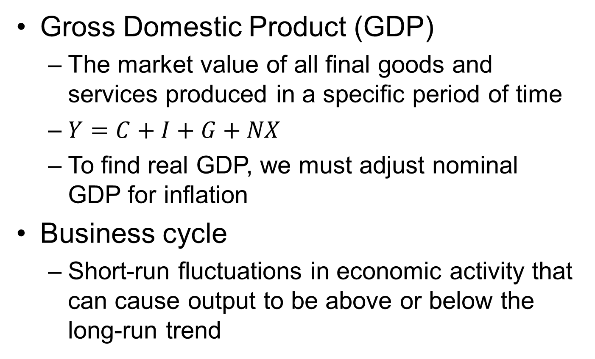
Previously
Gross Domestic Product (GDP)
  The market value of all final goods and services produced in a specific period of time
  $Y=C+I+G+NX$
  To find real GDP, we must adjust nominal GDP for inflation
Business cycle
  Short-run fluctuations in economic activity that can cause output to be above or below the long-run trend
Notes:
Lecture notes:
C = Consumption
I = Investment
G = Government purchases
NX = Net exports

Slide 3

Big Questions
What are the major reasons for unemployment?
What can we learn from the employment data?
Notes:
Writing to Learn: Google It!
This Writing to Learn exercise can be found in the Interactive Instructor’s Guide (See Tip #271).
What is the current unemployment level nationally, and how does it compare to the unemployment level in your state?
Hypothesize about the category or categories (structural, frictional, cyclical) of unemployment you believe may be responsible for the figures in your state and why.
Use the Internet to research the causes of unemployment in your state to determine the accuracy of your hypothesis.
Note to Instructor: These days most students carry around smartphones with Internet capability. Instead of fighting it, encourage responsible use of these devices during class. If you want students to use a piece of information that is readily available on the Internet, have them search for it.

Slide 4
U.S. Recession of 2008–2009
Why was unemployment so high after the Great Recession?
  Certain industries hit hard
    Housing
  Adjustment lags
    Corrections take time, are not instant
  Government policy
    Unintended consequences can lengthen unemployment
  How unemployment is measured
    If you are not looking for a job, you are not counted as unemployed
Notes:
Lecture notes:
There are several reasons that high unemployment rates were persistent following the official end of the Great Recession:
Industries (such as the construction sector and real estate) were significantly affected.
Adjustment lags—it takes time to switch jobs and it takes time to hire workers
Some government policies enacted during the recession had unintended consequences and inadvertently extended the duration of unemployment for many workers.
Unemployment measures are sometimes a bit inaccurate.
People who are not working and not actively searching for work are not considered part of the labor force, and are thus not considered unemployed. This is true even if the person really does want to work. Once that person starts to search for work, they are then once again considered part of the labor force and are unemployed.

Slide 5
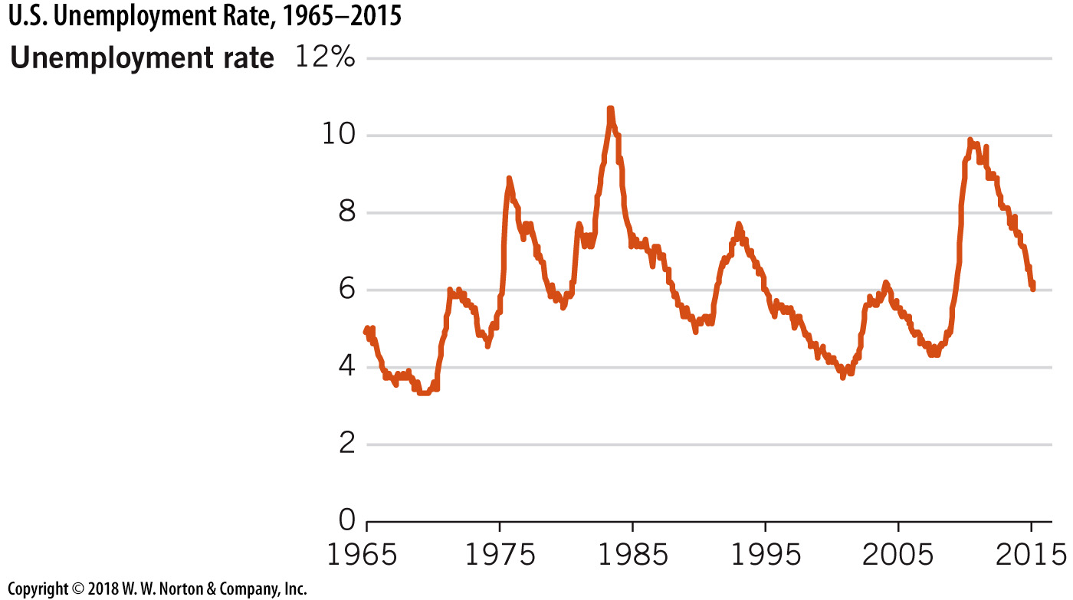
U.S. Unemployment Rate
1965–2015
Notes:
Image: Figure 20.1
Lecture notes:
The unemployment rate is an important indicator of the economy’s health.
Since 1960, the average unemployment rate in the United States has been about 6 percent.
During the Great Recession, the unemployment rate was over 10 percent. Since, it has fallen back to below pre-recession levels.

Slide 6
Three Types of Unemployment
Is it practical to have zero unemployment?
  Generally, unemployment is undesirable.
  However, as the economy evolves, jobs are created and destroyed.
Three types of unemployment
  Structural
  Frictional
  Cyclical
Notes:
Lecture notes:
Typically, unemployment is considered to be a drain on society and very difficult for certain individual households.
However, as the economy changes and progresses, jobs are created and jobs are destroyed.
Therefore, not all forms of unemployment (at least in the short run) are undesirable.
Lecture tip:
Ask your students:
What happens if we try to save every job?
Would we want to save the job of a scribe after the invention of the printing press?
Would we want to save the job of a milk delivery man after the invention of home refrigeration?
Are all book-printing jobs worth saving with the expansion of digital media?
With creative destruction, new technology can sometimes create new jobs but destroy old jobs. The people working in these old jobs may lose their jobs and be temporarily unemployed. We would not want to hold our economy and progress back by saving those jobs.

Slide 7
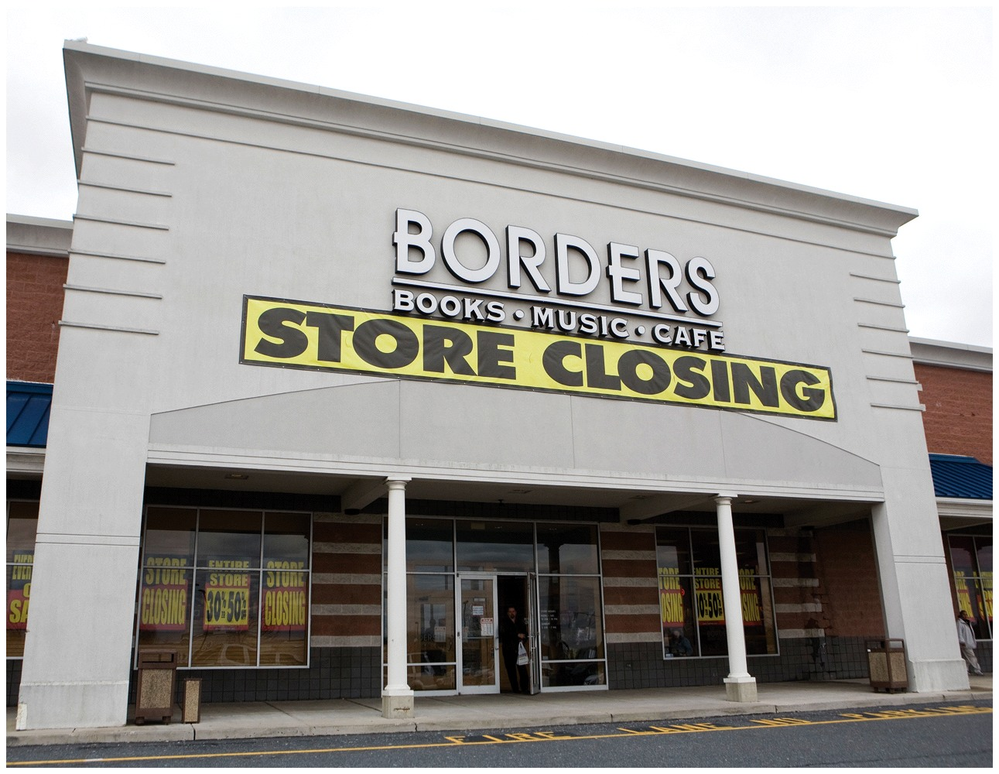
Structural Unemployment—1
Structural unemployment
  Caused by changes in the industrial makeup of the economy
  Joseph Schumpeter: “creative destruction”
  Industry creation and destruction is often a sign of a growing economy
Example:
  Borders (bookstore) went bankrupt in 2011
  Significant job losses in the book sale industry
  Why?
Notes:
Lecture notes:
Structural employment:
can create short-run problems of transition, but is usually a sign of a healthy, growing economy
is caused by changes in the makeup of the economy’s structure
can represent technological progress, as some jobs become outdated
creates trade-offs to economic progress, as some “old” jobs are destroyed
We could perhaps “protect” jobs that are about to be creatively destroyed, but doing so would be an inefficient use of resources and a drag on our economy.
For example:
Steel production has become much more efficient, safer, and advanced engineering has made it possible for firms to replace workers with automated equipment.
In 1980: 500,000 laborers
In 2010: 150,000 laborers
These changes mean that the steel that is manufactured today is safer than ever before but also that fewer workers are needed to make it.
That trade-off is reflected in the employment numbers for the industry.

Slide 8


Structural Unemployment—2
Agricultural
Working in fields
Manufacturing
Working in factories
Service
Working in offices (online)
Changes in American economy over time
  Today: United States = service economy
Notes:
Lecture notes:
Job turnover is normal in a growing economy.
In 2006, real GDP in the U.S. grew by 2.7 percent, and 2 million net jobs were created.
Yet, in that year of growth, there were approximately 5 million job separations (quits and layoffs) every month.
All of this churning causes temporary job loss.
In the short run, many workers’ jobs are rendered obsolete by the churn of creative destruction.
This leads to structural unemployment, and this unemployment exists even though there are jobs available and there are workers to fill those jobs.

Slide 9
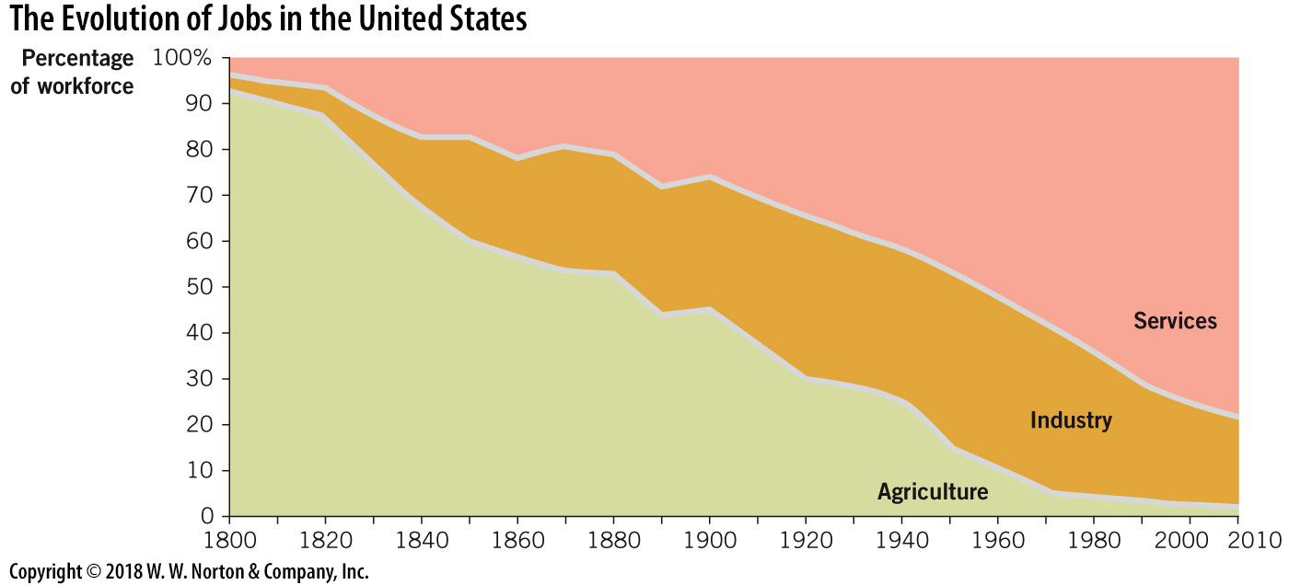
Growing and Changing Economies
Notes:
Image: Figure 20.2
Lecture notes:
From Text:
In the past 200 years the majority of lost jobs were first from agriculture and then manufacturing, as the service sector became the largest employment sector.
American workers moved from the fields into factories and then into office buildings, and today they are increasingly working online.
Since 1979, manufacturing employment in the United States. has fallen from almost 20 million to just 11.5 million.
Over the same period, employment in service-providing industries has risen from 65 million to about 112 million.
Today, five out of every six U.S. workers are employed in a service-providing occupation.

Slide 10

Structural Unemployment—3
Undesirable to save obsolete or inefficient jobs
What can structurally unemployed people do?
  Workers must retrain, reeducate, relocate, or change expectations about work and pay
Government can help with training programs or relocation subsidies
Notes:
Lecture tip:
You may want to talk to students about the costs and benefits of government programs here.

Slide 11
Luddites
Luddites
  Nineteenth-century English textile workers
  Destroyed automated looms that could be operated cheaply to produce clothing
Goal
  Trying to protect themselves from structural unemployment
Question to think about
  The industrial revolution may have left many people structurally unemployed. What are the trade-offs of technological progress and structural unemployment?
Notes:
“Beyond the Book” slide
Named after Ned Ludd, who allegedly destroyed two stocking frames thirty years earlier (Source: Wikipedia)
Answer:
When technology makes things cheaper and more efficient, it may often replace slower and more expensive human labor. This may cause unemployment for a few (costs for a few), but benefit many with more goods at a lower cost. We have to be careful when we try to “save jobs” or “create jobs” that may concentrate the benefits to a small number of people but have widespread costs.

Slide 12
Practice What You Know—1
Which of the following is an example of structural unemployment?
  Alfred the VCR repairman is unemployed because there are very few people who still own VCRs.
  Macy the construction worker is unemployed because no one is building houses right now.
  Lucinda the restaurant chef is unemployed because he and his wife recently moved to a new city.
Notes:
Clicker question:
Correct answer: A, Alfred the VCR repairman is unemployed because there are very few people who still own VCRs.
Structural unemployment is unemployment caused by changes in the industrial makeup (structure) of the economy. We no longer have VCRs, so we don’t need VCR repairmen.

Slide 13

Frictional Unemployment—1
Frictional unemployment
  Caused by time delays in matching available jobs and workers
  People do not always want to accept the first job offer
  Firms do not always hire the first applicant
Examples:
  Recent college grads
  Spouse of a person who moves for a new job
Notes:
Lecture notes:
When you graduate from college, it will likely take you a while to determine the very best job offer you have.
You won’t be just interested in any job, you want the best job possible.
On the other side of the job market, employers rarely hire the first applicant they see, even though it may be costly to leave the position vacant.
These time lags create frictional unemployment.
Frictional unemployment is considered “natural” and efficient by economists.
Frictional unemployment allows job seekers to efficiently match their skill sets with available jobs.

Slide 14
Frictional Unemployment—2
Length of frictional unemployment:
  Internet has decreased time and costs of job searching
  Also affected by government regulations that make it difficult to hire or fire
Consequences of unemployment insurance:
  Provides income to workers who are laid off
  Provides people time to find a new job
  Prevents economic problems from spilling over to other industries
  Reduces incentives to find another job quickly
Notes:
Lecture notes:
In terms of duration of unemployment, a generation ago, finding employment was a time-consuming process. It required searching the local want ads, hiring a recruiter, and knocking on doors.
Today, most job searches are done online, which has made the job search process more efficient.
However, if it is difficult to fire employees, firms take greater care in hiring employees and this raises unemployment as well.
The intent of policies that make it difficult to hire or fire is to offer safety nets for workers. But, too often, the unintended consequences of policy changes are ignored.
Unemployment insurance:
Benefits the worker by reducing consequences of being laid off and provides time to find a new job.
Helps macroeconomy by stopping economic problems from spreading to other industries.
The main unintended consequence of unemployment insurance is that it reduces incentives to quickly find another job.
Incentives matter for job seekers. Without unemployment insurance, workers would be much more motivated to seek immediate employment, thereby reducing the time they spend unemployed.
In fact, public policy may increase the amount of time people are unemployed.
However, in general, unemployment insurance is viewed as positive.

Slide 15
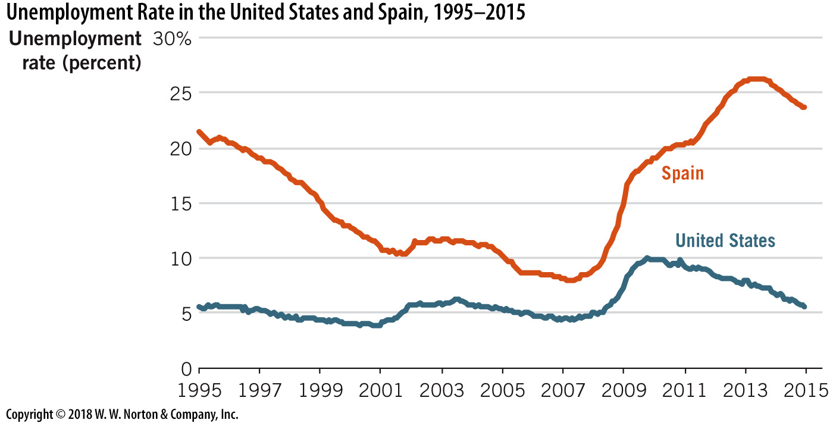
Hiring and Firing Regulations Increase Unemployment
Notes:
Image: Figure 20.3
Lecture notes:
From the text:
From 1995 to 2015, the unemployment rate in Spain was much higher than the unemployment rate in the United States.
This difference is largely a result of Spanish labor-market regulations, many of which were put in place to help workers. But the reality is that these regulations increase frictional unemployment.

Slide 16
Practice What You Know—2
Which of the following is an example of frictional unemployment?
  Alfred the VCR repairman is unemployed because there are very few people who still own VCRs.
  Bernie the construction worker is unemployed because no one is building houses right now.
  Carl the restaurant chef is unemployed because he and his wife recently moved to a new city.
Notes:
Clicker question:
Correct answer: C, Carl the restaurant chef is unemployed because he and his wife recently moved to a new city.
This is “natural” since Carl won’t find a job instantly. He may look for a while.
Answer B could be cyclical unemployment, a sign of a recession.

Slide 17
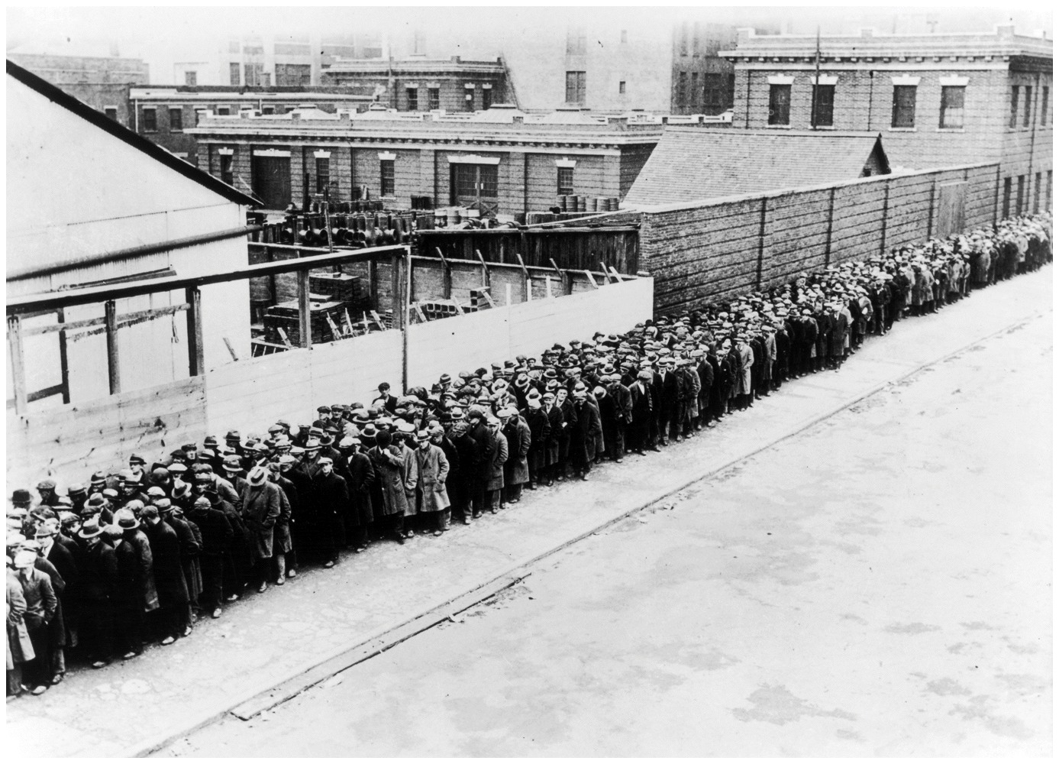
Cyclical Unemployment
Cyclical unemployment
  Caused by economic downturns
Example:
  Unemployment caused by the Great Recession
  In 2008:
    18 months
    10% unemployed
Notes:
Lecture notes:
Cyclical unemployment:
Considered the worst kind of unemployment.
Lasts for an unknown length of time.
Frictional unemployment is clearly temporary; it disappears when workers are matched with jobs.
Structural employment is also temporary; it disappears when workers take the new jobs created by the structural change.
But, the duration of cyclical unemployment is open ended.
This type of unemployment is due to general macroeconomic downturns, and nobody knows how long these may last.
Fortunately, recessions in the United States have been fairly short in recent times (with, arguably, the exception of the Great Recession).
Additional notation:
u: actual unemployment
u*: natural rate of unemployment
Y: actual output
Y*: full employment output

Slide 18
Natural Rate of Unemployment and Full Employment Output
Natural rate of unemployment (u*)
  Typical rate of unemployment in a healthy economy
Full employment output (Y*)
  Output by an economy with no cyclical unemployment

Slide 19
Types of Unemployment
Unemployment Rate during Recession
Cyclical
Bad!
Unemployment Rate during Normal Macroeconomic Conditions
Always occurring, denoted as u*
Structural
Structural
Natural Unemployment
Frictional
Frictional
Notes:
Lecture notes:
During recessions, people may be unemployed for any one of the three reasons.
But, during normal healthy economic periods, cyclical unemployment falls toward zero.
The unemployment that’s left (structural and frictional) makes up what we call the natural rate of unemployment.
The natural rate of unemployment (u*) is the typical rate of unemployment when the economy is growing normally.
The figure on the slide shows the relationship between all three types of unemployment and macroeconomic conditions.
Classroom activity: Think-Pair-Share: Classify the Unemployment Type (See Tip #282)
Ask your students to work with a partner to figure out how the following groups of people should be classified in terms of unemployment:
1. Workers in a high-end restaurant are laid off when the establishment experiences a decline in demand during a recession.
2. A group of automobile workers lose their jobs as a result of a permanent reduction in the demand for automobiles; these workers need to be retrained in order to acquire skills that will land them future employment opportunities.
3. A new college graduate spends three months searching for her first job and finally finds a placement.
Answers:
1. cyclically unemployed, due to decrease in demand
2. structurally unemployed, need to retrain to find a job in another industry
3. frictionally unemployed, time spent looking for a job after graduation

Slide 20
Economics in Mad Money
What are some of the major reasons for unemployment?
Notes:
“Economics in the Media” Slide
Lecture tip:
The clip mentioned on the slide can be found in the Interactive Instructor’s Guide. Access the direct link by clicking the icon in the PowerPoint above.
This clip is a good tool for introducing the distinctions between the categories of unemployment.

Slide 21
Natural Rate of Unemployment and Output
Healthy Economy | Recession | Super-Normal Expansion (Temporary)
u = u* | u > u* | u < u*
Y = Y* | Y < Y* | Y > Y*
Cyclical unemployment is zero | Cyclical unemployment is positive | Cyclical unemployment is negative
Notes:
Lecture notes:
Intuition:
You can think of the asterisk (*) as showing the natural or “optimal” levels.
u* is the natural rate of unemployment and Y* is the rate of output with that rate of unemployment.
u and Y (no asterisks) are the actual rates of unemployment and output in the economy.

Slide 22
Economics in Bronze Age Orientation
Mitchell and Webb
  This clip illustrates two cavemen facing possible structural unemployment during the movement from the Stone Age to the Bronze Age
Notes:
“Economics in the Media” Slide
Lecture tip:
The clip mentioned on the slide can be found in the Interactive Instructor’s Guide. Access the direct link by clicking the icon in the PowerPoint above.
The key concepts covered in this clip are:
Jobs and unemployment
Economic growth
Structural unemployment

Slide 23

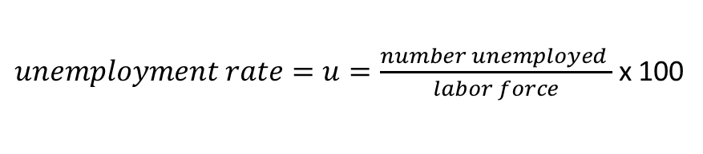
Looking at the Data
Labor force
  People who are employed or actively seeking work
Who is not in the labor force?
  Jobless people not actively seeking employment (no efforts made in four weeks)
  Retirees
  Students
  Institutionalized
$unemployment rate=u=\frac{number unemployed }{labor force}$ x 100
Notes:
Lecture notes:
It makes sense to remove groups of people who are not really looking for a job. These groups include:
Retirees
Stay-at-home parents
People in jail
Military personnel
Children
Many full-time students
Note that multiplying by 100 here converts this number to a percentage.

Slide 24
Measuring Unemployment in the United States, Dec. 2014
Relevant Population: 249,027,000
- Noninstitutionalized
- Civilian
- Aged 16+
Not in Labor Force: 92,898,000
- Students
- Homemakers
-Retirees
- Others
Labor Force: 156,129,000
Employed: 147,441,000
Unemployed: 8,688,000
5.6% of labor force
Notes:
Image: Based on Figure 20.5
Lecture notes:
To compute the unemployment rate, we divide the relevant adult population between those who are in the labor force and those who are not.
To be counted in the labor force, a person must either have a job or be actively seeking work.
The unemployment rate is the percentage of the labor force that is unemployed.
Classroom activity: Think-Pair-Share: Where Does the Unemployment Rate Come From? (See Tip #253)
This is a good activity to try with students to help them understand the unemployment rate and how it is measured.

Slide 25
Practice What You Know – 3
Who is considered unemployed?
  Jean, a college student who is currently not working
  Zoe, a recent college graduate who sent out job applications, but has yet to hear back from the businesses
  Michael, a stay-at-home dad
  All of the above
Notes:
Clicker question:
Correct answer: B, Zoe, a recent college graduate who sent out job applications, but has yet to hear back from the businesses
Full-time students and people who are currently not looking for jobs are not considered in the labor force and are therefore not considered unemployed. If Michael’s kids go to college and he starts looking for a job, he will then re-enter the labor force.

Slide 26
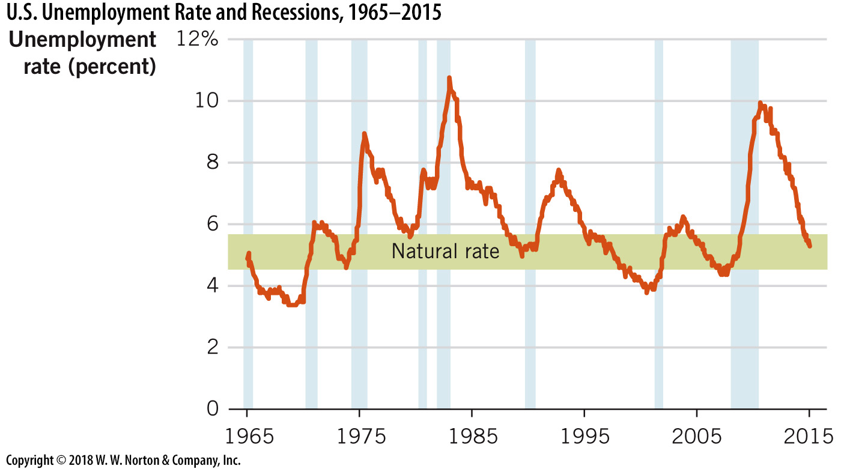
Historical U.S. Unemployment Rates—1
Notes:
Image: Figure 20.6
Lecture notes:
The average unemployment rate in the United States since 1960 is about 6 percent.
This is not the natural rate of unemployment, it’s just the long-run average.
On average, there is a little cyclical unemployment, so this number is above the natural rate.
But 6 percent is a good reference to compare unemployment rates across time and even across nations.
Rates above 6 percent are high by historical U.S. standards; rates under 6 percent are low.
Notice how the unemployment rate consistently spikes up during recessions.
This vividly illustrates cyclical unemployment.
But note also how long it takes for unemployment to return to natural levels (around 5 percent) when recessions end.
As we discuss below, this pattern is typical but also particularly noticeable after the 2008 recession.
Finally, notice that there is always some unemployment—no matter how significant or prolonged the economic expansion.
This is because structural and frictional unemployment are always positive.
For example, notice how the unemployment rate falls to less than 4 percent in 2000.
In April 2000, real GDP was expanding at a very significant 6.4 percent, and the unemployment rate was 3.8 percent.
That’s the lowest unemployment rate since 1970—but it’s still above zero.
Class activity: Think-Pair-Share: How Unemployment Differs by Region (See Tip #279)
This is a good activity to show students how unemployment rates can vary regionally.

Slide 27

Shortcomings of the Unemployment Rate—1
Discouraged workers
  People who want a job but get discouraged and give up looking for work
  Not included in the labor force and not considered unemployed
Underemployed workers
  Part-time workers who want
  full-time jobs
  Workers who are very
  overqualified at their job
  Considered employed
Notes:
Lecture notes:
The picture on the slide could be a classic example of an underemployed worker (i.e., a Ph.D. working in a grocery store).
The Bureau of Labor Statistics (BLS) releases unemployment figures for each month on the first Friday after the month is completed.
Sharp increases in unemployment rates are a reliable signal of recessions.
These two biases in the unemployment rate are not constant over time:
The existence of discouraged workers will underestimate the “real” unemployment rate.
There are people who really do want to work, but we’re not counting them as unemployed or even as part of the labor force.
The existence of underemployed workers will also underestimate the “real” unemployment rate.
A person is counted as having a job, even if he wants to work more or wants to work in a position more suited for his abilities and qualifications.

Slide 28
Unemployment Game Show
The video features four jobless workers
  Which of them are considered unemployed?
  The video illustrates the shortcomings of how we measure unemployment
Notes:
“Beyond the Book” Slide
Lecture tip:
The clip mentioned on the slide can be found in this Think-Pair-Share Activity in the Interactive Instructor’s Guide. Access the direct link by clicking the icon in the PowerPoint above.
Once you’ve completed the activity with students, you can show them the informative clip from “The Unemployment Game Show.”

Slide 29
Practice What You Know—4
If a discouraged worker re-enters the labor force and begins searching for jobs but doesn’t find one, the unemployment rate will:
  Go down because our economy is on the right track with more people wanting to work
  Stay the same because the number of people with jobs didn’t change
  Stay the same because the worker isn’t counted in the labor force until he finds a job again
  Increase because the percentage of labor force participants with jobs decreased
Notes:
Clicker question:
Correct answer: D, Increase because the percentage of labor force participants with jobs decreased
Due to the way unemployment is counted, you can actually have increased unemployment when a recession is ending. This is because more people re-enter the labor force, but they may not find a job immediately; thus, they are unemployed.

Slide 30
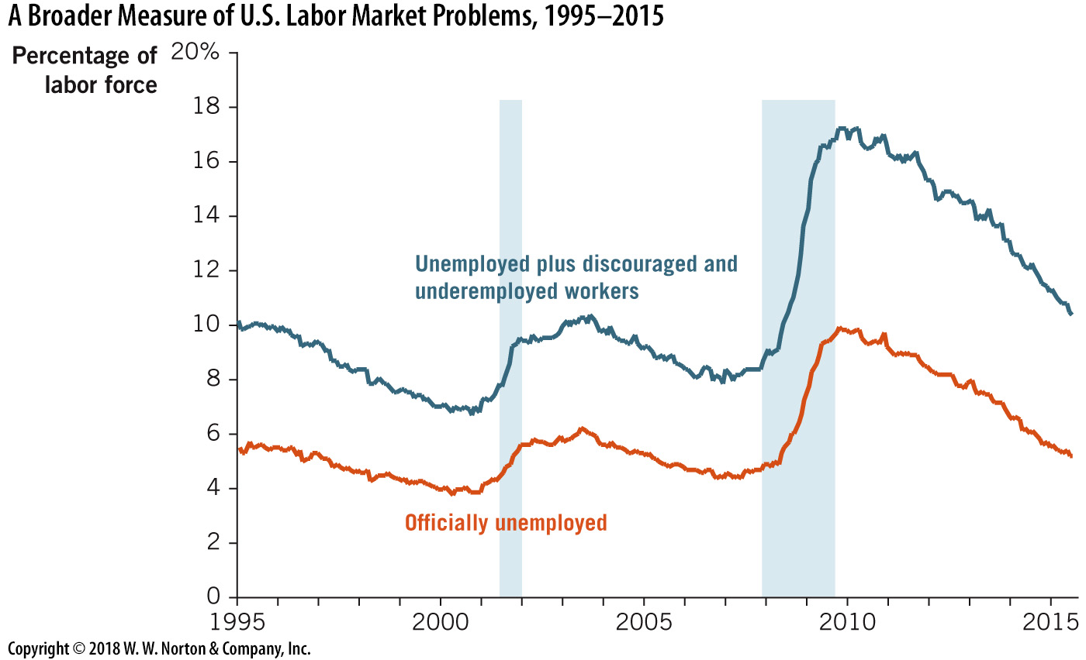
Historical U.S. Unemployment Rates—2
Notes:
Image: Figure 20.7
Lecture notes:
The orange line includes workers who are officially unemployed, discouraged workers who have given up the job search, and workers who are underemployed, or working part time when they would rather work full time.
The gap between this broader measure and the official unemployment rate, shown by the blue line, grows when the economy enters a recession.
The most recent gap is particularly evident beginning in 2008.

Slide 31

Shortcomings of the Unemployment Rate—2
Unemployment timeline
  Unemployment rate lags behind economic activity
  Recovery happens, people re-enter the labor force, and the unemployment rate can actually increase!
Who is unemployed?
  Do not know who is unemployed
  Do not know how long they have been out of work
  Short-run unemployment may not be a big concern, but long-term unemployment is a big concern
Notes:
Lecture notes:
Many people believe that the way that unemployment is “counted” is inaccurate.
Sometimes in a severe recession, unemployment is underestimated because people get discouraged and drop out of the labor force.
Once they re-enter the labor force to look for a job, unemployment rates actually go up (due to the way unemployment is counted), even though the job situation did not change for the workers. Discouraged workers just decided to start looking for a job again.

Slide 32
Lagging versus Leading Indicators
A leading indicator
  Helps us predict what’s coming, and will usually change before the economy as a whole does
  Example: Average weekly hours for manufacturing
  Example: Building permits
A lagging indicator
  Usually changes after the economy as a whole changes, so it doesn’t have much predictive power
  Example: Average duration of unemployment
  Example: Change in the price index
Notes:
“Beyond the Book” Slide
By the time we see high unemployment, we already know we’re in a recession (or we had a recession).
Also, lingering high unemployment does not necessarily mean we’re still in the recession.

Slide 33
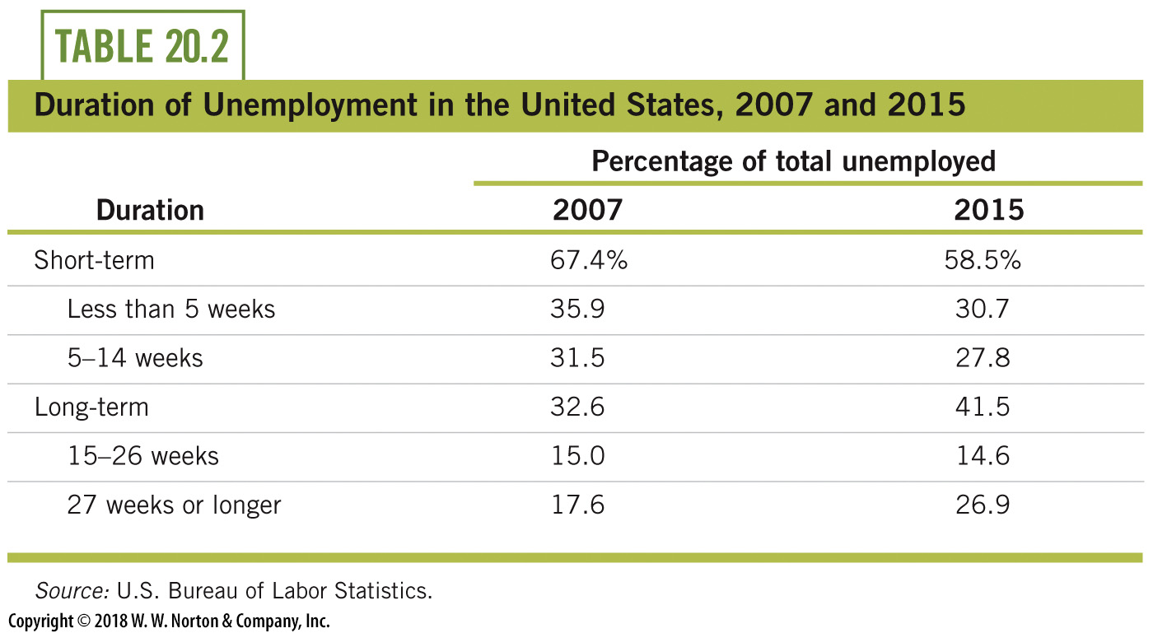
Duration of Unemployment, End of 2007, 2015
Notes:
Lecture notes:
The BLS keeps another alternative measure of unemployment, which only tracks persons unemployed 15 weeks or longer (long-term unemployed).
Some of these workers were probably unemployed for frictional and structural reasons, but many of these were cyclically unemployed.

Slide 34
Animated Unemployment
Geography of Jobs
  An interactive map which shows recession rates changing across America during the Great Recession which began in December 2007
Notes:
“Beyond the Book” Slide
Real-eorld example: Geography and Jobs (See Tip #283)
The interactive map mentioned on the slide can be found in the Interactive Instructor’s Guide. Access the direct link by clicking the icon in the PowerPoint above.

Slide 35
Other Labor Market Indicators—1
Labor force participation rate
  The portion of the population that is in the labor force
  Tells us the fraction of people who are working or looking for work
Applications
  Baby boomers retiring—Social Security and Medicare?
  Gender participation over time?
Notes:
Lecture notes:
The demographic changes associated with baby boomers and demographic changes come at a time when the labor force participation rate in the United States is already reaching modern lows.
The government will have to deal with the issues of Social Security and Medicare.
More people will be taking money from these programs, and fewer people will be providing funding for these programs in the form of taxes paid.
Ask your students, “What gender trend has happened in the last 50 years with the labor force?”
Answer: More women have joined the labor force.
Individuals tend to leave the labor force in bad economic times and re-enter in good times.
This movement causes the unemployment rate to lag economic conditions.
For this reason, economists closely monitor additions to employment as a secondary indicator (typically Nonfarm Employment is the cited statistic).

Slide 36
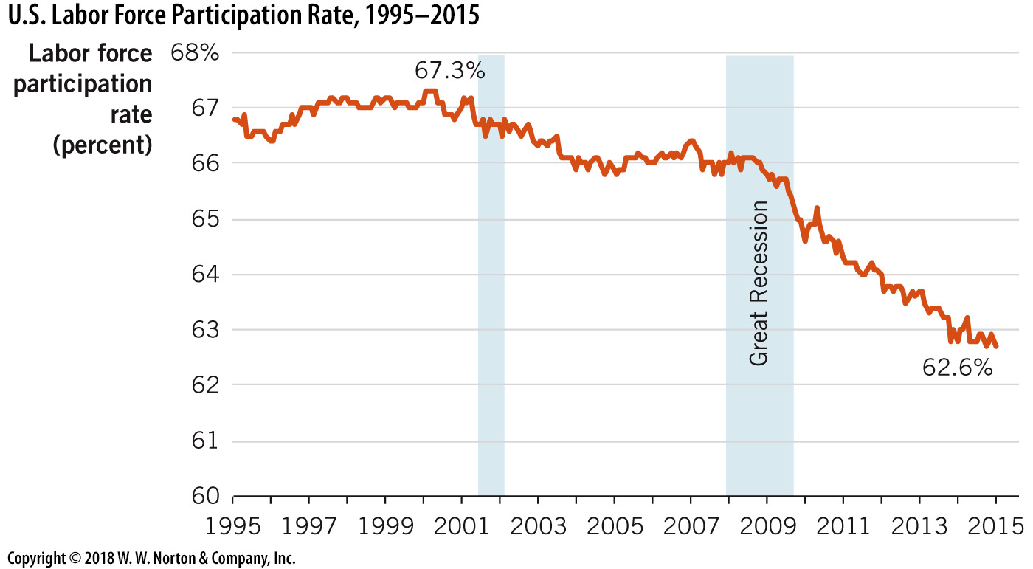
Labor Force
Participation Rate
Notes:
Image: Figure 20.8
Lecture notes:
The labor force participation rate in the United States peaked at 67.3 percent in 2000, but it has subsequently fallen below 63 percent.

Slide 37
Other Labor Market Indicators—2
People tend to leave the labor force in bad times and re-enter in good times
  Causes unemployment rate to lag economic conditions
  Secondary indicators include nonfarm employment
Total employment figures
  Reported each month
  Help evaluate cyclical effects
Notes:
Lecture notes:
Why look at nonfarm employment?
There are large deviations in farming income, payrolls, and output that make it more difficult to see trends.
In addition, a lot of farm labor may go unreported since family members may help out, or illegal immigrants may be employed.

Slide 38
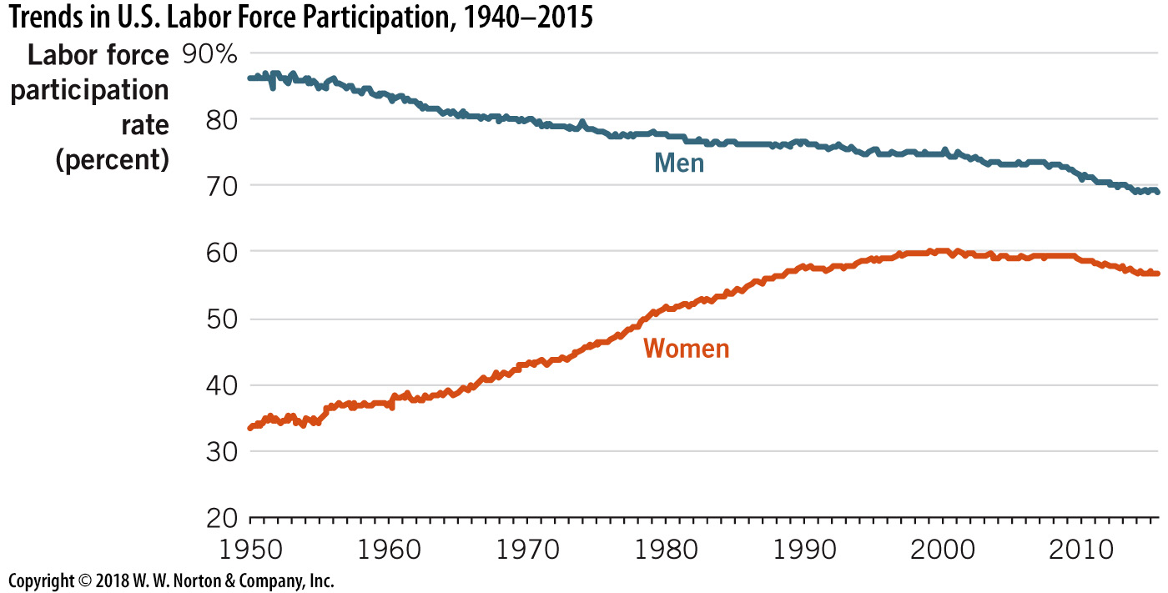
Trends in Labor Force Participation
Notes:
Image: Figure 20.9
Lecture notes:
Many more women have entered the workforce over the last 50 years.
Not only are women working more and more (increasing from a labor force participation rate of 37 percent in 1960 to almost 60 percent today), but male labor force participation is falling dramatically (from almost 90 percent to 70 percent).
While the notion that more women are participating in the labor force can be seen as progress, it might strike you as odd that fewer men are working.
There are a number of underlying reasons for the decline. Men are
living longer,
acquiring more education, and
spending more time helping to raise families.

Slide 39
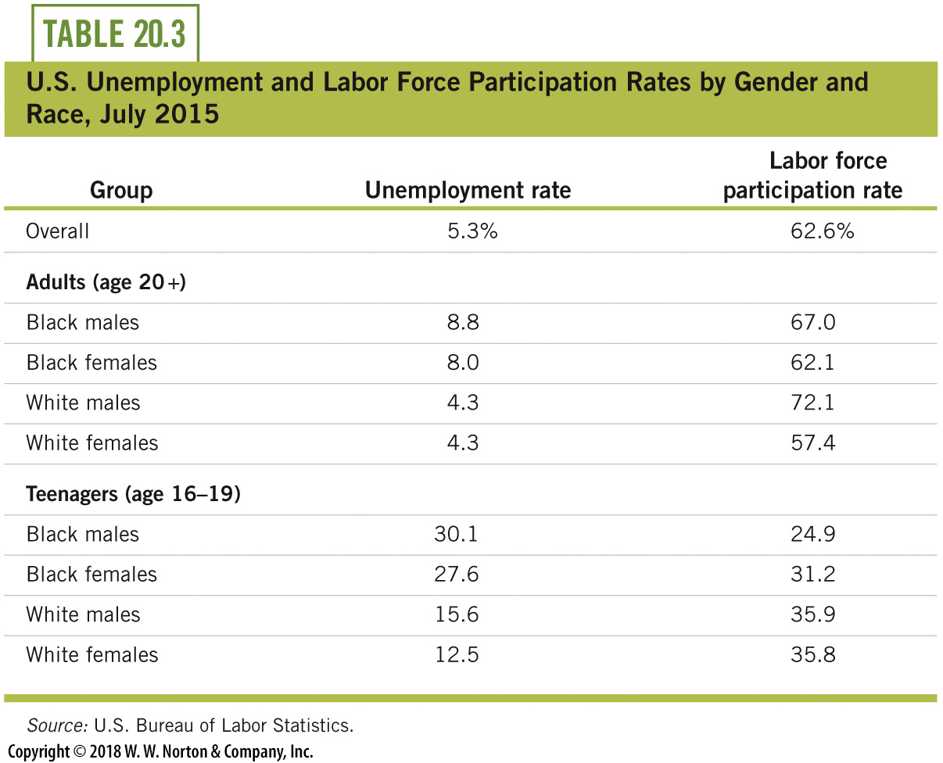
Labor Market Data: Race and Gender
Notes:
Lecture notes:
Notice also that labor force participation rates are very low among teenagers, with participation for white teenagers at about 36 percent but for black teenagers at just 25 percent.

Slide 40
Conclusion
Unemployment rate
  Monitored as an indicator of macroeconomic health
  Helps us gauge labor market conditions
  Can also be misleading and incomplete, since as an indicator it lags behind economic activity and doesn’t account for underemployment and discouraged workers
  Includes different types of unemployment, some worse than others
  Can be influenced by government policy. This seems to have played a big part in propping up rates in the aftermath of the 2008 recession.
Notes:
Lecture notes:
You can also conclude your lecture on unemployment by reiterating the following points:
Frictional and structural unemployment explain why unemployment is naturally greater than zero
Cyclical unemployment explains changes in the rate across the business cycle
The unemployment rate is the percentage of the labor force that would like to work but who are unemployed
The official unemployment rate understates the overall level of underemployment in society since it does not account for discouraged workers nor does it tell us anything about the duration of unemployment
The labor force participation rate and nonfarm employment changes are additional helpful labor market indicators.

