Slide 1
The Price Level and Inflation
21
Notes:
Pre-class music: “If I Had a Million Dollars” by Barenaked Ladies (See Tip #291)
This song is about the virtues of having a million dollars, and all that it could buy. However, things have certainly changed since this song was released, in 1992 – you could introduce your lecture on the price level and inflation by using the consumer price index to find the equivalent of money you’d need to possess today to buy what $1 million bought in 1992! You can also discuss the several items mentioned in the song that money couldn’t buy.

Slide 2
Previously
Unemployment rate
  Percentage of the labor force that would like to work who are unemployed
Labor for participation rate
  Percent of overall population in the labor force
  Additional labor market indicator
Notes:
Lecture notes:
Remind students that the unemployment rate is monitored as indicator of macroeconomic health and helps gauge labor market conditions. It’s also a good idea to reiterate the types of unemployment.

Slide 3
Big Questions
How is inflation measured?
What problems does inflation bring?
What is the cause of inflation?

Slide 4
Inflation—1
Inflation
  General increase in the price level
  Measured as the average price level growth rate
  Deflation: fall in the price level
Why is inflation problematic?
  Uncertainty about price changes
  Long-term wages and contracts difficult
Notes:
Lecture notes:
Inflation:
A continual rise in the general price level (the price of all goods)
Is not the price of a certain good going up due to a shift in demand or supply for that good
By itself, will decrease the purchasing power of your dollars
Creates uncertainty, a problem for firms and workers
May cause consumers to change buying patterns due to uncertainty
Deflation is the opposite of inflation. The price level falls or there is a negative percentage change in the price level

Slide 5

Consumer Price Index
Consumer Price Index (CPI)
  A measure of the price level based on the consumption pattern of a typical consumer
  Goal: measure the cost of living
Bureau of Labor Statistics (BLS)
  The government agency that reports inflation and unemployment data
  Determines how much “weight” to put on certain consumer prices
Notes:
Lecture notes:
The purpose of the CPI is to include everything purchased by a typical consumer to estimate cost of living.
Uses a “typical” consumer—we try to find what the “average” consumer buys.
Obviously, people do not all buy the same goods.
College students, senior citizens, and young parents may buy different goods.
Applying a “weight” on prices means that some price changes affect consumers more than others.
For example, if the price of housing goes up 20 percent, that could be a very harsh adjustment for many families.
However, if the price of popcorn goes up 20 percent, this would not be nearly as bad.
GDP and the GDP deflator are measures that are too broad to use here, since they include goods and services that the average consumer does not buy, such as tractors and wind turbines.

Slide 6
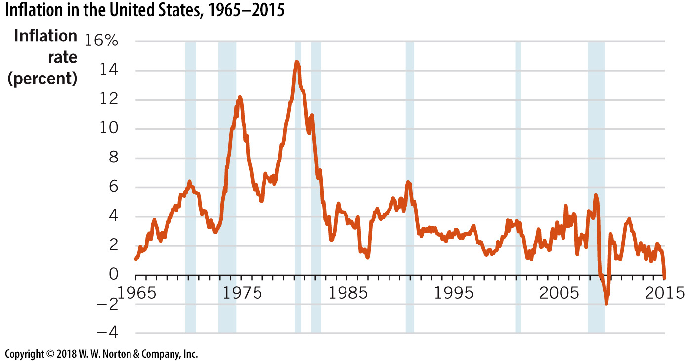
Inflation in the United States
Notes:
Image: Figure 21.1
Lecture notes:
From 1965 to 2015, inflation rates in the United States averaged 4 percent.
This number is high because of excessive inflation in the 1970s.
Inflation peaked at over 14 percent in 1980.
More recently, inflation rates have averaged less than 3 percent.

Slide 7

Economics in Austin Powers
Austin Powers (1997)
  After being frozen for 30 years, Dr. Evil wants to hold the world hostage but forgets about inflation
Notes:
“Economics in Media” Slide
Lecture tip:
The clip mentioned on the slide can be found in the Interactive Instructor’s Guide. Access the direct link by clicking the photo or icon in the PowerPoint above.

Slide 8
Practice What You Know—1
Which of the following spending categories makes up the largest portion of the CPI market basket?
  Travel (includes paying for gas)
  Housing
  Entertainment
  Food
Notes:
Clicker question:
Correct answer: B, Housing
People often spend 42 percent or more of their income on rent or mortgage payments.

Slide 9
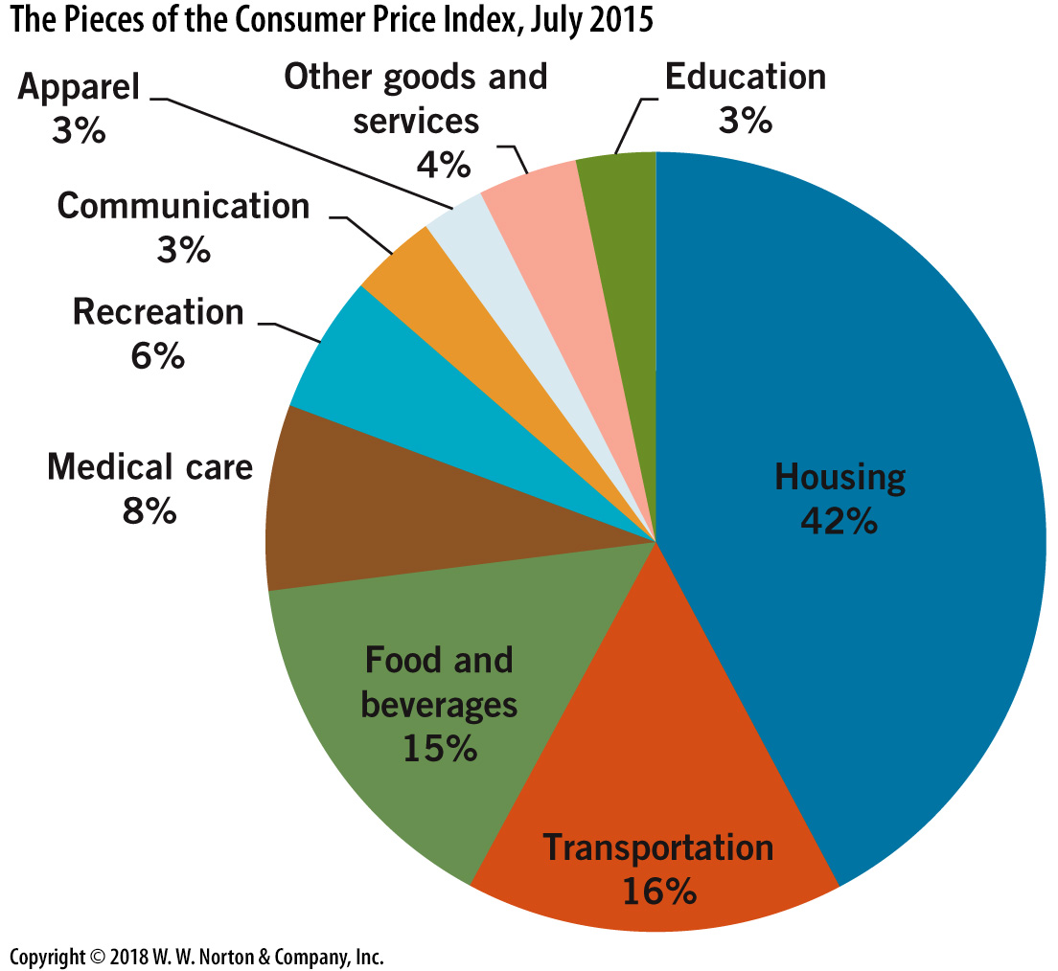
What Prices Are Included in the CPI?
Notes:
Image: Figure 21.2
Lecture tip:
Before showing this slide, you could ask the students what general types of expenditures they make.
Lecture notes:
Clearly, housing (rent or mortgage) is the biggest portion of the average consumer’s expenditures.
Note that inside these categories, there are very specific prices.
For example, “food and beverages” includes prices for everything from potato chips to oranges to flour.
The weights assigned to the different categories of expenditures are based on the spending patterns of a typical American.
For example, a typical American spends 16 percent of their expenditures on transportation and 42 percent on housing.

Slide 10
Computing the CPI
Each month, the BLS collects price information
  on over 8,000 goods and services each month
  in 211 categories
  for 38 geographic locations
Notes:
Lecture notes:
Categories could include food, clothing, entertainment, travel, housing, etc.
Geographic locations are included to account for cost of living differences of the East Coast, Midwest, West Coast, and rural and urban areas.
The BLS must also must estimate how each good impacts a typical consumer budget
Lecture tip:
On the next slide, we will use three goods to estimate CPI:
Popcorn
Soft drink
Movie ticket

Slide 11
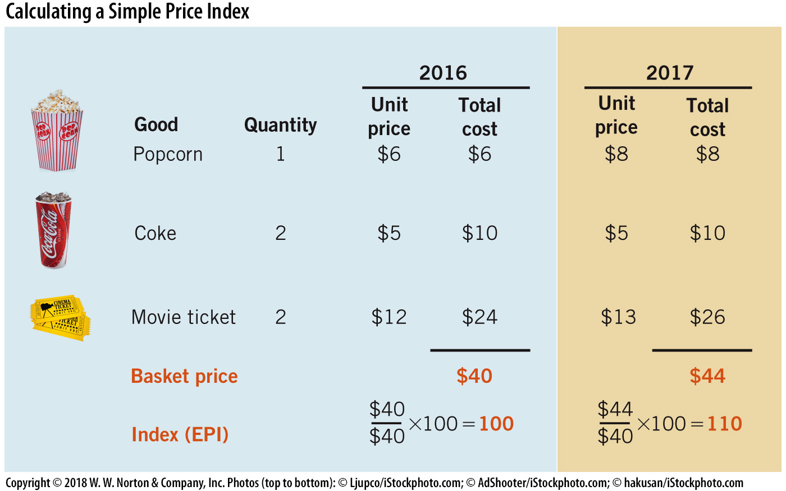
Calculating a Simple Price Index
Notes:
Image: Figure 21.3
Lecture notes:
Consider the three goods, each given a price and quantity.
Cost in this case is the total amount of money expended on the item.
Given a base year of 2016, we purchased some goods and spent $26.
In the next year, 2017, we purchased the same goods, but we note that some (but not all) of the prices have changed, and we spend a total of $44 for the same goods.
To create an index, we use our base year and give it an index of 100 as a figure to compare other years to.
To get the index for the other years, we divide the basket price in the new year divided by the basket price in the base year.
Note: when we multiply by 100 here this does not convert the number to a percentage; it simply indexes the price level.
With steady inflation, all indices before our base year should be less than 100, and all indices after our base year should be greater than 100.

Slide 12
Inflation—2
Calculating the price index
Using the price levels, we can find inflation with the percentage change formula.
  Typically, inflation rates are measured annually.
In the previous example
Notes:
Lecture notes:
Again, note that multiplying by 100 in the price index is not a percent.
In our example above, the price index rose from 100 to 110 in a year.
So the inflation for that year was 10 percent. (Here, multiplying by 100 creates a percent.)
Also note: The price index formula necessitates that the price level in the base year is equal to 100. The ratio of basket price to basket price in the base year is equal to 1 in the base year.
Lecture tip:
You may have to go back to the previous slide to show the numbers again.
You should alert students that the price index alone does not provide much information.
We can compare price level increases and decreases from the base year without any additional information, but an index is really only meaningful for comparisons between years, which requires at least two values for the price index.

Slide 13
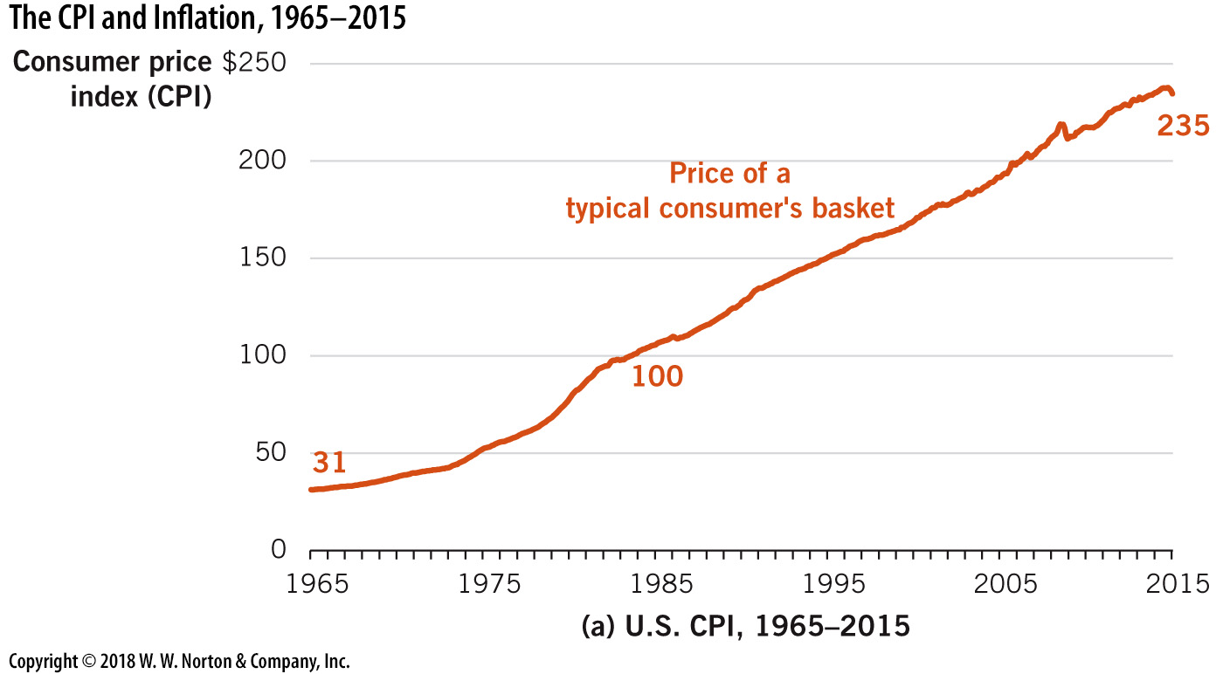
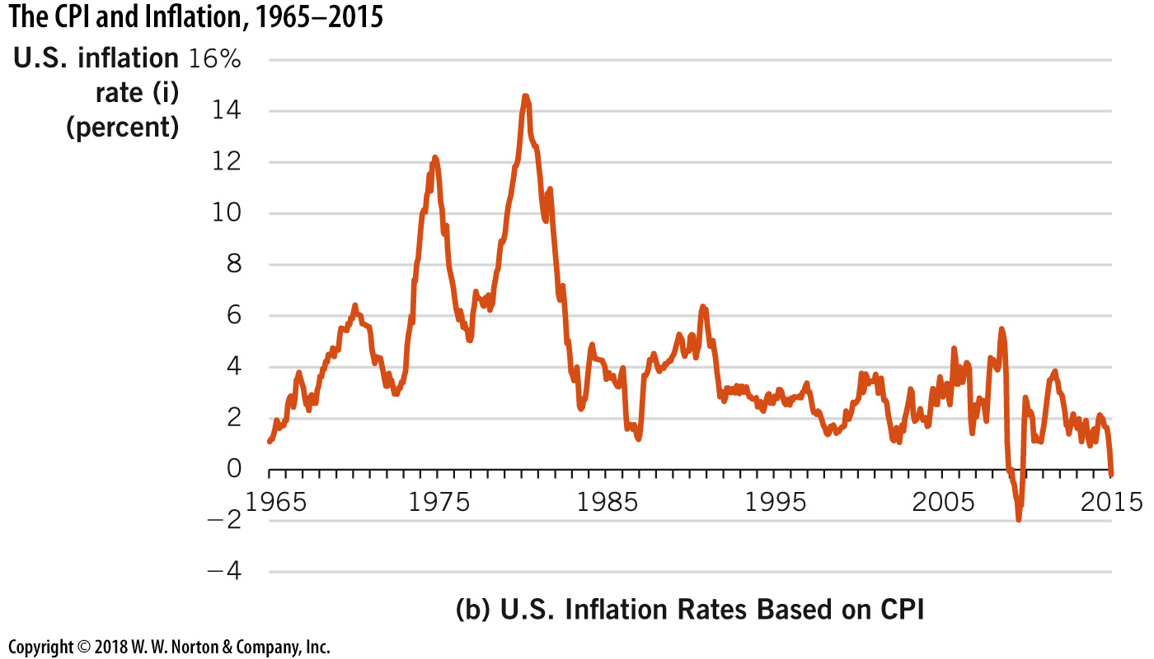
CPI and Inflation over the Long Run
Notes:
Image: Figure 21.4
Lecture notes:
CPI:
Measures the cost of a typical consumer’s basket of goods over time.
In the Figure on the slide, the index is set to 100 in 1982–84 (the base year)
Given the current level of over 235, consumer prices more than doubled on average since 1982–84.
Inflation rate:
The percentage change in the CPI from one year to the next
The higher the inflation rate, the greater the rate of CPI increases.
Some additional U.S. historical observations:
Historically, average inflation is about 4 percent
During the past 50 years
Inflation was highest in and around the decade of the 1970s
Inflation was over 14.5 percent between April 1979 and March 1980
Since 1983, inflation has averaged less than 3 percent
Inflation rates were negative only during the recession of 2008-09 (and briefly in 2015)

Slide 14
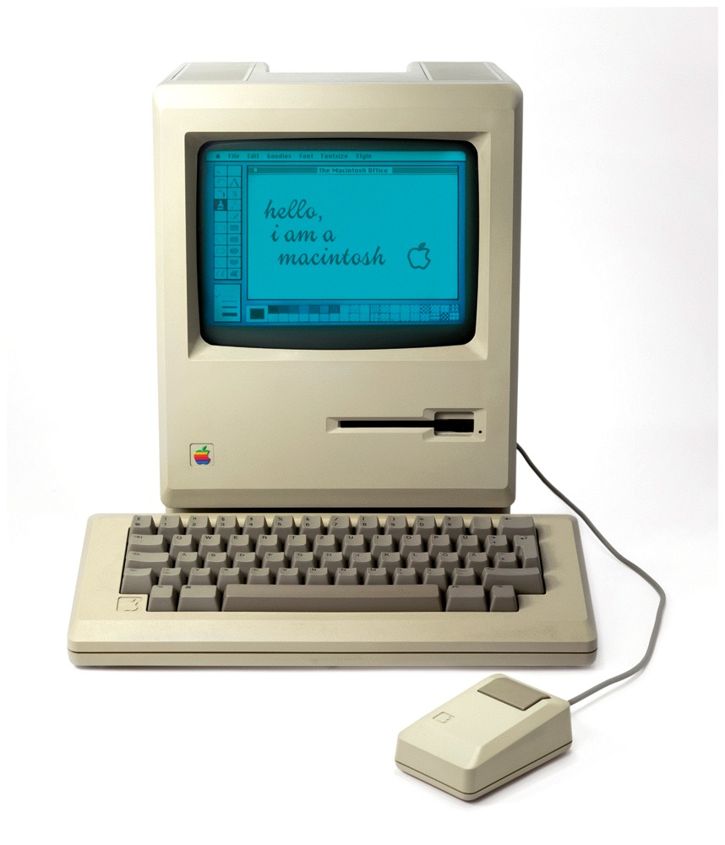
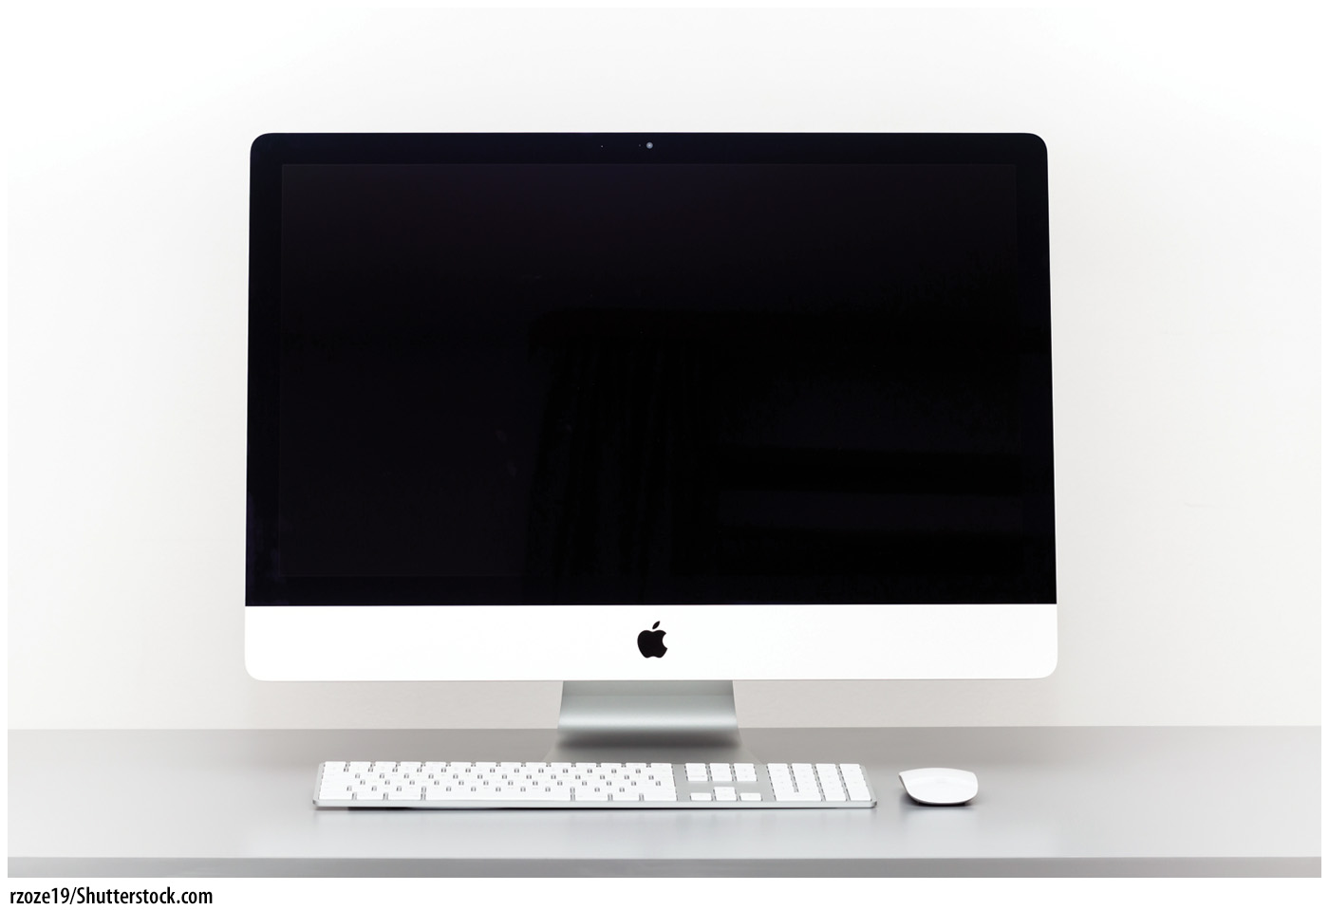
Prices Don’t All Move Together
Clearly, most prices rise over time (see the previous figure)
  Travel
  Education
  Health care
However, some prices fall over time
  Consumer electronics
  Usually due to a result of great
  technological advancements
    Tube TV 1997: $7,000
    Flat panel TV 2012: $500
Notes:
Lecture notes:
Technology
The best example of a price that usually falls over time.
Initial prices for technological advancements tend to be high and fall as technology improves.
This is a particularly unique market, because the quality of technology products usually increases over time (and the price decreases).
Another example: Computers
In the 1980s, computer operating discussions were about megabytes and megahertz. During this time, computers sold for around $3,000 to $5,000, if not more.
Today, we talk about terabytes and gigahertz, and the best computers are $2,500.
This represents an increase in quality and a decrease in price—a unique phenomenon.

Slide 15
Practice What You Know—2
If inflation is a general rise in the price level, why have consumer electronic prices fallen over time?
  The demand for electronics has decreased.
  Electronics are not counted in the CPI.
  Electronics are getting smaller in size so the price is falling as well.
  Increases in technology have greatly reduced production costs for these goods.
Notes:
Clicker question:
Correct answer: D, Increases in technology have greatly reduced production costs for these goods.
Increases in technology shift the supply curve rightward (according to standard micro theory).

Slide 16
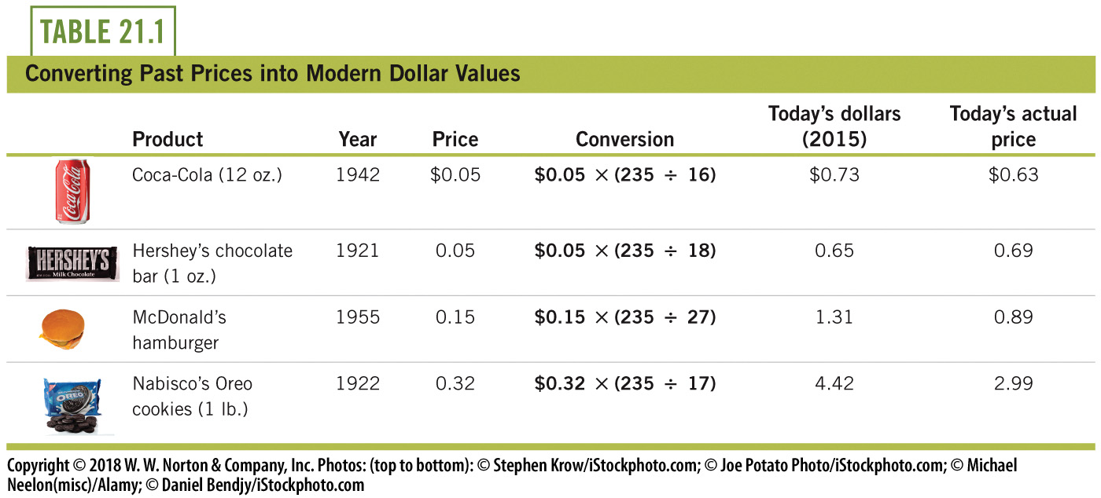
Historical Food Prices
Price levels for the years are shown in the table in the “Conversion” column
Notes:
Lecture notes:
The price level in 2015 was 235.
The price level in 1942 was 16.
The price level in 1921 was 18.
The price level in 1955 was 27.
The price level in 1922 was 17.
From the table, it appears that Coca-Cola and Hershey’s bars have had price changes (about) on par with inflation. McDonald’s hamburgers and Oreo cookies have gone down in real prices over time.
Lecture tip:
Students might hear the following phrase: “Back in my day, everything was cheaper.”
This is nominally true, but not necessarily true in real terms.

Slide 17
Concerns about CPI Accuracy—1
CPI overstates true inflation (upward bias) for three possible reasons:
  Substitution bias
  Changes in quality
  New products and locations
Substitution bias
  When the price of A rises, consumers buy more B.
  Since 1999, the BLS has used a formula that accounts for price changes and shifts in goods consumption.
Notes:
Lecture notes:
Substitution bias:
If the price of popcorn increases, a consumer may substitute a less expensive snack for popcorn.
If the market basket does not account for this shift, CPI would exaggerate the effects of the price increase.
This would cause an upward bias.
Some do not realize that the BLS makes these adjustments and incorrectly criticize CPI adjustments as overstating true rise in inflation on these grounds.
CPI may not be a perfect measure, but the BLS does attempt to adjust for substitution using a CPI model that is respected by statisticians.

Slide 18
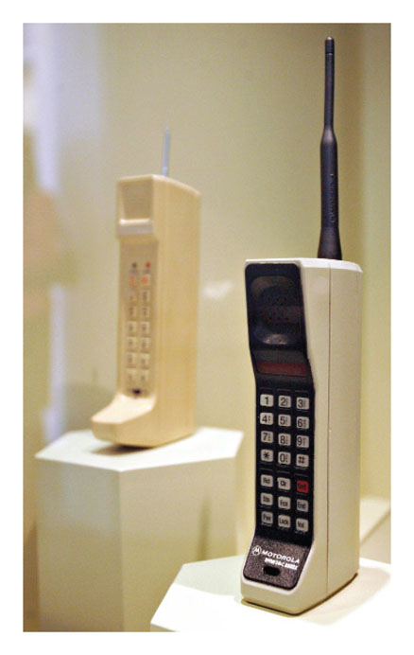

Concerns about CPI Accuracy—2
Quality changes
  Prices may rise because the quality of goods is better
  Example:
    Early 1990s: tube TVs
    Now: flat-screen HD TVs
  Since 1999, the BLS has used a careful adjustment method to account for quality changes.
Notes:
Lecture notes:
Quality changes:
Without accounting for quality changes, an increase in CPI appears to be an increase in the price of the same good, when in fact, there has been a change in the good itself.
But once again, many people falsely believe the BLS does not account for quality changes in the goods selection.
While these adjustments are probably never perfect, the BLS essentially uses a widely accepted method and has significantly reduced bias in CPI quality adjustments.

Slide 19
Concerns about CPI Accuracy—3
New goods, services, and locations
  For example, flash drives and iPads
Previously, the BLS updated CPI after long delays, causing upward bias for two reasons:
  New product prices often drop after a couple of years
  New retail outlets (such as online stores) offer better prices than traditional retail stores
In order to keep track of these price drops
  In 2000, a new chained CPI was instituted
    More difficult to measure
    Current reports not yet based on chained CPI
Notes:
Lecture notes:
Chained CPI:
More difficult to measure, but better indicator of inflation
Below is a quote from Mr. Robert Greenstein (Center on Budget and Policy Priorities):
“The regular CPI measures the costs each month of a market basket of items that average Americans may purchase each month, and so it tells us how much prices are rising, what the inflation rate is. The chained CPI is identical, really, to the regular CPI in all respects except one. It includes an adjustment so that if, for example, beef prices rise much faster than chicken prices, and consumers, as a result, buy less beef and more chicken, it picks up the switching from the beef to the chicken, which makes their total costs for the month rise a little less quickly than if you assumed they continued to buy the same amount of beef and the same amount of chicken as before.”
Source: www.npr.org/2011/07/20/138555779/whats-a-chained-cpi

Slide 20
The Costs of Inflation
Future price level uncertainty
  Firms often make long-term agreements that involve paying salaries to workers and paying back loans on capital goods.
  Uncertain inflation makes long-term contracts riskier.
  Workers fear getting underpaid next year.
  Lenders fear lending out money today and getting less-valuable dollars back next year.
  If long-term contracts don’t transpire, GDP growth is slowed.
Notes:
Lecture notes:
Here is an example: Suppose you own a coffee shop.
Before you can sell a single cup of coffee, you have to spend funds on your resources.
You have to buy capital goods like an espresso bar, tables, chairs, and a cash register.
You have to hire workers and give them some assurances that they will be paid someday.
The key for this discussion is this: if you are ever going to produce output (coffee), you have to spend first on resources.
Lenders are typically banks.
A firm may have to borrow money for large capital equipment and pay that loaned money back.
Inflation is bad for the lender (the bank). If inflation is not accounted for in the loan contract, this will decrease the real value the bank receives in return.
If there is a lot of uncertainty over inflation and the potential for large increases, this will make the bank less likely to make a large or long-term loan.

Slide 21
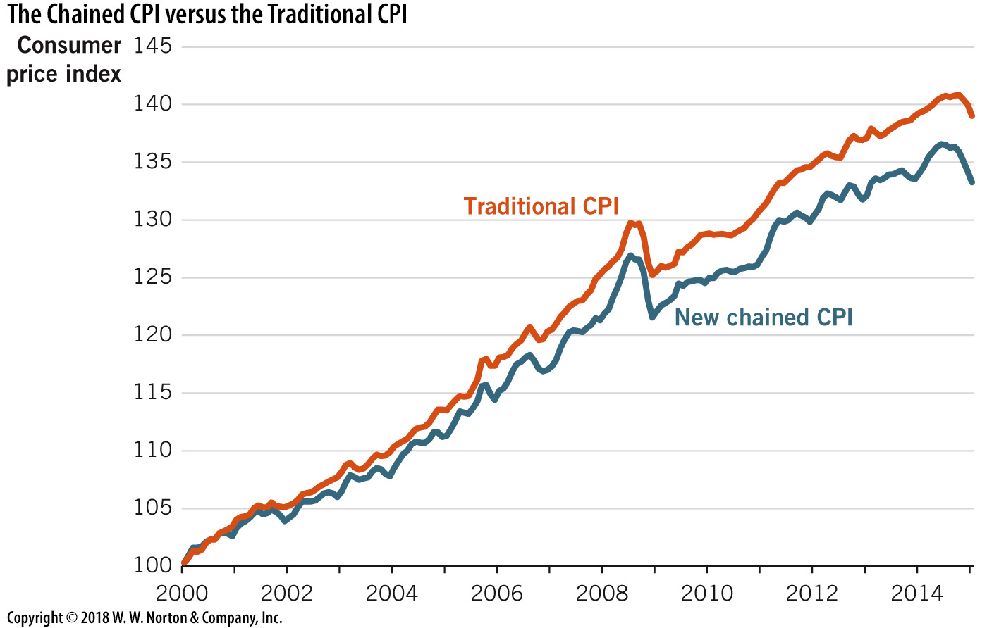
Chained CPI versus
Traditional CPI
Notes:
Image: Figure 21.5
Lecture notes:
The chained CPI reduces the upward bias of the traditional CPI by updating the consumer’s basket of goods every month.
This single correction accounts for price reductions that typically occur during the first few years after a new product has been introduced.
After correcting for the upward bias, chained CPI is lower than the traditional CPI measure.
Lecture tip:
Here you can mention that Figure 21.6 in the text shows an alternative price index (although less widely used).
The Billion Prices Project (BPP) is an independent index that tracks prices across the Internet as an alternative to the CPI.
As the data lines indicate, the BPP index looks very similar to the CPI; however, it is compiled exclusively from online retail prices and requires no input from government workers.

Slide 22
Pennies, Inflation, and Copper
With inflation, currency loses real value. That is, a given amount of currency won’t buy as many goods or services.
Can this make small denominations of currency not worth having? Remember that it still takes resources to mint currency!
Notes:
“Economics in the Media” Slide
Lecture tip:
The clip mentioned on the slide can be found in the Interactive Instructor’s Guide. Access the direct link by clicking the icon in the PowerPoint above.
These clips provide good examples of the value of money. There are a lot of other key concepts covered in this clip, including:
Money and banking
Economic growth
Monetary and fiscal policy
Inflation
Nominal value versus real value
CPI
Currency debasement

Slide 23
Costs of Inflation—1
Shoe-leather costs
  As prices go up, it becomes more costly to hold money
  Resources are wasted when people change behavior to avoid holding money
  People bear time, effort, and fuel costs when they try to use more money
Money Illusion
  People interpret nominal wage or price changes as real changes
  If prices and wages all go up by 2%, there is no real change in purchasing power. People with money illusion think they are richer in this case.
Notes:
Lecture notes:
Shoe-leather costs:
Money becomes more costly to hold when prices rise because the money will be worth less tomorrow than it is today.
Thus, people spend resources trying to use that money today rather than tomorrow.
Named because people would have to replace their shoes from walking to the bank so much.
Today, these types of costs include multiple bank or ATM visits.
Money illusion:
If the price of a movie goes up 10 percent, but our wages and all other prices go up about the same amount, we ought to conclude that the real terms of trade have stayed more or less the same.
But many people conclude, mistakenly, that movies have become more expensive.
They treat this as a change in relative price: they may go see fewer movies or make other decisions based on this new price.
Economists call this money illusion.

Slide 24

Costs of Inflation—2
Nominal wage
  The wage in current dollars
Real wage
  Nominal wage adjusted for inflation
Another money illusion example:
  Suppose nominal wages increase by 3% and prices go up by 5%.
  Money illusion may cause you to think of yourself as wealthier, but your real wages have actually decreased!
Notes:
Lecture notes:
The real wage is a better measure of what a worker earns in terms of purchasing power.
Money illusion causes workers to irrationally focus on their nominal wage instead of their real wage.
They might then insist on real wages that are too high, given changes in the price level.
Remind students that this is an important takeaway for their future wage negotiations:
If the price level increases more than your nominal wage, this is a real wage cut.
If the price level increases less than your nominal wage, this is a real wage increase.
If the price level and nominal wage increase by the same amount, there is no change in the real wage.
If the price level falls and there is no change to the nominal wage, this is a real wage increase.
Lecture tip: You can explain to students that nominal wage is analogous to nominal GDP.
Ask students to recall that inflation is the percentage change in the price level.

Slide 25
Practice What You Know—3
Suppose that prices and wages both double next year. What is true about next year compared to this year?
  Nominal wages are higher and real wages remained constant.
  Nominal wages and real wages are both higher.
  Nominal wages are higher and real wages are lower.
  Nominal wages increased and real wages decreased.
Notes:
Clicker question:
Correct answer: A, Nominal wages are higher and real wages remained constant
If prices and wages both change at the same rate, nothing changes in real terms.
However, they both went up, so that is a nominal (unadjusted) increase.

Slide 26
Practice What You Know—4
Suppose that Felix gets a 1% raise this year, but prices have also risen by 1%. Felix feels richer due to his raise and attempts to change his spending habits. Felix is suffering from
  irrational exuberance.
  macroeconomics.
  money illusion.
  inflation pricing.
Notes:
Clicker question:
Correct answer: C, Money illusion
Money illusion is where people only consider nominal changes instead of real changes in prices and wages.

Slide 27
Costs of Inflation—3
Menu costs
  The costs of changing prices
  Example: A restaurant will have to print new menus for price changes
Uncertainty about future price levels
  Wage and other input contracts often have long-term commitments
  Uncertainty about prices may make borrowing riskier
Notes:
Lecture notes:
Menu costs: Tangible costs to firms for changed prices
For example, if Walmart chooses to increase prices, they must reprint all price labels (using capital and inputs) and use more labor hours to replace the price tags.
The costs to Walmart of the paper, ink, rental cost of printing machines, and workers are part of menu costs.
Uncertainty about future price levels:
In a normal production process, funds must be spent today and then repaid in the future—after the output sells.
But for this sequence of events to occur, businesses must make promises to deliver payments in the future, including payments to workers and lenders.
Thus, two types of long-term agreements form the foundation for production: wages and loan contracts.
Both of these involve agreements for dollars to be delivered in future periods.
In other words, firms may have to borrow today and pay back the money later.
Uncertainty regarding future prices makes loans and contracts subject to inflation risk.
If the price level is not accurately predicted, this can impose costs on lenders or borrowers depending on the direction and magnitude of inflation (deflation).

Slide 28
Inflation and Long-Term Agreements
The real value of these future dollars depends on inflation.
Prepare to Produce
Produce
Sell Output
Borrow $$
Build Capital Goods
Hire Workers
Repay Loans $$
Pay Workers $$
Today
Future Periods
Time
Notes:
Lecture notes:
The future periods may have lower real values of money if inflation occurs.
This could hurt workers and lenders, and makes those parties incur risk when they agree to long-term monetary agreements.
Whether workers and lenders or borrowers are hurt depends on whether the price level rises or falls unexpectedly.
Lecture tip: Emphasize that the timeline shows that agreements are made before production begins.

Slide 29
Costs of Inflation—4
Wealth redistribution
  between borrowers and lenders
Example:
  Suppose you borrow $50,000 and expect to pay back $60,000 in five years
  If unexpected inflation occurs
    You are better off, bank is worse off
  If the inflation was expected
    The bank would have required more in return for the loan (i.e., you’d have to repay $75,000 in five years)
  If unexpected deflation occurs
    You are worse off, bank is better off
Notes:
Lecture notes:
If inflation unexpectedly rises during those five years:
Inflation will devalue your future (real) payment to the bank.
You (the borrower) will be better off, but the bank (the lender) will be worse off.
Surprise inflation redistributes wealth from lenders to borrowers.
If both you and the bank fully expect the inflation to occur:
The bank will require more in return for the loan.
Inflation will have any redistributive effects.
If unexpected deflation occurs:
Deflation will increase your future (real) payment to the bank.
You (the borrower) will be worse off, but the bank (the lender) will be better off.
Surprise deflation redistributes wealth from borrowers to lenders.
In the United States, inflation has been low and steady since the early 1980s.
Therefore, surprises are rare.
But nations with higher inflation rates also have a higher variability of inflation, which makes it difficult to predict.
This is one more reason why high inflation increases the risk of making loans, which are an important source of funding for business ventures.

Slide 30
Practice What You Know—5
In 2012, Juan takes out a 30-year bank mortgage loan at a fixed interest rate. He buys a house with the loan. In 2014 to 2018, inflation is high.
Who is hurt and helped by this inflation, ceteris paribus?
  Juan is helped and the bank is hurt
  The bank is helped and Juan is hurt
  Juan and the bank are both hurt
  Juan and the bank are both helped
Notes:
Clicker question:
Correct answer: A, Juan is helped and the bank is hurt
Suppose Juan borrowed $200,000 and buys a house:
In the next few years, inflation causes housing prices to rise, and the value of money to fall.
Juan’s house is now worth $250,000, but he still only owes the bank the original $200,000 that he borrowed (plus some interest).
The bank is hurt because the money it receives in the future from Juan (when he pays back the loan) will be worth less than when they loaned it out to him.

Slide 31
Costs of Inflation—5
Price confusion
  Are price changes a result of demand shifts or inflation?
  Implications are very different!
Increase in Demand?
Buy New Resources
Build Factories
Hire Workers
Increase Output
Price
Increase
No Change in Output
All prices affected
Inflation?
Notes:
Lecture notes:
If a business owner misreads the signal from a price increase, they could be in a lot of trouble!
What happens if you build a new factory or hire more workers when the cause of a price increase is inflation?
You will spend a lot of time, money, and effort, perhaps only to see the new business fail.

Slide 32
Costs of Inflation—6
Tax distortions
  Capital gains taxes are taxes on the gains realized by selling an asset for more than its purchase price
  Problem: often, the price rises due to inflation rather than an increase in the value of the good

Slide 33

Costs of Inflation—7
Example
  If you buy a house in 1980 for $80,000
  and sell the house in 2012 for $230,000
  Capital gains = $150,000
  You have to pay taxes on this $150,000
  However, CPI rose from 80 to 230 in those years, so the real value of the house is the same!
Notes:
Lecture notes:
In the given example:
The value of the house just kept pace with inflation.
In real terms, the value of the house did not rise.
However, the homeowner would still be required to pay a significant tax upon the sale of their home.
As it turns out, the amount of their tax is determined by inflation and not by the tax laws.
If there had been no inflation, the homeowner would have owed no tax.

Slide 34
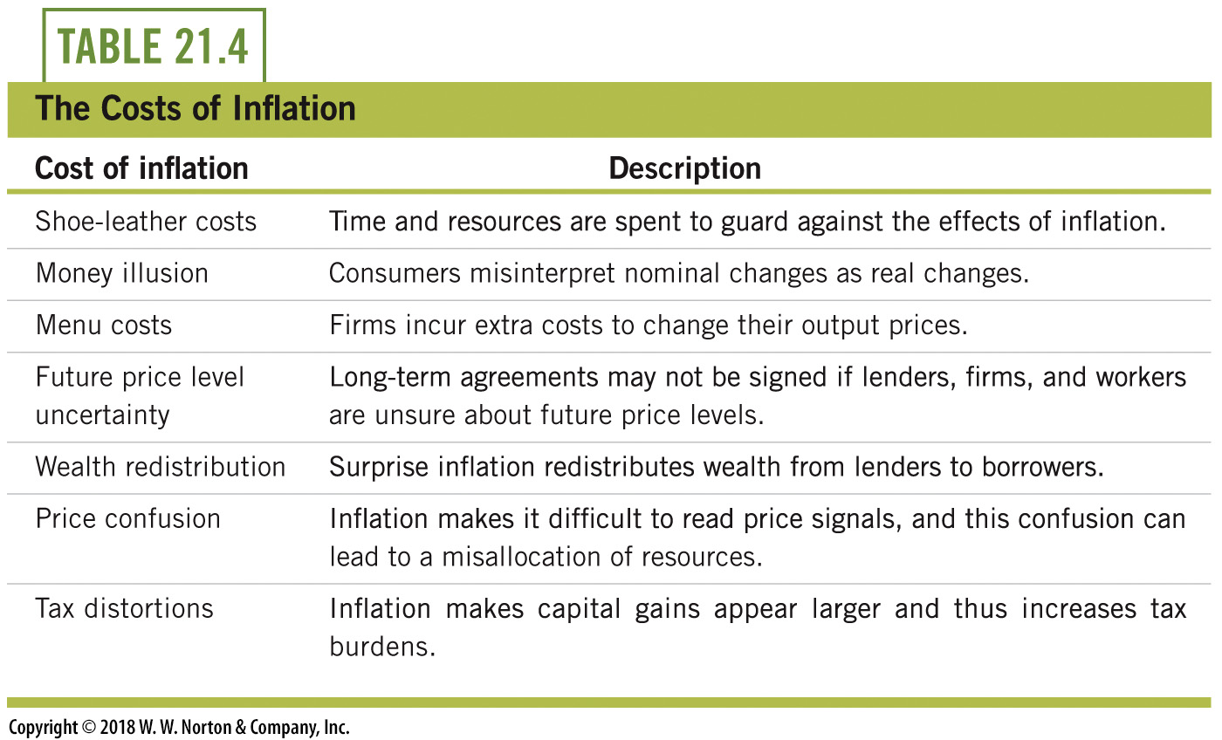
Costs of Inflation—8

Slide 35

The Cause of Inflation
No debate on the cause of inflation
  Expansions in the nation’s money supply
  Milton Friedman:“Inflation is always and everywhere a monetary phenomenon.”
However:
  Not all price increases are caused by inflation
  When the (relative) price of just one good rises, people sometimes call it inflation
Notes:
Lecture notes:
Inflation is a continued rise in the general price level.
This definition helps us focus on long-run price level changes.
The cause of inflation is when a nation’s money supply increases too quickly.
When the supply of money in an economy grows relative to the quantity of goods and services, then it takes more money to buy any particular good or service.
Money becomes less valuable—and this is inflation.

Slide 36
Equation of Exchange—1
Long-run relationship between the price level and the quantity of money:
M x V = P x Y
  M: quantity of money
  V: velocity of money
  P: price level
  Y: real GDP
Notes:
Lecture notes:
The long-run relationship between the price level and quantity of money is known as the equation of exchange.
Note, the right-hand side of the equation (PY) is nominal GDP.
The velocity of money is the number of times a unit of money exchanges hands in a given year. It represents the speed at which currency circulates.
The quantity of money includes paper currency and coins. (We will define the quantity of money more precisely in the upcoming chapters.)
Money includes whatever we use in exchange for goods and services.
For this reason, the equation of exchange is actually an identity— it is true by definition.

Slide 37
Equation of Exchange—2
In growth rates:
%ΔM + %ΔV =%ΔP + %ΔY
  where Δ represents “change”
  and %Δ represents “percent change”
Assuming constant velocity of money,
  %ΔP > 0 if %ΔM > %ΔY
  %ΔP < 0 if %ΔY > %ΔM
  %ΔP = 0 if %ΔM = %ΔY
Notes:
Lecture notes:
With a few math tricks, we can use the equation of exchange to arrive at a formula in terms of growth rates.
Assuming that the velocity of money is constant, the percent change in the velocity of money is zero, and we can draw the following conclusions:
Inflation (the percent change in the price level) is > 0 if the growth rate of the money supply is greater than the growth rate of real GDP.
Inflation is < 0 if the growth rate of the money supply is less than the growth rate of real GDP.
Inflation is = 0 if the growth rate of the money supply is equal to the growth rate of real GDP.

Slide 38
Using the CPI to Compare Dollar Values across Time
Prices from different time periods can be misleading.
  In 1924, you could buy a fully constructed house for $1,969.
  To compare prices over time, we can transform past prices into a price in today’s dollars,
Notes:
Lecture notes:
In order to compare prices over time, we take the earlier price and adjust it for the differences in prices levels between the past and present.
We are adjusting the past price for inflation to see what the price would be today.
We can then examine the “Price Today” that we found to see if the price of the good has generally risen slower or faster than the rate of inflation.
In other words, was there a real price increase or just a price increase that keeps up with inflation?
Note: This is essentially a unit conversion where dollar values in different years are the various units.

Slide 39
Conclusion
CPI is the foundation of inflation calculations
  Computation can be difficult because the typical basket of consumer goods changes over time
  The BLS tries to adjust for this
The macroeconomic costs of continued price rises include
  future price level uncertainty
  signal extraction problems
  menu costs
  money illusion
Notes:
Lecture notes:
Reiterate that inflation is often misunderstood by the general public.
You can conclude your lecture by also reiterating the following points:
CPI is the primary measure of the general price level in the United States
Uses prices from a basket of goods formed by the spending habits of the typical consumer
Forming the basket of goods is no simple task, especially given that the basket changes over time
Consumers substitute goods based upon relative price changes and quality changes
New goods and retail options change consumers’ buying habits
The BLS attempts to account for all of these changes
The inflation rate is the growth rate of the CPI, expressed in percentage terms.
CPI is also useful for equating monetary values (or prices) over time
There are several macroeconomic costs from inflation, including:
signal extraction costs
future price level uncertainty
menu costs
money illusion
Inflation is caused and controlled by expansions of a nation’s money supply

