Slide 1
The Five Foundations of Economics
1
Notes:
Pre-class music: “Soak Up the Sun” by Sheryl Crow (See Tip #002)
This song deals with the opportunity cost of ”sunning” oneself while the world goes by. The idea of trying to catch rays while they are still “free” makes an economist wonder if Ms. Crow understands that there is no such thing as a free sunbeam.

Slide 2
Big Questions
What is economics?
What are the five foundations of economics?
Notes:
Lecture notes:
The main goal of this course is to provide students with the tools they need to be able to make their own assessments about the economy.
Other goals:
To discover how the world works
To become an informed citizen
To understand how to live your life to the fullest
To understand the stock market
To make better personal finance decisions
To understand social security and health care

Slide 3
Here’s a question for you…
When you hear the term “economics,” what words come to mind?
Notes:
Lecture tip:
A great way to start off a new chapter is to pose a question to students and then the answer to the question is revealed over the course of the chapter.
The question can be general or specific.
Get the students involved with providing answers.
If their answer makes sense, compliment them and move on.
If their answer is doubtful or doesn’t really apply to the question, try to draw them out more to see where they are going with it. Sometimes they see the error of their answer as they are trying to discuss it with you.
Here, the question is a basic word association: What words spring to mind when they hear the term “economics”?
Many students will not have had an economics course.
Many students are confused as to why economics counts as a social science in their general education courses.
Many students believe that economists only study large world events (macro issues).

Slide 4
Purpose of This Course
Provide you with the tools to
  Discover how the world works
  Be an informed citizen
  Live your life to the fullest
  Understand markets
  Make better personal decisions
Notes:
Lecture notes:
The main goal of this course is to provide students with the tools they need to be able to make their own assessments about the economy. This course will change how students see the world.

Slide 5
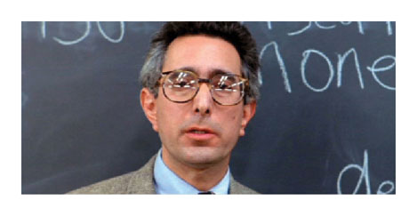
Economics in Ferris Bueller
Here is a stereotypical representation of a “boring” economics class. Hopefully, you’ll enjoy this course a little more.
Notes:
“Economics in the Media” Slide
Lecture tip:
The clip mentioned on the slide can be found in the Interactive Instructor’s Guide. Access the direct link by clicking the icon in the PowerPoint above.
Show the clip and then explain to students that you do not want your class to be this way. Start off the course making sure they understand that you expect them to participate.
[PARAMOUNT / The Kobal Collection/Art Resource, NY]

Slide 6
What Is Economics?
Scarcity
  The limited nature of society’s resources given society’s unlimited wants
Economics
  The study of how people allocate their limited resources to satisfy their unlimited wants
  The study of how people make decisions
Notes:
Lecture notes:
Start with the notion that we have unlimited wants and limited resources:
Unlimited wants > Limited resources
This is why scarcity exists and why choices have to be made.
When defining economics, make sure to stress that it is a study of behavior. In this case, we are studying how people behave under the condition of scarcity.
This is what makes economics a social science.

Slide 7
Practice What You Know—1
What can be said about scarcity?
  Scarcity forces us to make choices.
  Scarcity doesn’t affect the super-wealthy.
  Scarcity only affects commodities such as oil.
  Scarcity generally doesn’t affect our day-to-day living.
Notes:
Clicker Question
Correct answer: A, Scarcity forces us to make choices.
Each choice we make results in an opportunity cost.

Slide 8
Microeconomics and Macroeconomics
Microeconomics
  The study of individual units that make up the economy
    Focus on individuals, businesses, industries
Macroeconomics
  The study of the overall aspects and workings of an economy
    Focus on “big picture”
Notes:
Lecture notes:
Give several examples of questions that may be answered in each. Some examples can include the following:
Microeconomics:
How many movies does a family see each year?
What factors affect a person’s career choice?
How does a rise in sales taxes impact the retail industry?
How would an increase in the minimum wage affect teenage employment?
How does health insurance alter a patient’s demand for health care services?
Macroeconomics:
What is the current level of inflation?
How much has employment grown in India over the past 20 years?
Is the economy of Japan in a recession?
What will happen in the U.S. economy if the federal government raises taxes?
How does the federal debt affect the economy?

Slide 9
The Five Foundations of Economics—2
Incentives matter
Life is about trade-offs
Opportunity costs
Marginal thinking
Trade creates value
Notes:
Lecture notes:
Point out to students that this is just a list, and each will be discussed in detail in later slides.

Slide 10

Incentives Matter—1
Incentives
  Factors that motivate you to act or exert effort
People respond to incentives!
Notes:
Lecture tips:
Here is a great place for you to discuss the incentive structure in your course.
Attendance policies
Extra credit points
Participation points

Slide 11
Incentives Matter—2
Positive incentives
  Encourage action by offering rewards or payments
Negative incentives
  Discourage action by providing undesirable consequences or punishments
Notes:
Lecture notes:
Provide plenty of examples of each type of incentive.
Positive incentives:
Bonuses
Gifts
Allowance
Treats (even work with pets!)
Negative incentives:
Punishment (grounding, loss of favorite toy)
Fine
Jail
Loss of job

Slide 12
Incentives Matter—3
Direct incentive
  “Here is what I want you to do, and here is what I am going to do in order to get you to do it.”
    Generally easy to recognize
Indirect incentive
  A secondary change in behavior brought on by the original incentive
    More difficult to recognize
Notes:
Lecture notes:
Again, the key here is to provide as many examples possible so that the students grasp the difference between the types of incentives.
Direct incentives:
If your sales this month are over your sales quota, you’ll get a bonus.
Don’t get any tickets or have any accidents, and we’ll reduce your car insurance premiums.
Son, if you do the yard work, I’ll give you $40.
If you get straight As, I’ll give you $500.
Indirect incentives:
To reach the sales quota, the salesperson may push too hard with some clients or not spend time with family.
To avoid the insurance company knowing about a small “fender-bender,” the person may not report it to the police.
The kid may require payment for doing anything around the house now.
The child may cheat in order to keep straight As or give up all extracurricular activities.
The next slide is about unintended consequences, which is really what indirect incentives are all about.
Suggested video clip: The Office, “The Incentive” (See Tip #016 in the Interactive Instructor’s Guide)

Slide 13
Incentives Matter—4
Unintended consequence
  An unplanned result (usually negative and unwanted) of an incentive
Notes:
Lecture notes:
Example: Welfare programs
What is the intended effect of these programs?
To alleviate the suffering from poverty
To make sure children have enough food to eat and a place to live
What might be an unintended effect?
People could choose to not work
Make sure students understand that this is a big problem with most policies: policy makers must decide how much of a safety net to provide but must also try not to incentivize people to not work.
Suggested reading:
A great article that shows the unintended consequences of government policy is Phillips, M. M. (April 7, 2006). “In South Africa poor AIDS patients adopt risky ploy.” Wall Street Journal, page A1. Found online at http://www.wsj.com/articles/SB114437285980719599.
Government payments are based on how ill the person is.
Individuals are skipping medications and trying to become more ill to take care of families.
Suggested video clip: Freakonomics: The Movie, “Economist Potty Training” (See Tip #021 in the Interactive Instructor’s Guide)

Slide 14
Practice What You Know—2
Which of the following situations illustrates an incentive?
  Dave snacks all afternoon and isn’t hungry for dinner.
  Dirk’s children misbehave during dinner.
  Lee gives his children candy if they behave during dinner.
  Jaime goes to a restaurant for dinner.
Notes:
Clicker question:
Correct answer: C, Lee gives his children candy if they behave during dinner.
An incentive is a motivator to get someone to change his or her behavior. The children are given a positive incentive to behave.

Slide 15
Life Is About Trade-offs
Scarcity implies choice
Scarcity → Choice
  Every decision incurs a cost
  To have one thing, you have to give up another thing
Notes:
Lecture notes:
Students have to decide what to do with their time. There is a trade-off for coming to class. Ask them what that is.
Other examples:
If we spend $10 on a pizza, we cannot spend the same $10 on something else.
The government must decide how to spend tax dollars. Education or health care? Roads or defense?

Slide 16
Practice What You Know—3
The governor decides to increase funding for education. However, this will mean decreasing funding for infrastructure. This situation illustrates
  trade-offs.
  comparative advantage.
  incentives.
  markets.
Notes:
Clicker question:
Correct answer: A, trade-offs.
It also illustrates scarcity, choice, and opportunity cost.

Slide 17
Opportunity Cost—1
Opportunity Cost
  The highest-valued alternative that must be sacrificed to get something else
    Not all alternatives—just the next-best choice
Scarcity → Choice → Opportunity Cost
Notes:
Lecture notes:
Go back to asking students what they gave up to be in class. Ask what the next best alternative was (that is the opportunity cost).
Note that this is the next best alternative; economists assume you chose the best use of your time.
Suggested video clip: The Simpsons, “Joy of Sect” (See Tip #28 in the Interactive Instructor’s Guide)

Slide 18

Opportunity Cost—2
What is the opportunity cost of attending college?
  Tuition and fees
  Books
  Earnings from full-time work
What about room and board?
Notes:
Lecture notes:
This is an important question for students to understand because the “cost of college” according to an economist is different from what is generally reported in the media.
Real-world example: A good example to work through in class can be found in the Interactive Instructor’s Guide, Tip #039: Is Going to College Worth It?
[© Seanyu | Dreamstime.com]

Slide 19
Practice What You Know—4
The opportunity cost of buying a good is
  the sum of values of all the other goods you could have purchased.
  the value of the next-best alternative you could have purchased.
  irrelevant since you will purchase your highest-valued good.
  the average of values of all the other goods you could have purchased.
Notes:
Clicker question:
Correct answer: B, the value of the next-best alternative you could have purchased.
We can’t purchase ALL of the goods. Opportunity cost is just the value of the next best thing. Answer A is not correct, or else opportunity cost could be infinite!

Slide 20

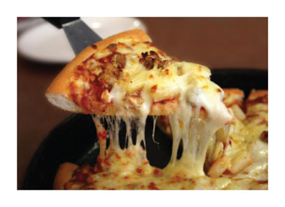
Marginal Thinking—1
Economic thinking
  Requires a purposeful evaluation of available opportunities to make the best decision possible
Marginal thinking
  Requires decision-makers to evaluate whether the benefit of one more unit of something is greater than the cost
Notes:
Lecture notes:
Marginal thinking is a process used by economic thinkers.
Teach students that when they hear the word “marginal,” they should think of the word “additional.”
Remind students of how most decisions are made:
Suppose they are with friends out eating pizza. They don’t start out thinking, “I’m going to have exactly three pieces of pizza.” They eat one and then decide if they want another. After they eat the second, they consider the third.
Use the same decision process to discuss other choices:
How many courses to take each semester
How many hours to work
[top: © Monkeybusi... | Dreamstime.com]

Slide 21
Marginal Thinking—2
Suppose you are vacuuming your living room. Will you move the couch and china cabinet to vacuum under them?
  Marginal benefit
    Small additional amount of carpet is cleaned
  Marginal cost
    Much more time and effort
Notes:
Lecture notes:
Students will recognize this decision. It also applies to cleaning under appliances and the bed.
The decision should depend on the sizes of the marginal benefit and marginal cost:
As long as the marginal benefit ≥ marginal cost, the individual will do the action.
Ask students what they would do.
If they say they move furniture to vacuum, ask why.
The marginal benefit outweighs the marginal cost for these students.
If no one chooses this, make up a student named Emmy who has a lot of allergy issues. Now, ask what Emmy will likely do.
Most students will say they do not. Ask why.
The marginal cost outweighs the marginal benefit.

Slide 22
Economics in Grey’s Anatomy
“Into You Like a Train” Episode
A train accident occurs, and two patients end up with a pole stuck between them
  Doctors have to choose who to save
Notes:
“Economics in the Media” Slide
Lecture tip:
The clip mentioned on the slide can be found in the Interactive Instructor’s Guide. Access the direct link by clicking the icon in the PowerPoint above.

Slide 23
Practice What You Know—5
With regards to marginal thinking, an individual will do an action if
  the probability of success is greater than 50 percent.
  the action has positive benefits.
  the costs of the action are small.
  marginal benefits ≥ marginal costs.
Notes:
Clicker question:
Correct answer: D, marginal benefits ≥ to marginal costs.
We need to compare the costs and benefits of the action!

Slide 24
Trade Creates Value—1
Markets
  Bring buyers and sellers together to exchange goods and services
Trade
  The voluntary exchange of goods and services between two or more parties
Notes:
Lecture tip:
Make sure that students understand the voluntary nature of trade. People do not enter into a trade if they are going to end up worse off.
Classroom demonstration:
This demonstration can be found in the Interactive Instructor’s Guide (see Tip #043).
Here’s an easy way to demonstrate that trade creates value:
Bring in 10 small gifts for students. (Candy makes a good choice.)
Ask for 10 volunteers.
Pass out the candy.
Ask students to rank their happiness from the gift; add up the total happiness.
Allow students to trade if they’d like.
Again ask students to rank their happiness after the trade; add up the happiness (it should increase).
Point out how trade created value.
Ask students who made the trade what happened to their happiness.
Ask students who didn’t trade why they chose not to.

Slide 25
The Circular Flow—1
Circular Flow
  Shows how resources and final goods and services flow through the economy
    Resource market
    Product market

Slide 26
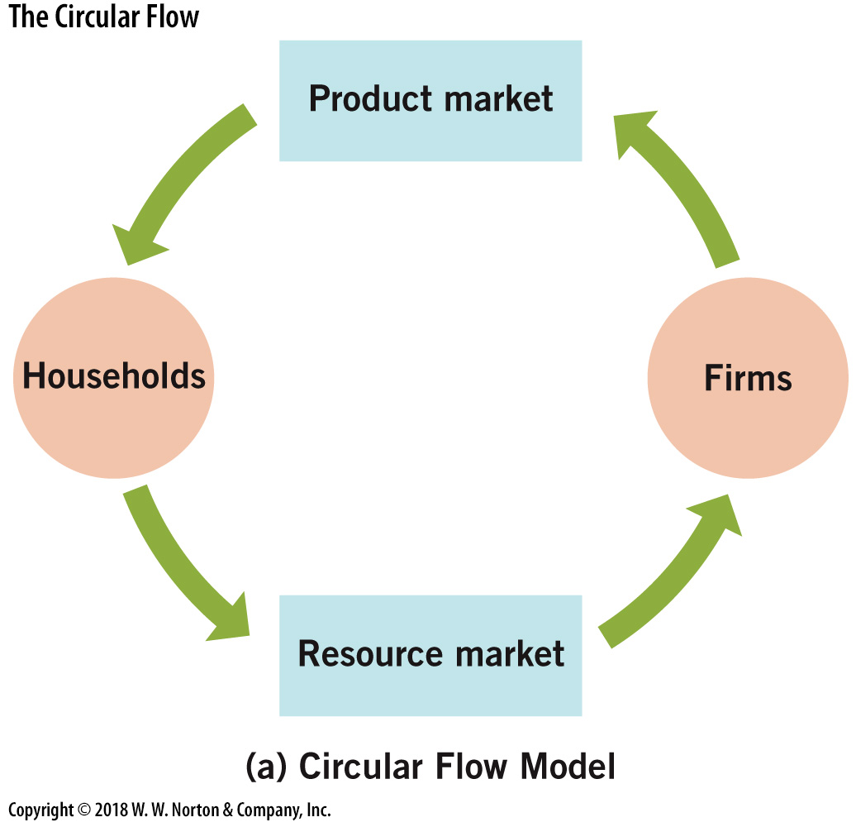
The Circular Flow—2
Notes:
Image: Figure 1.2A
Lecture notes:
Households work in the resource market for firms to produce goods.
Firms deliver the goods to the households through product markets.

Slide 27
The Circular Flow—3
Barter
  Individuals trading a good or service in exchange for something they want
Double coincidence of wants
  Occurs when each party in an exchange transaction has what the other person desires
Notes:
Lecture notes:
In an economy without money, individuals must barter.
This is difficult because it requires a double coincidence of wants.
Make sure students understand how hard it would be to find someone who not only has what you want, but also wants what you have.
To remove the difficulty, we use money in exchange.
Money does not require a double coincidence of wants.

Slide 28
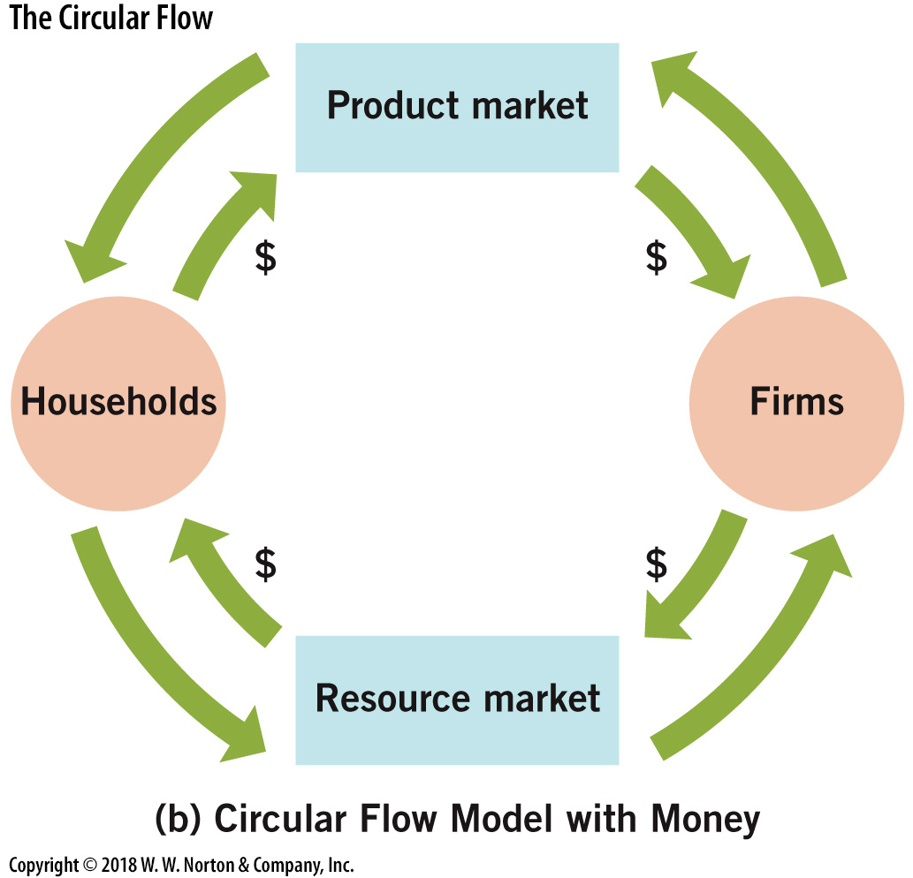
The Circular Flow—4
Notes:
Image: Figure 1.2B
Lecture notes:
Households work in the resource market for firms to produce goods.
Firms provide them with a paycheck.
Firms deliver the goods to the households through product markets.
Households use their earnings to purchase goods and services.

Slide 29

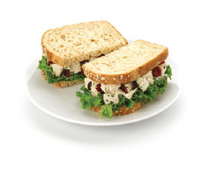
Trade Creates Value—2
Without trade, you would have to produce everything you consume.
Trade fosters exchange of goods and promotes specialization.
Comparative advantage
  The situation in which an individual, business, or country can produce at a lower opportunity cost than a competitor
Notes:
Lecture tip:
Ask students to think of everything they consume:
They would have to make their own food, clothing, housing, and electronics.
They would have to do all their own services as well (hair-cutting, plumbing, dentistry, education, etc.).
Explain to students that comparative advantage will be discussed in more detail in the next chapter.
[bottom: © TheCrimsonMonkey/iStockphoto]

Slide 30
Conclusion
Economists ask, and answer, big questions about life. This is what makes the study of economics so fascinating.
Economics is the study of how people allocate their limited resources to satisfy nearly unlimited wants.
The five foundations of economics:
  Incentives
  Trade-offs
  Opportunity cost
  Marginal thinking
  Trade creates value

