Slide 1
Model Building and Gains from Trade
2
Notes:
Pre-class music: “In the End” by Linkin Park (Link to Tip #050)
This song provides a good opportunity to ask students what they think is “scarce” throughout the song, and why time is overlooked compared to the financial cost when making decisions.

Slide 2
Previously
Economics is the study of how people allocate their limited resources to satisfy their nearly unlimited wants.
“Scarcity” refers to the limited nature of society’s resources.
Incentives are factors that motivate a person to act or exert effort.

Slide 3
Big Questions
How do economists study the economy?
What is a production possibilities frontier?
What are the benefits of specialization and trade?
What is the trade-off between having more now and having more later?
Notes:
Lecture tip:
This is probably the most important chapter to teach in a principles of economics class.
Understanding supply and demand allows students to do the following:
Predict changes in a market
How will the price of oranges respond to an early freeze in Florida?
Explain changes in a market
Why did the price of oranges increase last winter?
Understanding supply and demand will also help students understand how markets work. This will be important to future employers.

Slide 4
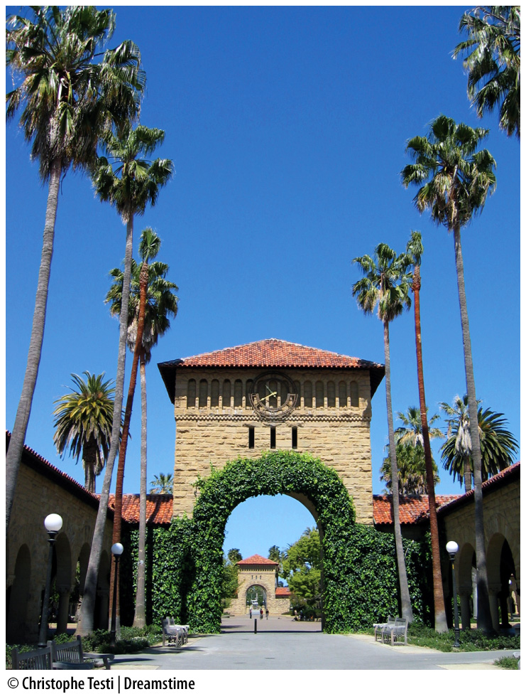
Here’s a question for you…
What are the benefits and costs of a being here in college?
Notes:
Lecture notes:
Chapter 1 discussed the costs of college. Here, in this chapter, focus on the trade-off.
The biggest cost of college is the foregone income while in school.
Lower income means students can’t buy as much.
Students must also postpone getting a house, new car, taking vacations, and so on.
What are the benefits of going to college?
Higher income in future
Better job in future
Less physical
Cleaner environment
The point here is to get students to realize that they are giving up consumption today for (more or better) consumption tomorrow.
[© Christophe Testi | Dreamstime]

Slide 5
The Scientific Method in Economics
Economists use the scientific method to explain economic phenomena:
  Observe a phenomena
  Develop a hypothesis
  Construct a model to test the theory
  Design an experiment to test how well the model works and collect data
  Revise or refute the theory based on evidence
Notes:
Lecture notes:
Economics is just like all other sciences in the approach it takes to answer questions.
Go through the scientific method with a specific question as an example:
Phenomena: People are buying more hybrid automobiles.
Hypothesis: (1) The price of hybrids has fallen and (2) the price of gasoline is higher.
Model to test theory: Supply and demand analysis (explain to students that you will get to that model in the next chapter)
Experiment: Gather data on car prices, gasoline prices, hybrid sales, and other variables of importance. Run appropriate statistical tests. Draw conclusions.
Economics differs from other sciences in important ways:
Economists don’t have a controlled lab; economic behavior takes place in the world around us.
Economists cannot always run controlled experiments and may sometimes have to rely on historical data

Slide 6
Positive and Normative Analysis
Positive statement
  Can be tested and validated
  Describes “what is”
Normative statement
  An opinion that cannot be tested or validated
  Describes “what ought to be”
Economists are concerned with positive analysis.
Notes:
Lecture notes:
Economists do their best to remain objective.
Consider a rise in the unemployment rate:
Economists try to understand why it occurred.
Economists do not determine who should receive unemployment benefits or other government assistance.

Slide 7
Practice What You Know—1
Is the statement positive or normative:
Rich people should be taxed more.
More taxes on the rich will increase tax revenues.
Everyone should donate to charity.
Government intervention in markets is bad.
Economics majors earn more on average than sociology majors do.
Notes:
Lecture tip:
As you go through each option, make sure to discuss the fact that the positive statements are testable (whether they are right or wrong).
Normative statements cannot be tested.
Normative
Positive; this statement can be tested.
Normative
Normative
“Bad” is a broad and poorly defined term. This statement could be turned into a positive statement perhaps if we listed more specific markets, government interventions, and the change in other variables such as prices, quantities, or consumer surplus.
Positive
We can look at salaries of graduates to see if this is true or false. It’s true.
Ask students if they see a trend in the “normative” statements—most of them contain the word “should,” or express an opinion.

Slide 8
Economic Models—1
Economists use models to understand the complex real-world economy.
Models
  Simplified versions of reality
  Built with some assumptions
  Are considered good if they predict accurately
Notes:
Lecture notes:
A map is a good model.
It is not completely realistic. It doesn’t have all the stop signs, stop lights, speed limits, and points of interest along the way.
But it works to get you from point A to point B.
Once again, we see what the model represents, even though that is not what a real molecule looks like.
Characteristics of good models:
Simple
Flexible
Useful for making predictions
Classroom demonstration: Building Paper Airplanes (Part 1)
This demonstration can be found in the Interactive Instructor’s Guide (See Tip #054).
Give the students a few minutes to construct a paper airplane.
Have a few try to fly them.
Point out that these are not very realistic, but there are many features in a paper airplane that model real flight.
Select a group of students and ask them to make a notch in the wing in the back.
Ask students to predict what will happen when these planes are flown.
How did their prediction work?

Slide 9
Economic Models—2
Ceteris paribus
  Latin: Means “other things being equal”
  Used to build economic models
  Allows economists to examine a change in one variable while holding everything else constant
Notes:
Lecture notes:
The goal is to isolate the effect of a change in one variable.
Suppose you are having some stomach difficulties. If you change your diet drastically (eliminating gluten, dairy, processed foods, etc.), you will not know what was causing the problems.
Classroom demonstration: Building Paper Airplanes (Part 2)
This demonstration can be found in the Interactive Instructor’s Guide (See Tip #054).
Select a different group of students and ask them to make the same notch but also bend down the tip in front and bend in the wings.
Ask students to predict what will happen when these planes are flown.
How did their prediction work?
Point out that (in this case) they cannot determine how much effect each of these changes had on the model. There were too many changes to sort it all out.

Slide 10
Economic Analysis
Endogenous factors
  Variables that can be controlled for inside a model
Exogenous factors
  Variables that cannot be accounted for in a model
Notes:
Lecture notes:
Researchers cannot control everything in a model.
Suppose we are interested in how a person chooses how many hours to work:
Endogeneous factors = how much he or she is paid
Exogeneous factors = the individual’s work ethic
Classroom demonstration: Building Paper Airplanes (Part 3)
This demonstration can be found in the Interactive Instructor’s Guide (see Tip #054).
Pick a target in the front of the class and have the rest of your students try to hit it.
The classroom provides a “controlled” experiment.
The models used are endogenous (built into the model).
Discuss what would happen if you took the experiment outside.
The weather and wind would affect the performance of the model but cannot be controlled (exogenous).

Slide 11
Models and Ceteris Paribus—1
Who gets paid more…
  Educated or uneducated individuals?
  Skilled or unskilled labor?
  Worker right out of college or older worker?
  New employee or veteran employee?
  Safe or dangerous job?
Notes:
Lecture notes:
Go through the list of questions on the slide.
For the last question, mention the show Deadliest Catch. Even though some of the people on the show are young, relatively unskilled, and don’t have a college degree, the Alaskan crab fishermen get paid a lot of money since the job is so dangerous.

Slide 12
Models and Ceteris Paribus—2
Positive effect
Positive or negative effect?
Positive effect
Positive effect
Negative effect
A negative effect here may be indicative of discrimination.
Notes:
Lecture tip:
Clicking through the slide will reveal the answers (of what kind of effect each example is), so ask students to predict first.
Lecture notes:
This is an example of a model to predict the wage of a person.
The equation uses function notation.
Read as, “The wage is a function of education, age, experience, skills, working conditions, and gender.”
These are all endogenous variables.
The goal is to understand the effect of each variable separately.
You must use the ceteris paribus assumption.
What happens if we change just one of the variables and hold the rest constant? How will wage be affected?
These are endogenous variables.
Ask students if they can come up with any exogenous variables. Some exogenous variables can include the following:
Labor market conditions
State of the economy (boom or bust)

Slide 13
Danger of Faulty Assumptions
When building a model, you must decide:
  What variables to include
  What variables to exclude
These aren’t known with certainty.
Model assumptions are also important for the model’s success in predicting outcomes.
  It is necessary to often examine and re-evaluate the assumptions in models.
Notes:
Lecture notes:
Prior to 2006, bank models assumed that real estate prices would continually rise.
They had risen for many years in the past
That faulty assumption cost banks and other financial organizations a great deal of money during the financial crisis.
The entire financial market was on the brink of collapse.

Slide 14
Practice What You Know—2
What is a possible problem with using faulty assumptions when building an economic model?
  The model could become too popular.
  It could lead to poor economic decisions.
  It means we never have to rebuild the model.
  It could cause too much wealth.
Notes:
Clicker question:
Correct answer: B, It could lead to poor economic decisions.
If your model is based on bad assumptions, the results given may not have the desired real-world results you hoped for.
Think about the financial crisis just discussed on the previous slide. The models did not include a variable for falling home prices because they assumed that the prices would never fall.

Slide 15
Production Possibilities Frontier—1
Production possibilities frontier
  Illustrates the combinations of outputs that a society can produce if all of its resources are being used efficiently
Assumptions (ceteris paribus):
  Technology fixed
  Quantity of resources fixed
  Society produces only two goods:
    Pizza and wings
Notes:
Lecture notes:
The assumptions of the model help preserve ceteris paribus. We will use pizzas and wings as an example of two goods.

Slide 16
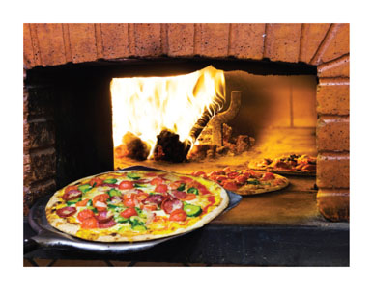
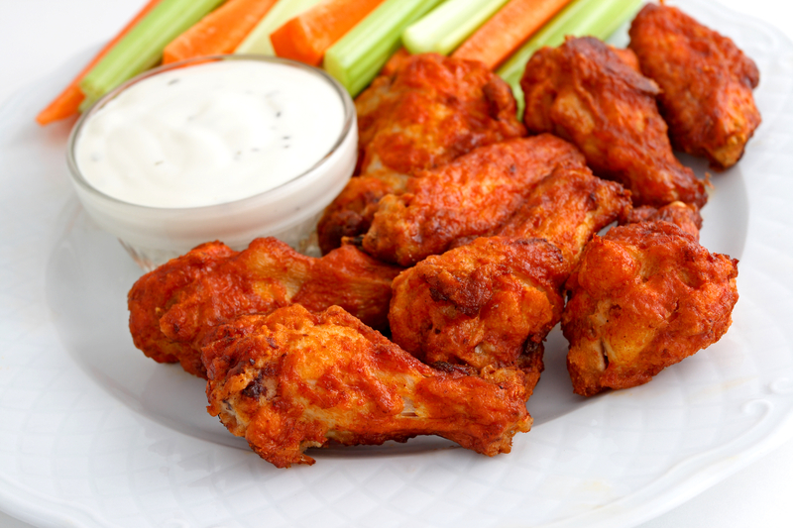
Production Possibilities Frontier—2
Notes:
Image: Animated Figure 2.1
Lecture tip:
Click through the slide to reveal each part of the figure.
Lecture notes:
The diagram shows the production possibilities frontier (PPF) for two goods:
Wings (measured on the horizontal axis)
Pizza (measured on the vertical axis)
First click:
If the economy uses all its resources and produces only pizzas, it can produce 100 pizzas (point A).
If the economy uses all its resources and only produces wings, it can produce 300 wings (point B).
Second click:
Alternatively, the economy may want to produce some of each good. (Variety is a good thing!)
At point C, the economy is using all its resources to produce 70 pizzas and 90 wings.
At point D, the economy is using all its resources to produce 50 pizzas and 150 wings.
At any point along the PPF, the economy is using all its resources.
Third click:
At point F, the economy is only producing 40 pizzas and 70 wings.
It could produce more wings, more pizza, or more of both goods by using more resources.
Fourth click:
Points inside the PPF indicate an inefficient use of resources.
Fifth click:
Points outside the PPF (such as point E) represent an unattainable level of output given the current resources and technology.
This is desirable but not feasible.
Classroom demonstration: PPF Game (Part 1)
This demonstration can be found in the Interactive Instructor’s Guide (see Tip #064).
Build a PPF with your class: student volunteers doing pushups and texting.
Spend 30 seconds each doing each activity.
You can return to this activity when you discuss specialization and trade.
[top: © Serafino Mozzo/iStockphoto]

Slide 17
Practice What You Know—3
With regard to the PPF, an efficient point is a point that is
  impossible to reach.
  inside the PPF.
  outside the PPF.
  on the PPF.
Notes:
Clicker question:
Correct answer: D, on the PPF.
Efficient points are ON the PPF; inefficient points are INSIDE the PPF.
Points outside the PPF are currently unattainable.

Slide 18
PPF and Opportunity Cost—1
Why is the PPF downward-sloping?
  Must give up one good to increase production of another
Recall opportunity cost
  Highest-valued alternative given up to pursue an action
Notes:
Lecture notes:
Go through several numerical examples here, moving from point A to point C, from point C to point D, and from point D to point B.
From point A to point C:
Gain 90 wings
Give up 30 pizzas
Opportunity cost of a wing = 30/90 = 1/3 pizza
From point C to point D:
Gain 60 wings
Give up 20 pizzas
Opportunity cost of a wing = 20/60 = 1/3 pizza
From point D to point E:
Gain 150 wings
Give up 50 pizzas
Opportunity cost of a wing = 50/150 = 1/3 pizza
Because the PPF is a straight line, the slope is constant.
The opportunity cost will also be constant.

Slide 19
Practice What You Know—4
If we move down and to the right along a PPF, the opportunity cost of this movement can be measured in terms of
  how much of the x-axis good we gain.
  how much of the y-axis good we gain.
  how much of the x-axis good we give up.
  how much of the y-axis good we give up.
Notes:
Clicker question:
Correct answer: D, how much of the y-axis good we give up.
Why is C not correct? The PPF is downward-sloping.
If we move down and to the right, we gain some x-axis goods, but it is at a cost of losing some y-axis goods.
Why is A not correct? Because opportunity cost is what we give up, not what we gain.

Slide 20
PPF and Opportunity Cost—2
Not all resources are perfectly adaptable for producing both goods
  The PPF will not have a constant slope.
  The opportunity cost of producing a good will rise as we produce more of it.
    The slope will get steeper as we move from left to right.
Notes:
Lecture notes:
Start with examples of resources that are better suited for the production of pizzas than of wings:
Pizza ovens
Pizza chefs
Mozzarella cheese
Then discuss examples of resources that are better suited for producing wings than for producing pizza:
Chickens
Deep fryers
Cooks who specialize in great sauces and rubs
Start with a position on the production possibility curve where the economy is producing only pizzas.
If we want to produce more wings, we need to shift resources from pizza production to wing production
Which resources will we shift first?
Those that are best suited for wing production: the deep fryer (that hasn’t really done much to produce pizzas)
The opportunity cost will be small (those resources aren’t producing many pizzas anyway)
But as we keep shifting resources from pizza production to wing production:
It will be more and more difficult to find resources that are highly useful in producing wings (so it takes more of them to increase wing production)
It will be more and more costly in terms of pizzas given up (some of the resources being shifted are highly productive in making pizzas)
This means the opportunity cost of increasing wing production will rise as we produce more and more wings.
The same story can be told in terms of pizza production, by starting where the economy is only producing wings and then increasing pizza production.

Slide 21
PPF and Opportunity Cost—3
Law of increasing opportunity cost
  The opportunity cost of producing a good rises as society produces more of it.
  The PPF will not have a constant slope.
    The slope will rise (in absolute value) as we move from left to right.
Notes:
Lecture notes:
This is just a name applied to the phenomenon we discussed in the previous slide.
The law of increasing opportunity cost occurs because some resources are better suited for the production of some things, while other resources are better suited for the production of others.
Resources are not interchangeable.

Slide 22
PPF and Opportunity Cost—4
Notes:
Image: Animated Figure 2.2
Lecture notes:
The slide starts with the PPF and point D. We will be calculating the opportunity cost of increasing pizzas by 20 units.
First click:
Movement from point D to point C
Pizzas increase by 20
Wings fall by 30
Opportunity cost of increasing pizza by 20 = 30 wings
Second click:
Movement from point C to point B
Pizzas increase by 20
Wings fall by 50
Opportunity cost of increasing pizza by 20 = 50 wings
Third click:
Movement from point B to point A
Pizzas increase by 20
Wings fall by 80
Opportunity cost of increasing pizza by 20 = 80 wings
It becomes increasingly more costly to expand the production of pizza as we produce more and more pizzas.

Slide 23
The PPF and Economic Growth—1
Economic growth
  The process that enables a society to produce more output in the future
  Can be shown by a shift outward of the PPF
    Some previously unattainable good combinations would now be possible to produce

Slide 24
The PPF and Economic Growth—2
The PPF could shift graphically in two ways.
  New resources or technology could be introduced that either
    affect the production of one good, or
    affect the production of both goods.

Slide 25
The PPF and Economic Growth—3
The PPF could shift out because of
  New technology
  New (or better) resources available
These changes in technology or resources could affect the production of
  Only one good
  Both goods
Notes:
Lecture notes:
Here, it is important for students to understand two things:
What can cause the PPF to shift out
That the shift may not be parallel and may be more of a rotation

Slide 26
The PPF and Economic Growth—4
Notes:
Image: Animated Figure 2.3
Lecture notes:
Here, a new technology allows us to produce more pizzas, but our wing production capabilities are not changed.
First click:
The PPF will tilt up and rotate.
Second click:
If the economy chooses to produce only pizzas, the number of pizzas it is able to produce has grown from 100 to 120.
If the economy chooses to produce only wings, the number of wings it can produce has not changed and remains 300.
In order to benefit from the new technology, society must use it (and produce pizza).
Third click:
The new technology actually allows society to increase its production of both pizza and wings.
This is true even though the new technology is for producing pizza.
For example, society can move from point A to point B.
It can increase pizza and wings.
This occurs because some resources that were being used to produce pizzas can now be shifted to produce wings because of the new technology.

Slide 27
Shift in the PPF
Notes:
Image: Animated Figure 2.4
Lecture notes:
Here, more resources allow society to produce more of all goods. Additional resources could include more people, land, or natural resources.
First click:
The PPF shifts out at both intercepts
Second click:
If the economy chooses to produce only pizzas, the number of pizzas it is able to produce has grown from 100 to 120
If the economy chooses to produce only wings, the number of wings it is able to produce has grown to 360
Third click:
The new resources actually allows society to increase its production of both pizza and wings
For example, society can move from point A to point C
Can increase pizza and wings

Slide 28
Practice What You Know—5
(True/False) Point A represents the amounts of cars and bicycles that will be sold.
False.
It represents how many cars and bicycles are produced, not sold.
Bicycles
A
Cars
Notes:
Clicker question:
Correct answer: False
Point A represents the amounts of cars and bicycles that will be produced, not sold.

Slide 29
Practice What You Know—6
(True/False) Movement along the curve from point A to point C shows us the opportunity cost of producing more bicycles.
True.
Bicycles
C
A
Cars
Notes:
Clicker question:
Correct answer: True
As we move from point A to point C, we can measure the number of cars we give up as we increase bicycles. This would be the opportunity cost of producing more bicycles.

Slide 30
Practice What You Know—7
(True/False) If we have high unemployment, then the curve shifts in.
Bicycles
False.
?
Cars
Notes:
Clicker question:
Correct answer: False
If we have unemployment, we are not using all our resources. It doesn’t affect our PPF; it just means we are operating at a point inside the PPF.

Slide 31
Practice What You Know—8
(True/False) If an improved process for manufacturing cars is introduced, society will be able to produce more cars and more bicycles.
Bicycles
True.
Cars
Notes:
Clicker question:
Correct answer: True
Even though the technology change is only in the car sector, resources can now be freed up from that sector and moved to producing bicycles.
The PPF rotates. (Draw this for students and work through it.)

Slide 32
Practice What You Know—9
Suppose there is high unemployment. With respect to the PPF, what will happen?
  The PPF will shift inward.
  The PPF will shift outward.
  We will produce at a point inside the PPF.
  We will produce at a point outside the PPF.
Notes:
Clicker question:
Correct answer: C, We will produce at a point inside the PPF.
Unemployment means we aren’t being fully efficient. It doesn’t decrease what we can produce.

Slide 33
Specialization and Trade—1
Improvements in technology and resources can make an economy more productive.
Specialization and trade can also create gains for society.
Specialization
  The limiting of one’s work to a particular area

Slide 34
Specialization and Trade—2
Assume now:
  Two goods (pizza and wings)
  Two people with different abilities in the production of pizza and wings
Notes:
[left; © Serafino Mozzo/iStockphoto]

Slide 35
Specialization and Trade—3
 | Daily Production
Person | Pizzas | Wings
Debra Winger | 60 | 120
Mike Piazza | 24 | 72
Absolute advantage
  One person can perform one task more effectively than the other person can.
  Who has the absolute in pizza? In wings?
Notes:
Lecture notes:
Here, Debra and Mike can each make pizza and wings.
It appears Debra is better than Mike at production of both goods.
She has an absolute advantage.
This does not mean she should “do it all.”
Even given her absolute advantage in both goods, they can benefit from specialization and trade.
[left; © Serafino Mozzo/iStockphoto]

Slide 36
Specialization and Trade—4
Notes:
Image: Animated Figure 2.5
Lecture notes:
The slide starts with the table and axes for each person’s PPF.
Debra:
If Debra puts all her time into making pizzas, she can produce 60.
If Debra puts all her time into producing wings, she can produce 120.
Mike:
If Mike puts all his time into making pizzas, he can produce 24.
If Mike puts all his time into producing wings, he can produce 72.
Demonstrate these points as the intercepts for each person’s PPF.
Why a linear PPF for an individual?
For society, the PPF was curved due to heterogeneity of inputs.
This means that different inputs (capital and labor and resources) all have different abilities in production.
Here, we are just looking at a single person and his/her ability to produce pizza or wings.
Debra and Mike each face a constant trade-off between producing pizza and wings.
For Debra, this means that her trade-off between producing pizza and wings is fixed at 1:2 (she produces 60 pizzas for every 120 wings).
Mike’s trade-off between producing pizzas and wings is fixed at 1:3 (he produces 24 pizzas for every 72 wings).
Since Debra and Mike can produce at any point along their production possibilities frontiers, it is helpful to assume that they initially enjoy both foods equally, so they try to produce the same amount of each.
When this is the case, Debra produces 40 pizzas and 40 wings, while Mike produces 18 pizzas and 18 wings.
Since Debra is more productive in general, she produces more of each food. We say that Debra has an absolute advantage, meaning that she is as good, or better, than Mike at producing both items.

Slide 37
Specialization and Trade—5
 |  | Without Trade
Person | Good | Production | Consumption
Debra | Pizza | 40 | 40
 | Wings | 40 | 40
Mike | Pizza | 18 | 18
 | Wings | 18 | 18
Without specialization and trade:
  Mike and Debra each have to produce their own wings and pizza
  Each person can only consume what they produce
Notes:
Lecture notes:
Without trade, a person can only consume what he or she produces and nothing more.
Consumption = production
Can they do better?

Slide 38
Specialization and Trade—6
 |  | With Trade |  | Gains from Trade
Person | Good | Production | Consumption
Debra | Pizza | 60 | 41 (keeps) | + 1
 | Wings | 0 | 47 (from Mike) | + 7
Mike | Pizza | 0 | 19 (from Debra) | + 1
 | Wings | 72 | 25 (keeps) | + 7
With specialization and trade:
  Debra produces pizza and gives 19 pizzas to Mike
  Mike produces wings and gives 47 wings to Debra
  Each person consumes more with trade
Notes:
Lecture tip:
Click through to show the table.
Lecture notes:
Let’s suppose that Debra decides to specialize in pizza and Mike specializes in wings.
First click:
This is the output of Debra and Mike if they specialize.
Debra produces 60 pizzas and 0 wings.
Mike produces 0 pizzas and 72 wings.
Specialization has resulted in 2 additional pizzas and 14 additional wings.
Second click:
Suppose Debra gives 19 pizzas to Mike in exchange for 47 wings.
Third click:
Debra is left with 41 pizzas (60 – 19).
Debra is left with 47 wings (all from Mike).
She has gained 1 pizza and 7 wings.
Fourth click:
Mike is left with 19 pizzas (all from Debra).
Mike is left with 25 wings (72 – 47).
He has gained 1 pizza and 7 wings.
Each person now has more than he or she could have had alone.
They are consuming outside of their PPFs.
When Debra specializes and produces only pizza, her production is 60 units. In this case, her individual pizza output is greater than the combined production of 58 pizzas (Debra’s 40 + Mike’s 18). Similarly, if Mike specializes in wings, he is able to make 72 units. His individual wing output is greater than their combined output of 58 wings (Debra’s 40 + Mike’s 18). Specialization has resulted in the creation of two additional pizzas and 14 additional wings.
But Debra and Mike would like to have both pizzas and wings. So if they specialize and then trade with each other, they will each benefit. If Debra gives Mike 19 pizzas in exchange for 47 wings, they are each better off by 1 pizza and 7 wings.

Slide 39
Gains from Trade—1
Notes:
Image: Animated Figure 2.6
Lecture notes:
Start with the two PPFs:
Without specialization and trade, Debra and Mike can only consume what they produce.
At point B for each:
Debra is consuming 40 pizzas and 40 wings.
Mike is producing 18 pizzas and 18 wings.
First click:
After specialization and trade, Debra is consuming 41 pizzas and 47 wings (point C).
This point lies outside of her PPF.
It would not have been possible without specialization and trade.
Second click:
After specialization and trade, Mike is consuming 19 pizzas and 25 wings (point C).
This point lies outside of his PPF.
It would not have been possible without specialization and trade.

Slide 40
Gains from Trade—2
 | Daily Production
Person | Pizzas | Wings
Debra Winger | 60 | 120
Mike Piazza | 24 | 72
 | Opportunity Cost
Person | 1 Pizza | 1 Wing
Debra Winger | 2 wings (120 ÷ 60) | 1/2 pizzas 60 ÷ 120)
Mike Piazza | 3 wings (72 ÷ 24) | 1/3 pizzas (24 ÷ 72)
Notes:
Lecture tip:
Click through to show the bottom table.
Lecture notes:
Opportunity cost is what could have been produced instead. When Debra makes pizzas, she could have made wings instead. We can use division to find the numerical quantities.
First click:
Debra can use her time to produce either 60 pizzas or 120 wings.
What does she have to give up to produce 1 pizza?
Opportunity cost of 1 pizza = 120/60 = 2 wings
Opportunity cost of 1 wing = 60/120 = 1/2 pizza
Important: Take the time to show students that the opportunity cost of one good is the reciprocal of the other.
Second click:
Mike can use his time to produce either 24 pizzas or 72 wings.
What does he have to give up to produce 1 pizza?
Opportunity cost of 1 pizza = 72/24 = 3 pizzas
Opportunity cost of 1 wing = 24/72 = 1/3 pizza
Again, note that the opportunity cost of a pizza is the reciprocal of the opportunity cost of a wing.

Slide 41
Gains from Trade—3
 | Opportunity Cost
Person | 1 Pizza | 1 Wing
Debra Winger | 2 wings (120 ÷ 60) | 1/2 pizzas (60 ÷ 120)
Mike Piazza | 3 wings (72 ÷ 24) | 1/3 pizzas (24 ÷ 72)
Comparative advantage
  The ability to produce a good at a lower opportunity cost
    Debra: pizza
    Mike: wings
Notes:
Lecture notes:
The definition of comparative advantage is covered in Chapter 1, but it is still a good idea to repeat it for students.
Make sure that students understand it is impossible to have a comparative advantage in the production of both goods if the individuals have different opportunity costs.
This is because the opportunity cost of one good is a reciprocal of the opportunity cost of the other.
Show them that: 3 < 4 BUT 1/3 > 1/4
As long as two individuals face different opportunity costs, they will be able to gain from trade.

Slide 42
Gains from Trade—4
How did we know that Debra and Mike would both be willing to trade 19 pizzas for 47 wings?
Terms of trade
  The relative prices or exchange rate of goods
  We can express this as a ratio (Pizza:wings)
      For Debra, it is 1:2
      For Mike, it is 1:3
Notes:
Lecture notes:
For terms of trade, we need to ask the following: how are the terms of trade determined so trade can benefit both people?
We can think in terms of ratios to see what each would find attractive.
Debra:
Opportunity cost of a pizza = 2 wings
Express this as a ratio (pizza: wings)
1:2
Mike:
Opportunity cost of a pizza = 3 wings
Express this as a ratio (pizza: wings)
1:3

Slide 43
Gains from Trade—5
Person | Opportunity Cost | Ratio
Debra Winger | 1 pizza equals 2 wings | 1:2 = 0.50
Terms of trade | 19 pizzas for 47 wings | 19:47 = 0.40
Mike Piazza | 1 pizza equals 3 wings | 1:3 = 0.33
As long as the terms of trade are between the opportunity costs of the trading partners, the trade benefits both sides.
Notes:
Lecture tip:
Click to reveal the middle row of the table.
Lecture notes:
For a trade to appeal to both, the terms of trade must fall between their relative opportunity costs.
Trade ratio must fall between 1:2 (0.50) and 1:3 (0.33)
First click:
The trade we used was 19 pizzas for 47 wings.
Ratio = 19:47 = 0.40
Classroom demonstration:
PPF Game (Part 2)
This demonstration can be found in the Interactive Instructor’s Guide (see Tip #064).
Go back to the data on the PPF built in class with pushups and texts.
Calculate opportunity cost for each volunteer.
Determine comparative advantage.
Examine if gains from trade are possible and determine the terms of trade.

Slide 44
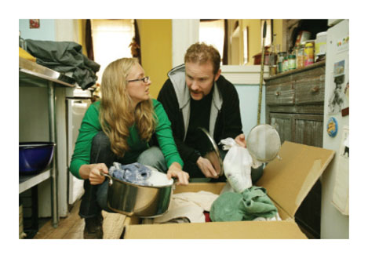
Practice What You Know—10
We often think of specialization and trade occurring between countries.
However, it can occur on much smaller levels as well.
Examples…
  Within a home?
  At a gathering of friends and/or family?
Notes:
Lecture tip:
Ask the students the questions asked below (see the Think-Pair-Share Activity in the Interactive Instructor’s Guide, Tip #074).
Lecture notes:
Suppose there are two spouses in a house, Spouse A and Spouse B.
What are some possible examples of specialization within a home?
Spouse A mows lawn while Spouse B goes grocery shopping.
Spouse A cooks dinner for the whole family while Spouse B runs errands. Children mow the lawn and clean the house.
Spouse A cooks dinner and Spouse B does dishes afterward.
Examples of specialization at a family gathering:
Everyone brings one type of food. Mike brings potatoes, Jon brings pie, and Julie brings chicken. We all don’t bring a little bit of each food we want.
Adults finish preparing the food while children set the table.
[© FX Networks/Courtesy:Everett Collection]

Slide 45
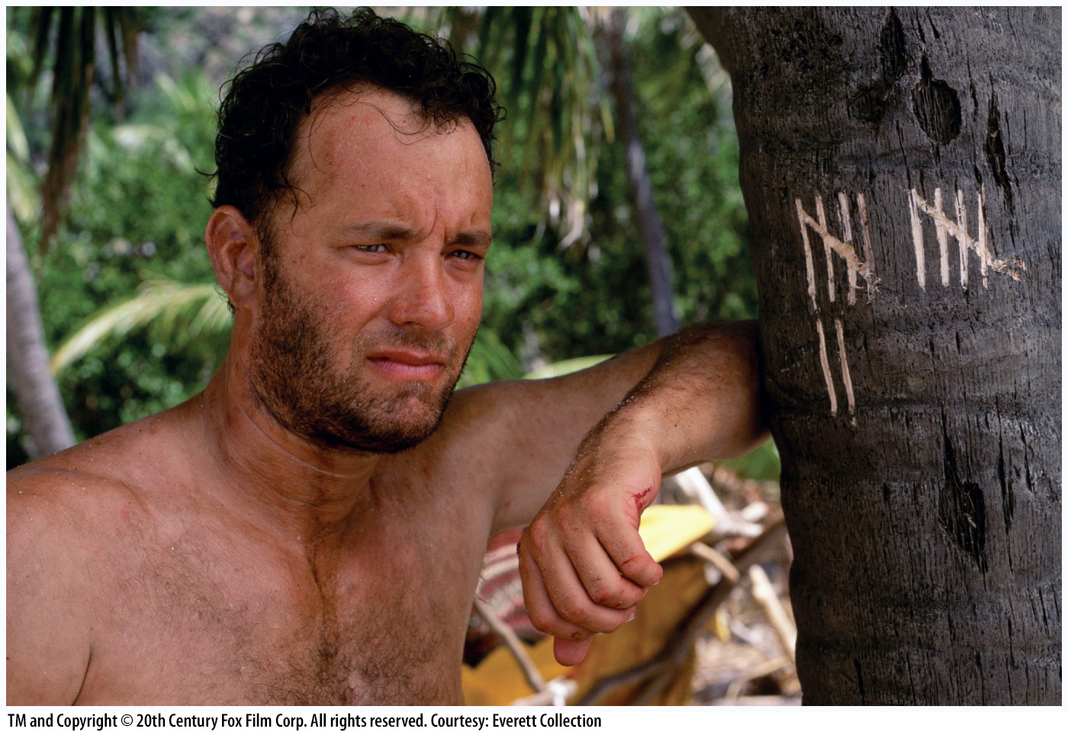
Economics in Cast Away
Cast Away (2000)
  Imagine a world in which there was no specialization and trade.
    Your consumption = your production
Notes:
“Economics in the Media” Slide
Lecture tip:
The clip mentioned on the slide can be found in the Interactive Instructor’s Guide. Access the direct link by clicking the icon in the PowerPoint above.

Slide 46
Trade-off Between Present and Future—1
Short run
  The period in which we make decisions that reflect our immediate or short-term wants, needs, or limitations
    Consumers can only partially adjust behavior
Long run
  The period in which we make decisions that reflect our needs, wants, and limitations over a long time horizon
    Consumers have time to fully adjust to market conditions
Notes:
Lecture notes:
Make it clear to students that there is no “set” definition of these time periods in economics. It depends on the circumstances and how easily someone can adjust to market changes.

Slide 47
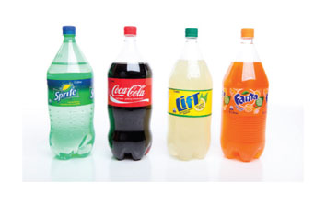
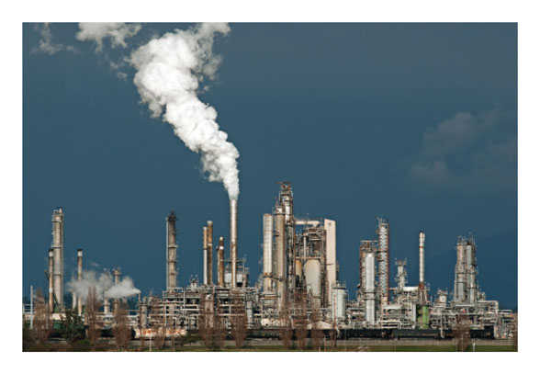
Trade-off Between Present and Future—2
Consumer goods
  Goods produced for current consumption
Capital goods
  Goods that help produce other valuable goods
Investment
  Using resources to create or buy new capital
Notes:
Lecture notes:
Examples of consumer goods:
Food
Housing
Clothing
Entertainment
Examples of capital goods:
Buildings
Factories
Roads
Machinery
Computers
Education
[top: © Showface | Dreamstime.com; bottom: © Charlieb34 | Dreamstime.com]

Slide 48
Capital Goods and Future Growth—1
Notes:
Image: Animated Figure 2.7.a
Lecture notes:
At point A:
Society has chosen to produce many consumer goods and fewer capital goods.
First click:
This production of even a small amount of capital goods will increase the PPF in the long run, leading to economic growth.
Second click:
Because society chose some investment in capital goods, output is now greater.

Slide 49
Capital Goods and Future Growth—2
Notes:
Image: Animated Figure 2.7.b
Lecture notes:
At point B:
Society has chosen to produce many capital goods.
First click:
This production of capital goods will increase the PPF in the long run by a great deal.
Second click:
Because society chose a large investment in capital goods, output is now much greater.
Make sure you highlight the differences between these two slides.
More investment in capital goods today means more of everything tomorrow.

Slide 50
Visualizing Investment—1
Suppose that instead of producing pizza, we spent resources in order to improve pizza-making technology.
What happens…
  Today?
  Tomorrow?
Notes:
“Beyond the Book” Slide
Lecture notes:
There is an opportunity cost of investing in capital goods.
The consumption we give up today
People aren’t always willing to do that (what if we aren’t around to see the payoff?)
Ask students what will happen, and then use the next slide to demonstrate it.

Slide 51
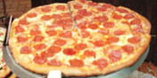
Visualizing Investment—2
Investment in Capital Goods
Time Period
1
2
3
4
No Investment
Notes:
“Beyond the Book” Slide
Lecture notes:
In period 1, there is no investment, just producing pizzas.
First click:
We decide to spend period 2 producing a new pizza oven instead of producing pizzas.
What do we give up? (two pizzas)
What is the benefit? (Go to next click.)
Second click:
We can now produce three pizzas (rather than two).
Third click:
The higher number of pizzas continues in later periods as well.
The opportunity cost is short term, the benefits can be long term.
[© Serafino Mozzo/iStockphoto]

Slide 52

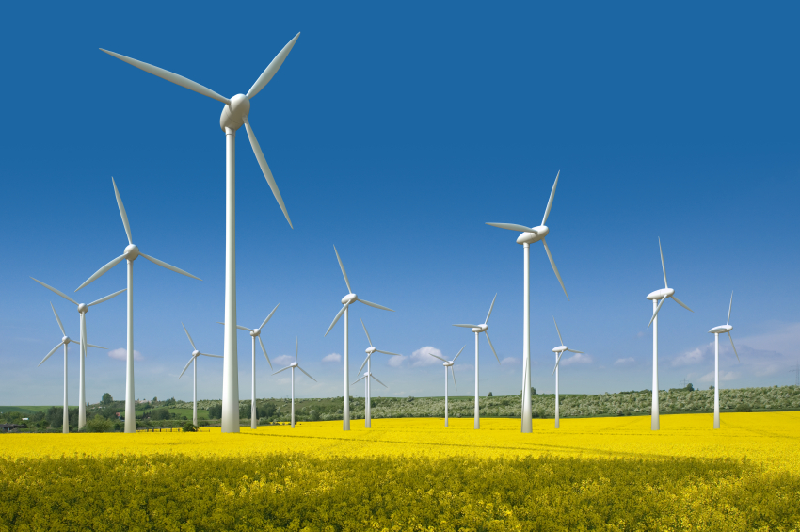
Visualizing Investment—3
Other examples of long-term investment:
Notes:
“Beyond the Book” Slide
Lecture notes:
Left picture: Wind farm
Expensive (big opportunity cost; could do something else with money)
Take a long time to pay for themselves
However, in the very long run, we get cheap, renewable, and clean energy.
Right picture: Investment in human capital (going to college)
Expensive (direct expenses)
There is also a big opportunity cost of time (takes four to five years of your time).
However, in the long run, you may end up having more skills as a result of higher education, and you may become a more productive worker. This could land you a higher paying job.
[right: Robert Nicholas/OJO Images RF/Getty Images]

Slide 53
Practice What You Know—11
What is the opportunity cost of producing capital goods instead of consumer goods?
  We give up consumption today.
  We give up consumption tomorrow.
  We have less employment today.
  We have a lower standard of living tomorrow.
Notes:
Clicker question:
Correct answer: A, We give up consumption today.
We don’t “directly” consume capital goods. If we produce them, we don’t have as many consumable goods “today,” but we’ll have more tomorrow.

Slide 54
Conclusion
Economists use simplified models to understand how the economy works.
The production possibilities frontier (PPF) illustrates the benefits of trade and allows us to describe ways to grow the economy.
When producers specialize, they focus their efforts on those goods and services for which they have the lowest opportunity cost and trade with others who are good at making something else.

