Slide 1
FAILURE MODE AND EFFECT ANALYSIS
Lucas Phillips
Anurag Nanajipuram

Slide 2
INTRODUCTION
What is FMEA?
A systematic approach to determine the failures and their effect on the system.
Identify and prioritize the factors that cause failures at every level of the process.
Determine the actions to correct these failures.

Slide 3
DEFINING FMEA TERMS
Failure Mode- Identifies the failure location and type of failure.
Effect Analysis- Documenting the failures and analyzing the severity of the failures to the process. Also shows the consequences of the failures.

Slide 4
Why FMEA?
It allows for failures to be identified early in design of process
It helps identify the process that has the highest probability of success
Can help identify problems with new changes to an existing process
Identifies Single Failure points
Identifies areas that need monitoring and fault detection devices.
Allows for planning around potential failures “troubleshooting or action plans”
Gives a numeric value to failures to allow for prioritizing

Slide 5
Reasons behind to implement FMEA
Get it correct in first time.
Continuous improvement.
TQM.
Reduce waste.
Where to focus.
Systematic approach to problem solving in the process.

Slide 6
FMEA Process
1.Define the system to be analyzed, and obtain necessary drawings, charts, descriptions, diagrams, component lists. Know exactly what you’re analyzing; is it an area, activity, or equipment? – all of it, or just part of it? What targets are to be considered? What mission phases are included?
2.Break the system down into convenient and logical elements. System breakdown can be either Functional (according to what the System elements “do”), or Geographic/Architectural (i.e., according to where the system elements “are”), or both (i.e., Functional within the Geographic, or vice versa).
3.Establish a coding system to identify system elements.
4.Analyze (FMEA) the elements.

Slide 7
How to conduct FMEA?
Identifying the individual functions of the process.
      Breaking down a process into multitude of sub-processes
      Example: Making a pizza.
Identify all possible failures.
      List all possible failures.
Identify likelihood that the failure occurs.
      Take into account preventative measures taken.
      List all failures in a chart according to the severity levels.
      Rate the severity levels in range of 1-10.
      1 represents lowest severity level and 10 represents highest severity level.

Slide 8
Continued….
Severity of failure
    Take into account all redundant processes used to offset severity
    What effect does this failure have on the system
    10 means if it occurs it is devastating to the system
    1 means time or waste is incurred
Detection
    Take in to consideration detection devices and methods in place
    Likelihood of detection.
    1 means it is easily detected
    10 means it is impossible to detect

Slide 9
Any other ways where FMEA is useful IN TQM?
Discussion

Slide 10
Concept FMEA
Analyze the potential failures that are caused by functional concepts in development process.
Verify the concepts with the cross functional teams with multiple systems.
What failures could new implementation cause and the effect on the process

Slide 11
Design FMEA
Design is the key step where the probability of occurrence of failure is likely high.
Identifies locations for detection and focus
Maintain documentation that can clearly represent the areas where the process needs to be implemented.

Slide 12
Process FMEA
All the implementation analysis is done in process FMEA.
Identify the potential process failures that have the highest effect on the process
Continuous improvement ( how can the process run better?)

Slide 13
ROLE OF TEAM LEADER IN FMEA
Co-ordinate with team members in regular time intervals.
Follow up with each team member regarding assignments.
Maintain a record of FMEA that was implemented.
Assisting team members in processing FMEA.
Ensure the FMEA is done before the deadline.

Slide 14
FMEA Fields
Factors: It includes the circumstances, conditions, events and factors that cause failure.
Potential Failure Mode: The way in which system can fail
      Human error
      Due to atmosphere
      Equipment failure
      Etc
Effects of Failure: Consequences of failure

Slide 15
Continued…
Severity: Rating the severity of the consequences of failure
    Example: Negligible, Minor, Moderate, Major, Catastrophic
Probability: Numeric rating of estimated probability that failure occur
    Example: Occasional, common, frequent, unlikely

Slide 16
Risk Priority Number (RPN)
RPN= Severity* Occurrence* Detection
This will be a value between 1-1000
This will allow for the prioritizing of failures

Slide 17
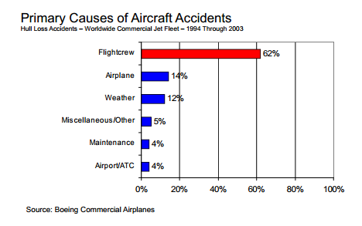
Aviation Safety

Slide 18
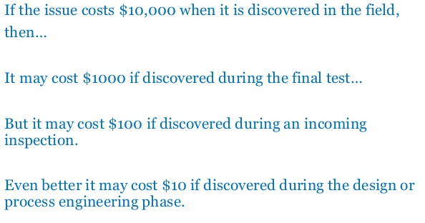
Rule of Ten

Slide 19
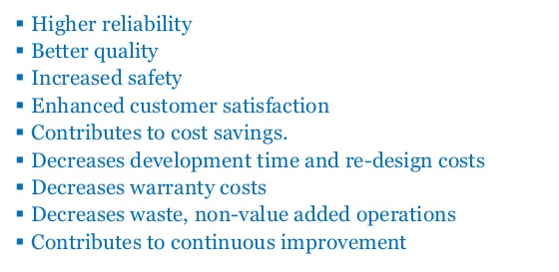
Benefits

Slide 20
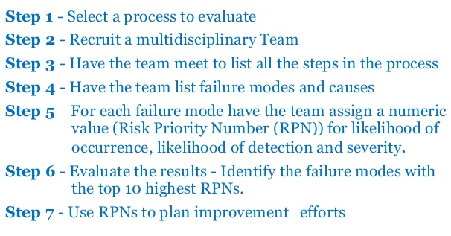
FMEA Process

Slide 21
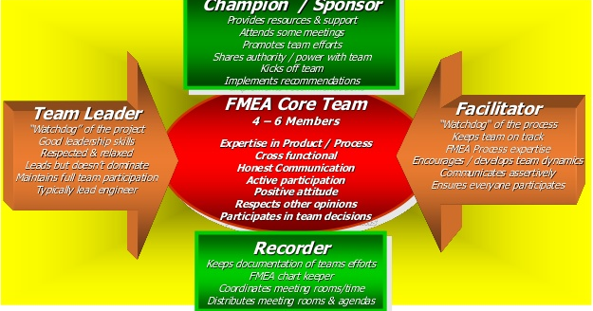
Team Roles

Slide 22
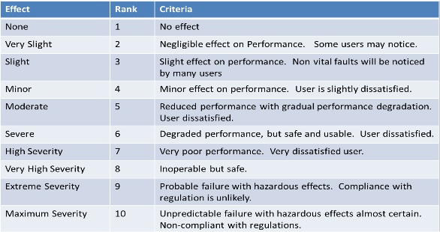
Risk Guidelines

Slide 23
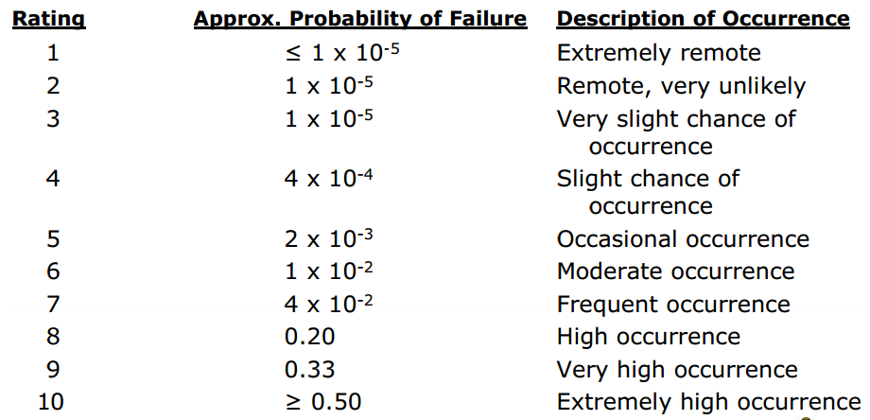
Occurrence Guidelines

Slide 24
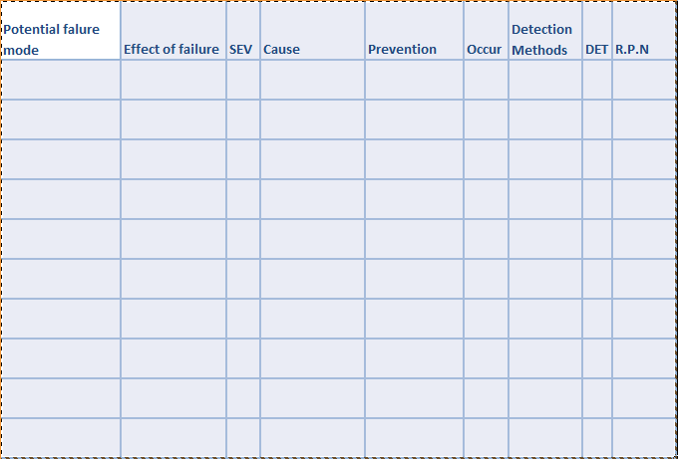
ACTIVITY SHEET

Slide 25
QUESTIONS?

