Slide 1
Lean Operations, Six Sigma, & Lean Six Sigma
Madhav Kasukurthi & Bill Ryan

Slide 2
Lean Operations
Six Sigma & Lean Six Sigma
Q & A

Slide 3
Total Quality: The Umbrella
An approach to doing business that attempts to maximize the competitiveness of an organization through the continual improvement of the quality of its products, services, people, processes, and environments.

Slide 4
Lean Operations
Referred to ‘Lean Manufacturing’.
Results appreciated by Practitioners.
Adapted by the service sector.
Based on concept of ‘Toyota Production System’ developed at ‘Toyota Motor Corporation’.

Slide 5
What is Lean?
(Operations, Manufacturing, or Production)
Lean is about doing more with less: less time, inventory, space, labor, and money.
Lean manufacturing, a shorthand for a commitment to eliminating waste, simplifying procedures and speeding up production.
Driven by…cost, quality, delivery, safety, & morale
Motto
Doing more with less and doing it better.

Slide 6
Types of Waste
OverProduction Waste
Manufacturing Setting – Producing 100 products when only 50 are needed.
Service Setting – Pumping 20 gallons of gas when customer requires only 15.
Inventory Waste
Carrying more inventory than needed causes extra burden to maintenance.

Slide 7
Motion Waste
Incorporating unnecessary movement into production process or into delivering services.
Manufacturing Setting - Programming too many motions into a CNC (Computer Numeric Control) milling machine.
Service Setting - Move around office several times to obtain everything needed to complete paperwork.
Transportation Waste
Manufacturing Setting– Excess movement of parts.
Service Setting – Typically means excess movement of people.

Slide 8
Defects Waste
Manufacturing Setting – A part that is faulty as it does not meet customer requirements.
Service Setting – Rewrite an insurance policy as it has faulty calculations in the original document.
Waiting Waste
Manufacturing Setting – An expensive machine which cuts the material, but the material s not available yet.
Service Setting – Not delivering the product to the customers as there are no resources available.

Slide 9
Over processing Waste
Manufacturing Setting - Going beyond customer requirements in ways that create no additional value when producing a product.
Service Setting – Doing more service than the customer wants.
Underutilization Waste
Manufacturing Setting – Limited knowledge on machines.
Service Setting – Also limited knowledge on machines.

Slide 10
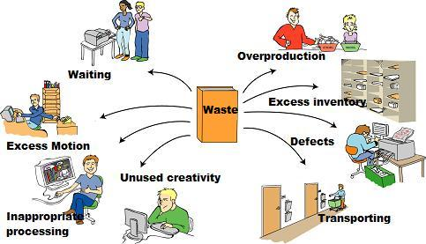

Slide 12
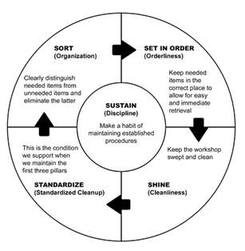
Tools and Techniques of Lean
Five S workspace organization

Slide 13
Visual workspace systems
Promotes ease of communication.
Layout
Achieve optimum plant layout so that motion and transportation wastes are eliminated.
Standardized Work
Involve repetitive tasks that are to be done in most efficient way and productive manner. Used for eliminating errors.
Pull Systems/ Kanban (“Sign” a Japanese word)
Used to provide a visual method. Lets one step in the process know that the next step is ready for it’s output.

Slide 14
Point of Use Storage
Ensures that the tools and parts needed at a given workstation are stored conveniently near the station. Helps to minimize movement and transportation waste.
Batch Size Reduction
Achieves efficiency for the entire system rather than for a given process within the system. Ensures that work flows smoothly and continuously from one process to another rather than bunching up at any workstation. Makes process conversions as rapidly as possible.
Quick Changeover
Involves changing tools quickly in a manufacturing setting. Eliminates time wasting in making process changes.

Slide 15
Poka Yoke
Error proof a process to the extent possible. It is especially important for situations where there is potential for human error. It involves in questioning like “What can go wrong here?” when setting up a process and finding ways to eliminate them.
Self Inspection
Involves having personnel check their own work rather than just passing along errors to the next step in the process. To apply this tool, individual employees must be trained, provided with inspection standards.
Autonomation
“Automation with a human touch.” Used to build automatic alarms/ process notifications into the system so that when any problem arises a person will be notified.

Slide 16
Cellular and Flow
Used to ensure a steady and consistent flow of work through the system. When output of one step in the process sits idle waiting to be used in the next step, time is wasted. A steady, continuous flow of work is achieved through this tool which is efficient.
Just In Time(JIT)
Ensures that items are delivered to the step in the process just in time to be used.
Total Productive Maintenance(TPM)
Ensures all equipment in a system and all parts of all processes that make the system are in good condition and ready when called on.

Slide 17
Value Stream Mapping (VSM)
Japanese concept of ”Kaizen”.
Identify the process groups (of tasks).
Develop a map of current state
Develop a map of desired future state.
Develop a plan to achieve the future state map.
Teamwork
Ensures all the other concepts of Lean can be implemented effectively.

Slide 18
How to eliminate waste?

Slide 19
Metrics of Measurement
Overproduction: 1.Number of specimens delivered per hour. 2.Number of batches per shift. 3.Batch size passed between each process step. | Wasted Motion: 1.Travel distance associated with completing all process steps one time. 2.Spaghetti diagrams of your staff during peak operation times. 3.Walking distance to areas where materials, supplies, and/or specimens are obtained.
Transportation: 1.Steps associated with tube-travel diagrams. 2.Time and distance specimens spend in courier cars. 3.Distance your staff travels carrying reagents and supplies. | Waiting: 1.Telephone time spent waiting to relay a critical results. 2.Length of time patients wait for outpatient phlebotomy. 3.Length of time technologists spend waiting for specimens.

Slide 20
Over processing: 1.Count the number of times specimens are sorted in specimen processing. 2.Count the number of times technologists sort specimens before placing them on an analyzer. 3.Count the number of times specimens are sorted before being placed into storage. | Defects: 1.Track defects passed downstream from process step to process step. 2.Count the number of corrected reports per day. 3.Count the number of specimens that required clean-up (re-spun, redraw, re-label, etc.) prior to analysis per analyzer.
Inventory: 1.Measure staff hours spent on ordering. 2.Measure staff time spent on rotating stock. 3.Measure the amount of consumables you have stored in the laboratory vs. in the store room. | Staff Talents: 1.Count the number of process improvement suggestions received each day from staff. 2.Measure staff morale and satisfaction levels. 3.Count the number of continuing education hours devoted to training your staff on process improvement methodologies and project management.

Slide 21
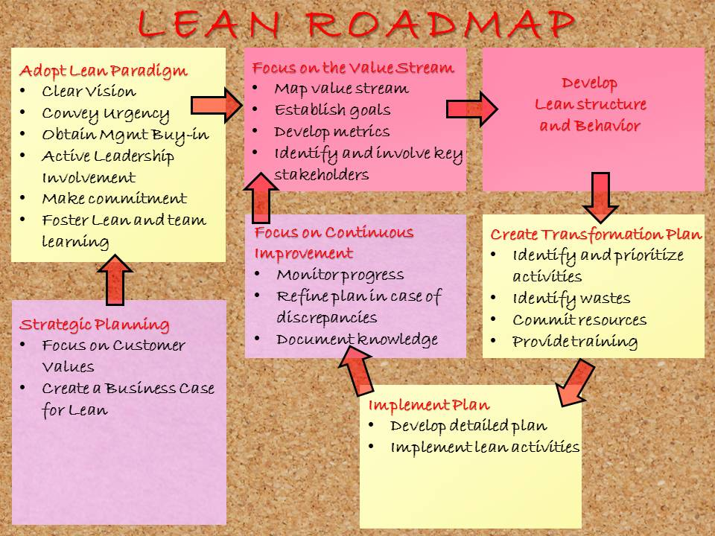

Slide 22
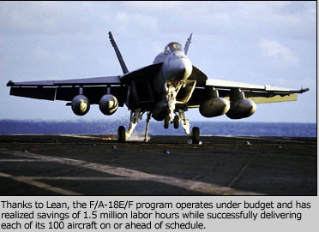

Slide 23
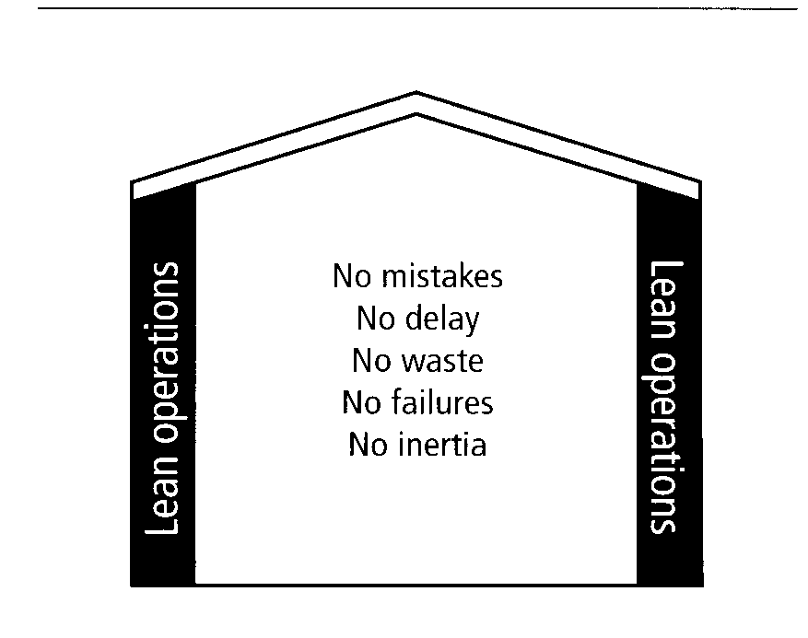

Slide 24
Six Sigma
Sigma is a concept that sets goals to try to reduce defect rates to 3.4 defective parts per million opportunities (dpmo)
Lean is a concept used to eliminate waste and improve process flow
Lean Six Sigma Links the two concepts via DMAIC Roadmap, and Belt system

Slide 25
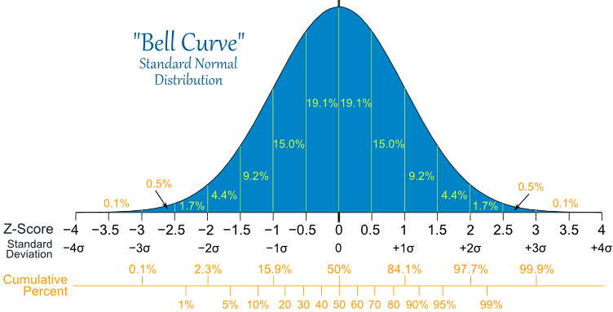

Slide 26
History of Six Sigma
In a series of challenges from 1981 to 1993, Motorola president Rob Galvin sought to improve quality by over 100 times throughout the entire corporation, which had already recently implemented significant improvements to the company’s performance.
The company achieved Six Sigma quality and boosted profits.
Word of this spread, and Jack Welch the CEO of GE implemented Six Sigma and made the concept famous in the US in 1995.

Slide 27
Six Sigma Characteristics
Six Sigma is problem focused with a view that process variation is waste
Variation refers to the amount of control you have over your processes
Six Sigma uses statistics to understand variation
Six Sigma uses the DMAIC approach
Scientific and numbers-based organizations stand to benefit most from Six Sigma.

Slide 28
Six Sigma Concept
Important to note that Six Sigma is a subset within a much larger concept of total quality. Six Sigma is a strategy that moves the target to a much higher level of quality than past concepts.
It’s not a concept to replace total quality, but a newer way to pursue higher quality under the total quality umbrella

Slide 29
Six Sigma Concept cont.
Six Sigma seeks to improve the quality of process outputs by identifying and removing the causes of defects (errors) and minimizing variability in manufacturing and business processes.
It uses a set of quality management methods, including statistical methods, and creates a special infrastructure of people within the organization (“Champion”, “Black Belts”, “Green Belts”, etc.) who are experts in methods.

Slide 30
Six Sigma expanded
Six Sigma comes from the concept of standard deviation (for all you Greek fans in the crowd, it’s the lowercase σ, not to be confused with the upper case Σ, which is commonly affiliated with summation in math).
The variation of processes and their output products is typically measured in the number of standard deviations from the mean (usually the ideal point, which can vary up to 1.5 deviations).
Most good companies operate between 3 & 4 Sigma.
Statistically 6σ is 1 failure in 500 million. Practical application 6σ is 3.4 dpmo.

Slide 32
If 99.9% Quality was good enough, then…
22,000 checks per hour would be deducted from the wrong bank accounts
Two million documents would be lost by the IRS this year
12 babies born today would be given to the wrong parents
18,322 pieces of mail would be mishandled in the next hour
20,000 drug prescriptions would be written incorrectly this year

Slide 33
Nonconformances (Motorola different from statistical)

Slide 34
Six Sigma Road Map
Appoint a champion
Select a cross-functional team
Develop quantifiable goals
Develop an implementation plan that establishes training, addresses data collection, and includes a program maintenance plan
Coordinate the road map

Slide 35
Six Sigma Process
Core of Six Sigma is a six-step protocol for process improvement. The six steps follow:
Identify the product characteristics wanted by customers (by including customer & improving process = more profits)
Classify the characteristics in terms of their criticality.
Determine if the classified characteristics are controlled by part and/or process
Determine the maximum allowable tolerance for each classified characteristic
Determine the process variation for each classified characteristic
Change the design of the product, process, or both to achieve a Six Sigma process.

Slide 36
DMAIC

Slide 37
DMAIC
Define
1)initiate the project
2)define the process
3)determine customer requirements
4)define key process output variables
Measure
1)understand the process
2)evaluate risks on process inputs
3)develop and evaluate measurement systems
4)measure current performance
Analyze
1)analyze data to prioritize key input variables
2)identify waste
Improve
1)verify critical outputs
2)design improvements
3)pilot the new process
Control
1)finalize the control system
2)Verify long-term capability

Slide 39
Six Sigma vs. Lean

Slide 40
Total Quality: The Umbrella
An approach to doing business that attempts to maximize the competitiveness of an organization through the continual improvement of the quality of its products, services, people, processes, and environments.

