Slide 1
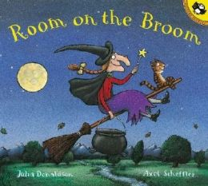
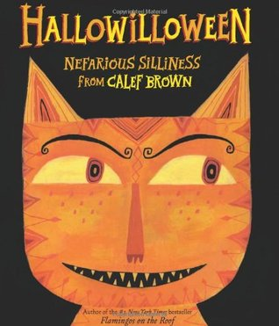
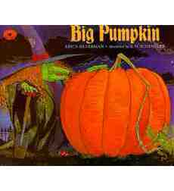
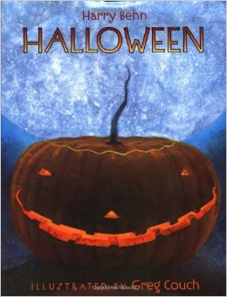
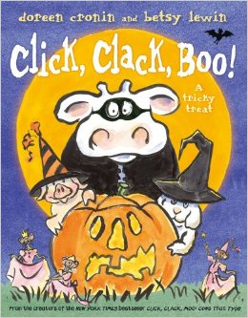
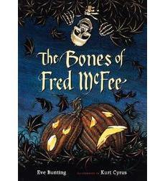
Spooktacular Books & Activities
SRC Meeting
October 23, 2014
http://www.eiu.edu/~reading

Slide 2
The Bones of Fred McFee
Author: Eve Bunting
http://www.kidsreads.com/authors/eve-bunting
Illustrator: Kurt Cyrus http://www.kurtcyrus.com/
Synopsis: In this rhythmic story, an unsuspecting brother and sister bring a toy skeleton home from the harvest fair. They name it Fred McFee and hang it from a sycamore tree. Soon, eerie things begin to happen: The rooster disappears. The hens won't lay. Most terrifying of all, Fred's bones dance "clickety-clack" as night winds howl. And then on Halloween night, Fred McFee vanishes!
http://www.scholastic.com/teachers/book/bones-fred-mcfee#cart/cleanup

Slide 4
Click-Clack-Boo!
Author & : Doreen Cronin http://www.doreencronin.com/
Illustrator: Betsy Lewin http://www.betsylewin.com/
Synopsis: This book is the sequel to the book Click, Clack, Moo. Farmer Brown does not like Halloween and as he keeps hearing different sounds through out the night, the animals are getting ready for a Halloween Party. But will Farmer Brown join in the fun? Find out in this fun sequel with a Halloween twist!

Slide 5
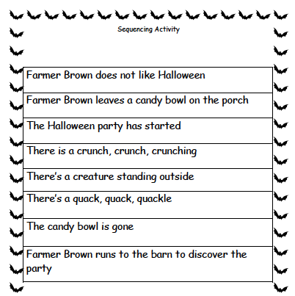

Slide 6
The Hallo-Weiner
Author: Dav Pilkey http://www.pilkey.com
Synopsis: In the beginning the neighborhood dogs make fun of Oscar, but later they proclaim him a hero. What causes them to switch Oscar’s nickname from “Wiener Dog,” to “Hero Sandwich?”

Slide 7
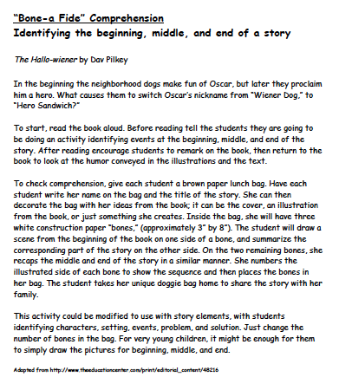

Slide 8
Big Pumpkin
Author: Erica Silverman
Illustrator: S.D. Schindler
Synopsis: The witch has planted pumpkin so that she can make a pumpkin pie. The only issue is that the pumpkin is so large that she can't get it off the vine! Her friends come to help her solve her problem.
Activity: While the students listen to the book they will place the pictures of the characters into the correct box on their handout. After the story students will draw their favorite part of the story.
https://www.youtube.com/watch?v=bHkuZKAW7bs​

Slide 9
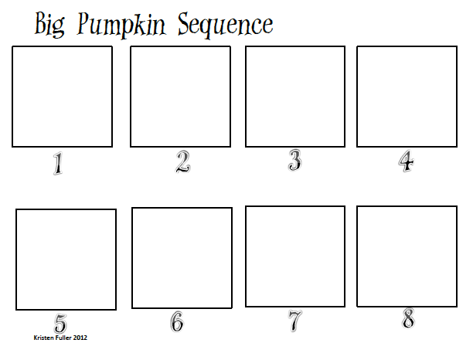
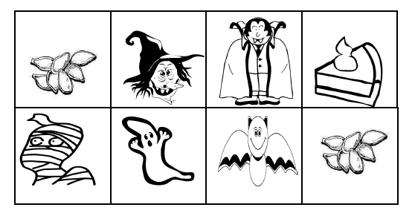

Slide 10
Halloween
Author: Harry Behn
http://en.wikipedia.org/wiki/Harry_Behn
Illustrator: Greg Couch
http://www.bookish.com/authors/greg-couch/0419aa3f-f80d-4c8d-ba67-2b70263b993c
Synopsis: A skeleton, a witch, and
a devil go out to trick-or-treat,
but are frightened by every sound
they hear and everything they see.

Slide 11
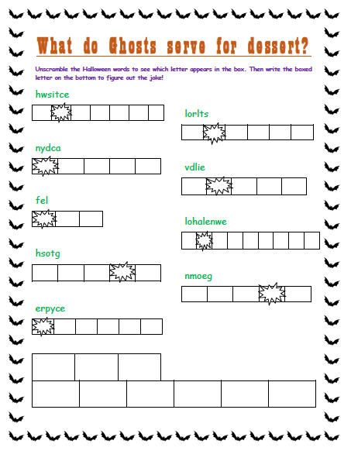

Slide 12
Hallowilloween: Nefarious Silliness
Author: Calef Brown http://www.calefbrown.com/
Synopsis: It includes different
poems about Halloween
characters like Frankenstein,
vampires, witches, etc.

Slide 13
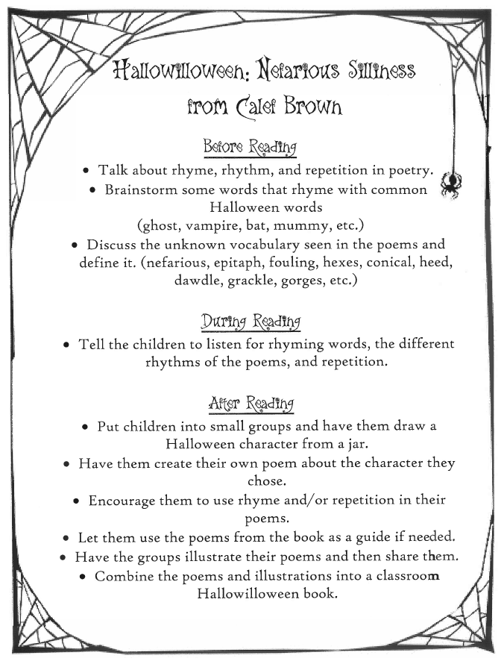

Slide 14
Room on the Broom
Author: Julia Donaldson
http://www.juliadonaldson.co.uk/
Illustrator: Axel Scheffler http://www.childrensbookillustration.com/view_artist.php?id=30&bid=95
Synopsis: The witch and cat are flying on her broom when the wind blows off her hat, she lands her broom and discovers that her hat has been found by a dog. The witch, cat, and dog continue their flight until …. (What will happen next?”
Room on the Broom Reading and Completion Activity:
Chorally read the stanza.
Draw a sketch to illustrate what rose out of the bubbling cauldron.

Slide 15
Room on the Broom
Introducing Vocabulary
Introduce unfamiliar words that will help children understand the story
Introduce the words in the same context as the story.
Read the words to the children and ask if anyone has heard the word before.
Look up the words in the dictionary so you can give a clear definition and write the definition in language the children will understand.

Slide 16
Room on the Broom Vocabulary
Word | Context
ginger | The witch had a cat and a hat that was black, and long ginger hair in a braid down her back. Definition: adjective A light reddish-yellow or orange-brown color. (chiefly of hair or fur)
bog | Down they went tumbling into a bog. Definition: noun Wet, spongy ground with soil composed of decayed plants.
cloak | The witch dried the wand on the fold of her cloak. Definition: noun A loose fitting cape that wraps around your shoulders.
squelched | It dripped and it squelched as it walked from the ditch. Definition: verb walk heavily in water, mud, or wet shoes and making a squishy sound.
cauldron | Then she filled up her cauldron. Definition: noun A large kettle or pot

Slide 18
Room on the Broom Activity Websites
Pinterest
http://www.pinterest.com/shellsowerby/room-on-the-broom/
Scholastic Read & Respond
http://images.scholastic.co.uk/assets/a/b6/b7/room-on-the-broom-activities-1070440.pdf
Teaching Ideas
http://www.teachingideas.co.uk/library/books/roomonthebroom.htm
MakingLearningFun.com
http://www.makinglearningfun.com/themepages/RoomontheBroom-LiteracyActivities.html

