Slide 1
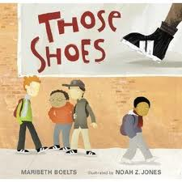
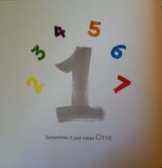
Teaching Kindness Through Trade Books
Eastern Illinois University
Student Reading Council Meeting
3/1/2017
Presenters: SRC Officers

Slide 2
Bullying
In kid-friendly terms, we might say,
The reason why one kid would want to bully another kid is this: when you make someone feel bad, you gain power over him or her. Power makes people feel like they’re better than another person, and then that makes them feel really good about themselves. Power also makes you stand out from the crowd. It’s a way to get attention from other kids, and even from adults.
(PBS Kids 2009/Laminack 2012/page xiii)

Slide 3
Teasing vs. Bullying
What is the line between teasing and bullying?
“… nasty teasing occurs when the instigator seeks to intimidate the recipient. When done repeatedly and in the presence of a power differential, nasty teasing becomes bullying.” (Gregory, et al 2004,page 127)

Slide 4
Types of Bullying
Direct Bullying Behaviors
Physical
Verbal
Indirect Bullying Behaviors
Social
Relational
Cyber Bullying Behaviors

Slide 5
http://www.heinemann.com/products/E04356.aspx

Slide 6
A Framework (Laminack & Wadsworth, 2012, pp. 8-9)
Layer 1 | Layer 2 | Layer 3 | Layer 4 | Layer 5
We have so much in common. | There are ways in which we are different. | Thinking, feeling, acting. | When others are not thoughtful, caring and kind. | An opportunity to explore the actions of others, reflect on our own feelings, and redirect our behaviors toward fellow human beings.
Essential Understanding: Across the globe we are more alike than different. | Essential Understanding: There are a range of differences in humanity, some more obvious than others. These differences do not make us better or lesser than others. | Essential Understanding: Our actions reflect our feelings, our thoughts and our values. | Essential Understanding: We can learn to change our beliefs and treatment of others. We can view all people worthy of kindness and respect. | Essential Understanding: We can choose to respect ourselves and think and act accordingly. We can choose to not be bystanders. We are responsible for our actions.

Slide 7
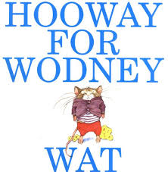
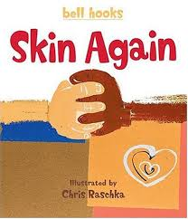
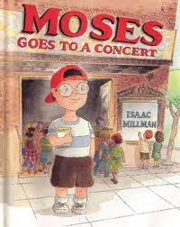
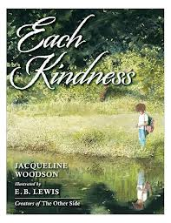
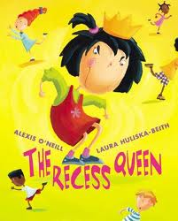
A Framework (Laminack & Wadsworth, 2012, pp. 8-9)
Layer 1 | Layer 2 | Layer 3 | Layer 4 | Layer 5
We have so much in common. | There are ways in which we are different. | Thinking, feeling, acting. | When others are not thoughtful, caring and kind. | An opportunity to explore the actions of others, reflect on our own feelings, and redirect our behaviors toward fellow human beings.

Slide 8
Bumper stickers!

Slide 9
Your turn
Select a book to read with a partner.
Carefully look at the pictures.
What questions would you ask about the art/illustrations as you do a Visual Tour?
What would you have the students focus on as you Read Aloud?
What would a possible bumper sticker be?
What activities could you use to help students build on the essential understandings from the book?

Slide 10
References
Laminack, L. L. & Wadsworth, R. M. (2012). Bullying Hurts: Teaching Kindness Through Read Alouds & Guided Conversations. Portsmouth, NH: Heinemann.
WITS Program: Creating Responsive Communities for the Prevention of Peer Victimization
http://www.witsprogram.ca/
Hooway for Wodney Wat by Helen Lester
http://witsprogram.ca/pdfs/schools/books/hooway-for-wadney-wat/hooway-for-wodney-wat.pdf
The Recess Queen by Alexis O’Neill
http://www.witsprogram.ca/pdfs/schools/books/recess-queen/the-recess-queen.pdf
Whoever You Are by Mem Fox
http://www.witsprogram.ca/pdfs/schools/books/whoever-you-are/whoever-you-are.pdf
Curriculum Corner – The Kinder Corner (Diversity: Differences Make Us Unique)
http://www.thecurriculumcorner.com/thekindercorner/2014/08/21/diversity-differences-make-us-uniqu
http://www.thecurriculumcorner.com/thekindercorner/wp-content/pdf/diversity/ihavebook.PDF
Fantastic Fun & Learning: Character Lessons About Bullying to go with The Recess Queen
http://www.fantasticfunandlearning.com/character-lessons-bullying-recess-queen.html
A Good Case of Stripes: Celebrating Uniqueness and Making Connections
http://character.org/lessons/lesson-plans/elementary/allen-creek-elementary-school/
A RIF Guide for Educators
http://lcps.k12.nm.us/wp-content/uploads/2015/06/SS-G-II-E-Whoever-You-Are_All.pdf

